Slide 1






SUCCESS STORIES WARD DEVELOPMENT SUPPORT COMMITTEES (WDSC) MICHIKA LGA
January 2024 – April 2024

Slide 2
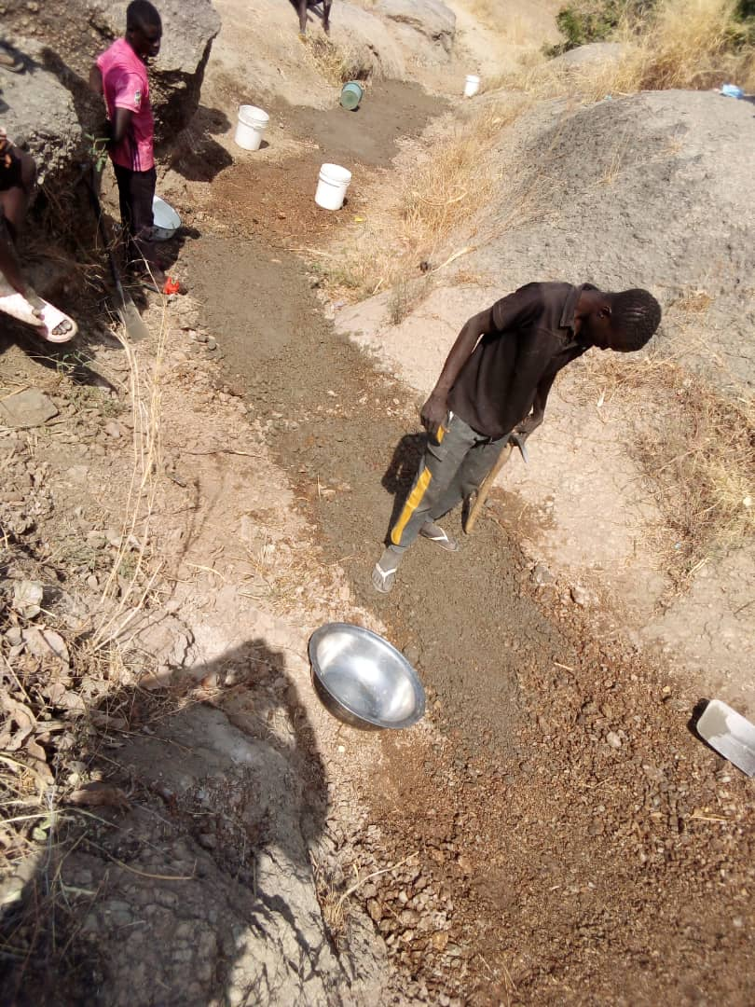
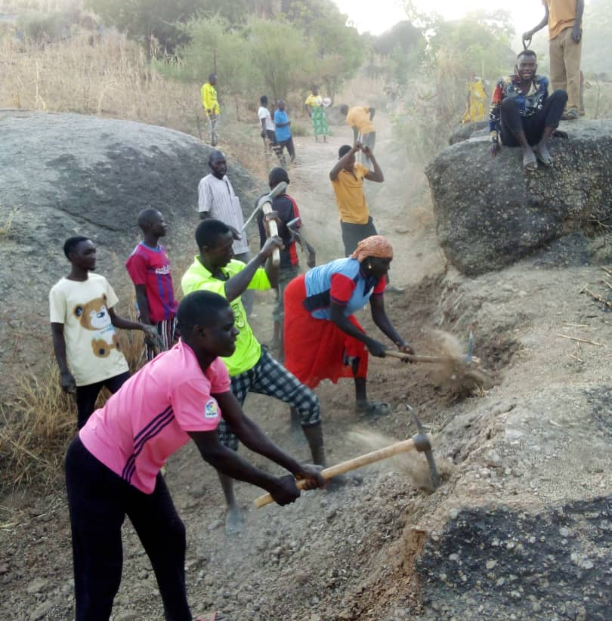
Mukavacitta WDSC:
Self-Help Road Rehabilitation Project at Pee Wa’ati

Slide 3
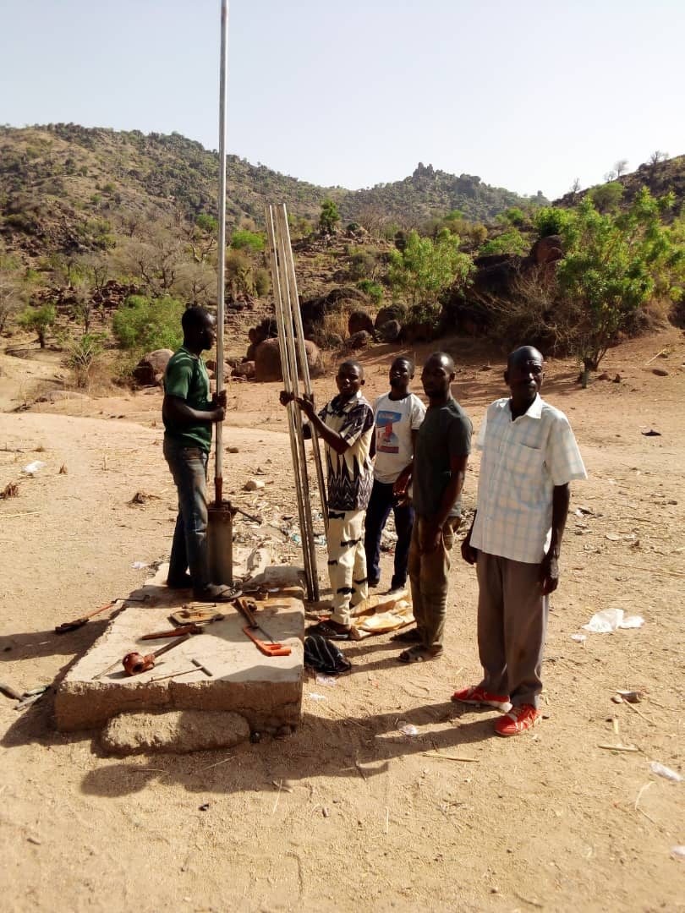
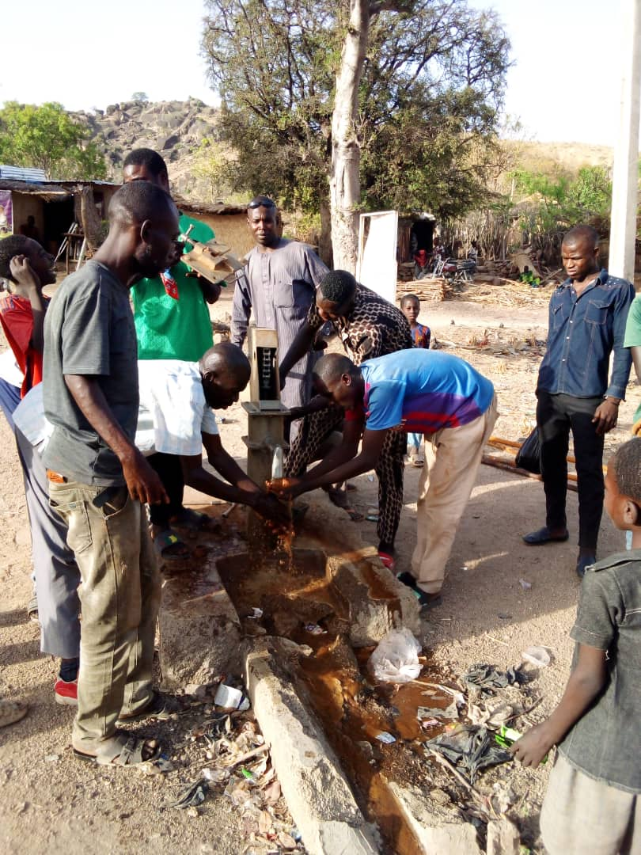
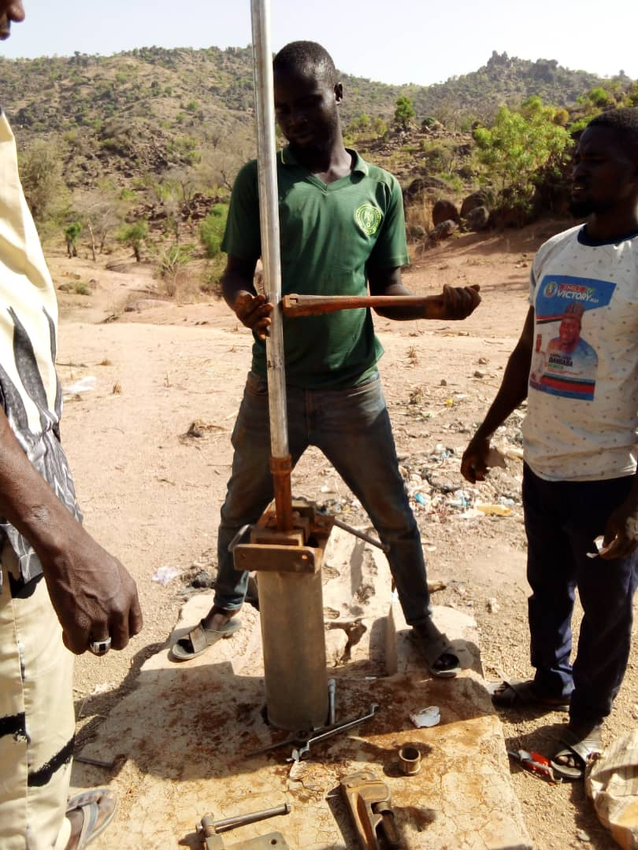
Mukavacitta WDSC: Self-Help projects: Repairs of broken borehole at Munni, and Nkafa communities

Slide 4
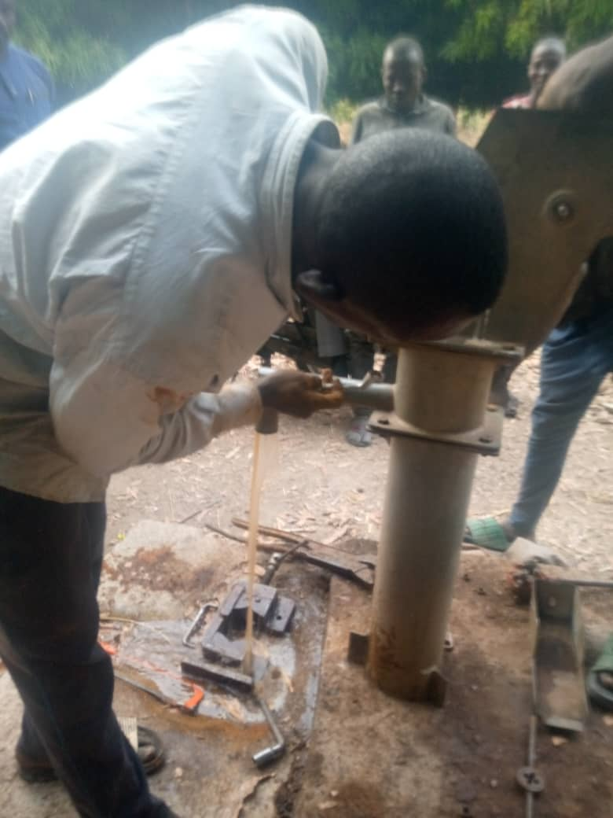
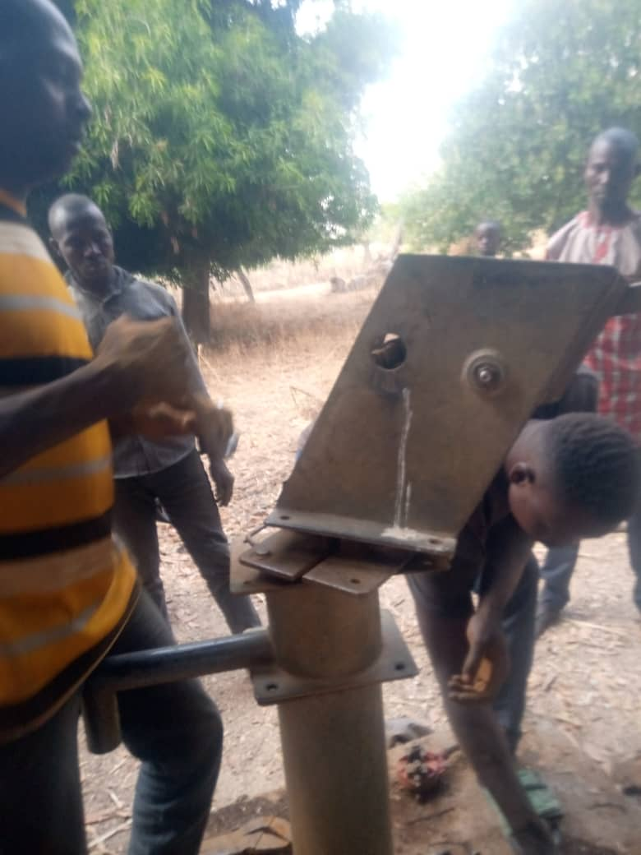
Vi Bokka WDSC:
Repairs of broken borehole through advocacy & lobby at Sabon Layi, and Walavi communities

Slide 5
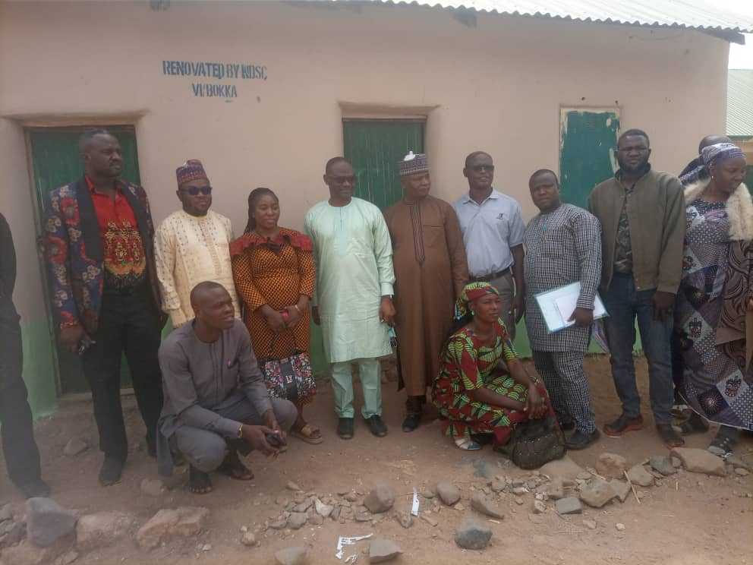
Vi Bokka WDSC
Renovation of Headmistress
Office Vi Head mistress office, a testament of self-help initiative

Slide 6
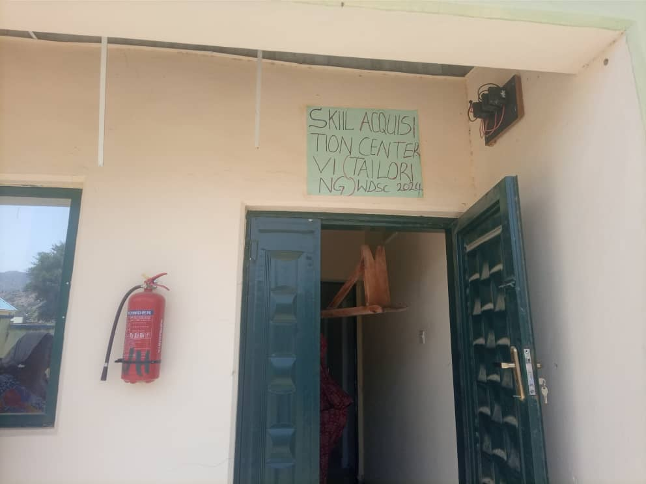
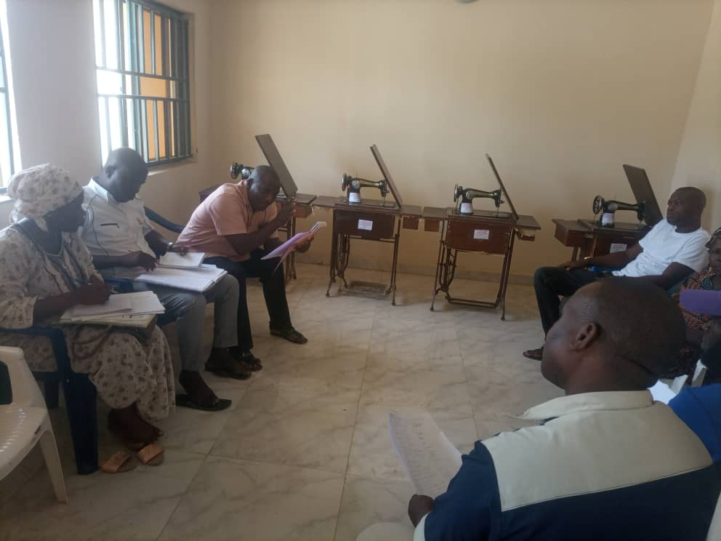
Vi Bokka WDSC
Skill Acquisition Training: Lobbied 4 Sowing
machine and vacant office space for training
purposes

Slide 7
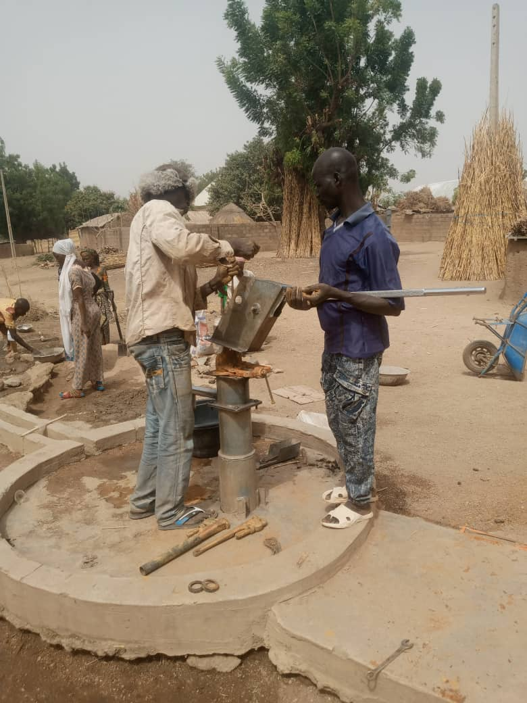
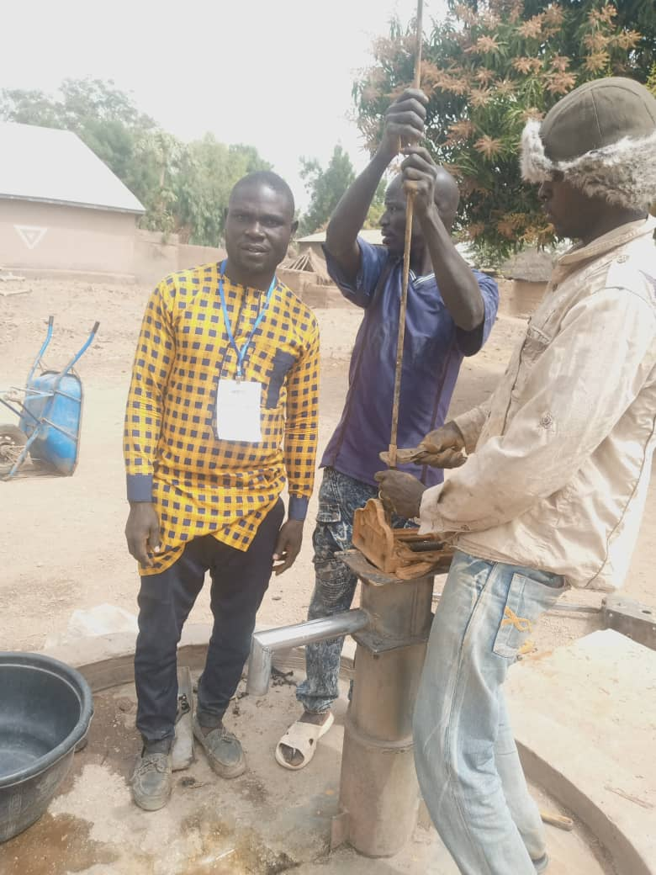
Wambilimi Tilli WDSC
Self Help Project:
Water rehabilitation project at kofan tsarki

Slide 8
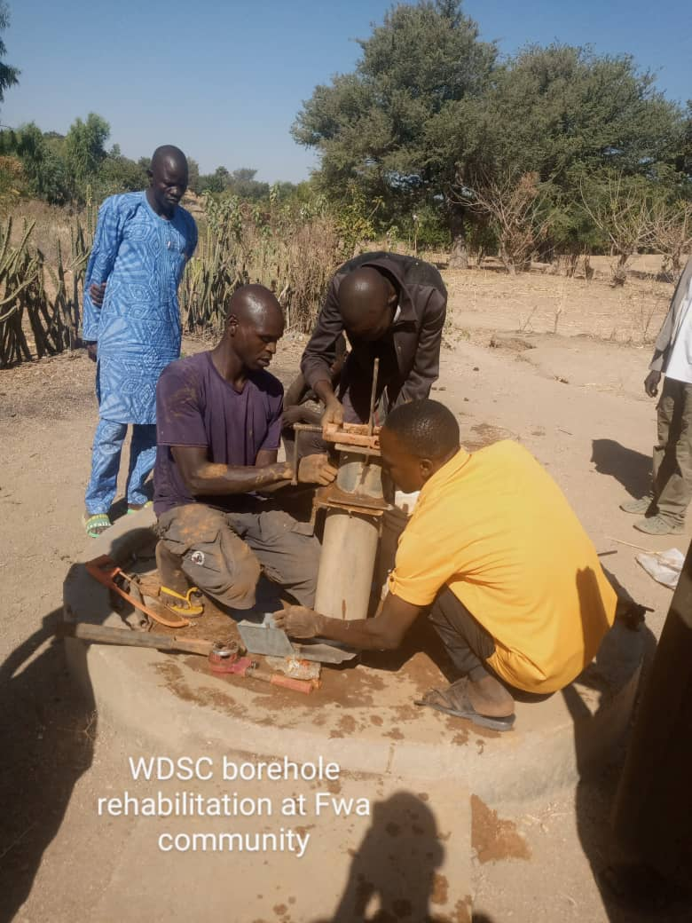
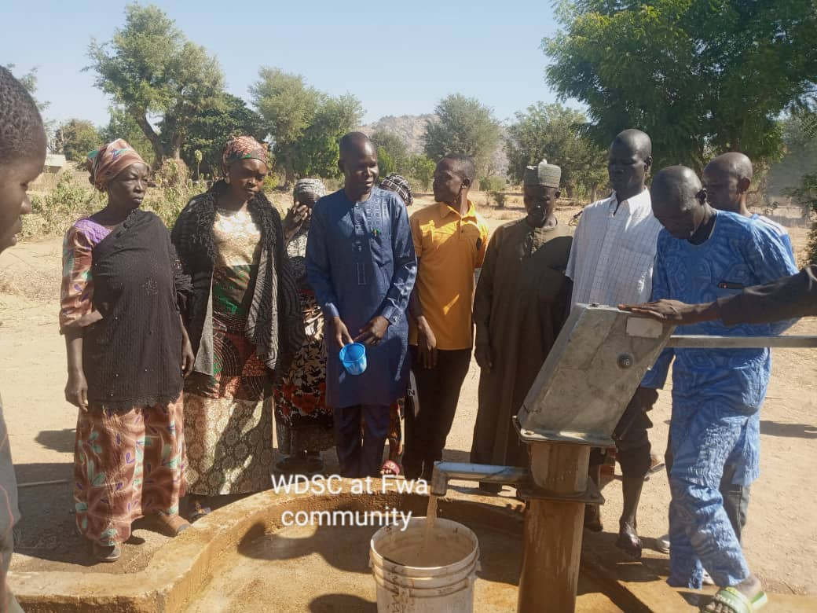
Wambilimi Tilli WDSC
Self Help Project:
Water rehabilitation project at Fwa

Slide 9
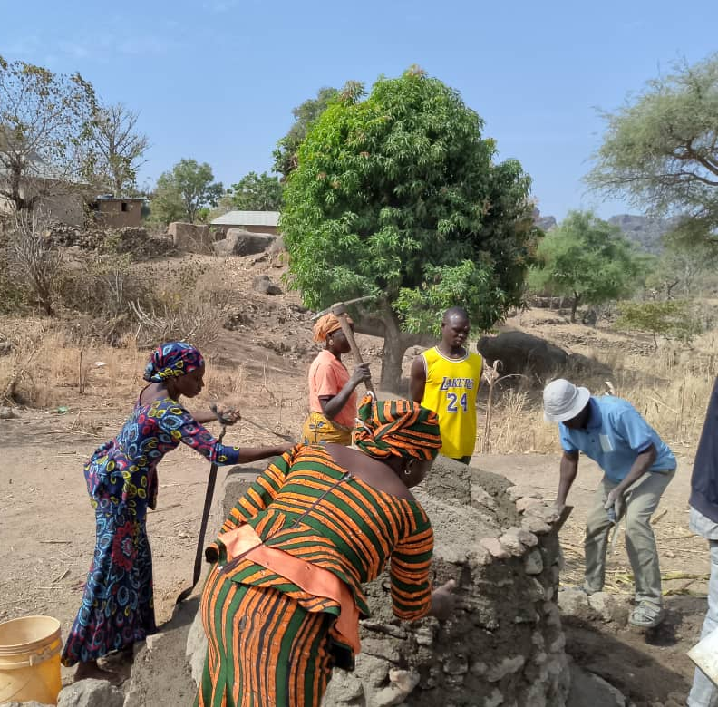
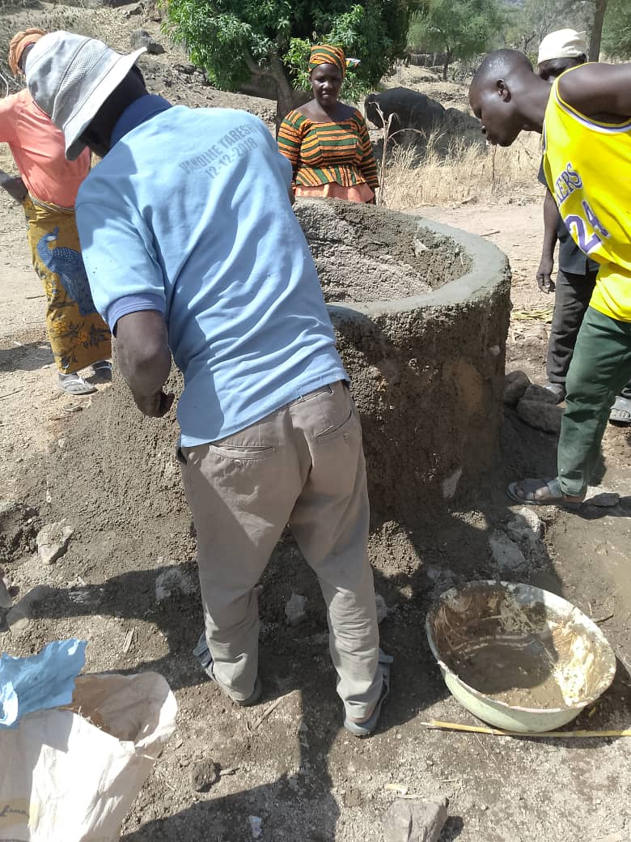
Wambilimi Tilli WDSC
Self Help Project:
Rehabilitation of well-water at Tilli

Slide 10
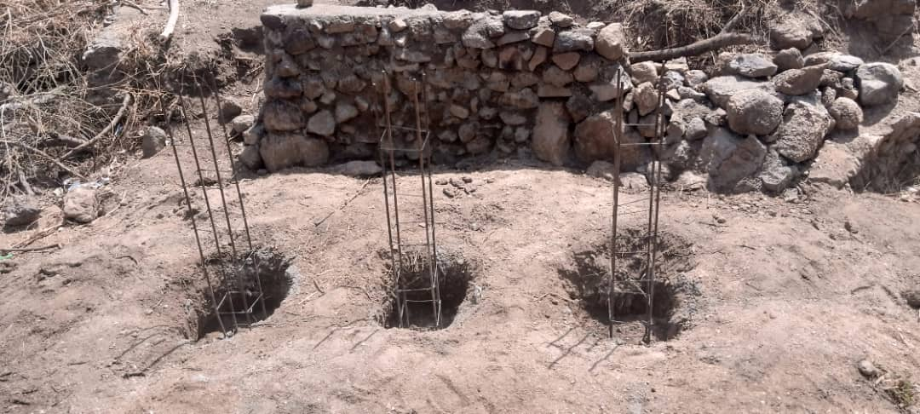
Wambilimi Tilli WDSC
Self Help Project:
Excavation of a Culvert located between Warakanza and Fwa

Slide 11
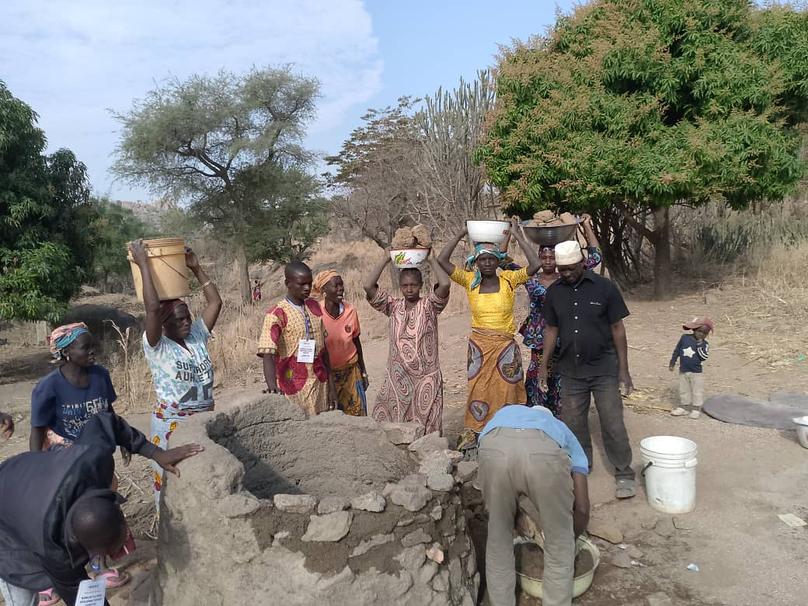
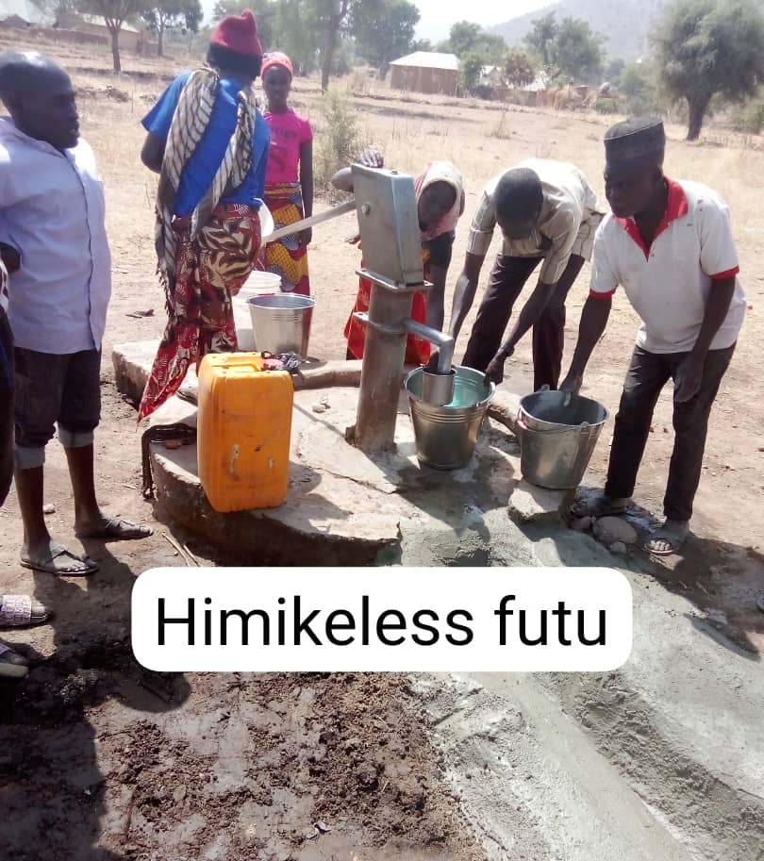
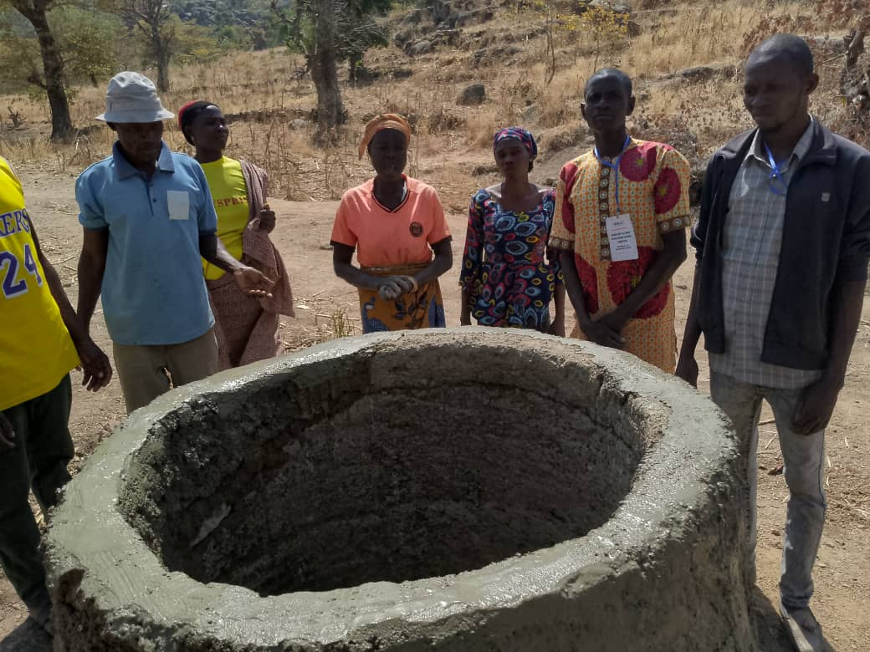
Futudou/Futuless WDSC
Self Help Project:
Rehabilitation of water project at Himikeless

Slide 12
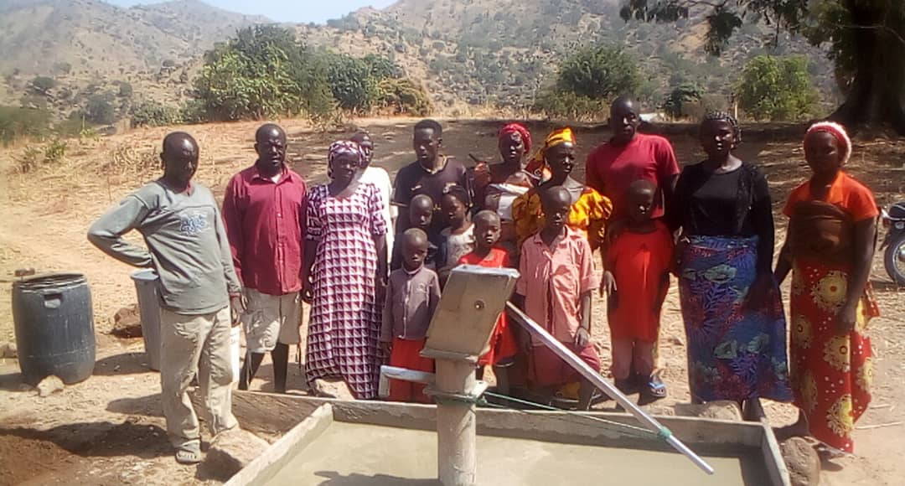
Futudou/Futuless WDSC
Self Help Project:
Rehabilitation of water project at Vwa

Slide 13
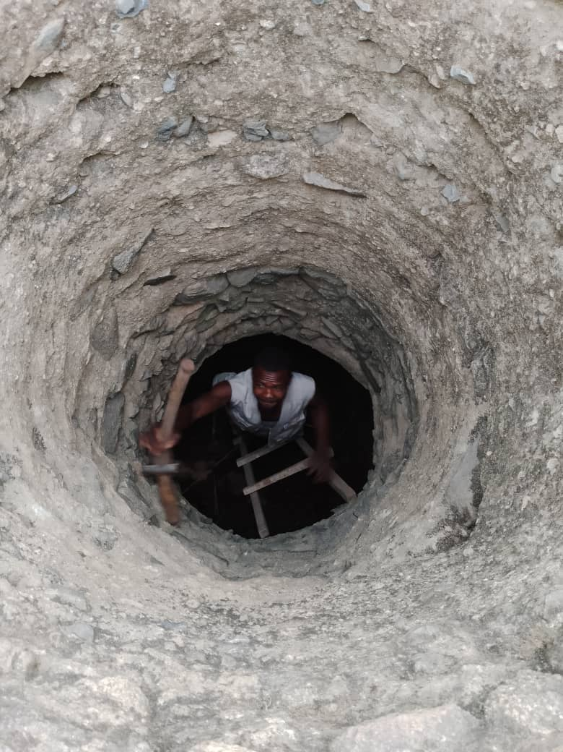
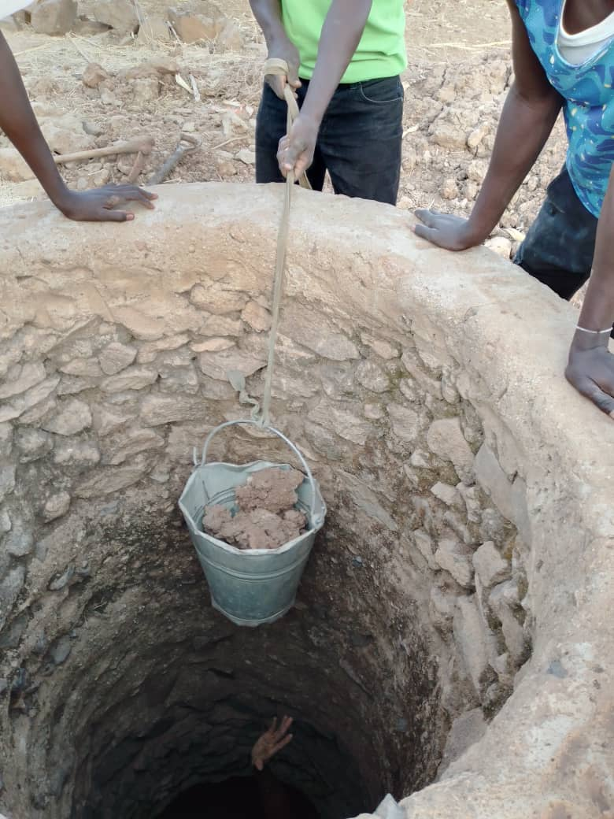
Futudou/Futuless WDSC
Self Help Project:
Rehabilitation of water project at Himikey

Slide 14
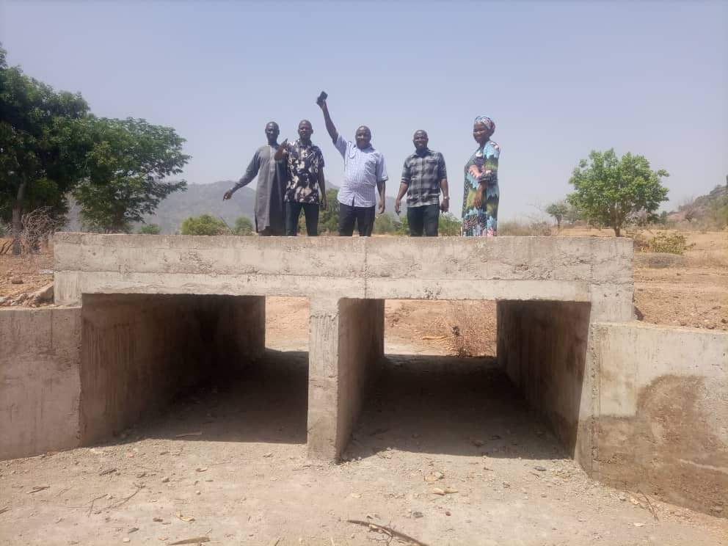
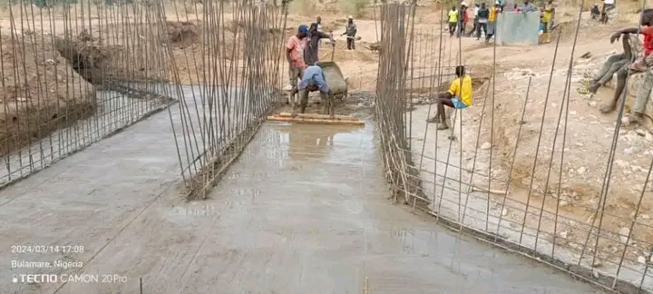
Futudou/Futuless WDSC
Construction of a culvert through advocacy and lobby efforts: A road connecting Mbororo with Futu

Slide 15
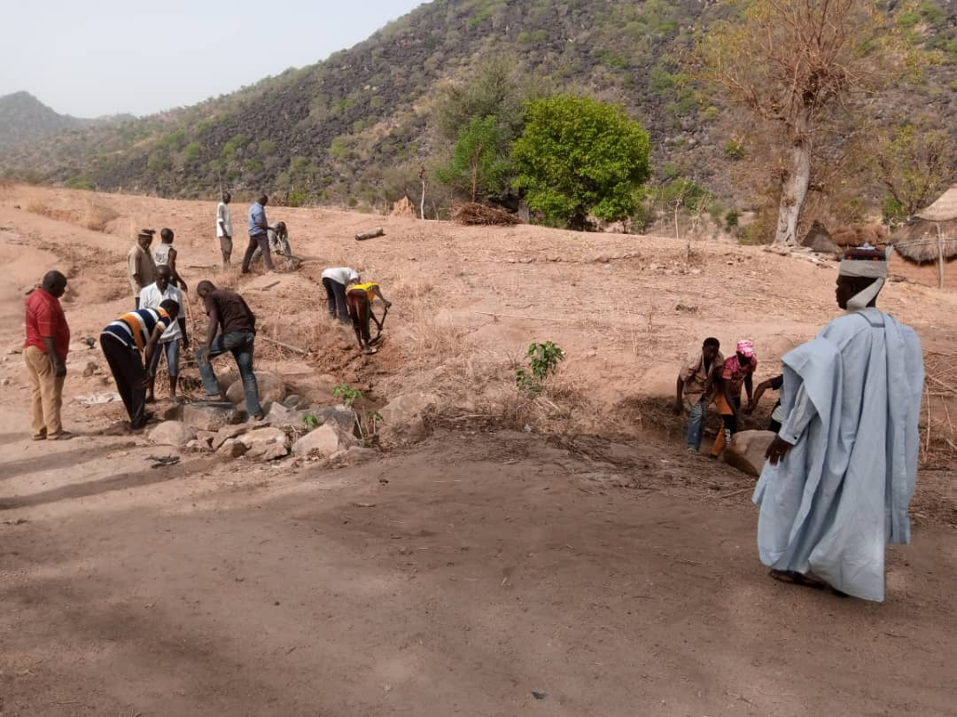
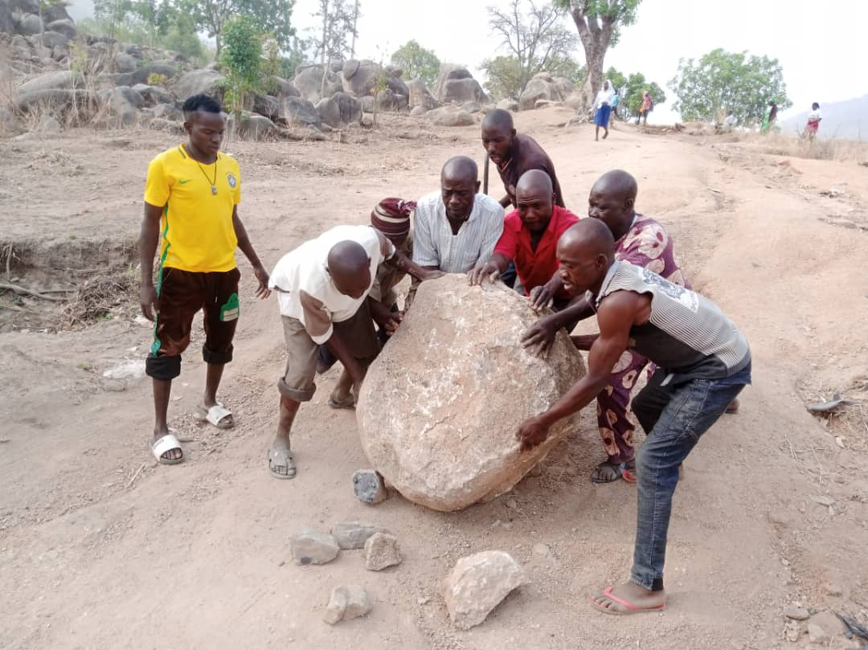
Futudou/Futuless WDSC
Self help project: road rehabilitation

Slide 16
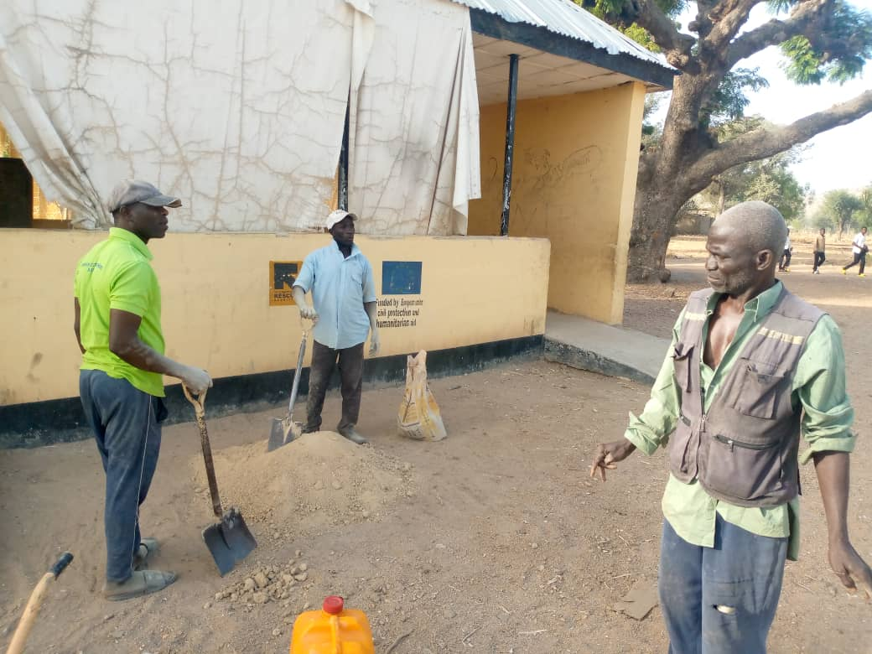
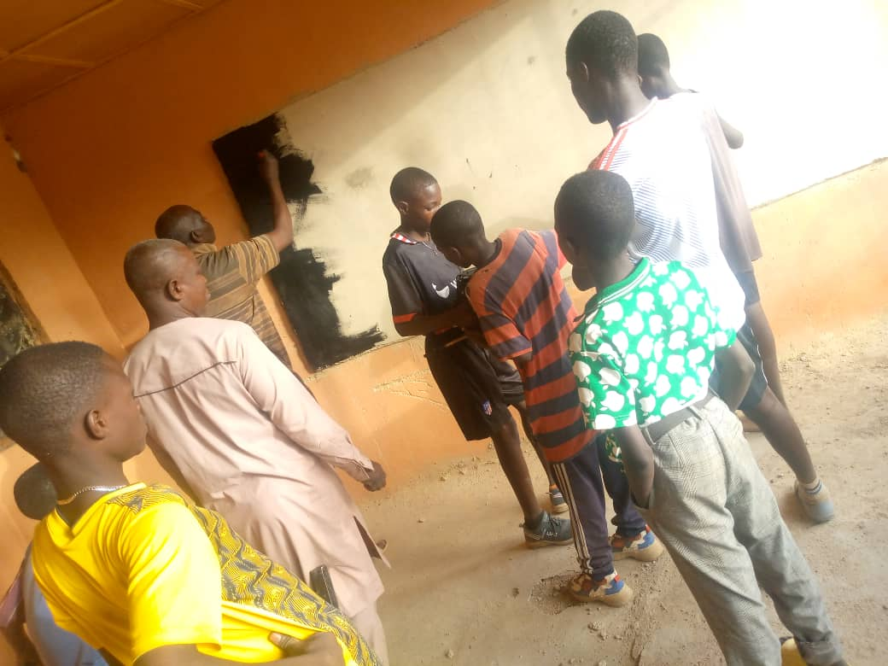
Madzi WDSC
Self help project: Construction of 4 Black Chalk Board at Bidi Primary School; a joint effort with Bidi Development Association

Slide 17
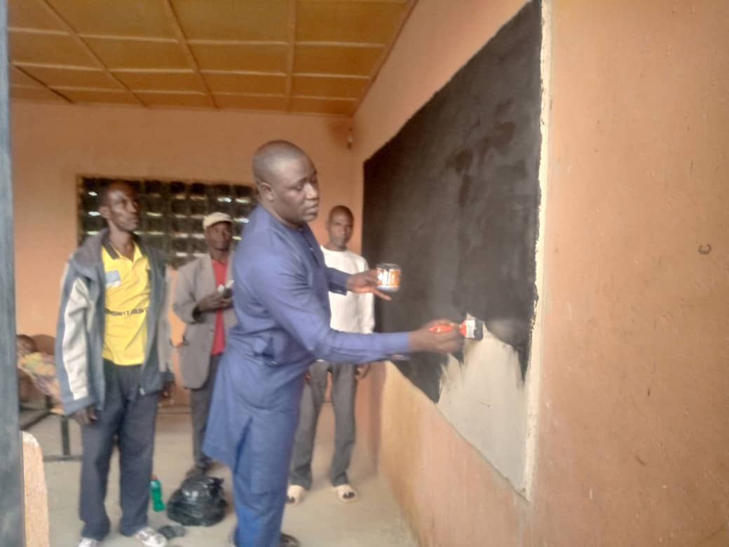
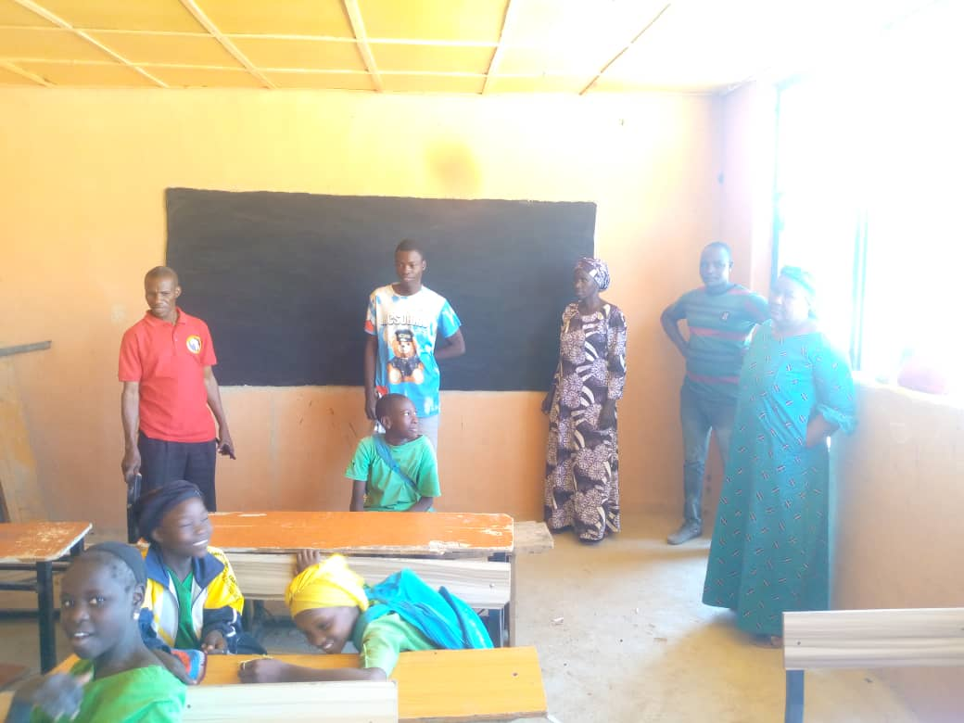
Madzi WDSC
Self help project: Construction of 4 Black Chalk Board at Bidi Primary School; a joint effort with Bidi Development Association Contd.

Slide 18
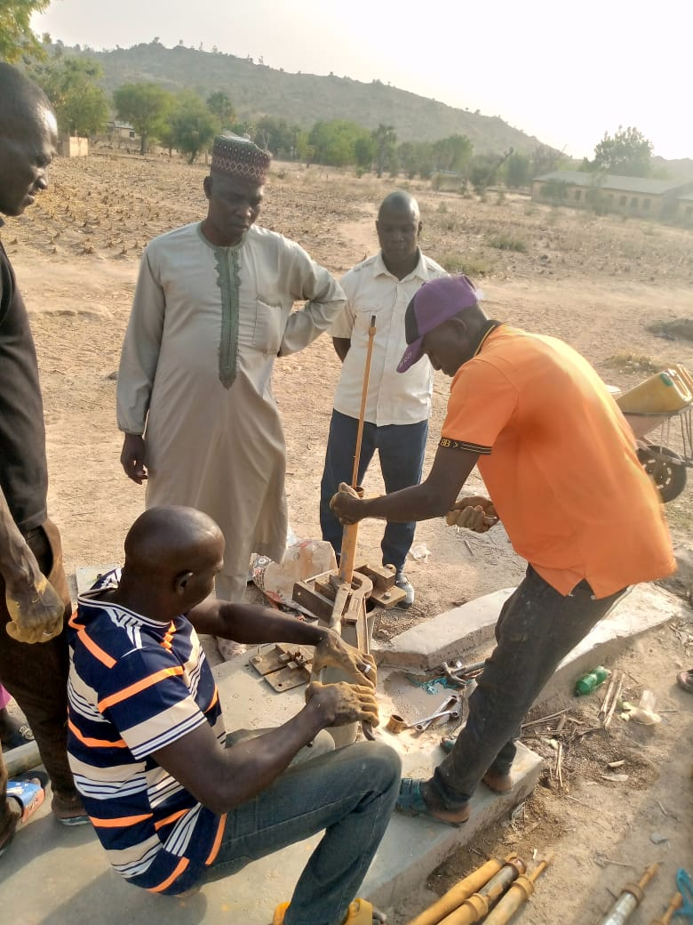
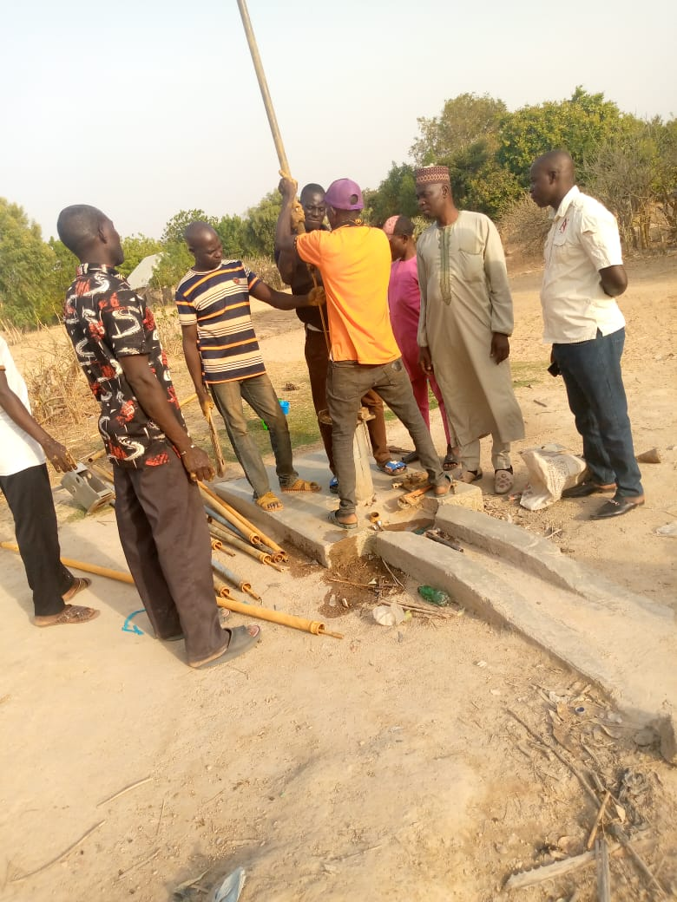
Madzi WDSC
Self help project: Water rehabilitation project at Yambule community.

Slide 19
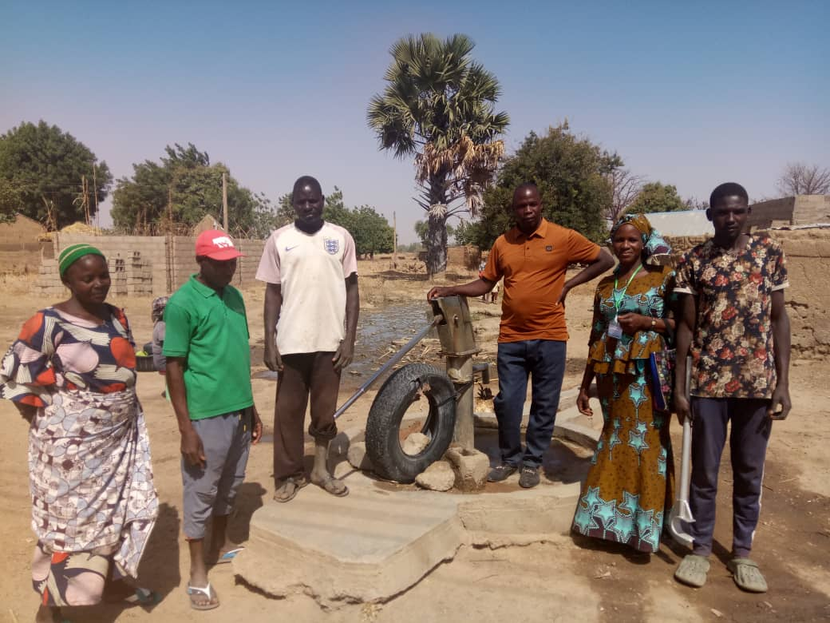
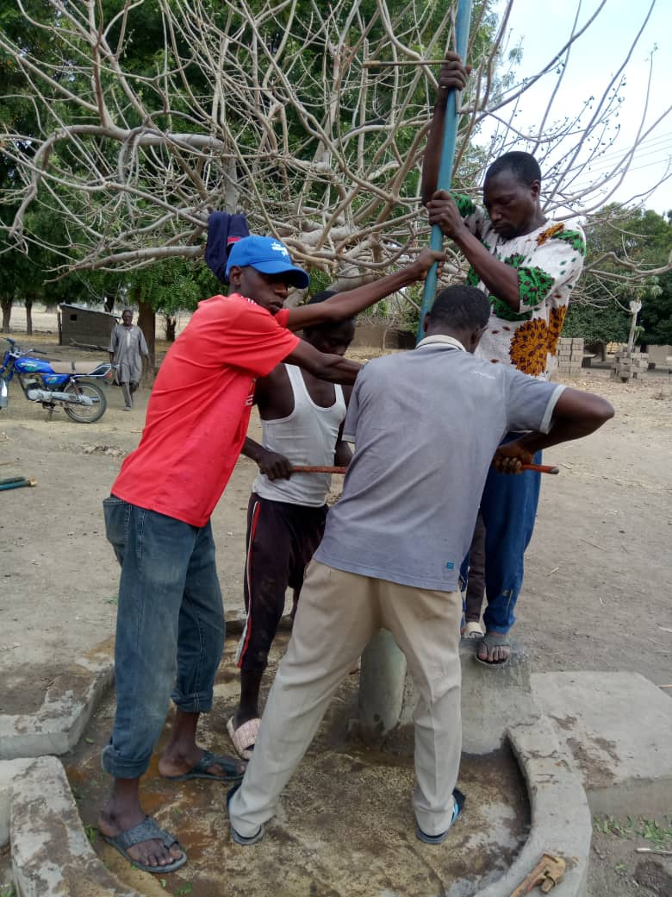
Madzi WDSC
Self help project: Water rehabilitation project at Thuri community.

Slide 20
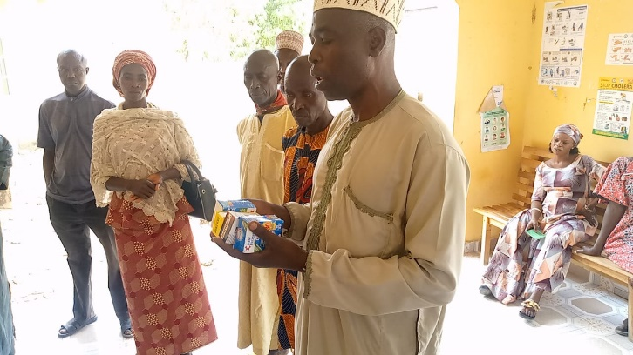
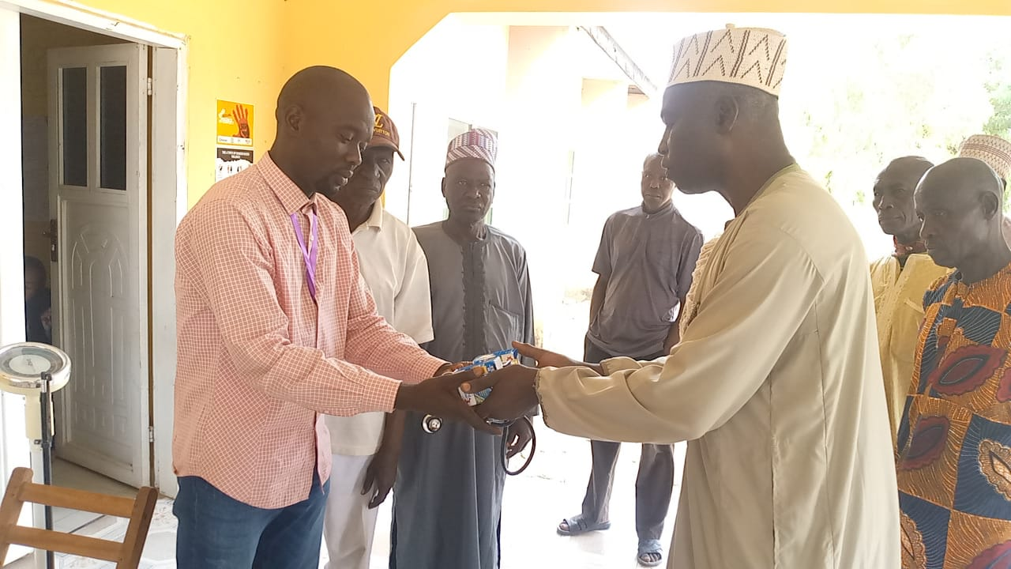
Madzi WDSC
Self help project: Distribution of free Drugs at Watu PHCC, Kudablashafa PHCC and Kuburshosho PHCC

Slide 21
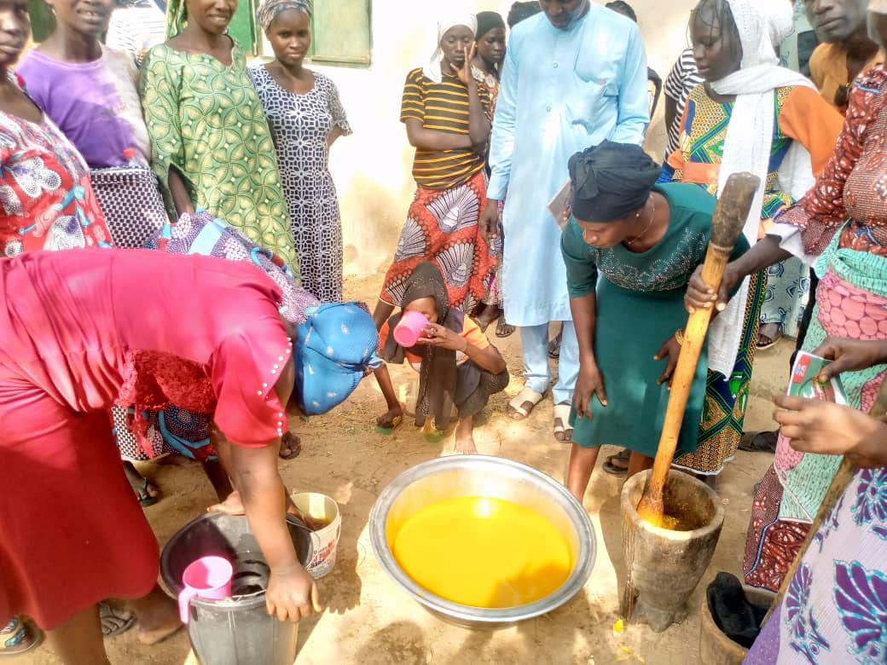
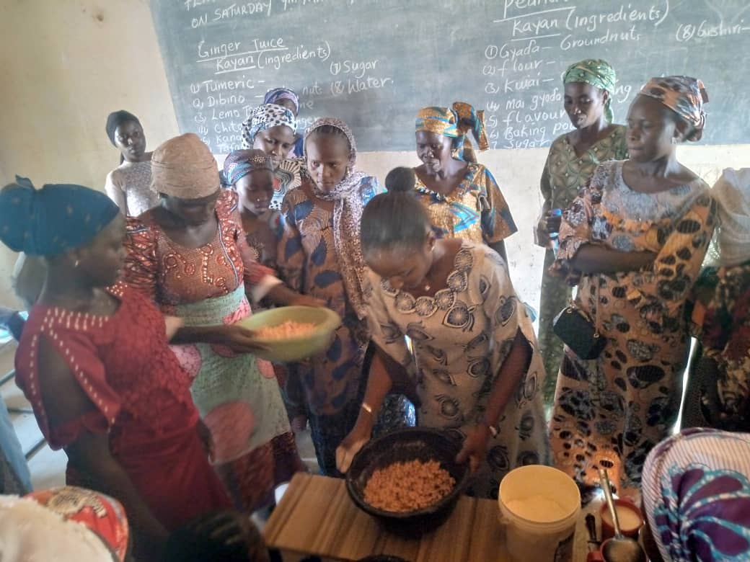
Madzi WDSC
Skill Acquisition Training: Empowering a Community through Peanut Production

Slide 22
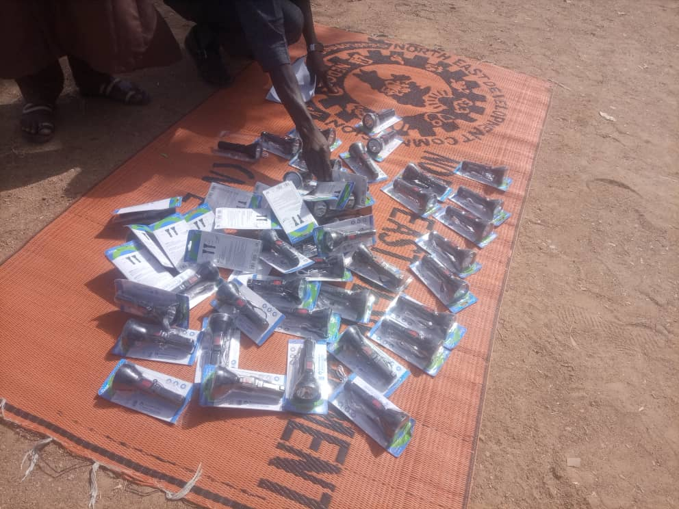
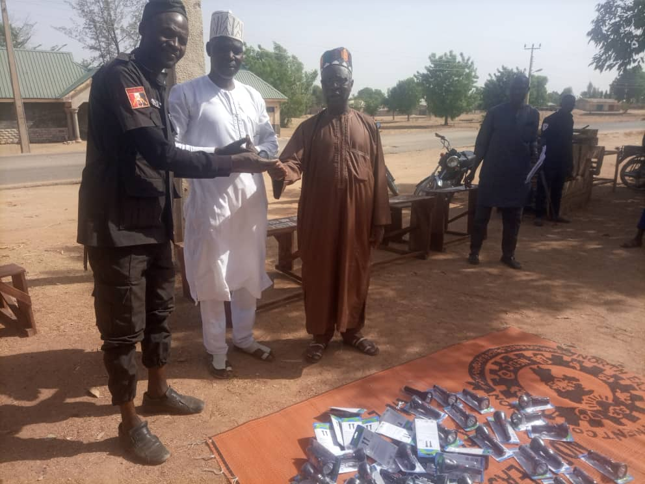
Madzi WDSC
Distribution of 50 security Touch Lights to members of the Vigilante

Slide 23
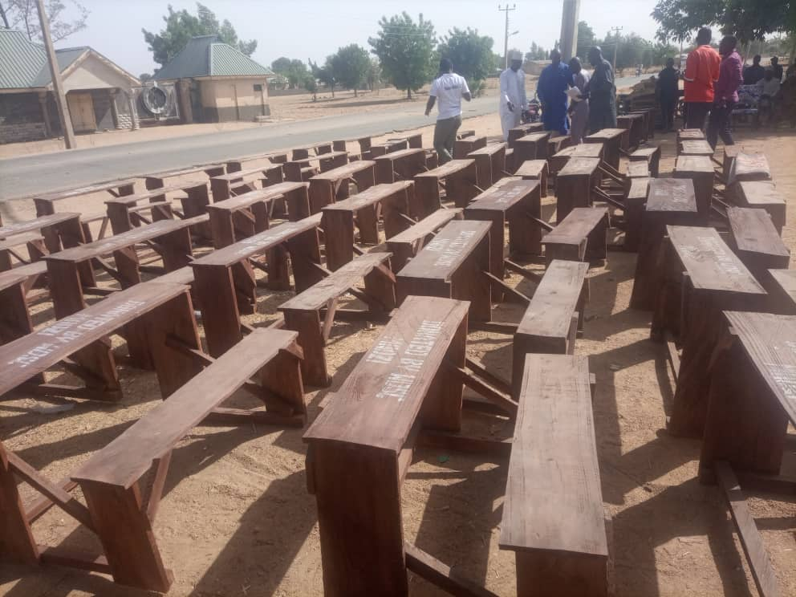
Madzi WDSC
Self-Help Project: Production of 42 3-seater chairs across 8 schools

Slide 24
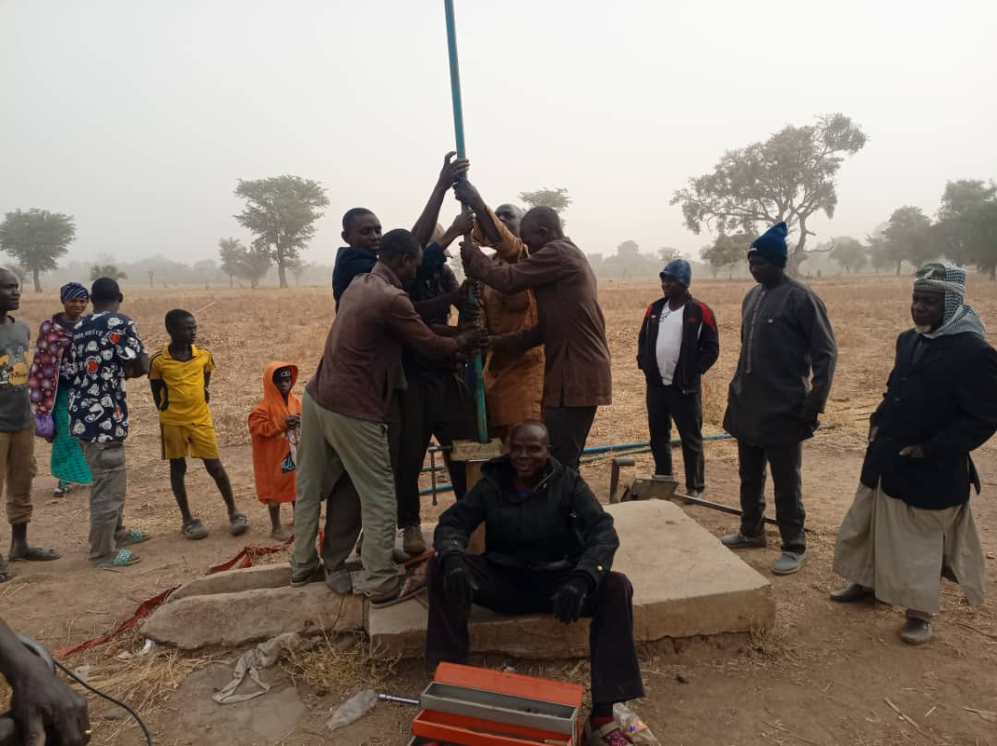
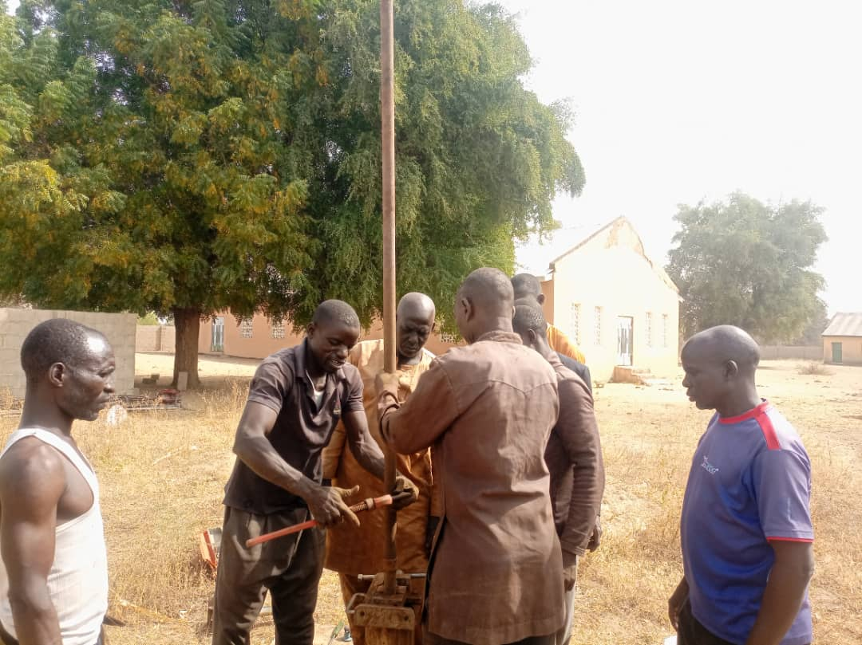
Jigalambu WDSC
Self-Help Project: Repairs of broken borehole at Kankilia Kasa, and Kankilia Sama Communities

Slide 25
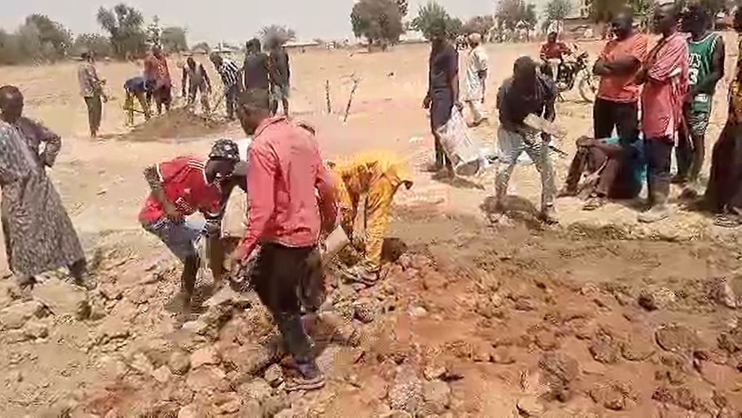
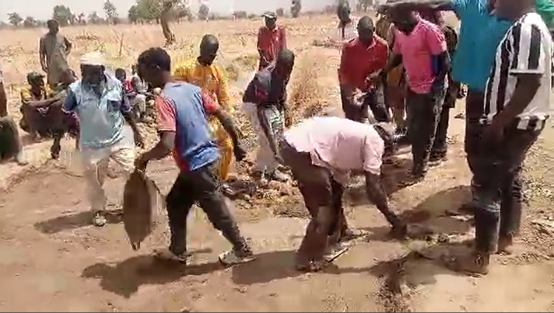
Jigalambu WDSC
Self-Help Project:
Rehabilitation of drift at Kura Road

Slide 26
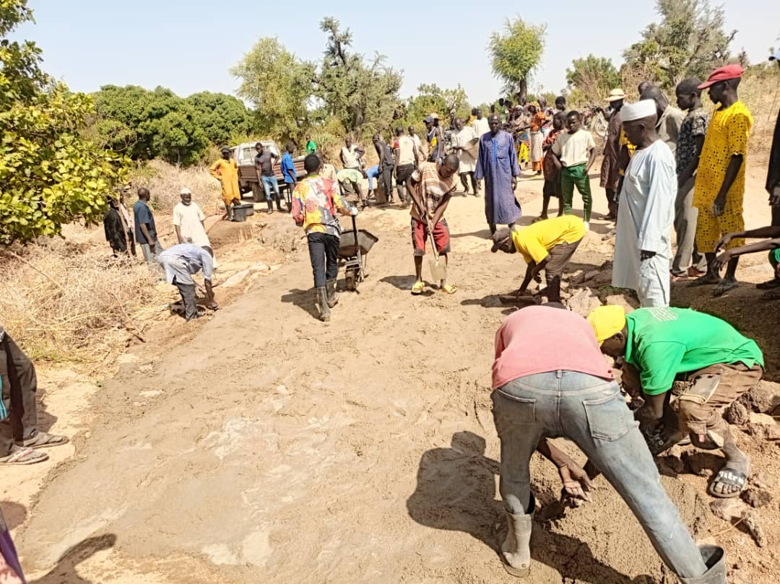
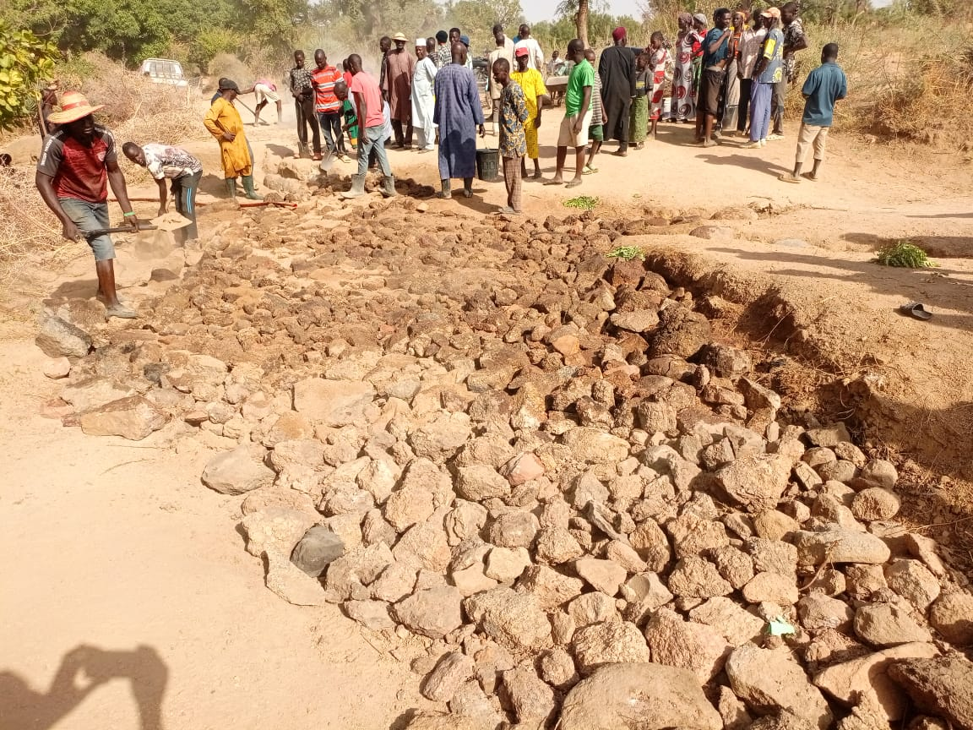
Jigalambu WDSC
Self-Help Project:
Rehabilitation of drift at Kura Road

Slide 27
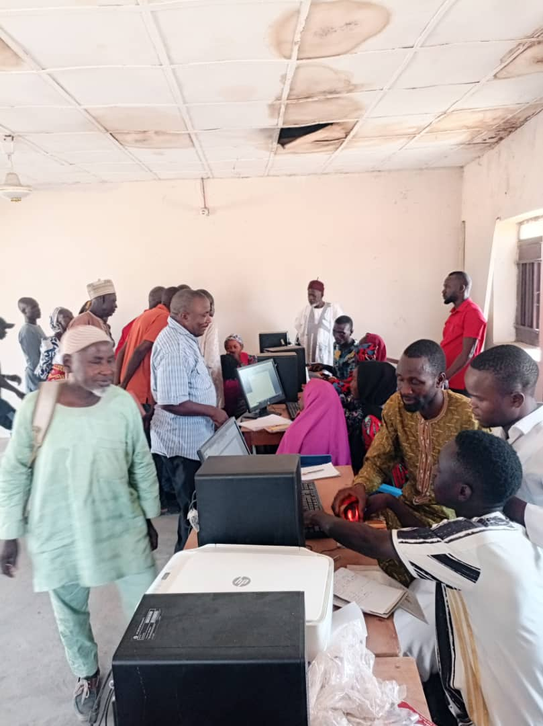
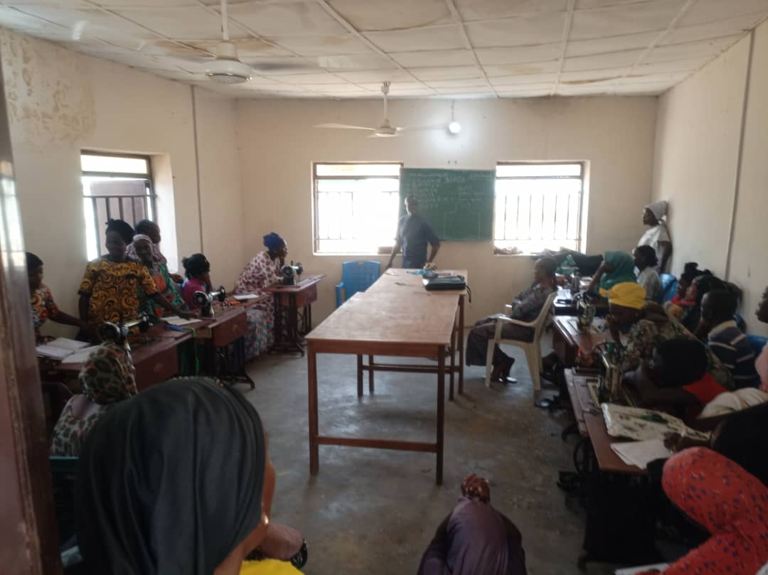
Jigalambu WDSC
Self-Help Project:
Skills Acquisition Training: Successfully lobbied a nonfunctional Training Acquisition Center an made operational (Tailoring & Computer Training):

Slide 28

Jigalambu WDSC
Self-Help Project:
Lobbied 40 2-seater benches and distributed to Primary and Secondary School Kankra

Slide 29


Jigalambu WDSC
Self-Help Project:
Rehabilitation of School floor

Slide 30


TUMBARAGABIRI:
Repair of two (2) Boreholes in Chi and Anguwan Shanu
:

Slide 31


TUMBARAGABIRI:
Provision of Drugs and other consumables at keli health post.

Slide 32


ZAH:
Repair of access road at kashewa and zdadi

Slide 33


ZAH:
Repair of access road at kashewa and zdadi

Slide 34


ZAH:
Repair of hand pump borehole at Buppa (kofan sarki) and Kali Primary schhol, Zah

Slide 35


ZAH:
Repair of hand pump borehole at Buppa (kofan sarki) and Kali Primary schhol, Zah

Slide 36


ZAH:
Repair/Renovation of well at mintama and kulang bumpa.

Slide 37


ZAH:
Repair/Renovation of well at mintama and kulang bumpa.

Slide 38


ZAH:
Welding/instullation doors and windoors at kara zah primary school

Slide 39


ZAH:
Repair of hand pump borehole at Mampe and Grita, Zah

Slide 40


MICHIKA 1:
Repair of hand pump borehole at kofan sarki and campala.

Slide 41


MICHIKA 1:
Repair of hand pump borehole at wutu and Hausari primary school

Slide 42


MICHIKA 1:
Sanitation and cleaning of drainages at Kampala

Slide 43


MICHIKA 1:
Reconstruction of kampala and sabon layi luhu culvert

Slide 44


MICHIKA 1:
Training of young grils on hpow to produce grounurt oil and grounurt cake.

Slide 45


MINKISI WURO NGIGI:
Workshop/sensitization on how to improve the production of agricultural out put in minkisi

Slide 46


MINKISI WURO NGIGI:
Workshop/sensitization on entrepreneurship

Slide 47


MINKISI WURO NGIGI:
Recruiting volunteer teachers to various primary and secondary schools in pampla.

Slide 48


MINKISI WURO NGIGI:
Building of two blocks of classroom at Dira minkisi .

Slide 49


MINKISI WURO NGIGI:
Repair of borehole at Jiddel and Thifarshi nomadic primary school

Slide 50


MINKISI WURO NGIGI:
Renovation of well kilawanje

Slide 51


SINA KAMALE:
Repair of hand bump borehole at sina kunde market and kumbida

Slide 52


SINA KAMALE:
Construction of double seater school bench at junior secondary school, sina kwande

Slide 53


MICHIKA 2
Self help project
Rehabilitation of yasukule primary school fence

Slide 54


Michika 2
Self help project
Rehabilitation of borehole

Slide 55


TSUKUMU TILLIJO
Self help project
Distribution of food items to less privileges at tsukuma Tillijo ward.

Slide 56


Tsukumu Tillijo
Self help project
Rehabilitation of borehole at michijimba

Slide 57


TSUKUMU Tillijo
Self help project
Sanitation at tsukumu tillijo unguwan Mudan kasa.

Slide 58


Tsukumu tillijo
Self help project
Rehabilitation of handpump borehole at unguwan Sylvester wada.

Slide 59


MODA/DLAKA WDSC
Self help project:
Rehabilitation of a drift road at moda/dlaka

