Slide 1
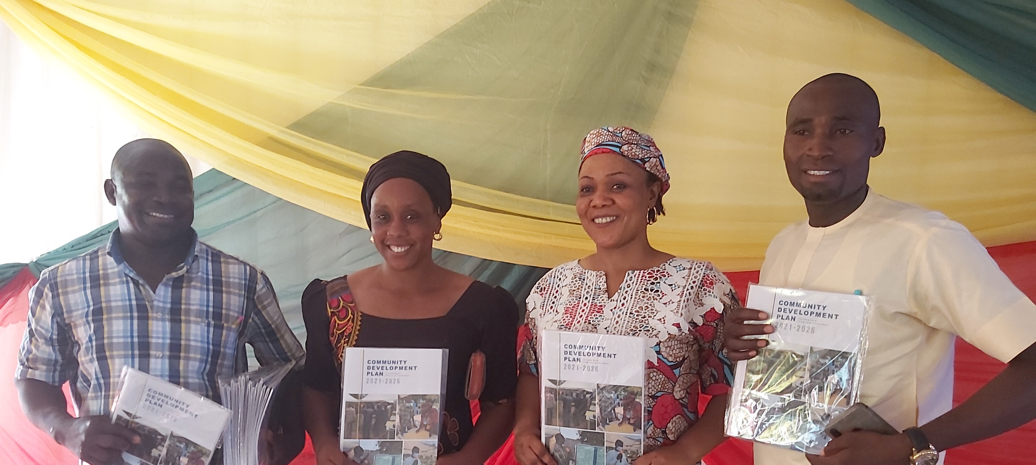



SOME SUCCESS STORIES FROM ACTIVITIES OF WDSCs IN OTHER LOCATIONs

Slide 2

Objective
To Inspire WDSC using evidence of Self-help project carried out by Ward Development Committees in other locations

Slide 3
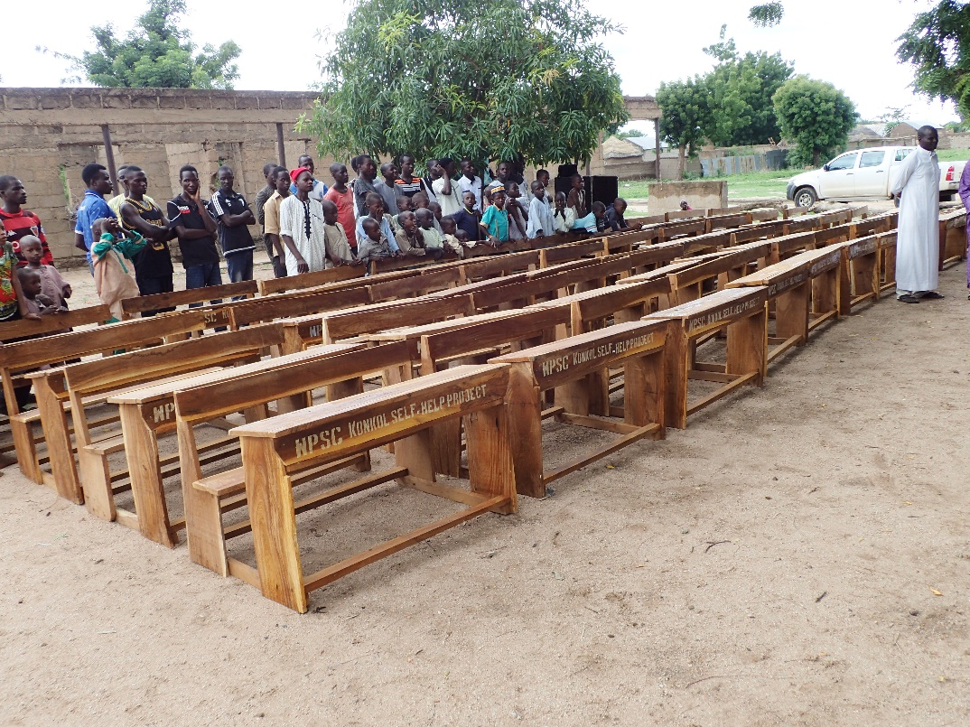
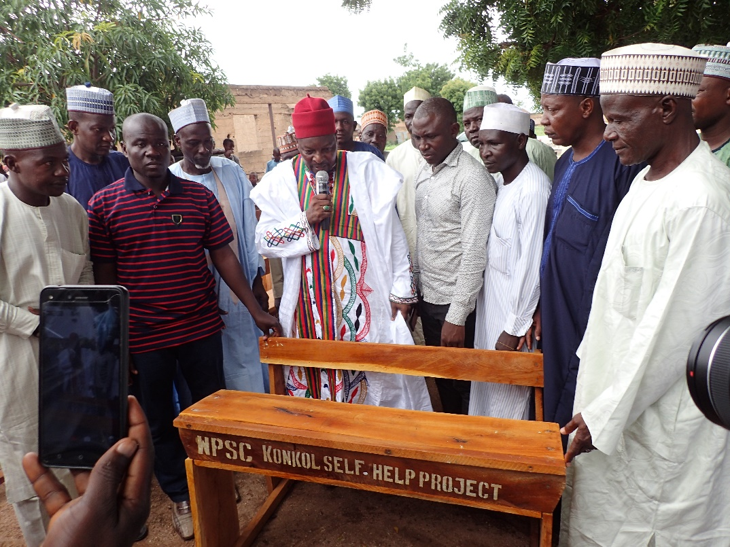
WDSC purchased 40 benches (three- seater) for 4 different schools within the ward (Self-Help Project) through efficient Fund-Raising efforts

Slide 4
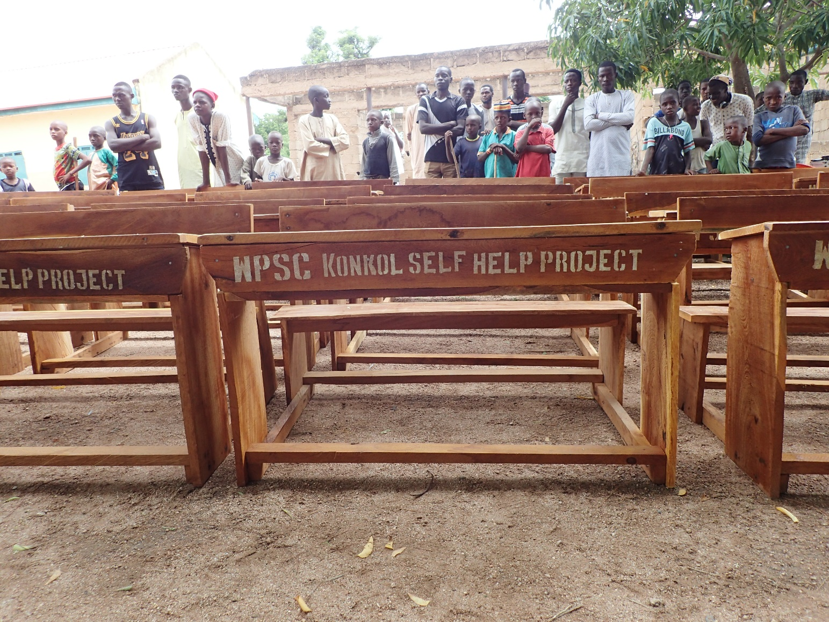
Self-Help Project through Fund Raising
- WDSC Konkol

Slide 5
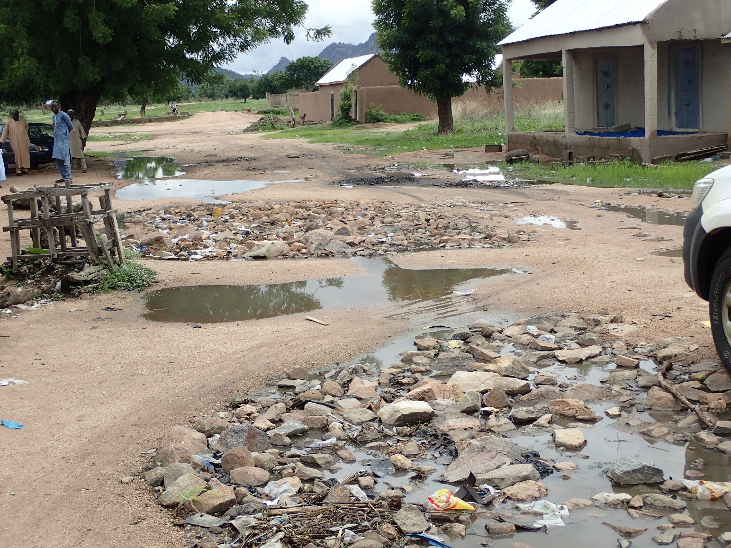
Filling of eroded Road
- WDSC Konkol

Slide 6
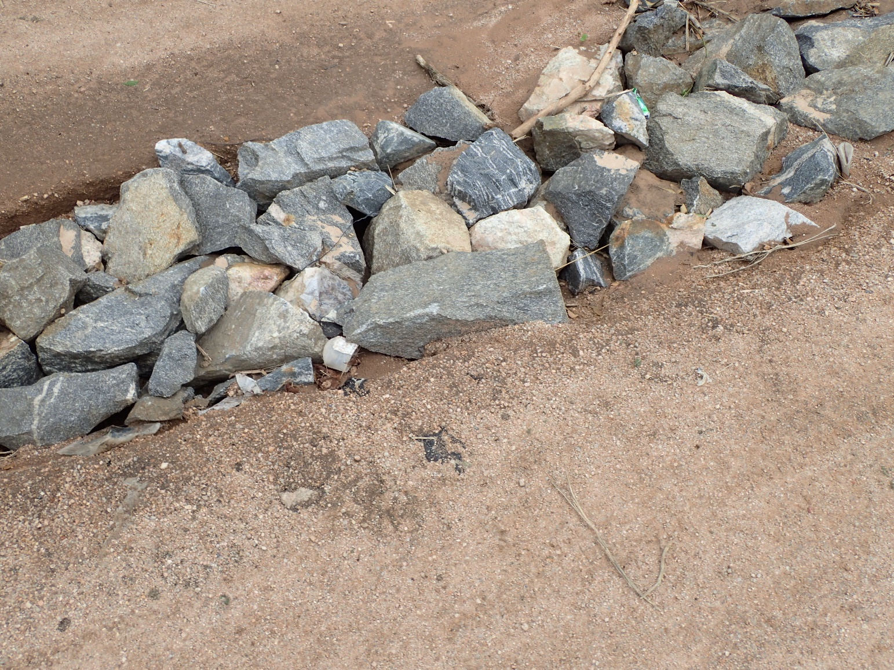
Controlling erosion through communal effort
- WDSC Manjekin

Slide 7
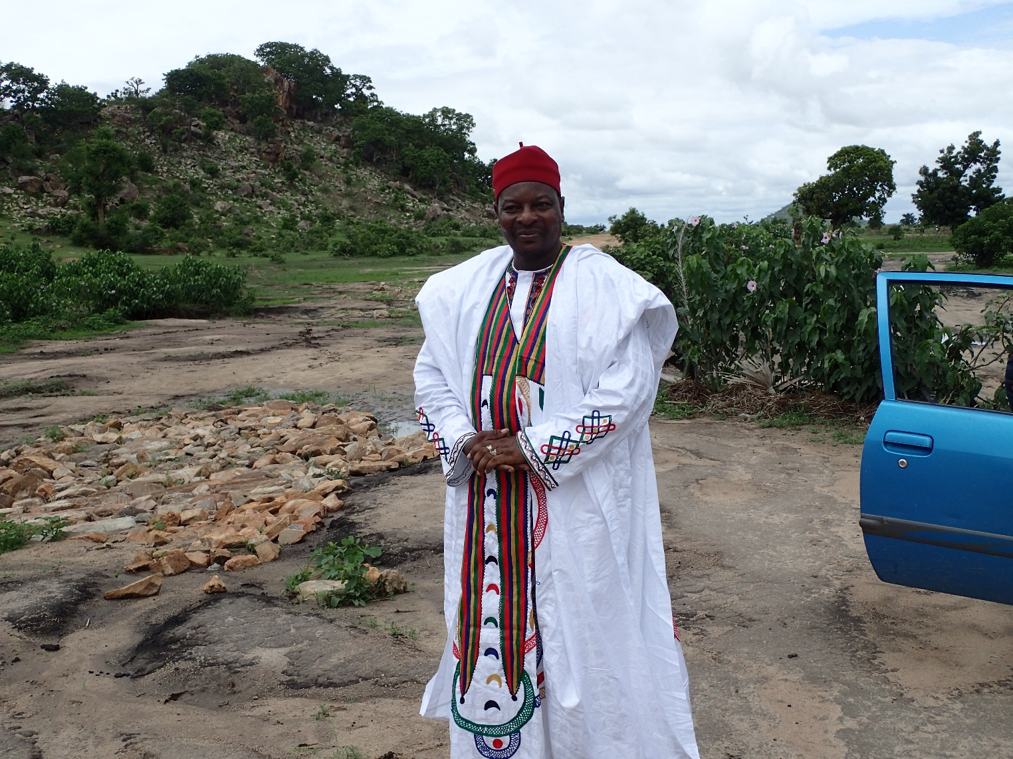
Rehabilitation of almost abandoned road with the help of communal effort
- WDSC Belel

Slide 8
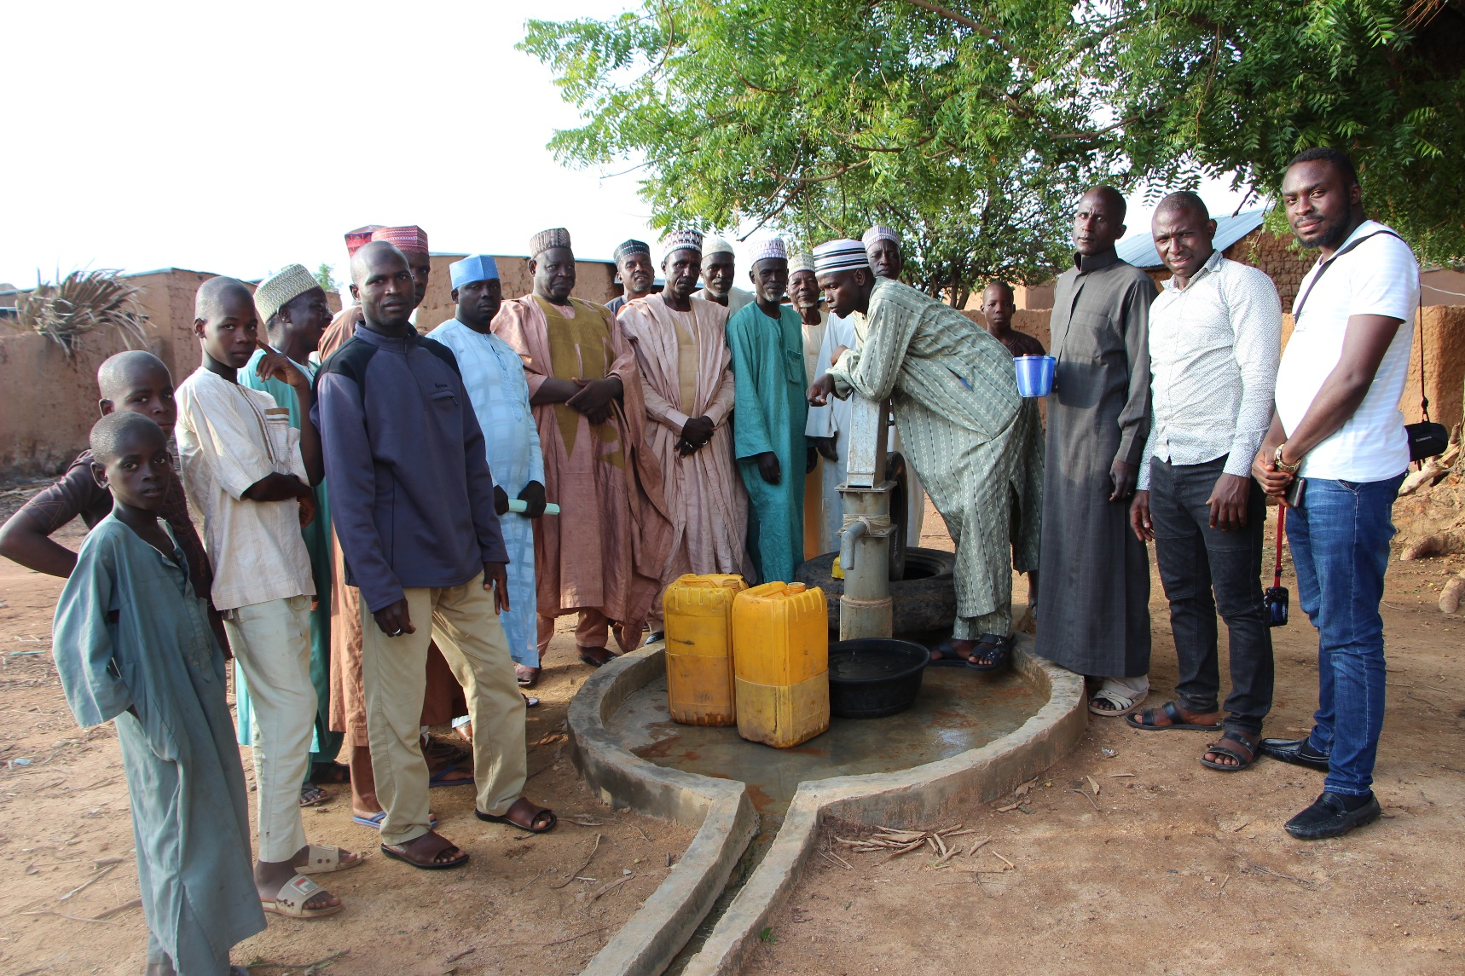
Construction of New Borehole in Manjekin by the Manjekin WDSC

Slide 9
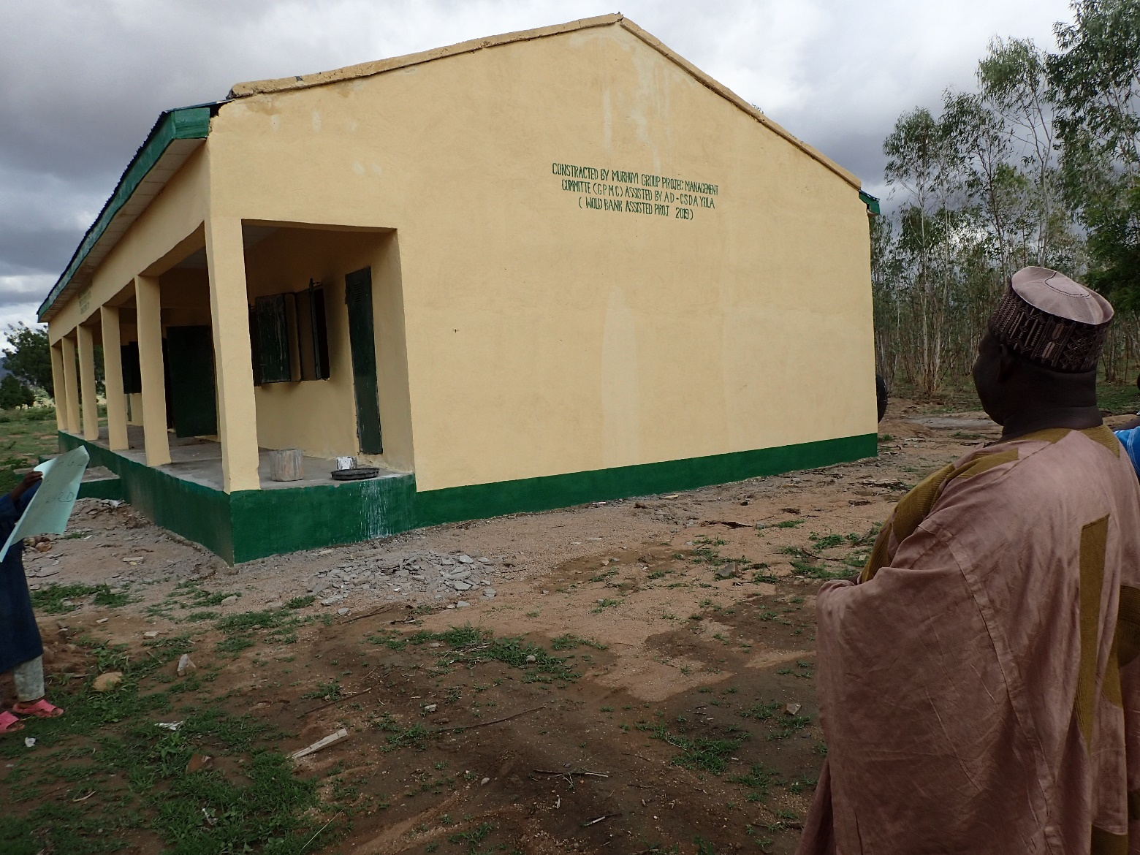
WDSC Manjekin lobbied for the construction of two classrooms, an office and a toilet in Government Day Secondary School (GDSS) through the Community Social Development Agency (CSDA) in November 2018
-

Slide 10
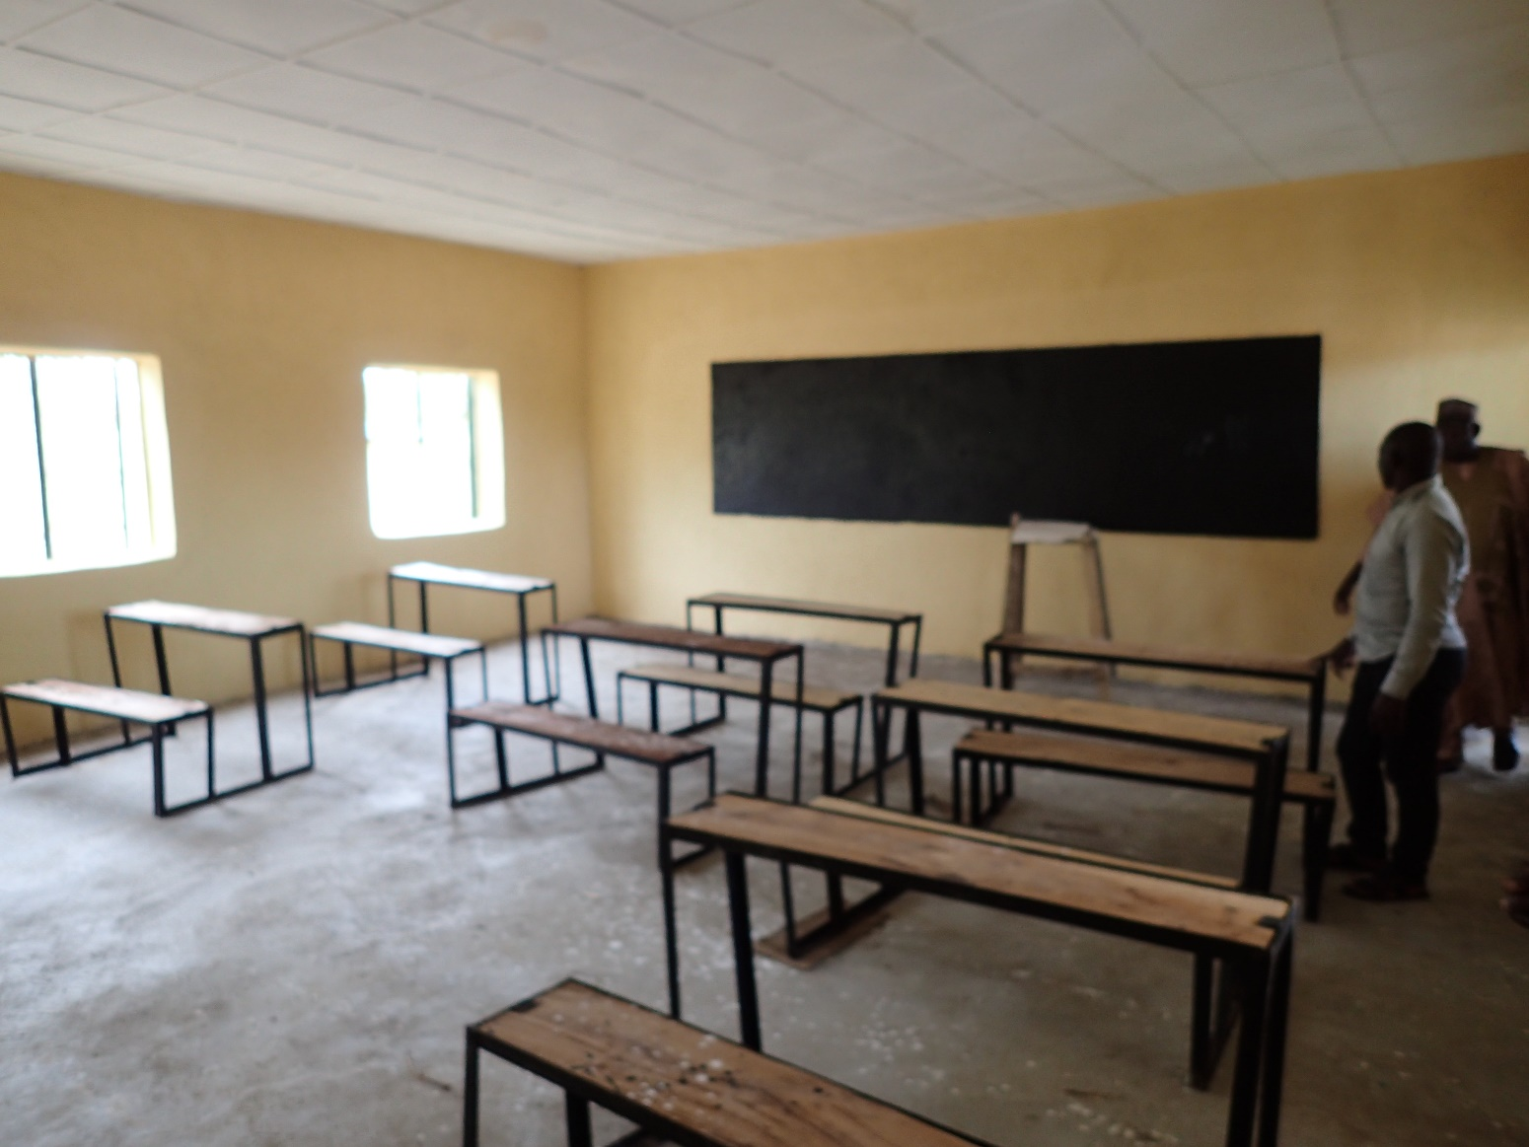
Inside view of the constructed Classroom
Lobbied through CSDA
- WDSC Manjekin

Slide 11
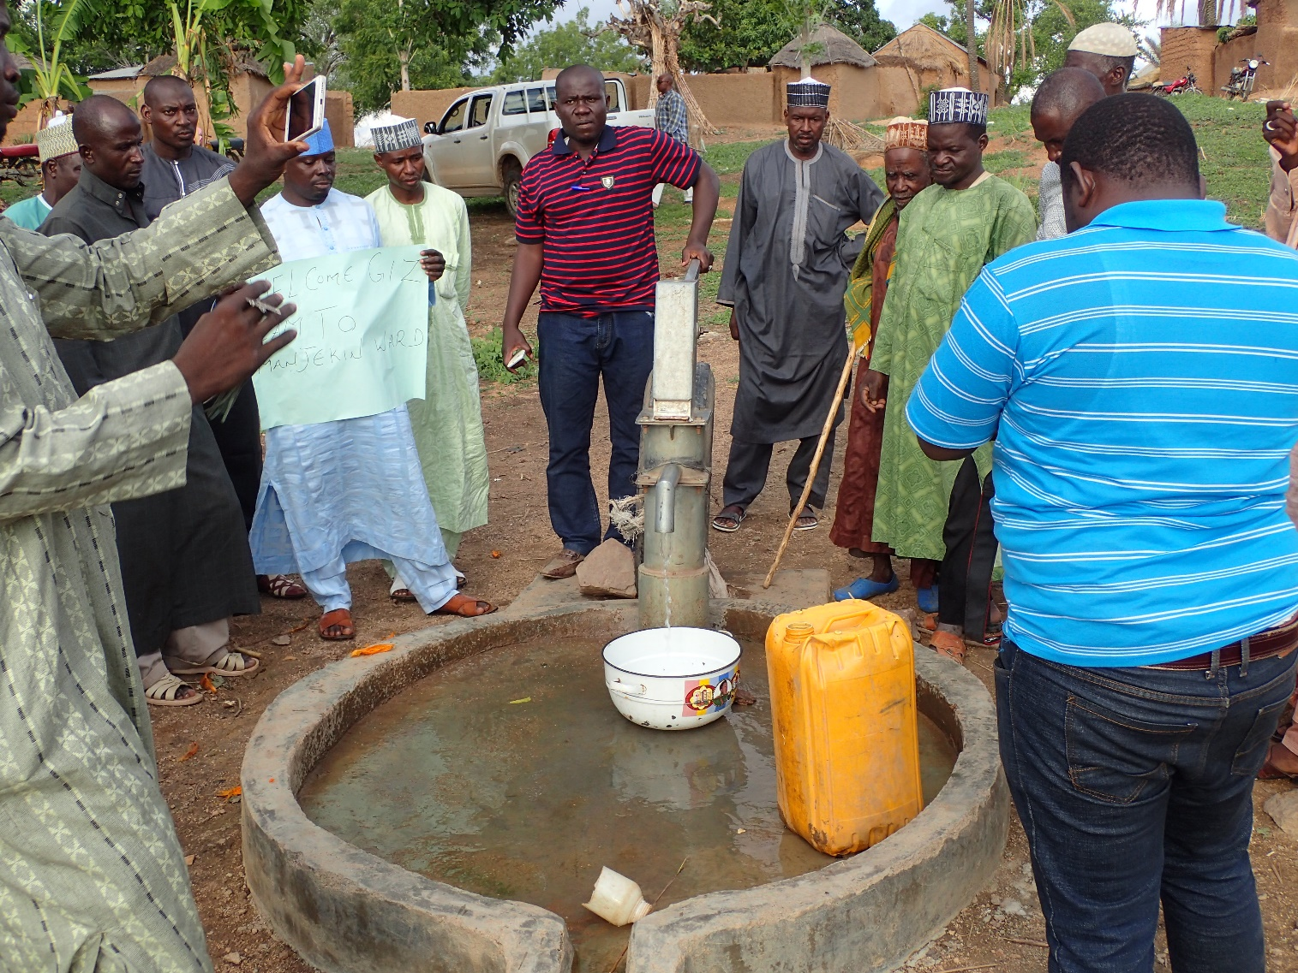
Construction of a new Borehole through funds lobbied from CSDA – Manjekin WDSC

Slide 12
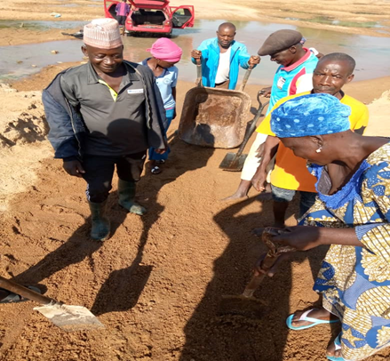
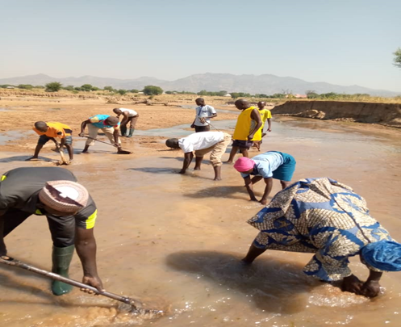
Self-help project Betso ward (Duda)

Slide 13
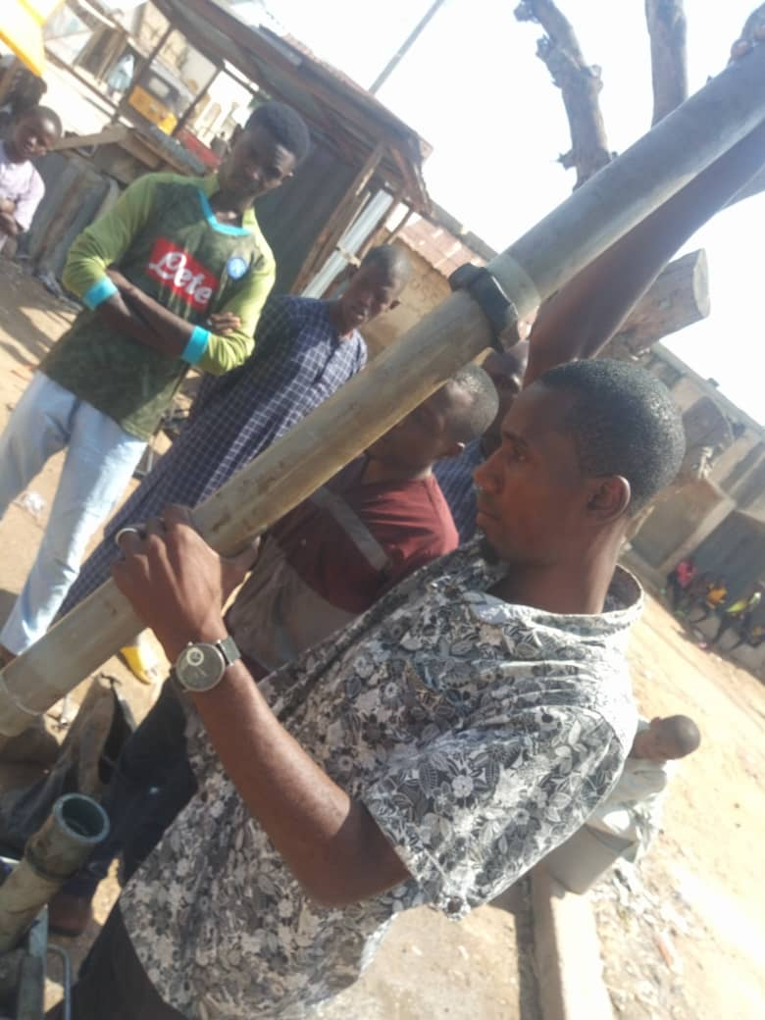
Self-help Projects
Sabon-layi ward Repairs of borehole

Slide 14
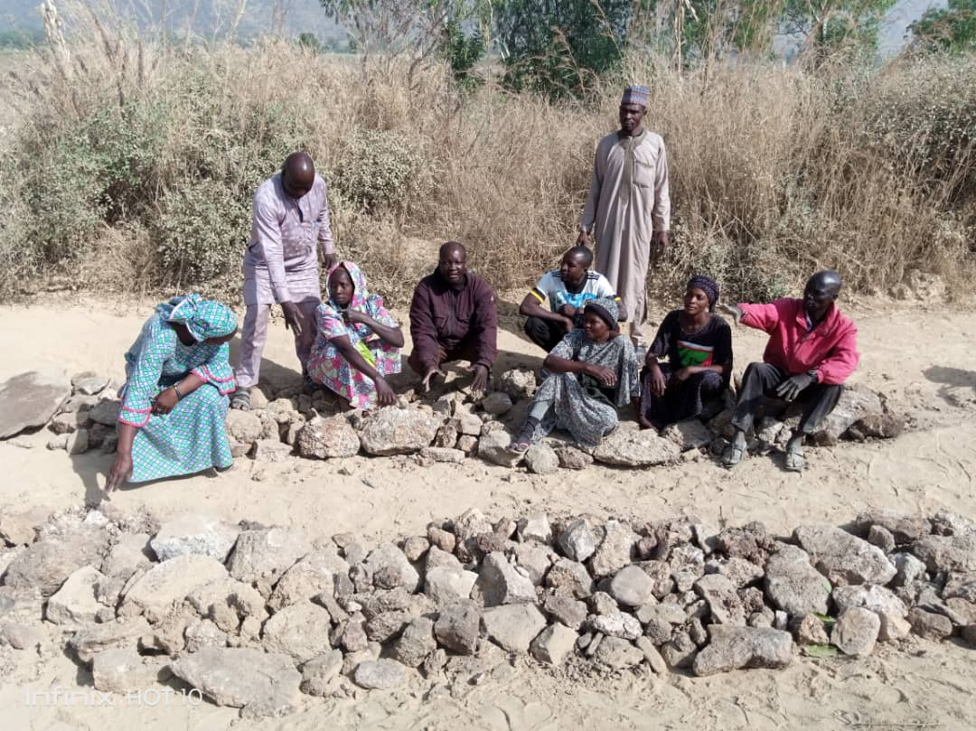
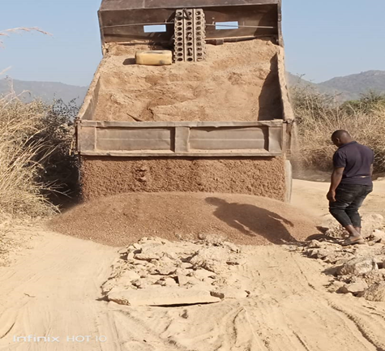
Self help project Contd. Bahuli community

Slide 15
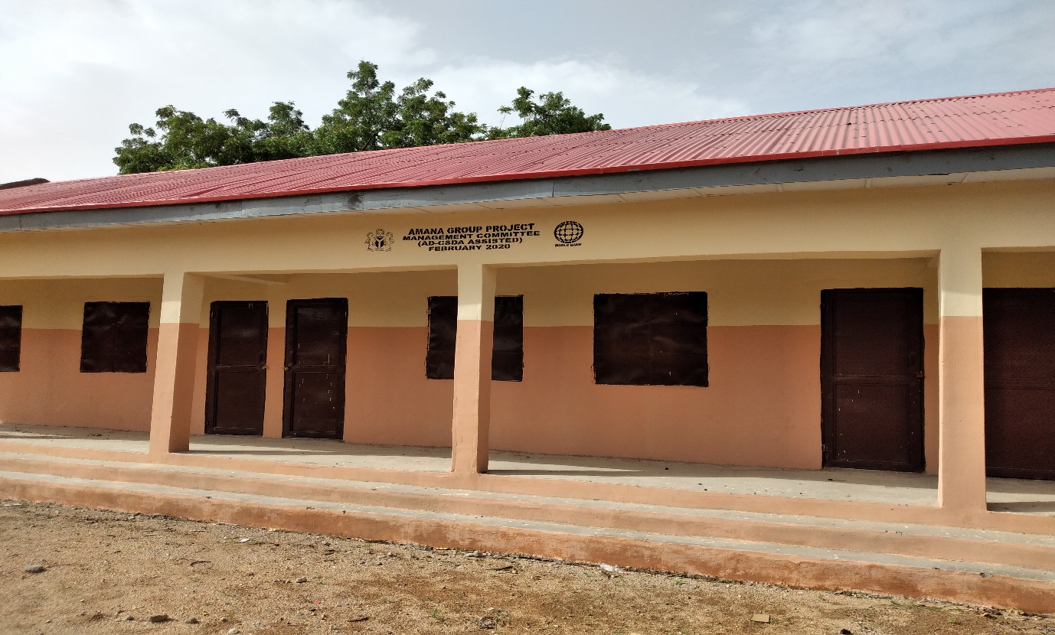
KOLERE WARD, MUBI NORTH LGA
Applied for grant from the AD-CSDA and got N6.8 million that the committee used for the construction of a block of three classrooms, provision of furniture for the constructed classrooms
To access this fund, the committee had to raise N456,000 as counterpart funding. The committee members raised a total of N115,000 from the committee membership while the deficit of N341,000 was raised through fund raising efforts by the committee

Slide 16
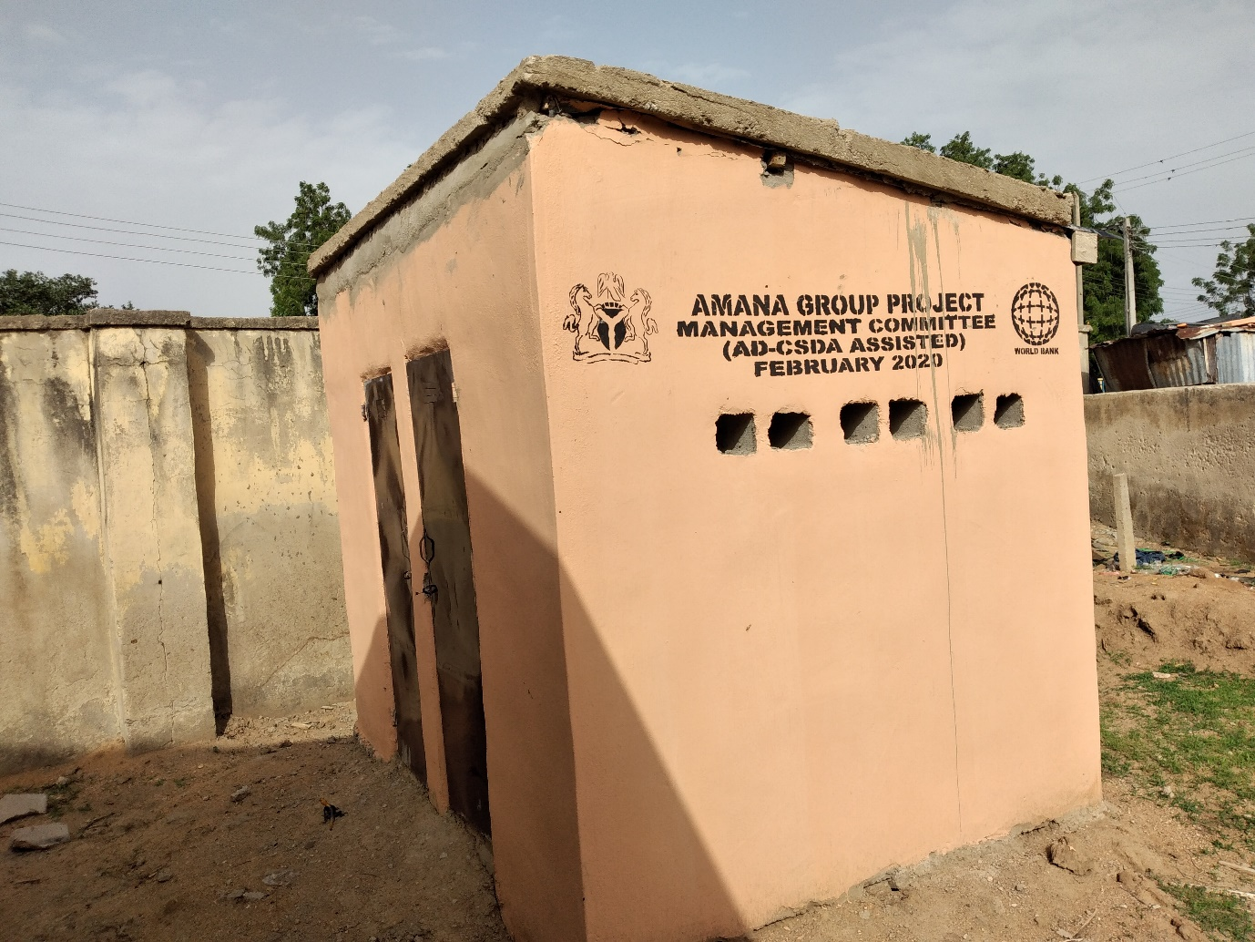
KOLERE WARD, MUBI NORTH LGA
Construction of two VIP toilets within kolere primary school

Slide 17
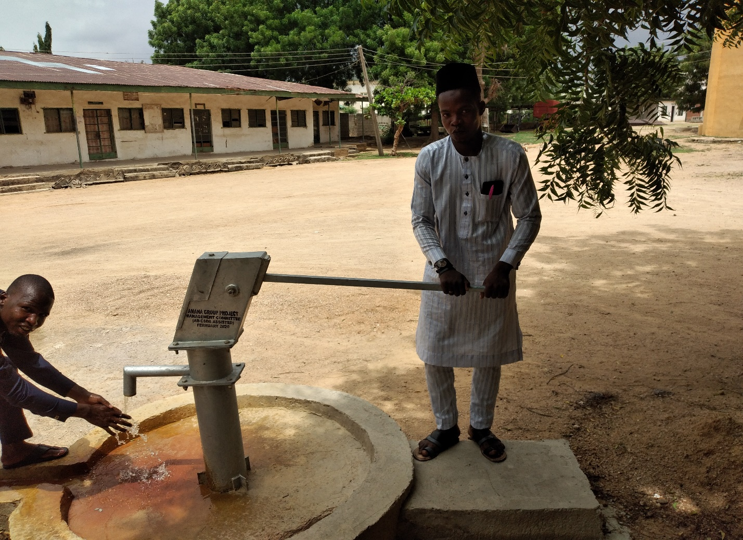
KOLERE WARD, MUBI NORTH LGA
Some members of the Kolere WDSC showcasing one of the boreholes constructed by the committee sited at the LGA headquarters

Slide 18
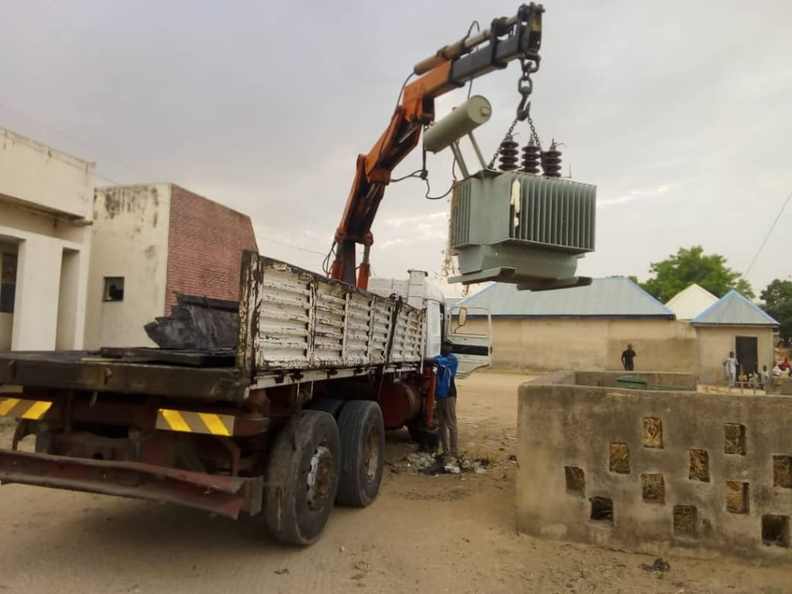
NASSARAWO WARD, MUBI SOUTH LGA
The committee has successfully lobbied an electricity transformer from the former member house of representative Hon. Alh. Abubakar Wambai (Madawaki Mubi). Installed at Sebore

Slide 19
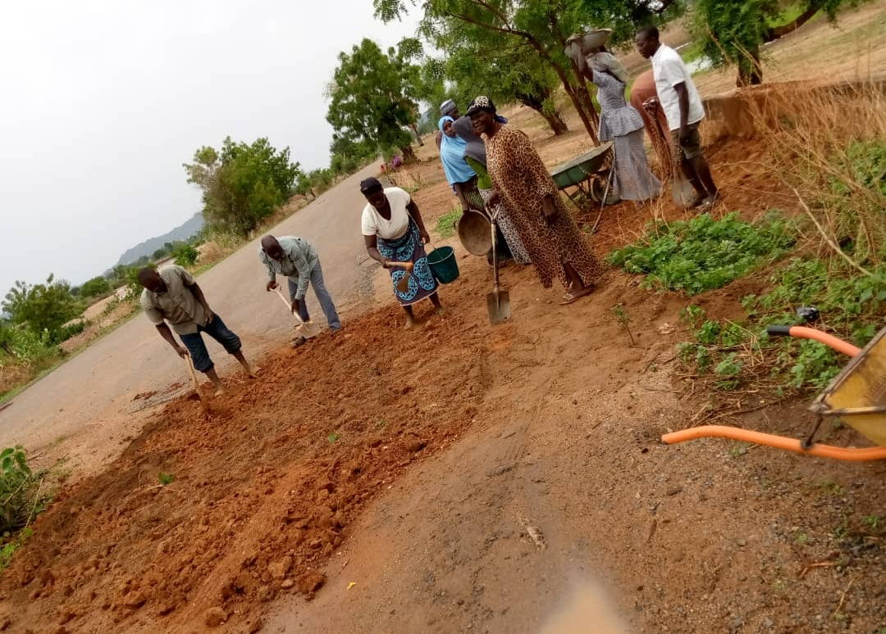
MAYO-BANI WARD
Organized and mobilized for the repair and filling of potholes on the Mayo-bani – Qotirde road.

Slide 20
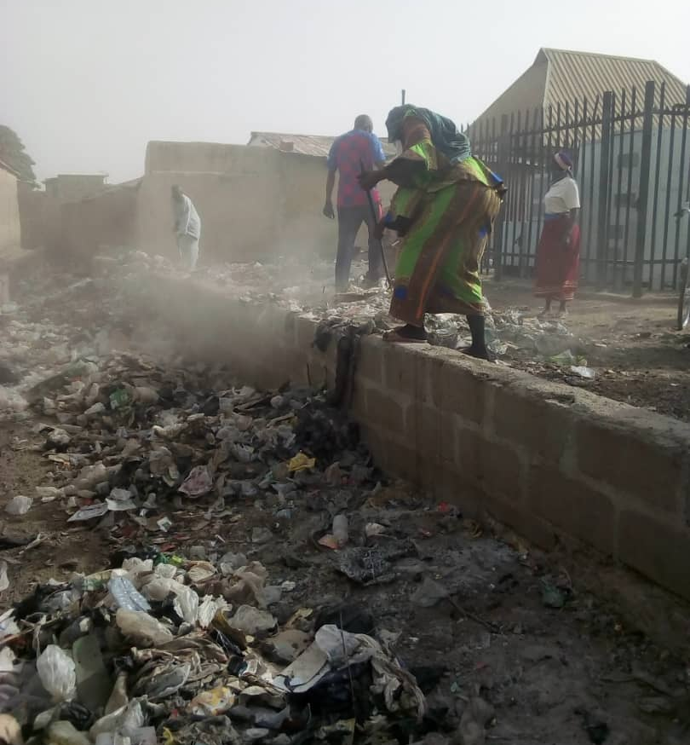
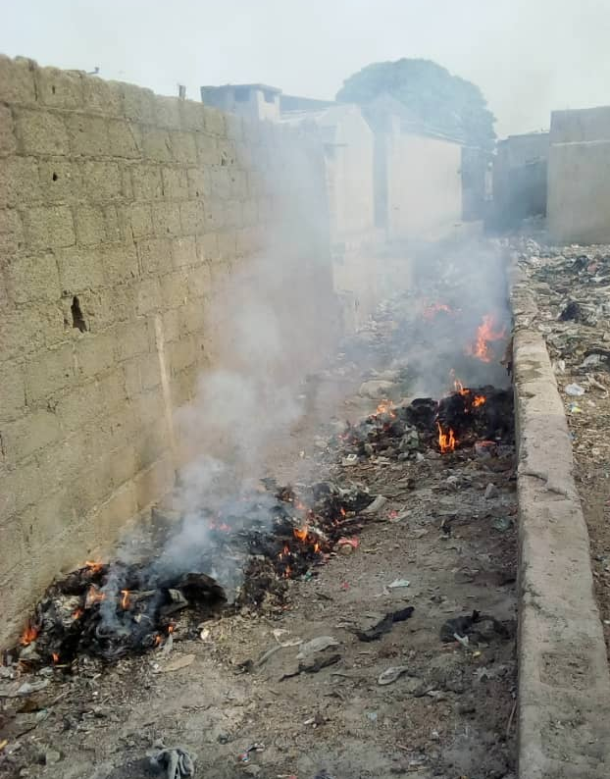
YELWA WARD, MUBI NORTH
Mobilised the community to carry out sanitation in the whole ward every first Saturday of the month.

Slide 21
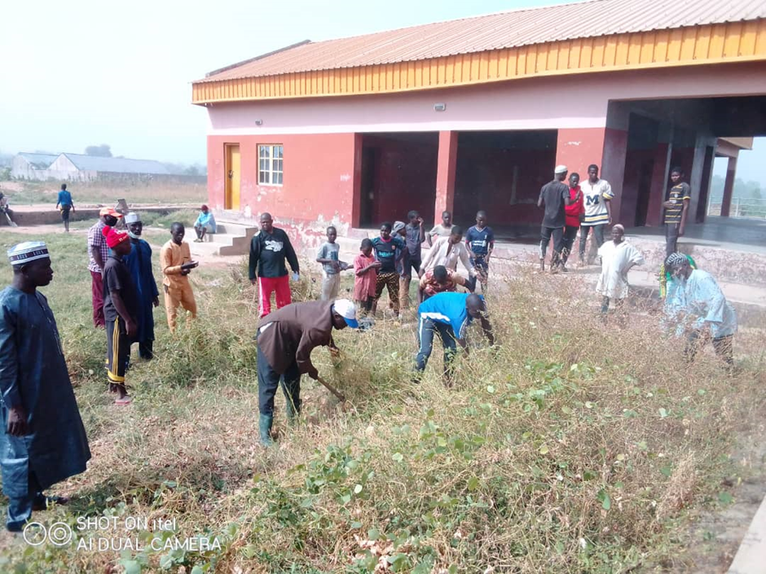
Self-help Project at Mayo Nguli Ward (Sanitation of Abattoir)

Slide 22
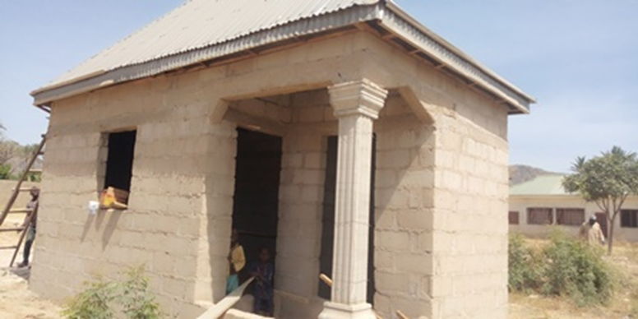
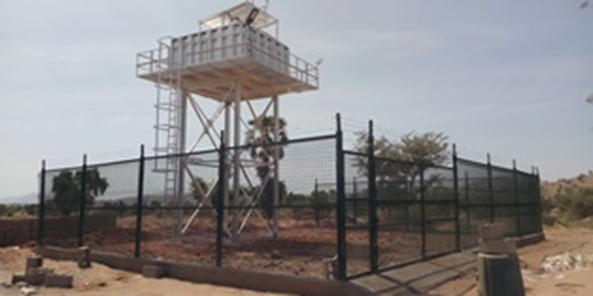
Vigilante’s office Solar Borehole at Maiha Gari Ward

Slide 23
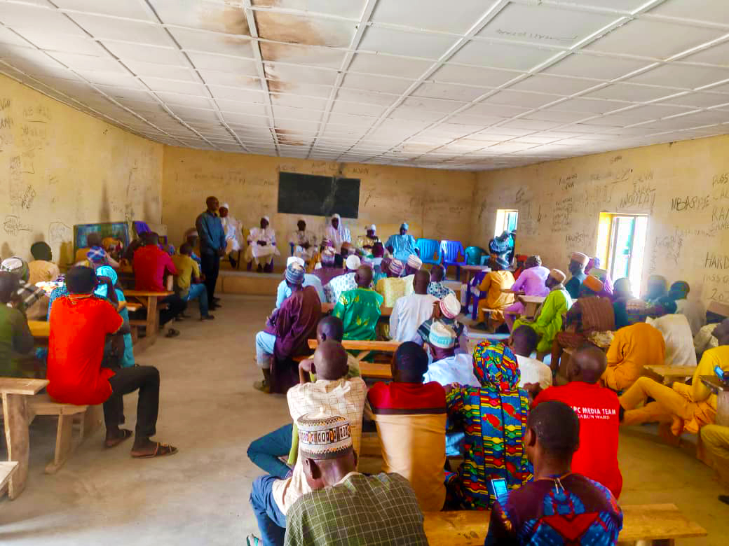
Feedback Report To The Community Members And Leaders In Ganda Ward.

Slide 24
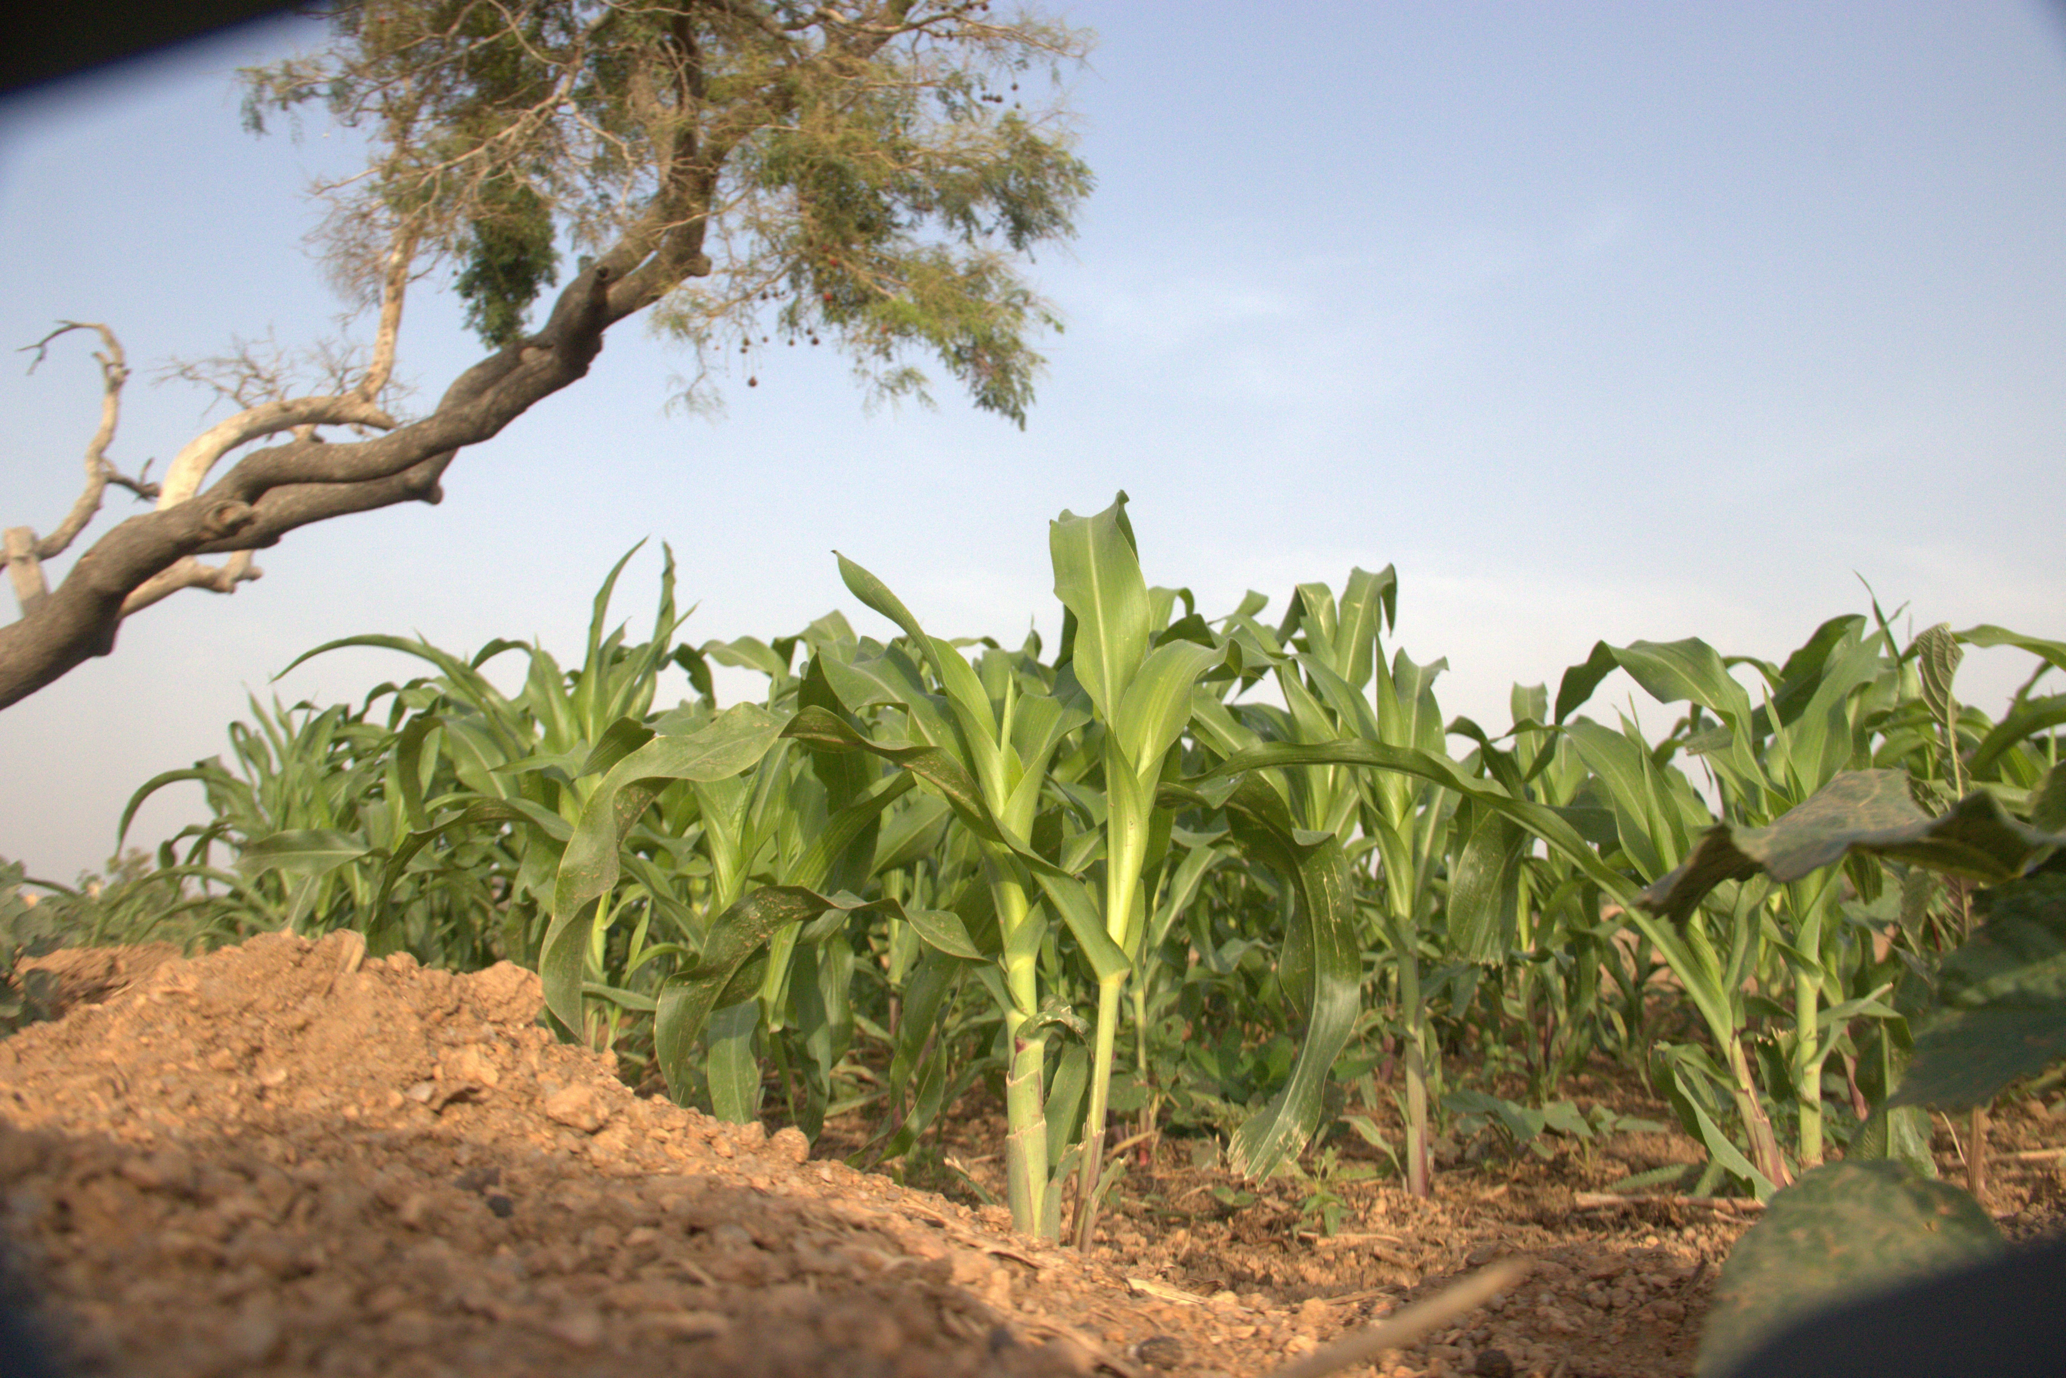
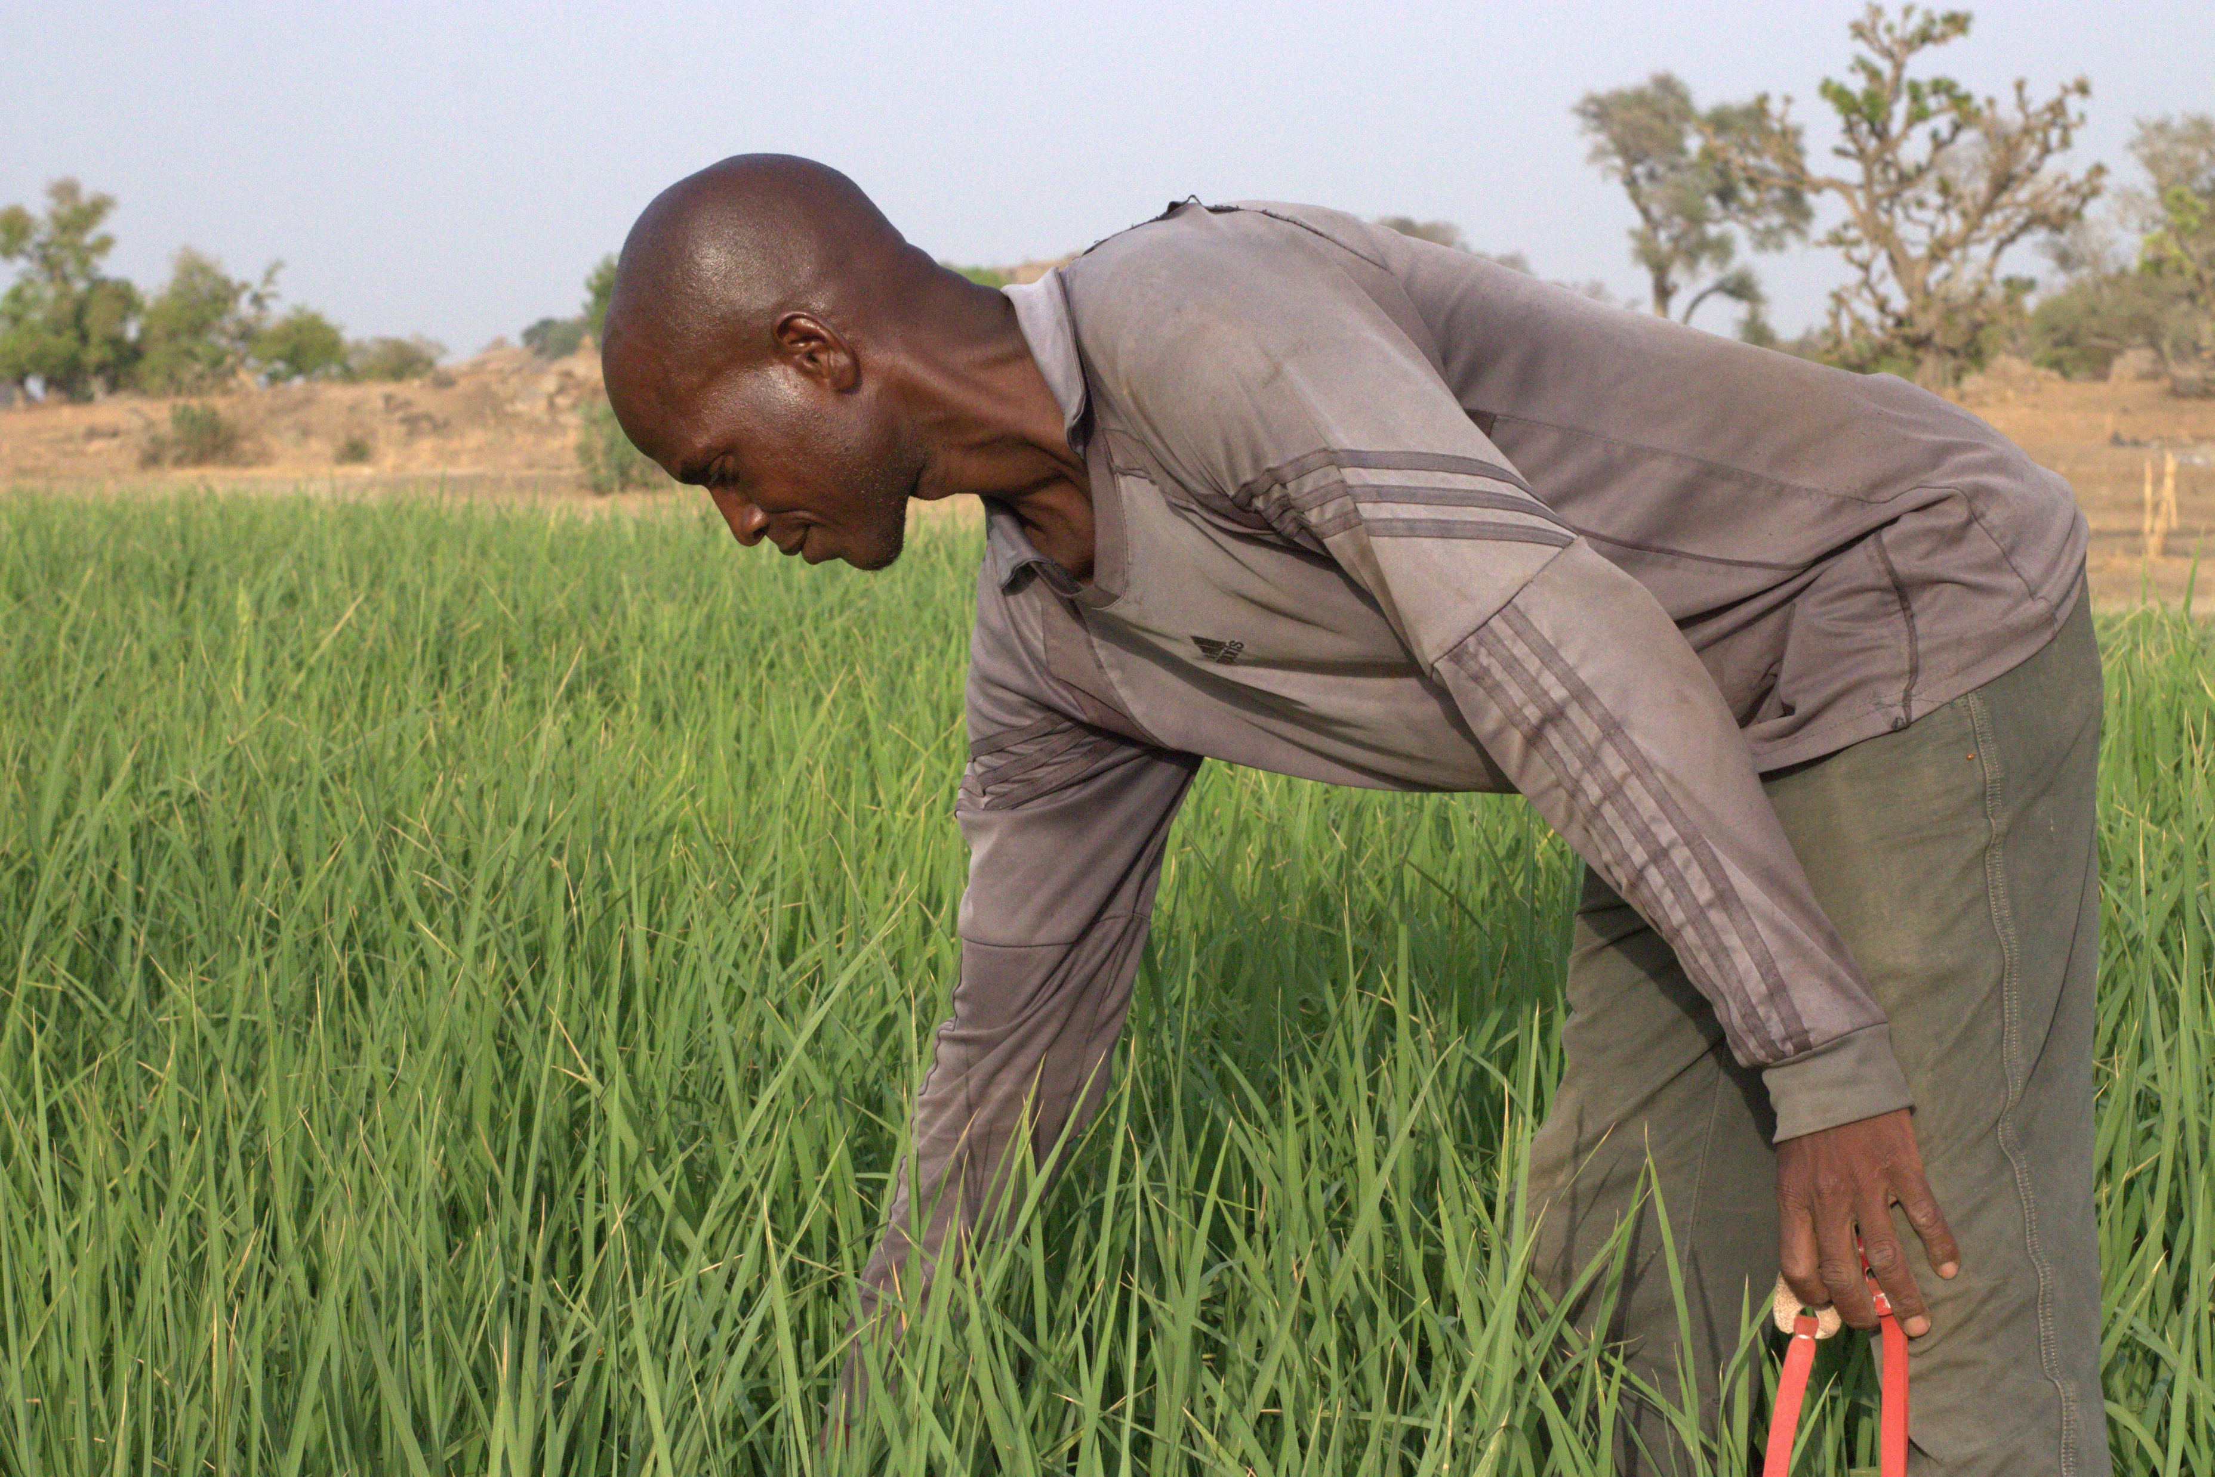
Demonstration Farm by WDSC in Gombi LGA

Slide 25
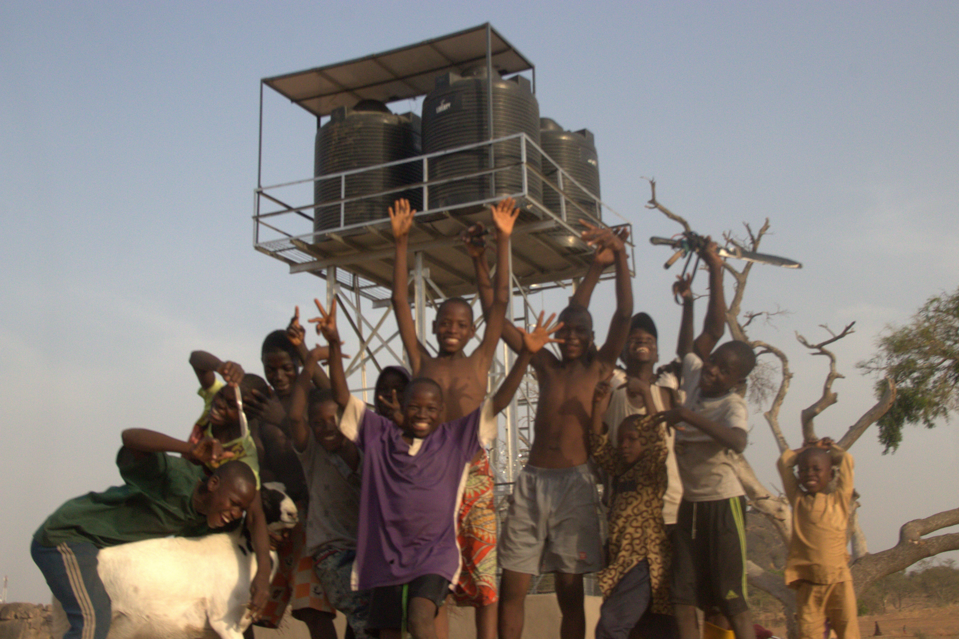
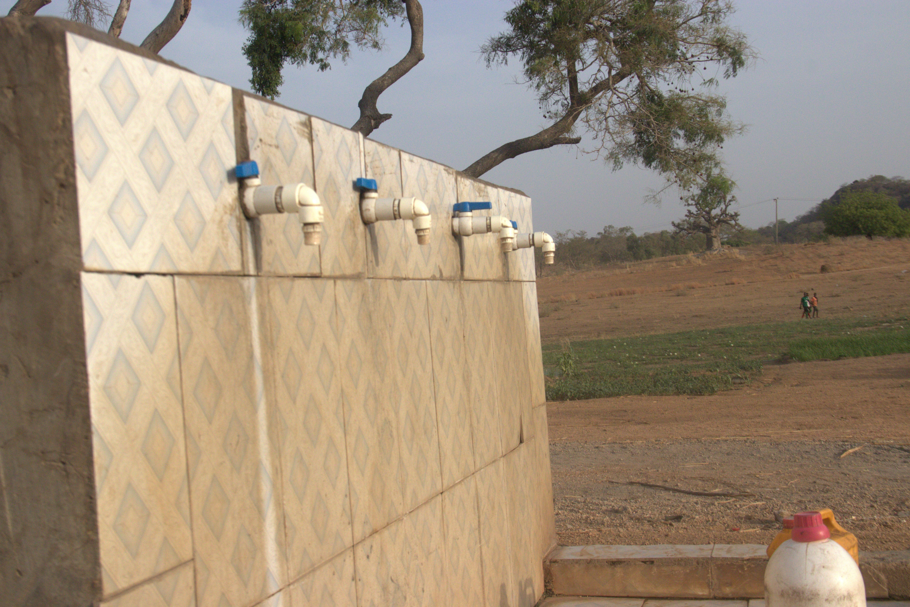
Construction of Water Point by WDSC in Gombi LGA,
the Borehole also provides water to the Demonstration
Plot and the surrounding Community.

Slide 26
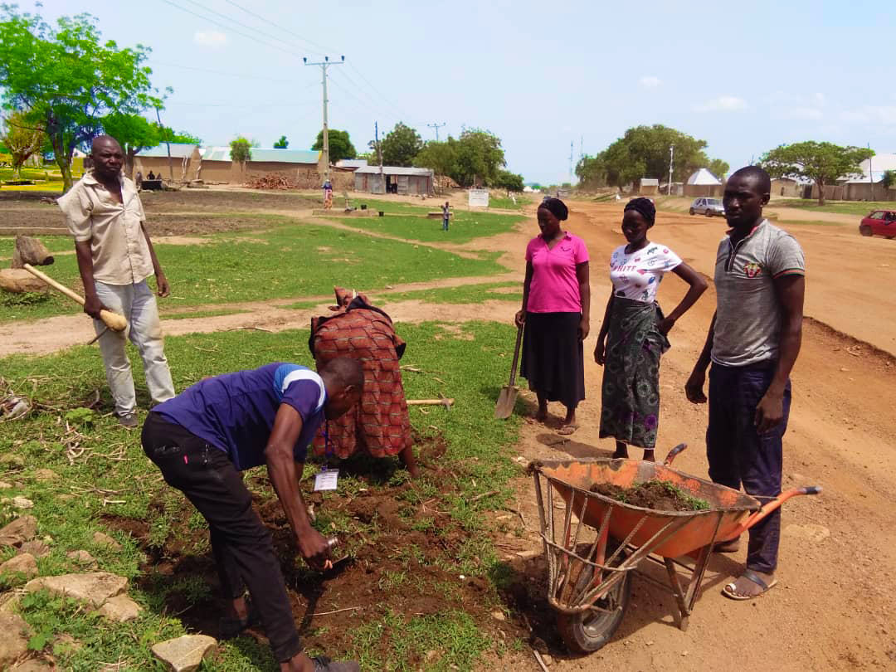
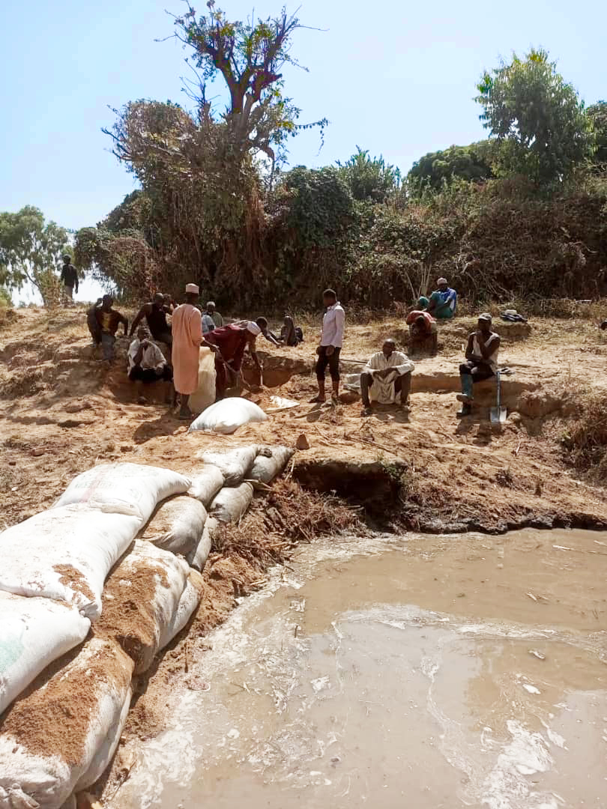
Road Repair By Members Of The Guyaku WDSC

Slide 27
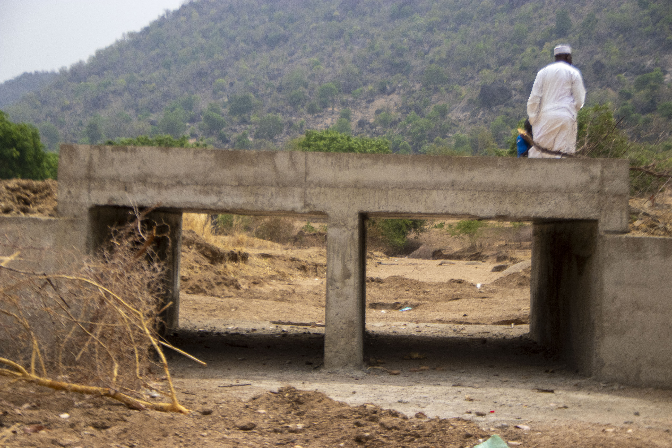
WDSC lobbied the MFHR for the Construction of
link Bridge in Michika LGA

Slide 28
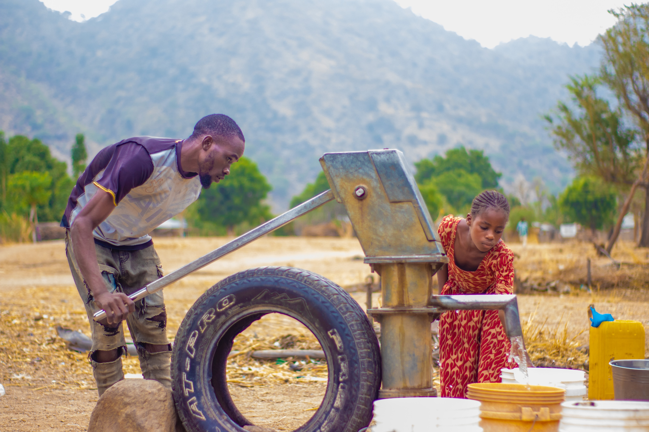
Road Repair By of Borehole by WDSC Members
in Futu Michika LGA

Slide 29
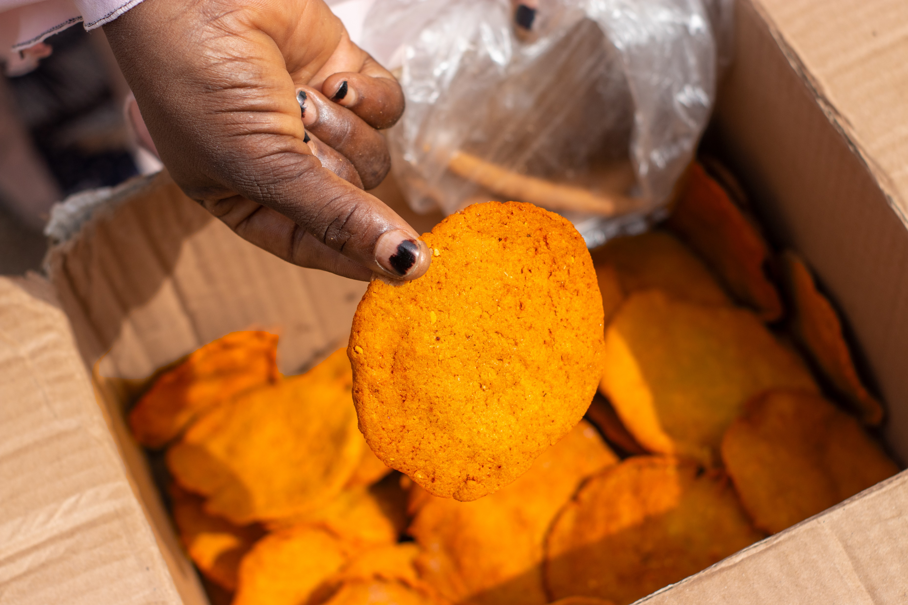
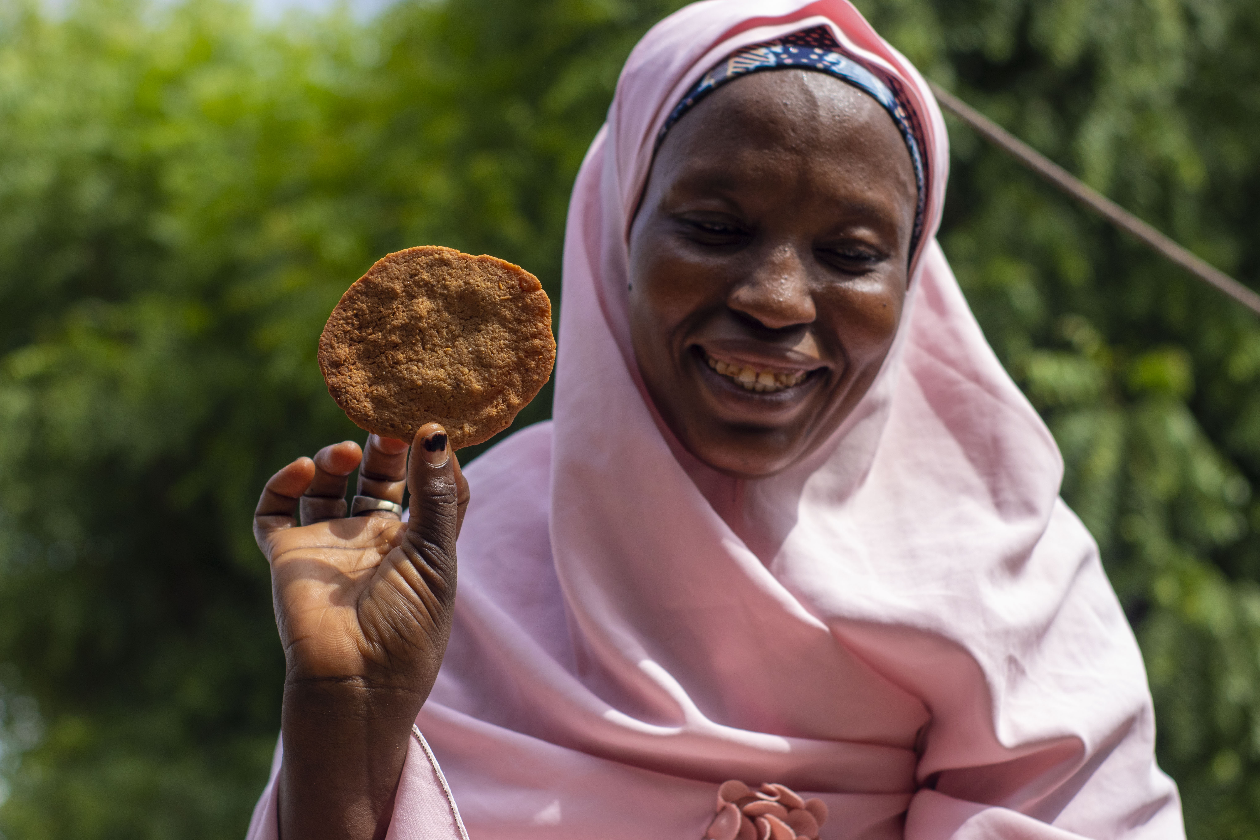
Skill Acquisition Training for Female Community Members by WDSC Members in Minkisi Michika LGA

Slide 30
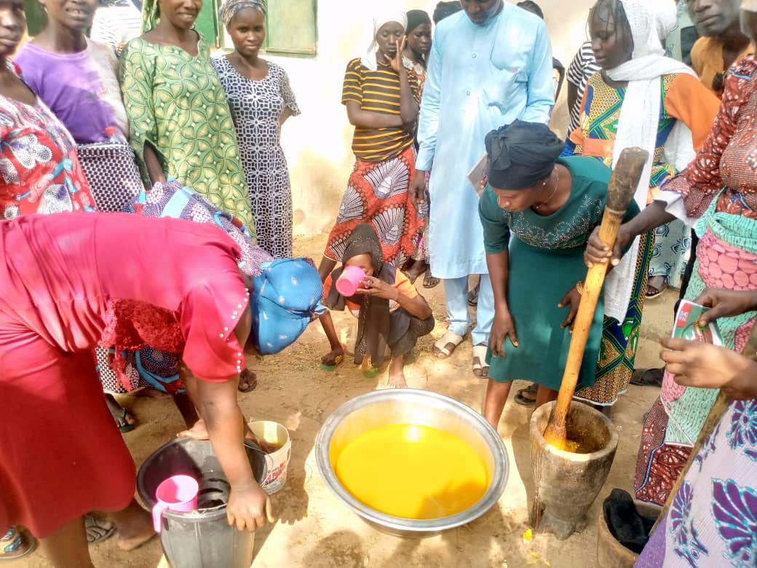
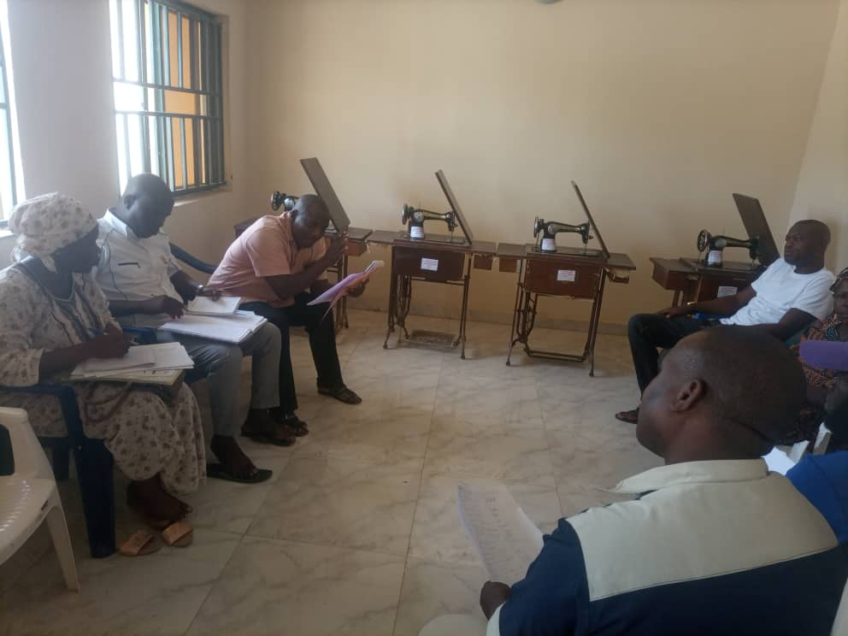
Skill Acquisition Training Ginger Juice Production Madzi WDSC and Lobby For Sowing Machines and Vacant Space For Training Purposes By Vi Bokka WDSC, Michika

Slide 31
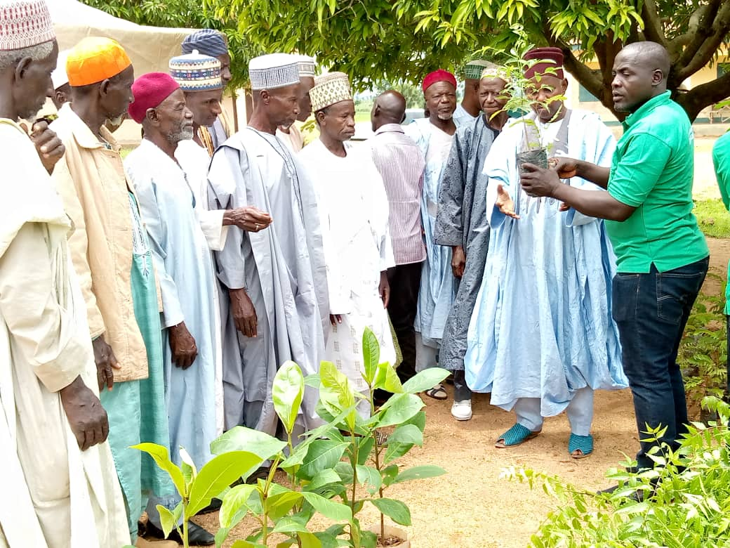
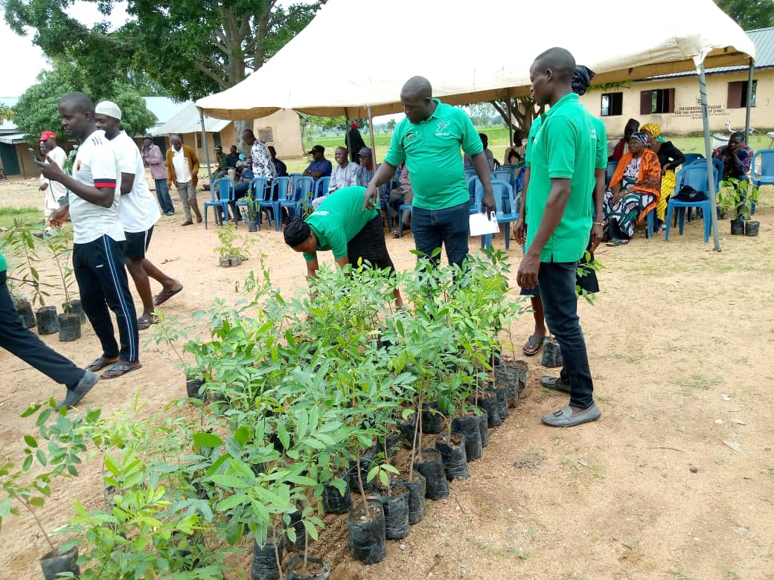
Distribution of Tress to Community Members During a Tree Planting Campaign by Mayo lope WDSC in Hong LGA

Slide 32
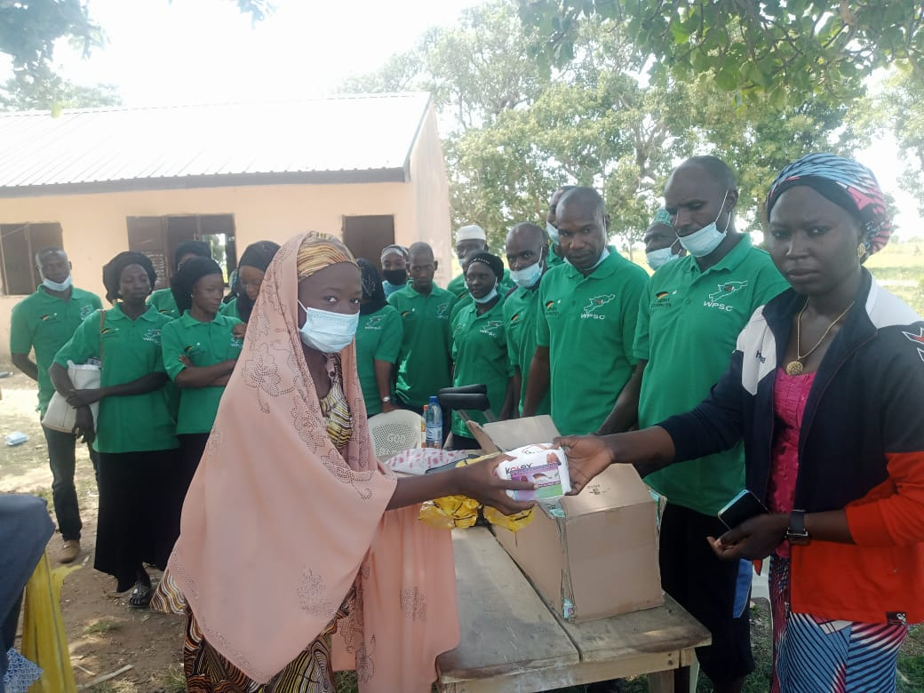
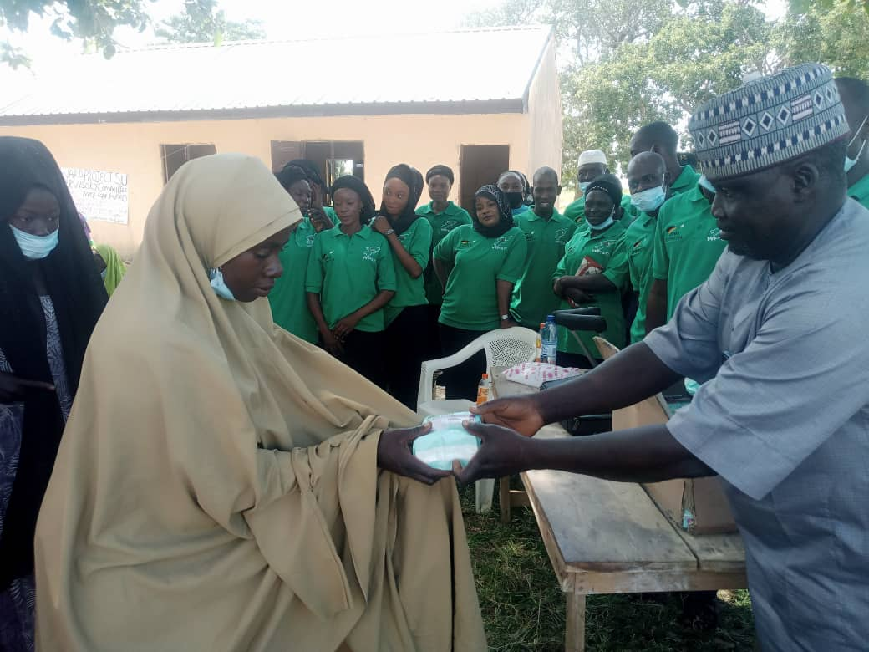
Community Members Receiving Hygiene Materials Distributed by Mayo lope WDSC in Hong LGA

Slide 33
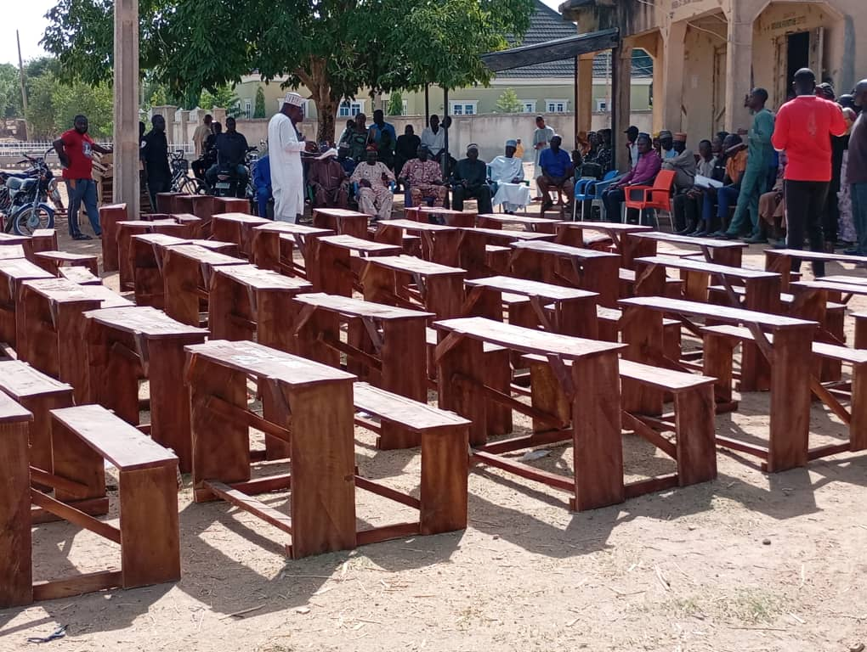
Handover Of 43 Classroom Furniture To 8 Schools in Madzi Ward By Madzi WDSC, Michika LGA

Slide 34
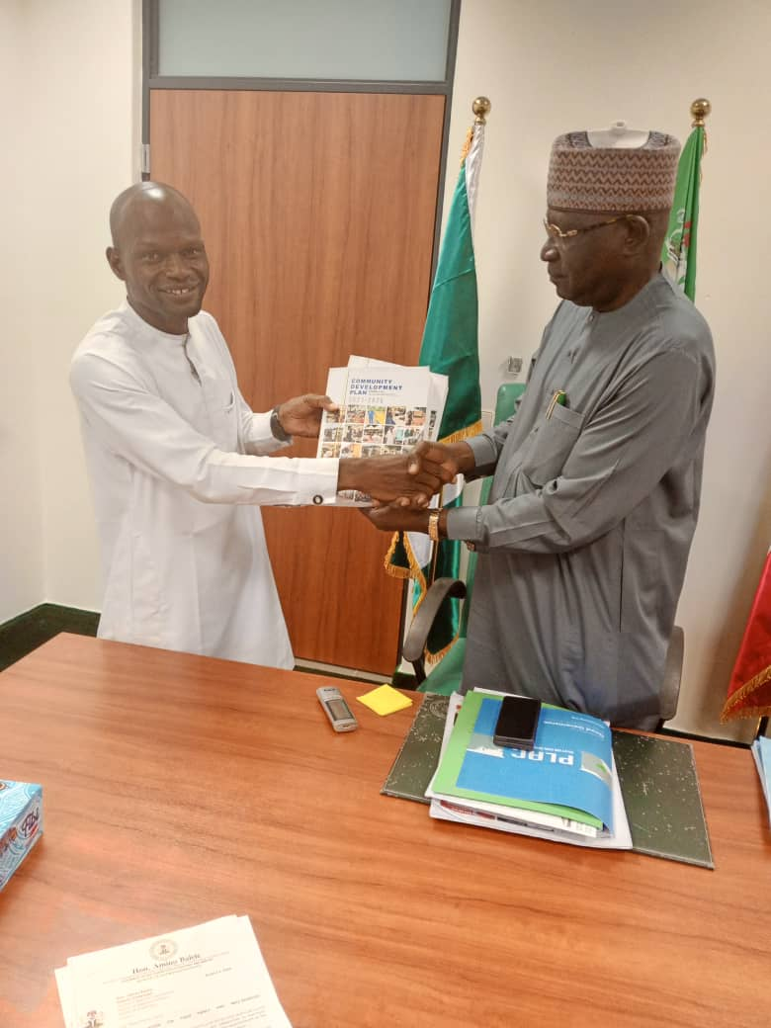
Representative Of The Gombi WDSC Presents the LGA CDP Plan To Rt Hon James Shuaibu Barka Member Representing Gombi Hong Federal Constituency.

Slide 35
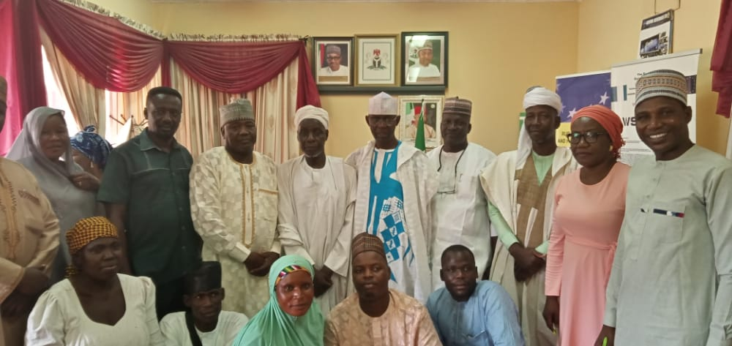
Advocacy Visit to the Commissioner Ministry of Water Resources on the Implementation of CDP Plans For Ga'anda Ward, Gombi LGA

Slide 36
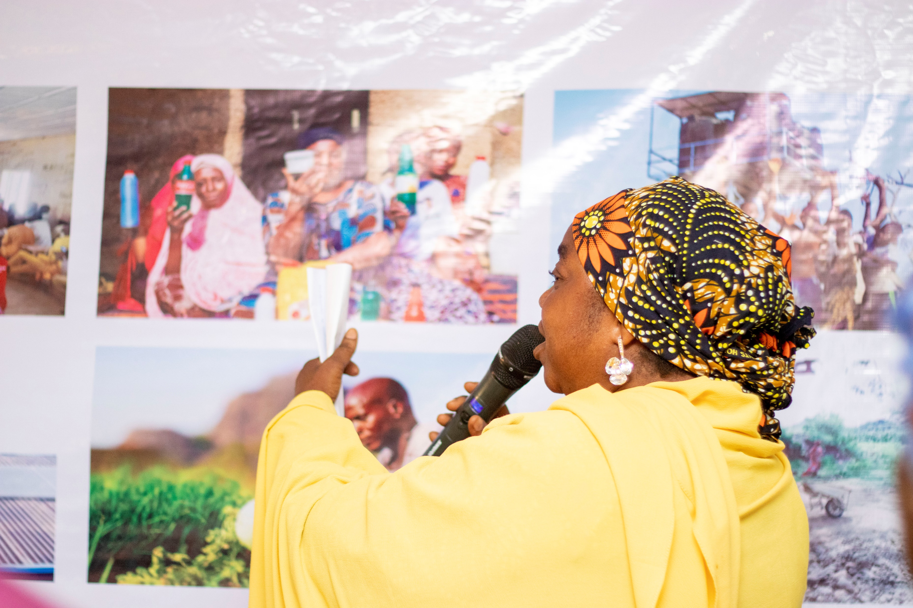
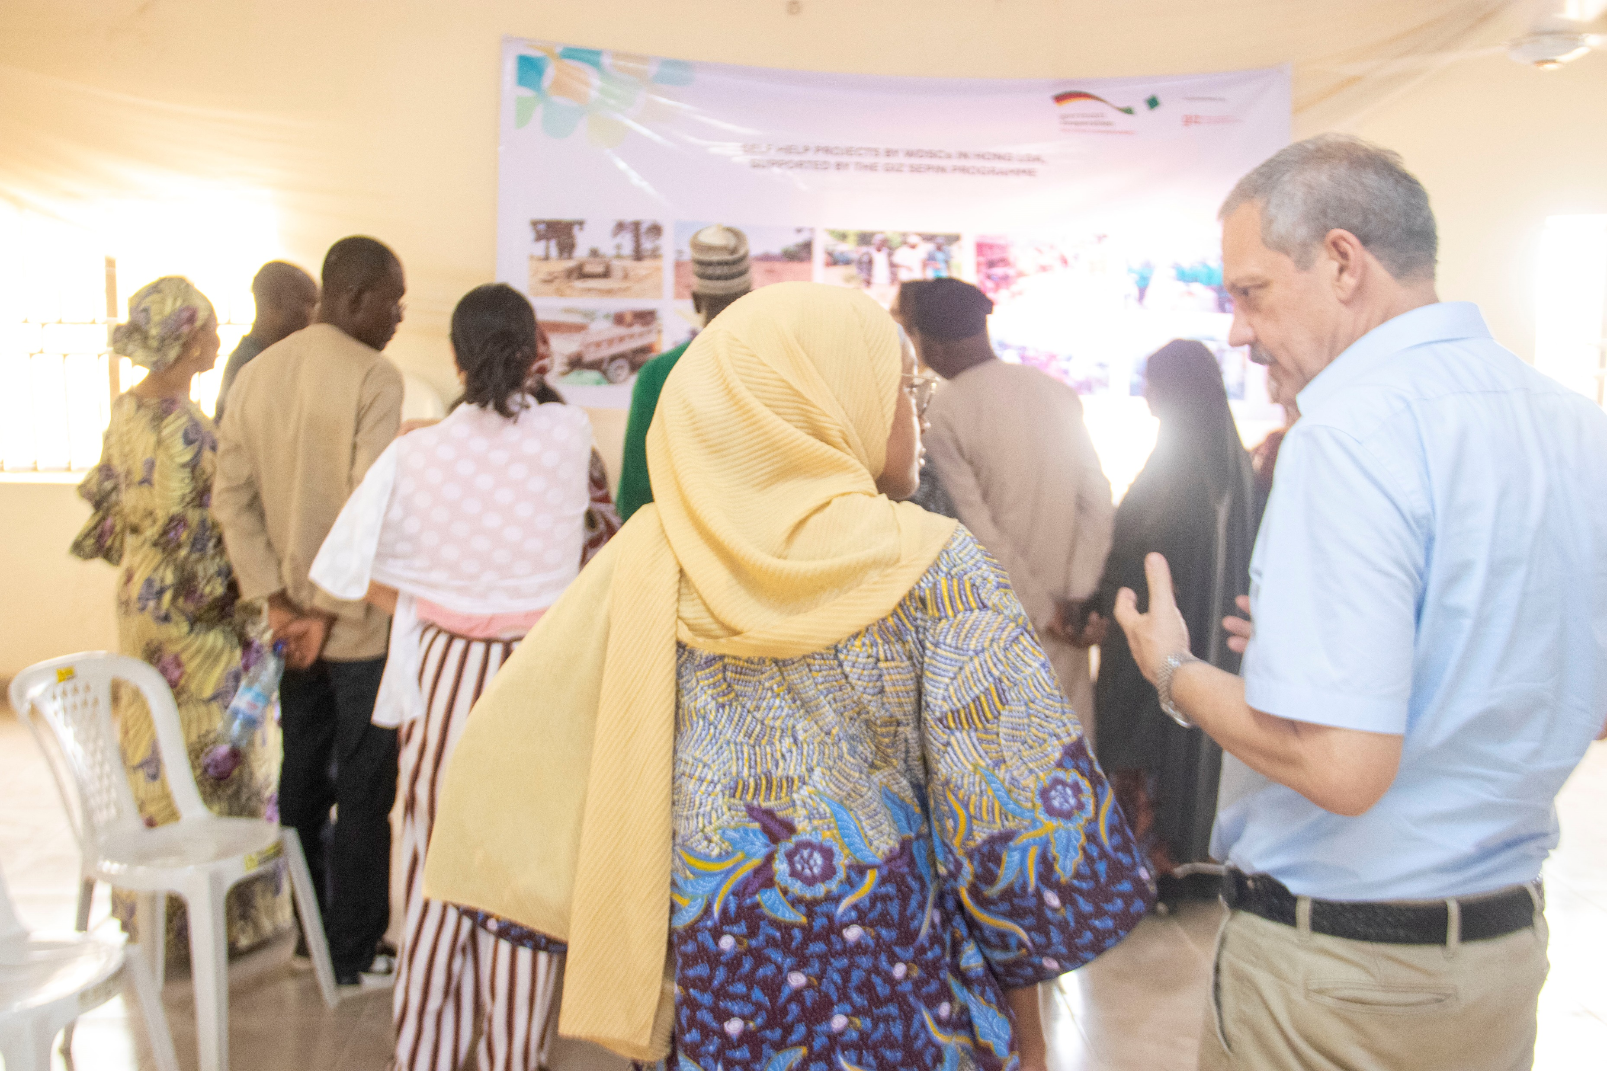
Members of the WDSCs from 5 LGAs Showcasing their work to International visitors

Slide 37
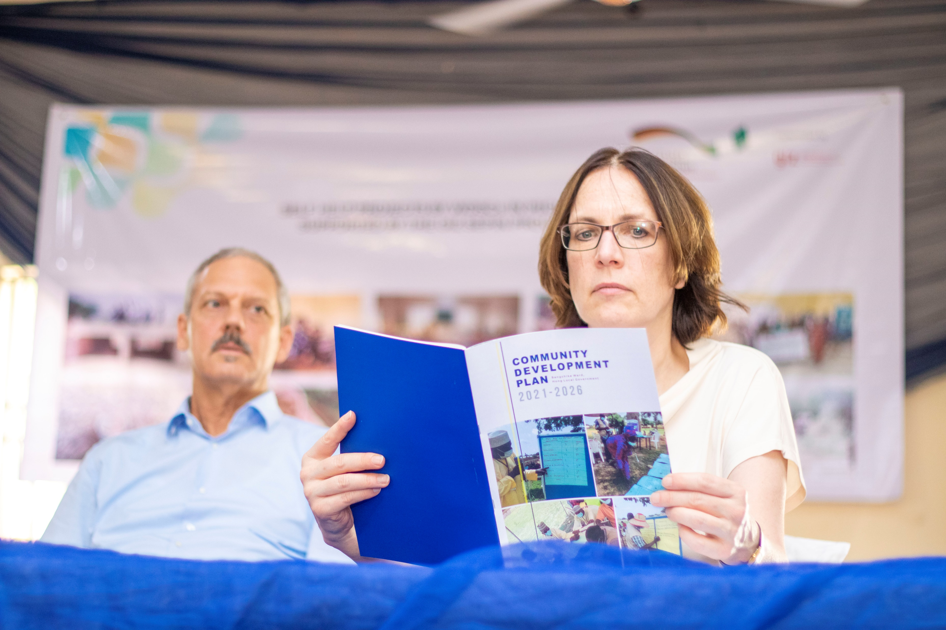
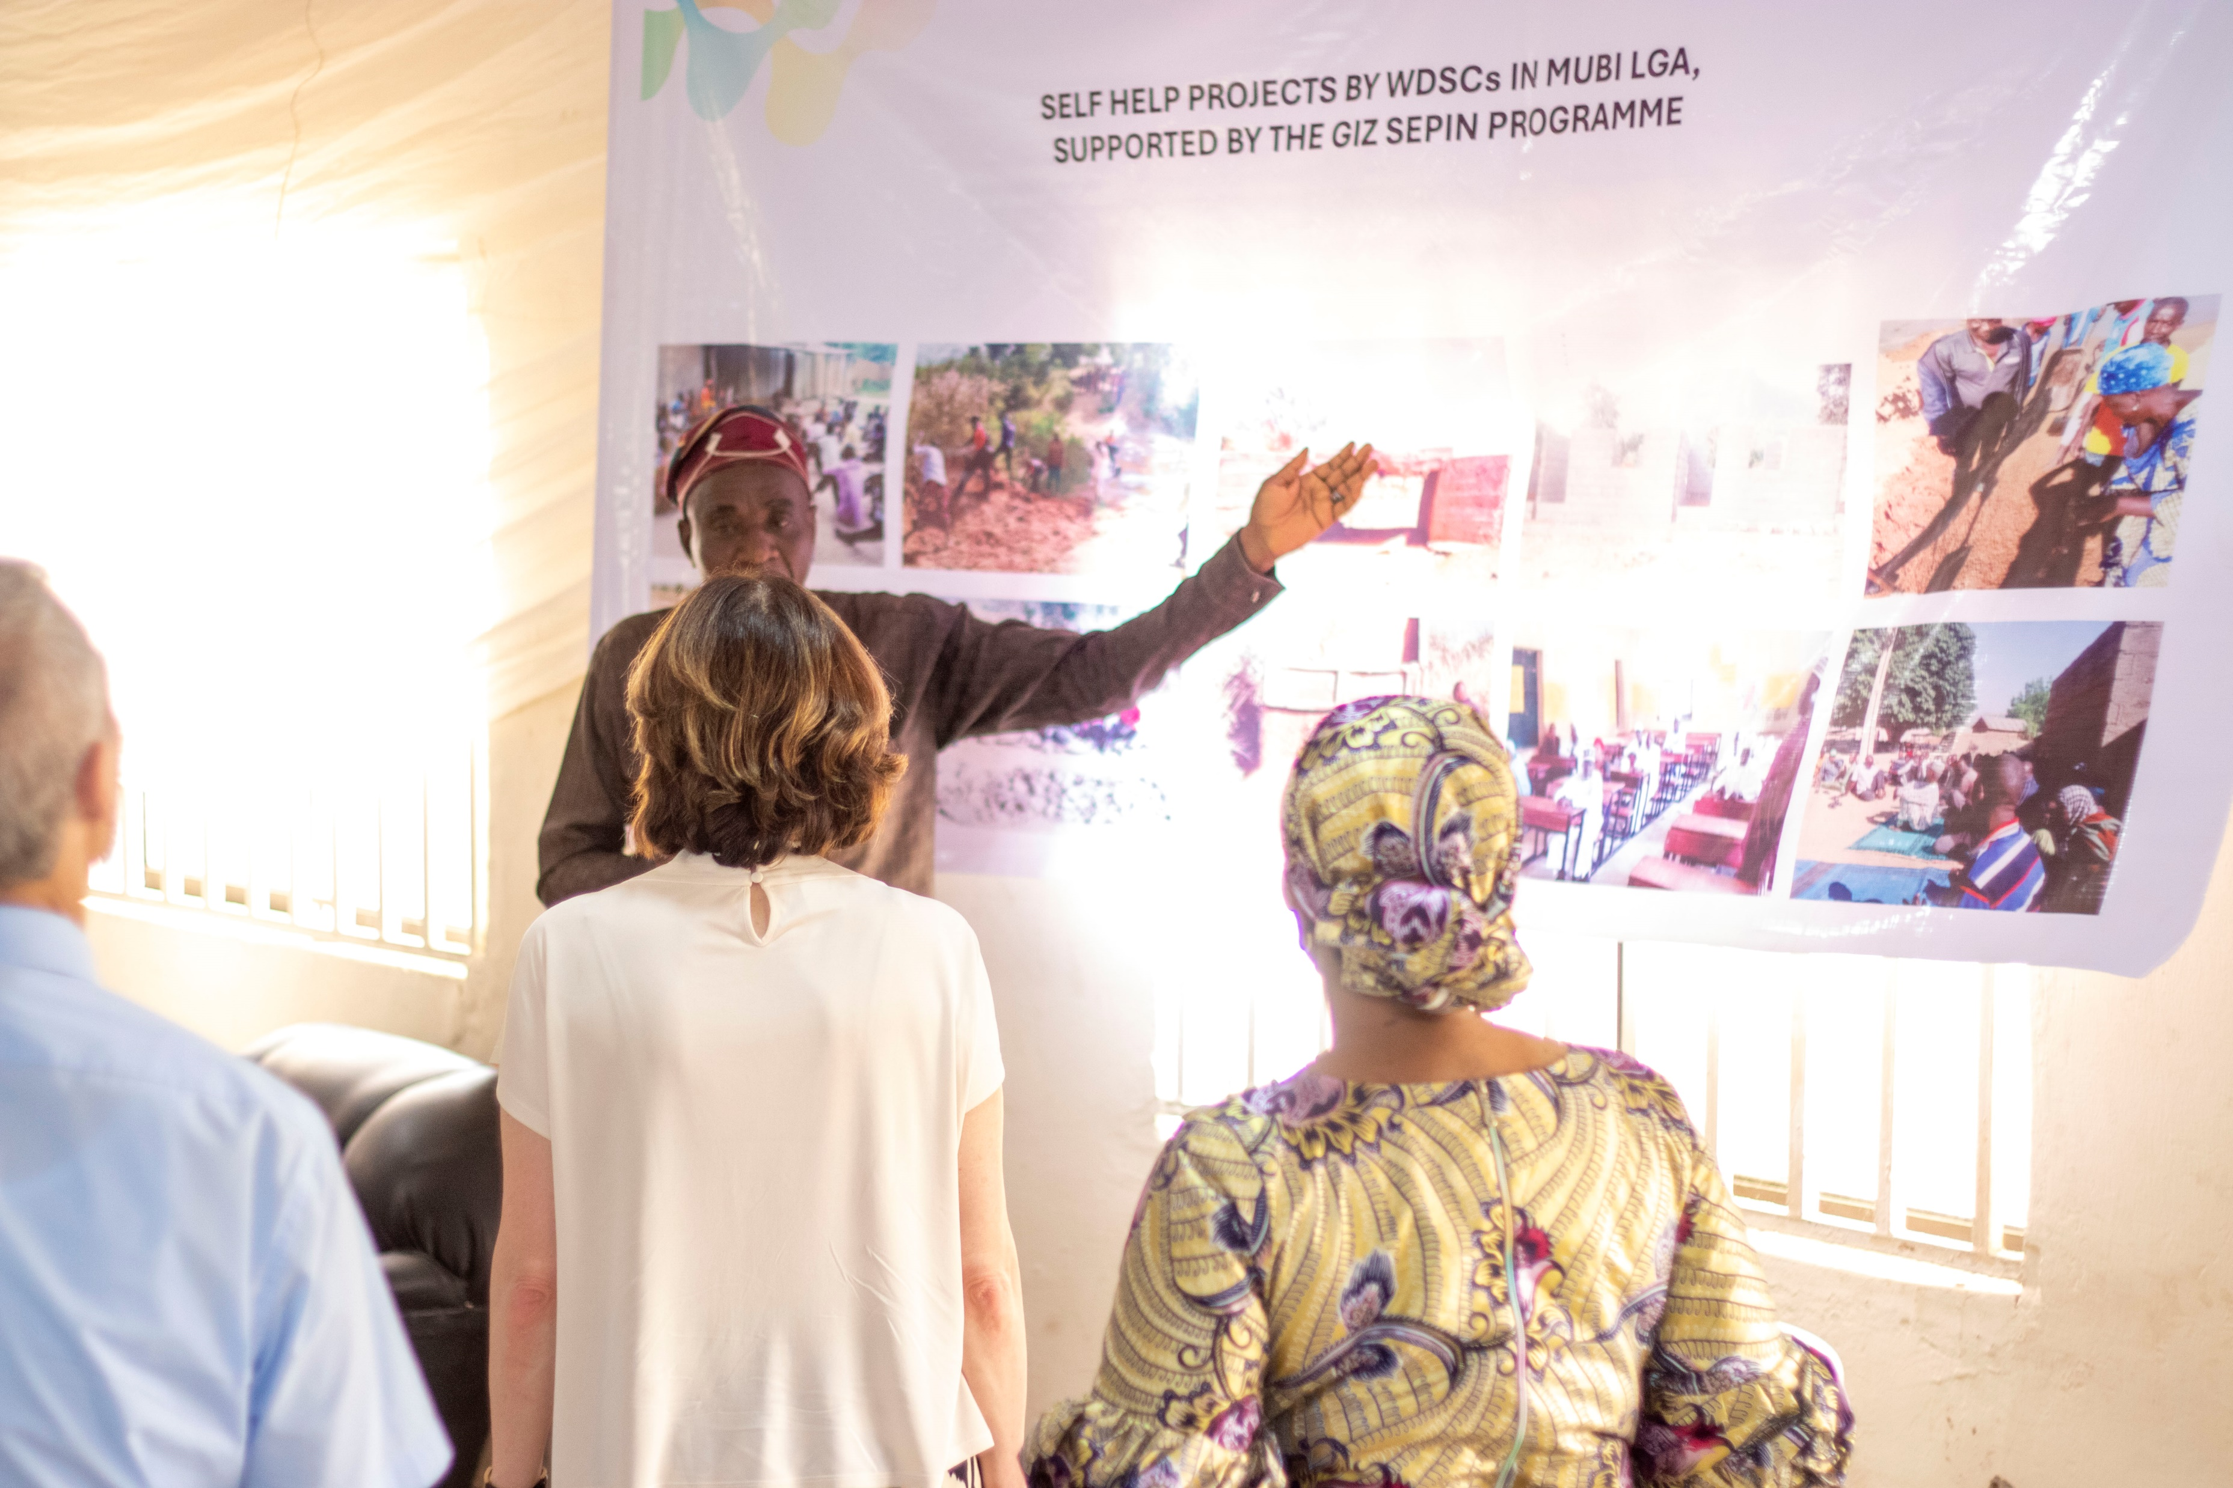
Members of the WDSCs from 5 LGAs Showcasing their work to International visitors

Slide 38


THANK YOU

