Slide 1
SOME SUCCESS STORIES FROM WARD DEVELOPMENT SUPPORT COMMITTEES (WDSC) IN OTHER LGAs

Slide 2
OBJECTIVES OF THE SESSION
To inspire WDSCs of Demsa LGA using evidence of Self-help projects carried out by Ward Development Committees in other locations.

Slide 3
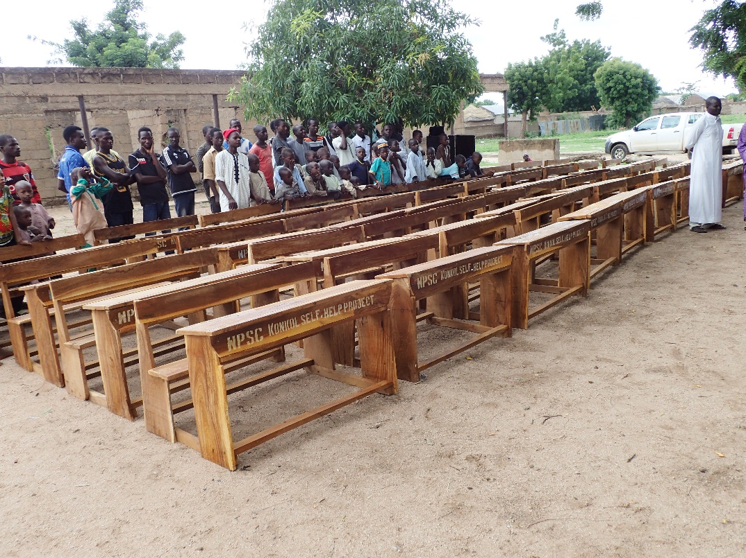
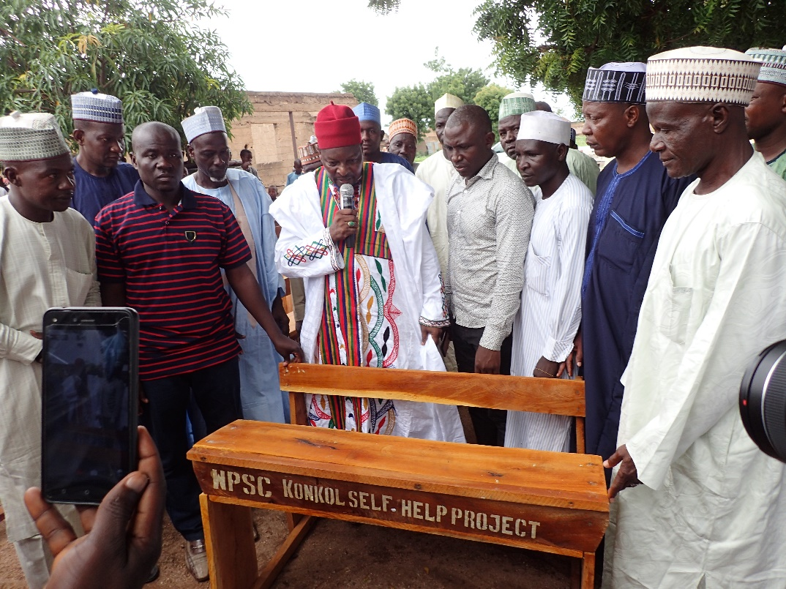
Through fundraising, WDSC of Konkol Ward in Maiha LGA purchased 40 three-seater benches for 4 different schools within the ward

Slide 4
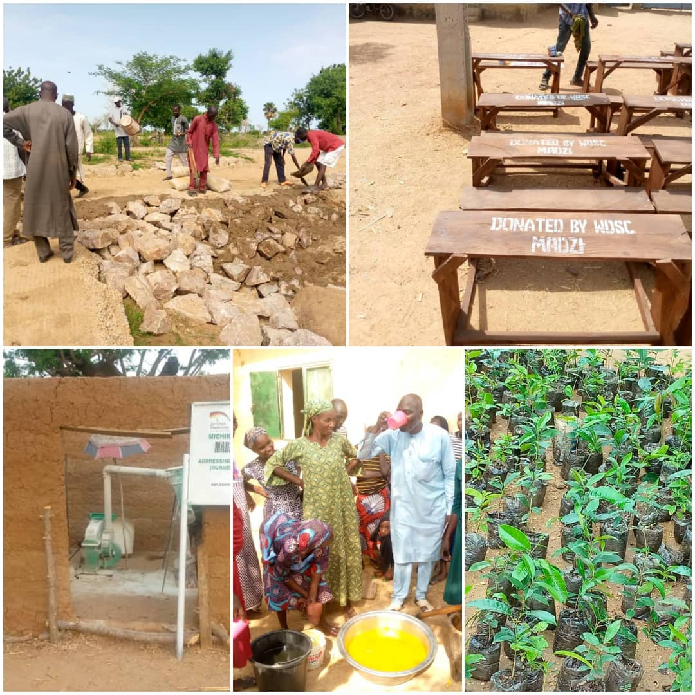
WDSC MADZI WARD (Michika LGA)
Environmental Conservation Campaign
Access to Clean Water
Women and Disability Empowerment through Skill Acquisition
4. Road Rehabilitation

Slide 5
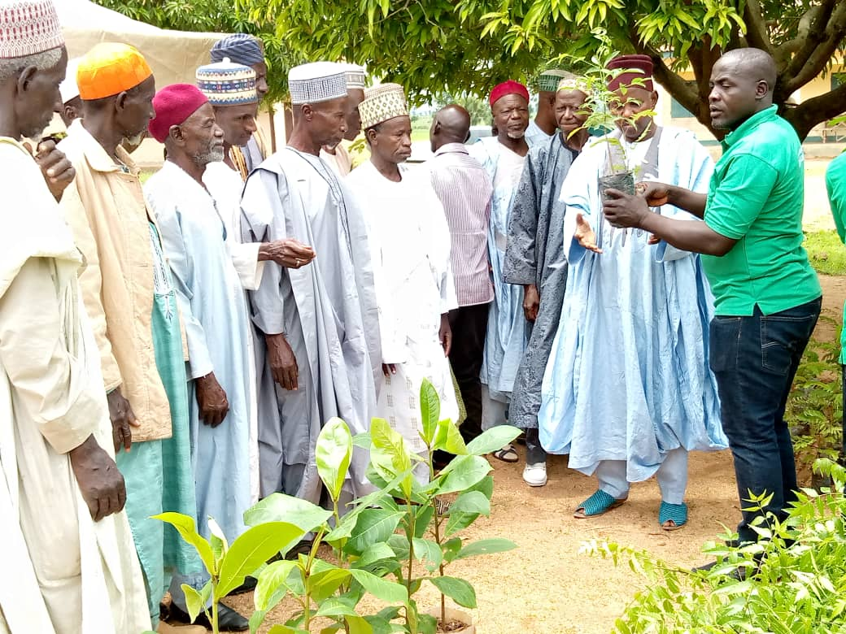
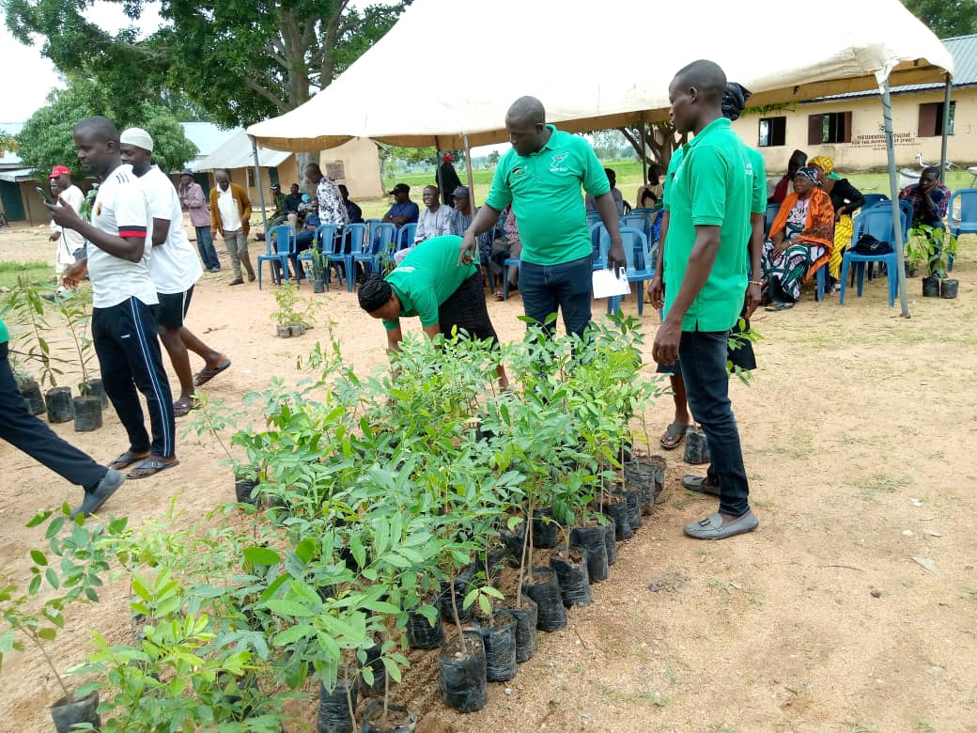
Distribution of Trees to Community Members During a Tree Planting Campaign by Mayo-Lope WDSC in Hong LGA

Slide 6
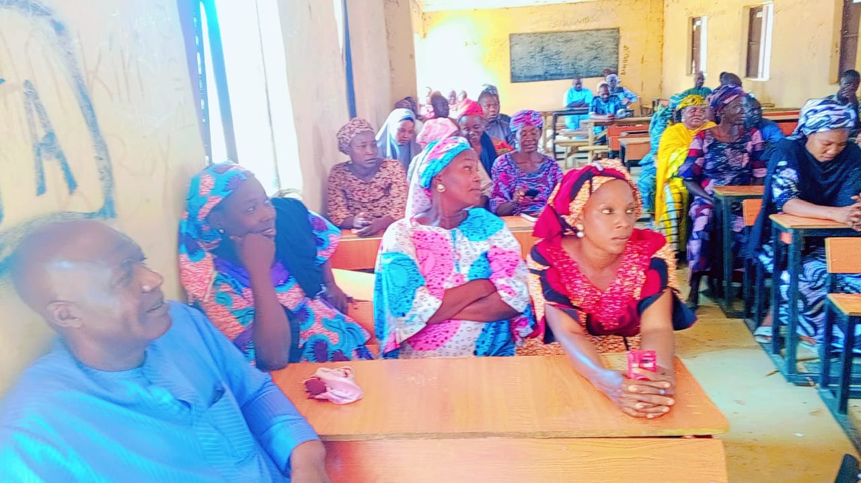
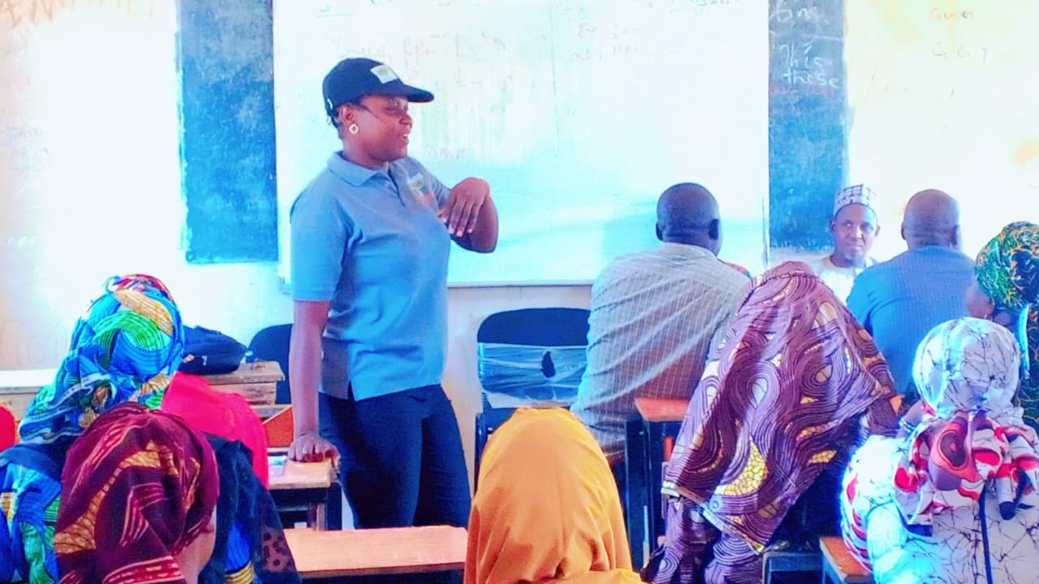
5 WDSCs in Hong LGA collaborated and accessed a N38,000,000 revolving fund grant from ACReSAL to be given to the community members.

Slide 7
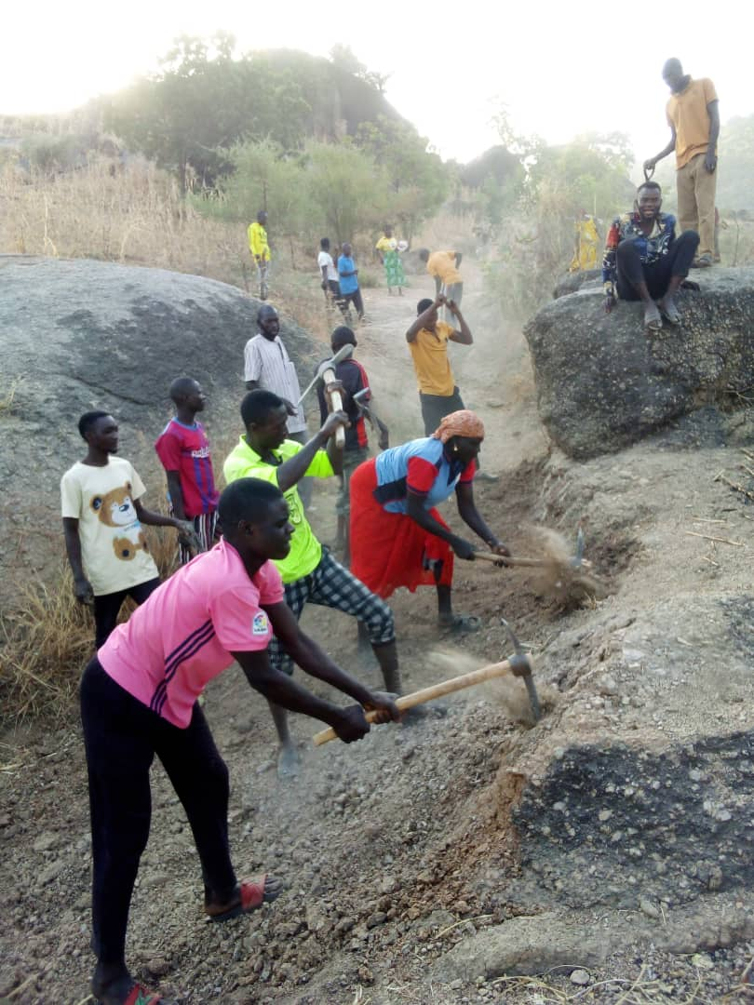
Mukavacitta WDSC (Michika LGA)
Self-Help Road Rehabilitation Project at Pee Wa’ati

Slide 8
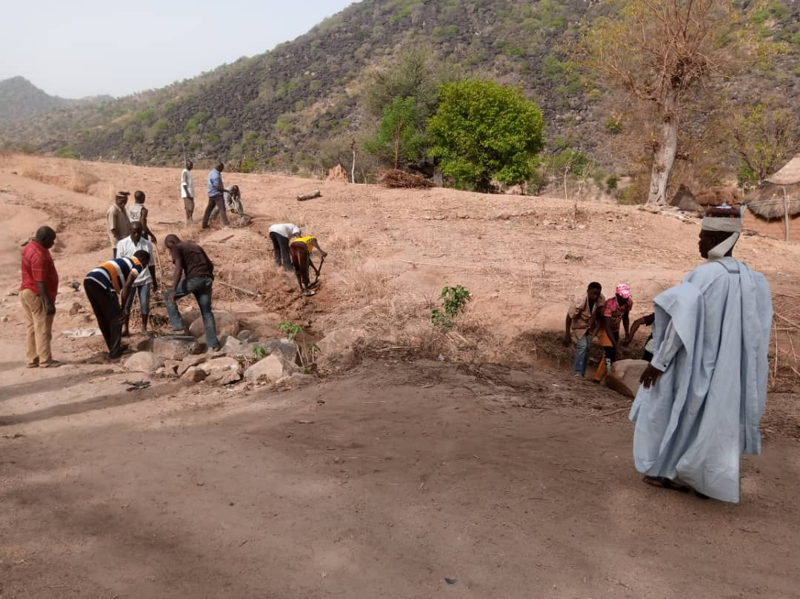
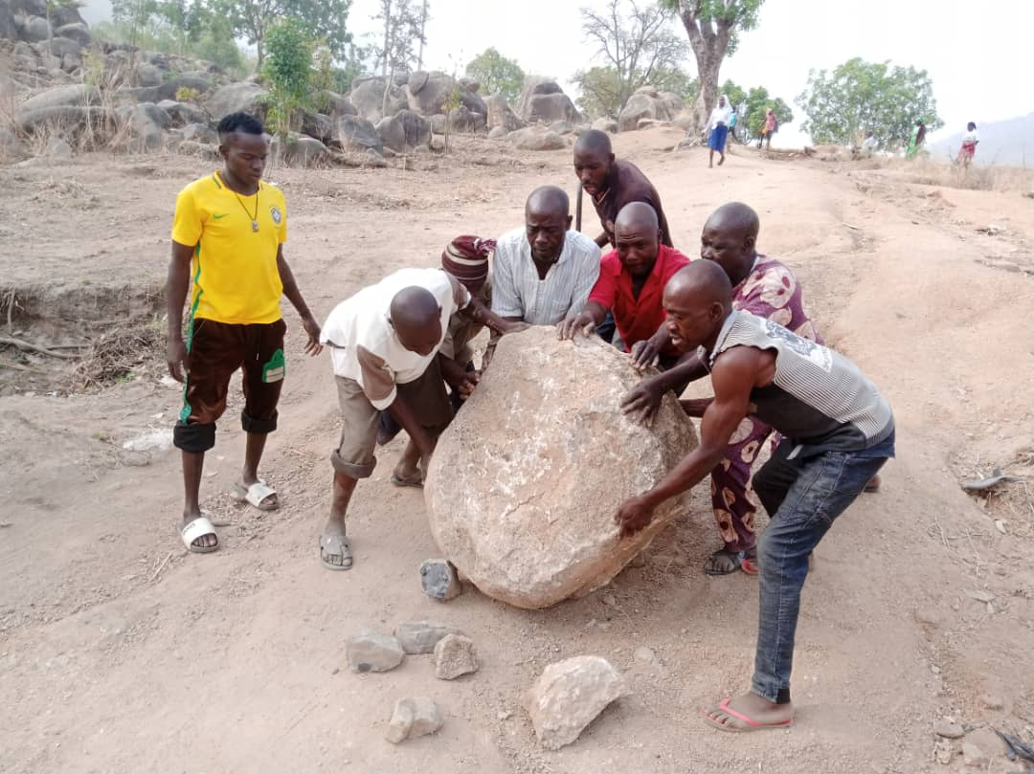
Road Rehabilitation Futudou/Futuless WDSC (Michika LGA)

Slide 9
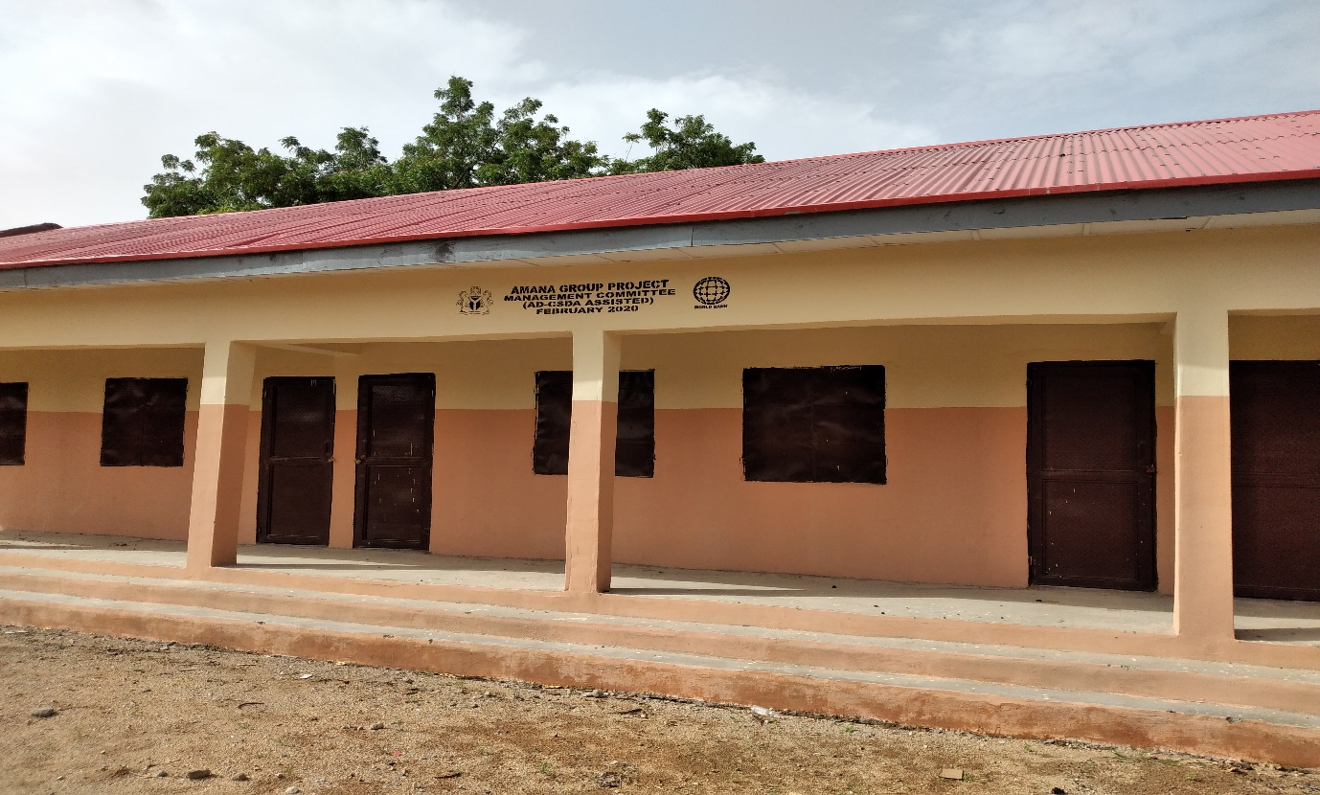
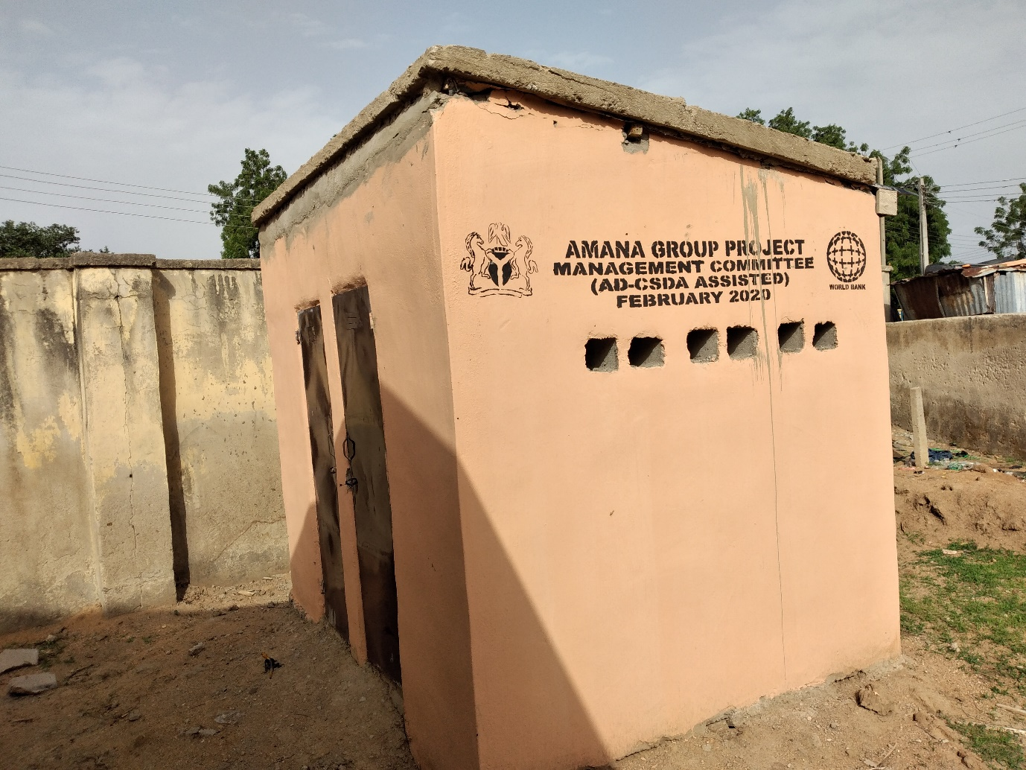
KOLERE WARD, MUBI NORTH LGA
Applied for a grant from the AD-CSDA and got N6.8 million. The committee used the money to construct a block of three classrooms with VIP toilets and provide furniture for the constructed classrooms.
The committee had to raise a counterpart funding to access this fund.

Slide 10
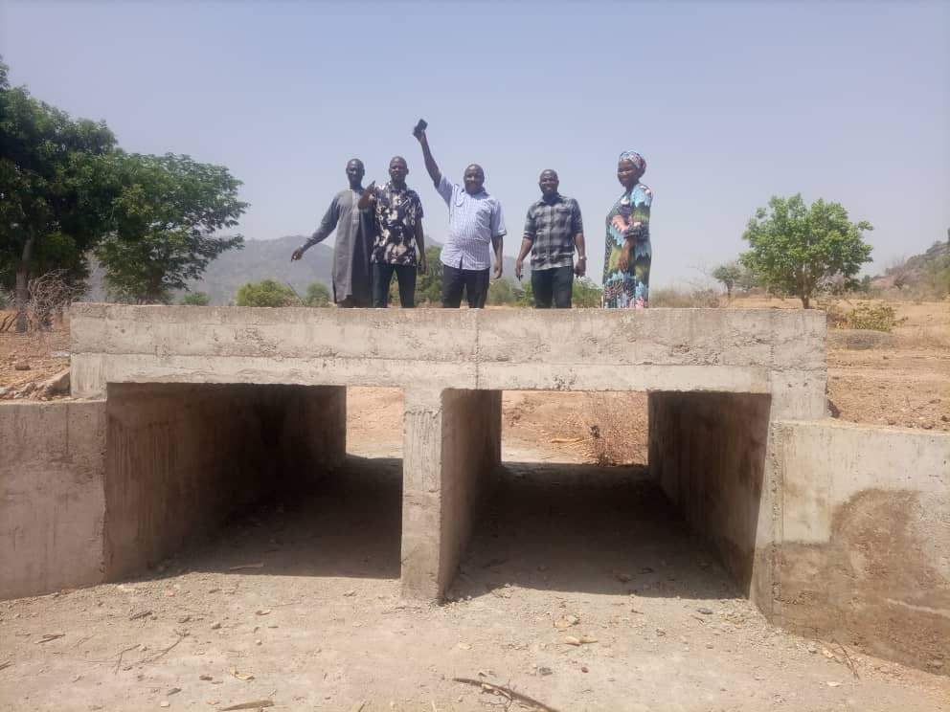
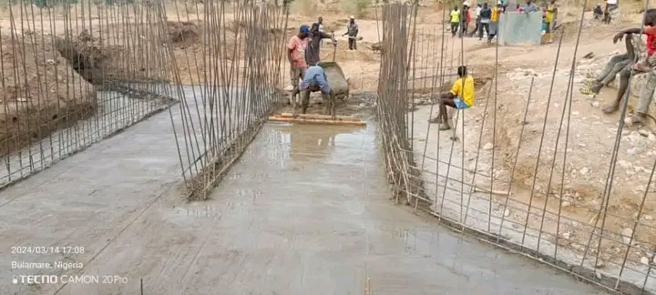
Construction of a link-culvert through advocacy and lobby efforts: A road connecting Mbororo with Futu by WDSC Futu (Michika LGA)

Slide 11
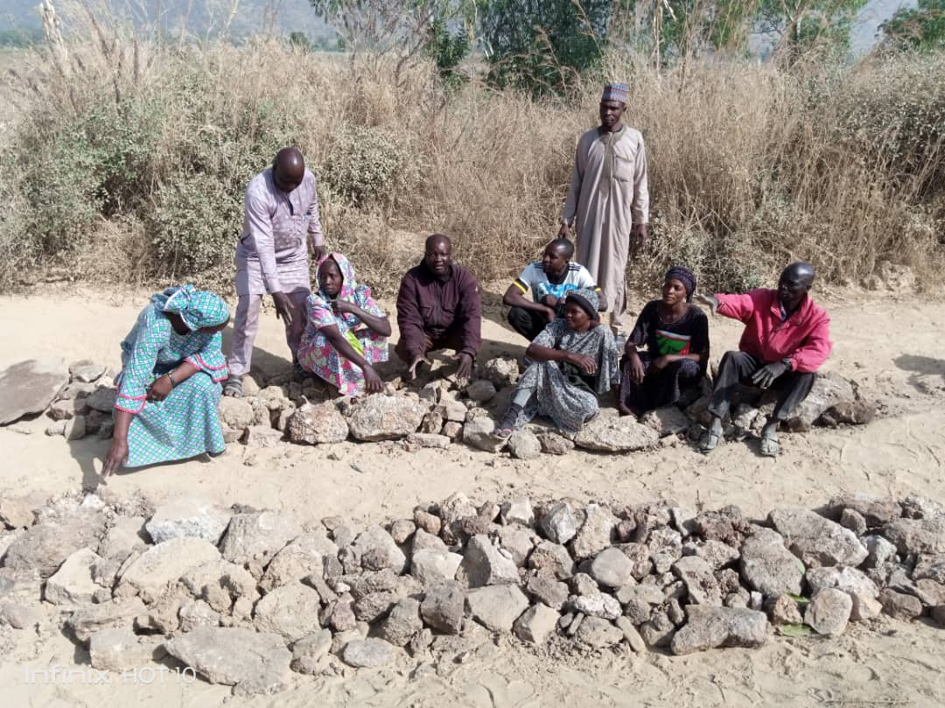
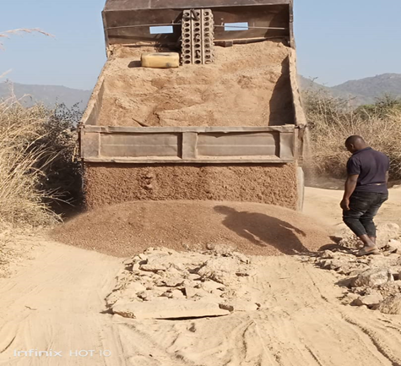
Road Construction by the WDSC of Bahuli Ward in Mubi North

Slide 12
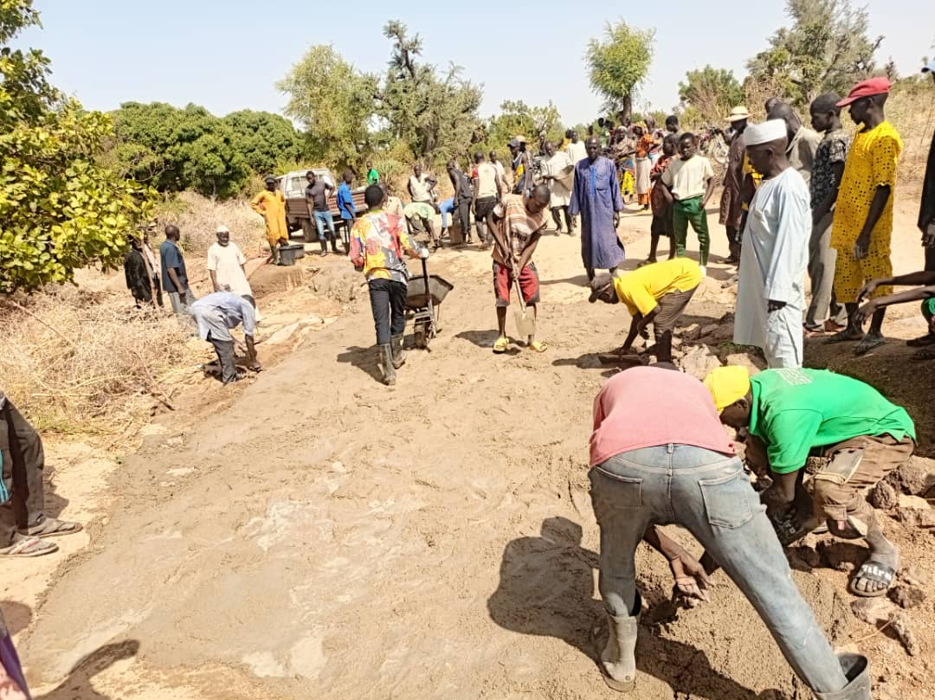
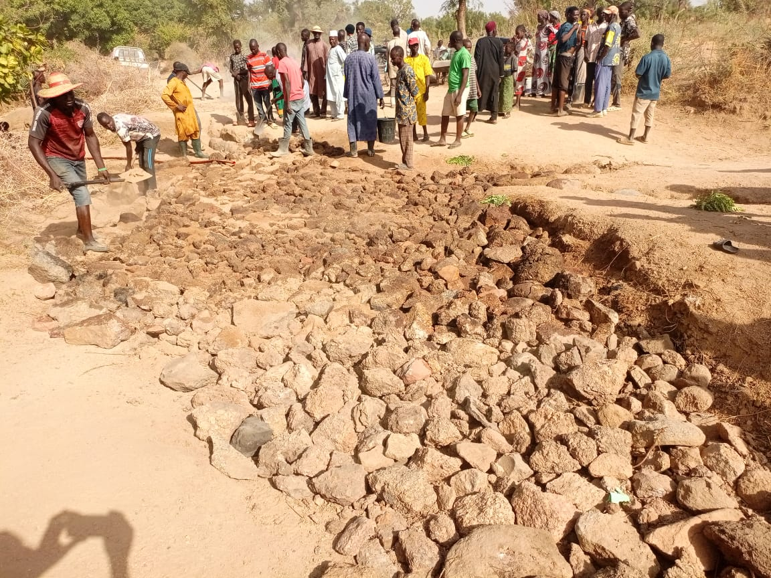
Rehabilitation of drift at Kura Road
Jigalambu WDSC (Michika LGA)

Slide 13
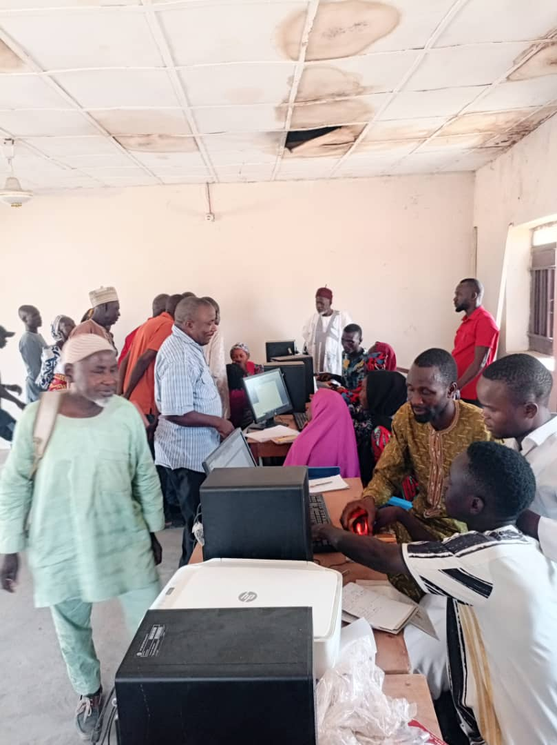
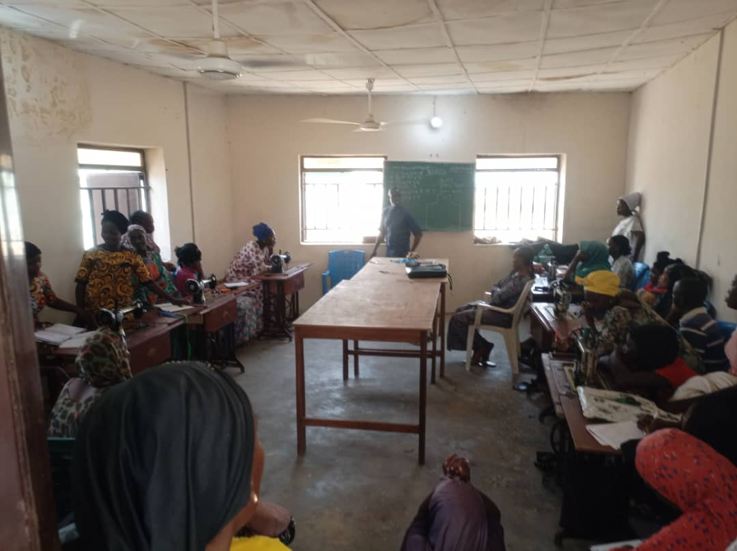
Jigalambu WDSC (Michika LGA)
Self-Help Project:
Skills Acquisition Training: Successfully lobbied a nonfunctional Training Acquisition Center and made operational (Tailoring & Computer Training):

Slide 14
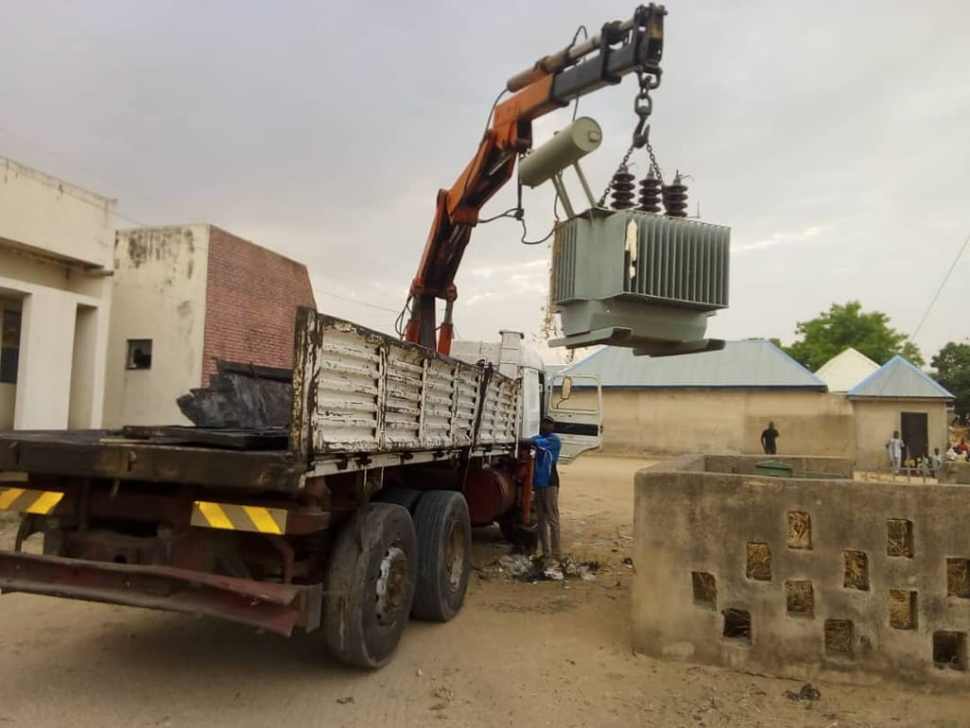
NASSARAWO WARD, MUBI SOUTH LGA
The committee has successfully lobbied for an electricity transformer from the former member House of Representatives, Hon. Alh. Abubakar Wambai (Madawaki Mubi). Installed at Sebore

Slide 15
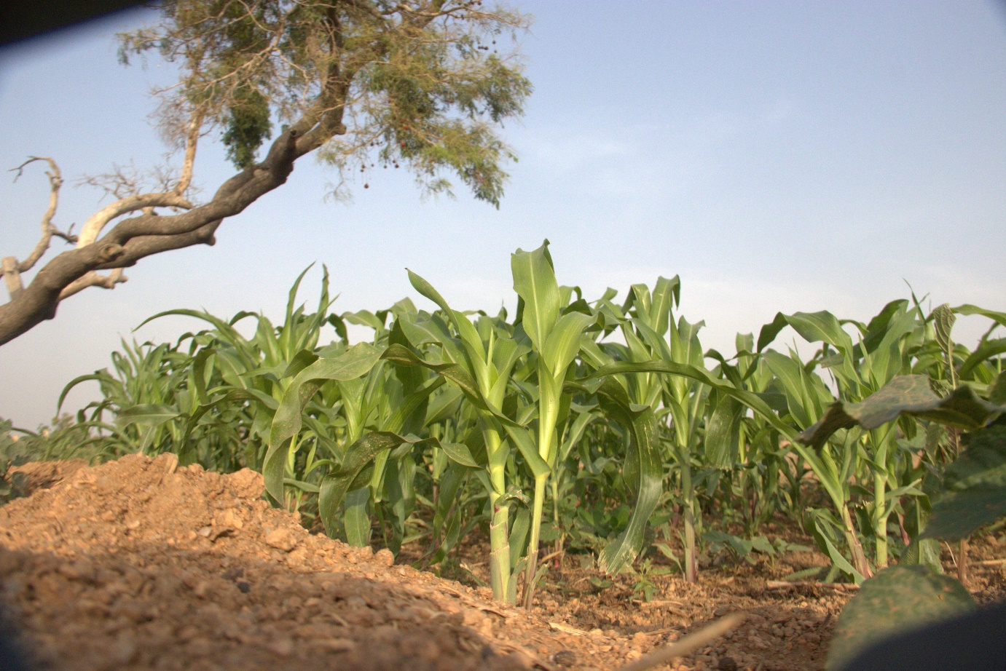
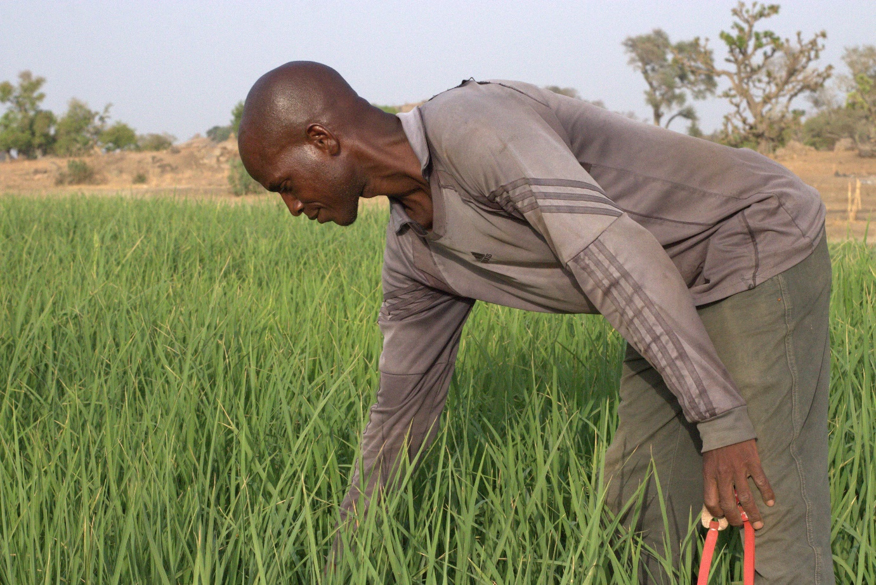
Demonstration Farm by WDSC Ga’anda in Gombi LGA

Slide 16
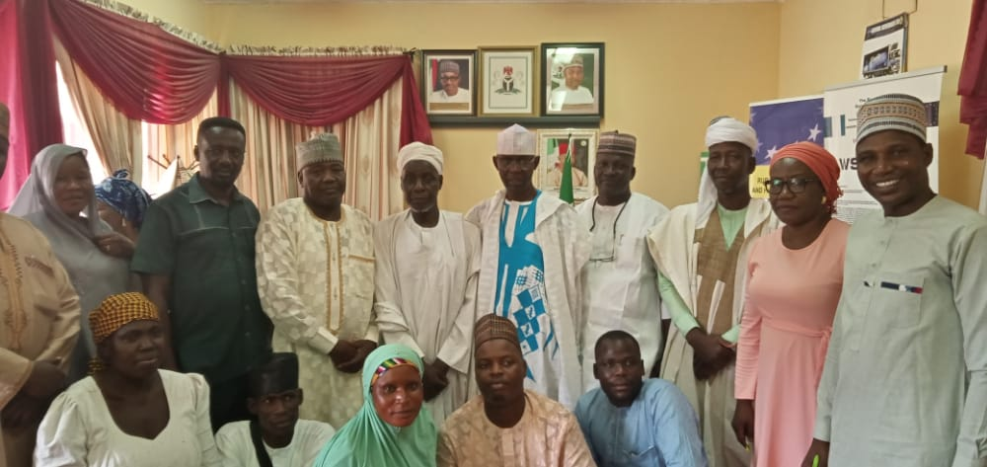
Advocacy Visit to the Commissioner, Ministry of Water Resources on the Implementation of CDP Plans For Ga'anda Ward, Gombi LGA

Slide 17
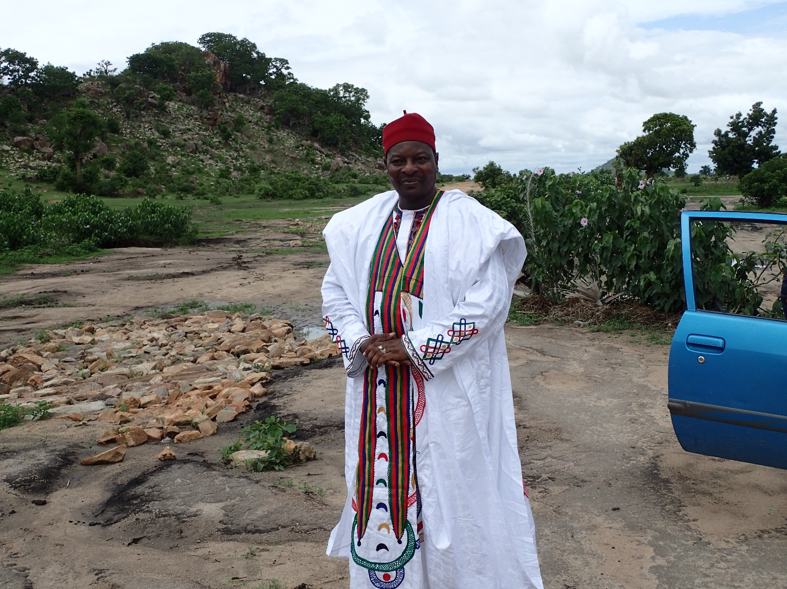
Rehabilitation of an almost abandoned road with the help of communal effort
- WDSC Belel (Maiha LGA)

Slide 18
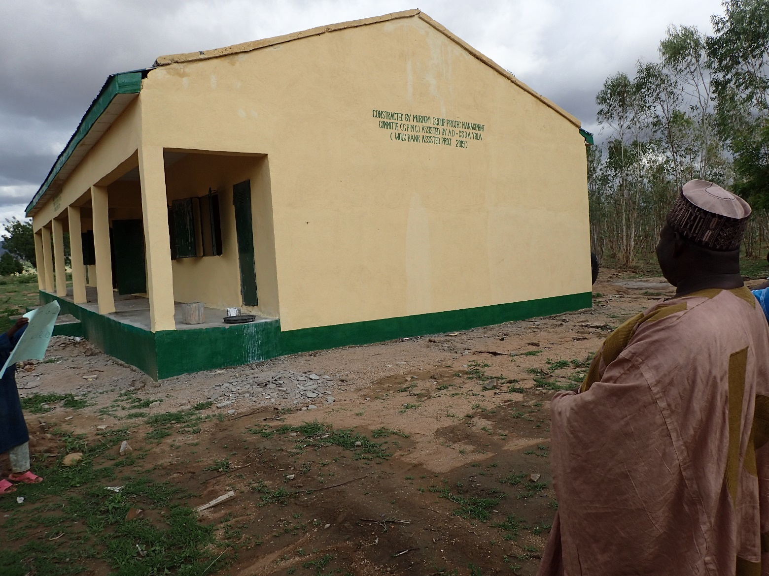
WDSC Manjekin (Maiha LGA) lobbied for the construction of two classrooms, an office, and a toilet in GDSS through the Community Social Development Agency (CSDA) in November 2018
-

Slide 19
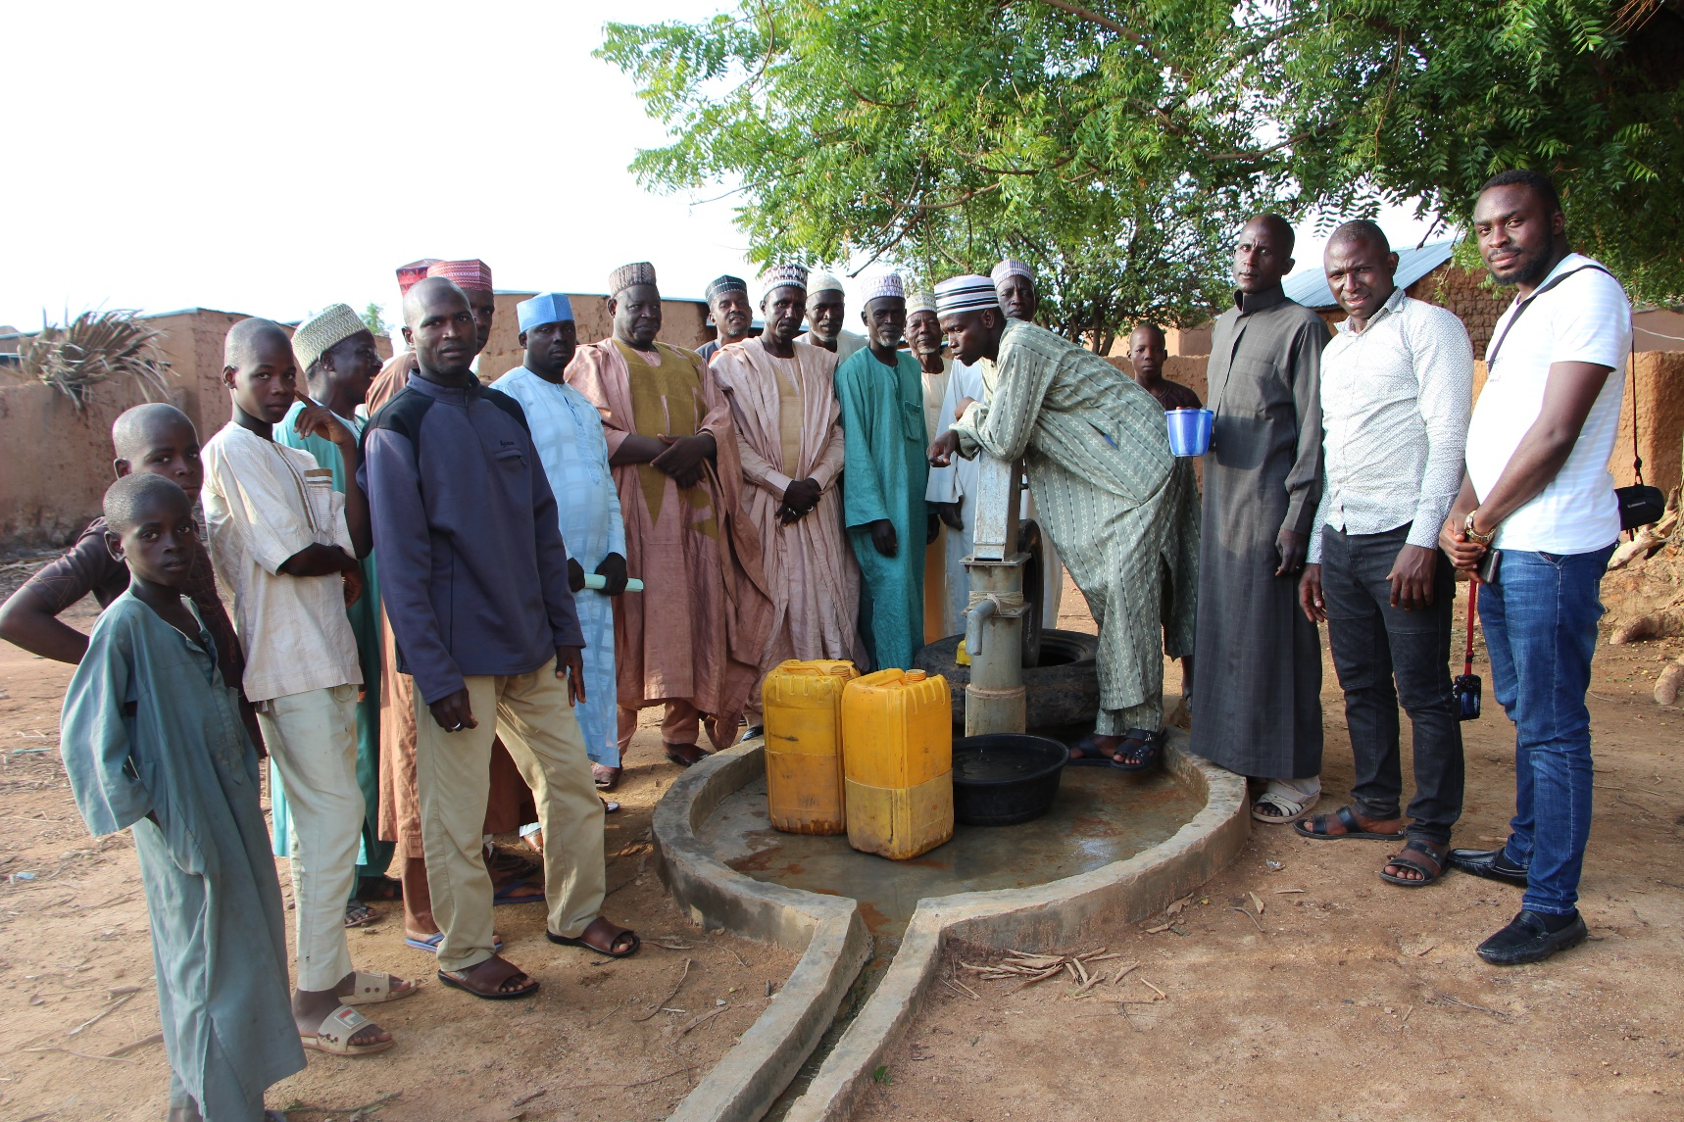
Construction of New Borehole in Manjekin by the Manjekin WDSC (Maiha LGA)

Slide 20
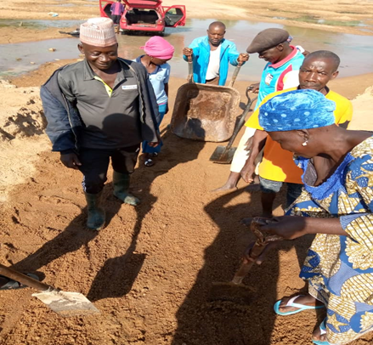
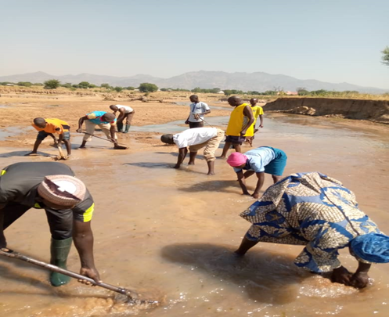
Self-help project Betso WDSC in Mubi North LGA

Slide 21
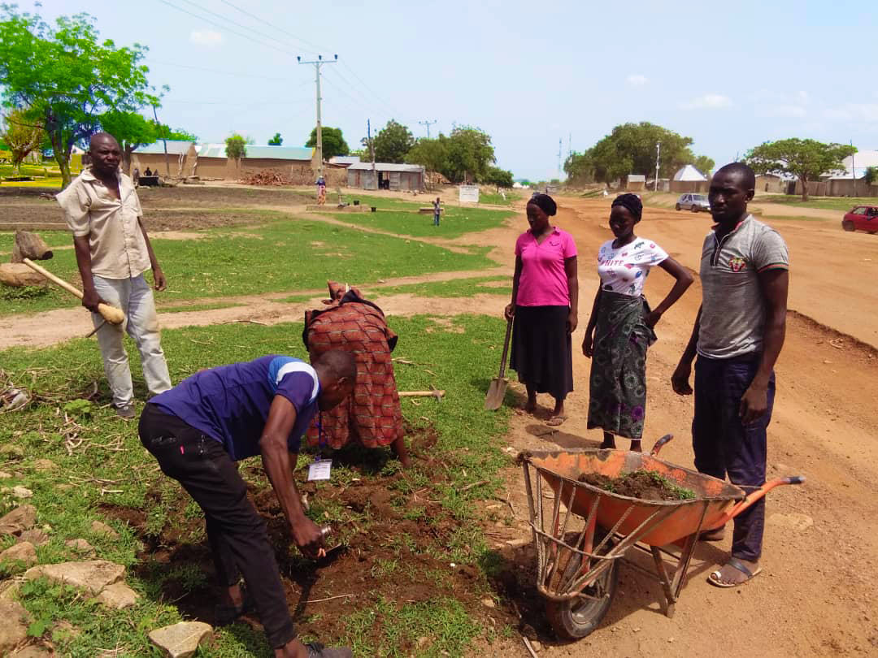
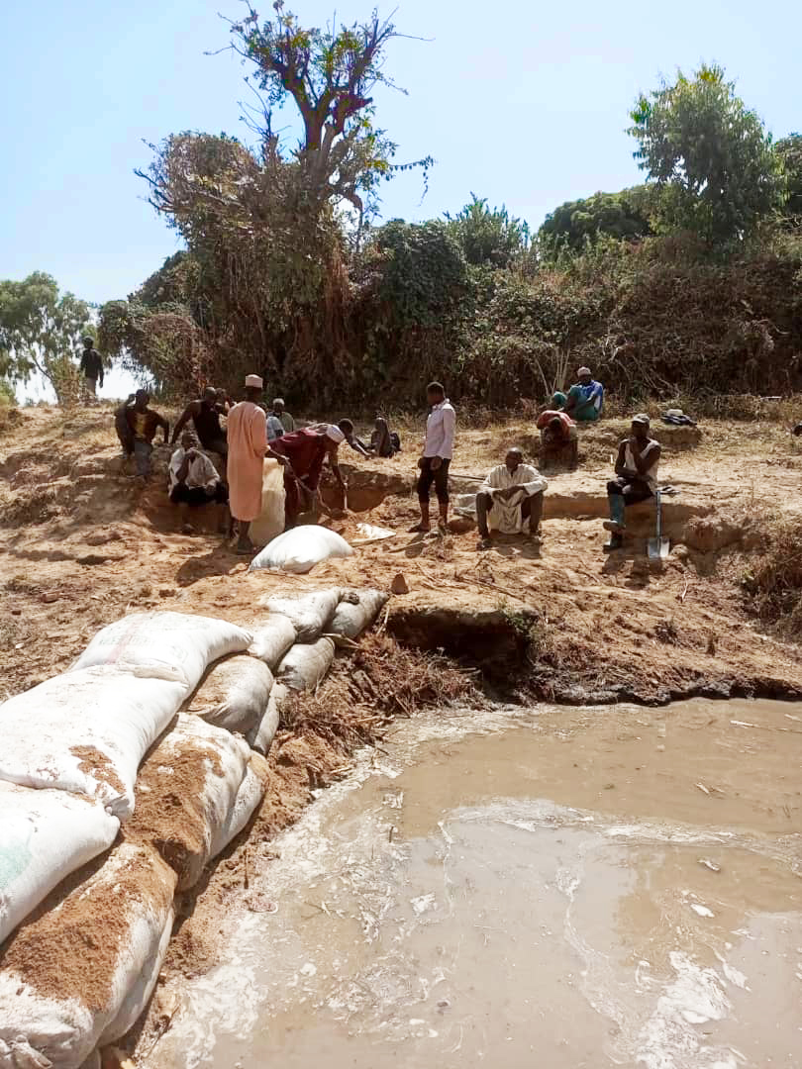
Road Repair By Members Of The Guyaku WDSC

Slide 22
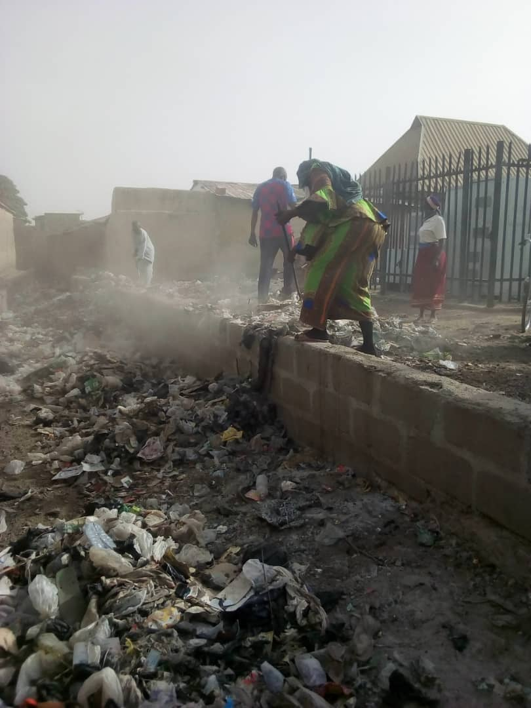
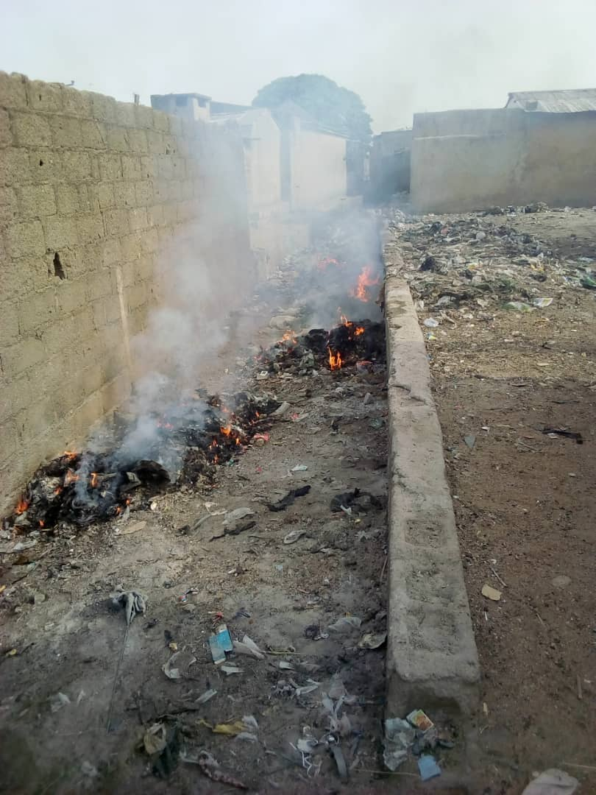
YELWA WARD, MUBI NORTH
Yelwa WDSC mobilised the community to carry out sanitation in the whole ward every first Saturday of the month.

Slide 23
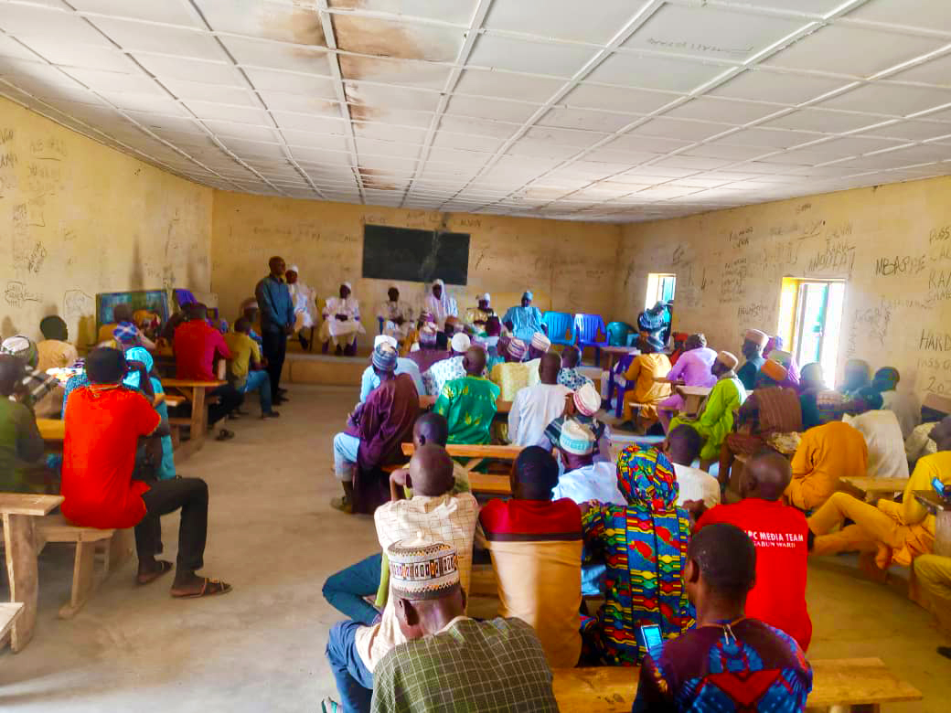
Feedback Report To The Community Members And Leaders In Ganda Ward.

Slide 24
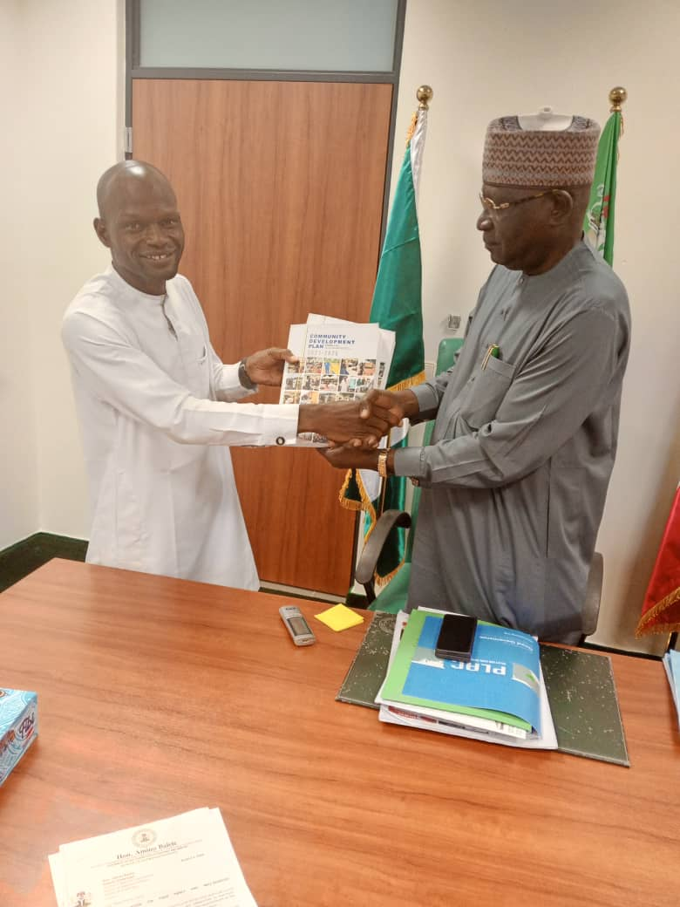
Representative Of The Gombi WDSC Presents the LGA CDP Plan To Rt Hon. James S. Barka, Member Representing Gombi Hong Federal Constituency.

Slide 25
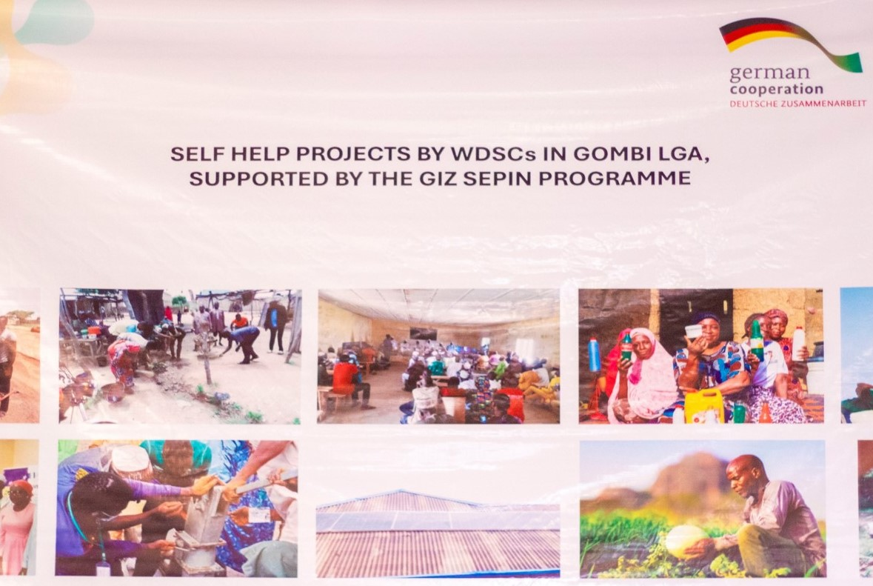
THANK YOU!!!

