Slide 1





Strengthening Access to Reproductive and Adolescent Health in Nigeria (SARAH)
2ND EU-SARAH GOVERNANCE & COORDINATION COMMITTEE MEETING
Update from Adamawa State
04 December 2025

Slide 2
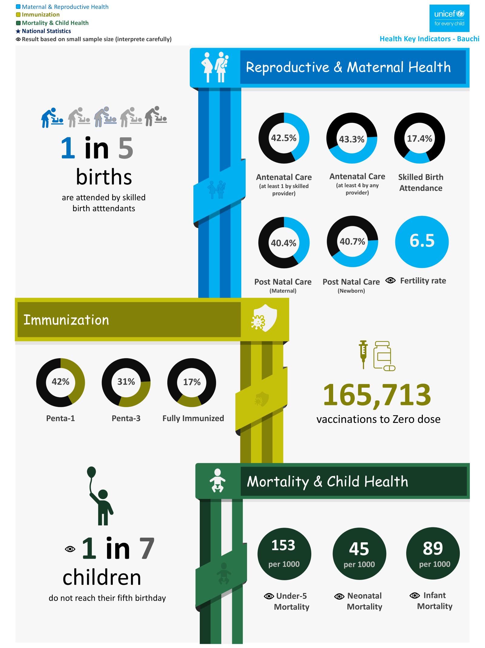

Total Population (Projected) | 5,357,785
Women of Childbearing Age | 1,017,725
Pregnant women | 267,889
U1 Population | 214,311
U5 Population | 1,071,557
Adolescent population (10-19) | 841,173
144
40
77
NDHS 2023/2024

Slide 3
State Governance and coordination structure for EU SARAH and RMNCAH
EU-SARAH Multi-sectoral governance and coordination meetings held two meetings under Chairmanship of the HCH
The State Taskforce on PHC meeting held quarterly, chaired by the Deputy Governor and attended by LGA Chairmen, with defined follow-up actions/tracker to ensure implementation and continued progress on health priorities.
1-Day Orientation of the State taskforce on PHC performance review and reporting
1-Day multi-sectoral stakeholder sensitization meeting was held to foster collaboration and awareness among key sectors, aiming to improve integrated health responses and ensure stakeholders understand the importance of coordinated efforts.
2-Day Engagement and Orientation of 21 LGA Chairmen on national PHC guidelines and SWAp to enhance Operationalization of LGA Taskforce and leadership for PHC
Re-activation and 2-day orientation of TWGs to revitalize their operations and program effectiveness (Steering Committee, RMNCAH+N, Adolescent TWG, Health Financing)

Slide 4
Alignment of EU SARAH with SWAp and other health system reforms
SARAH initiative supported:
State health sector Joint Annual Review (JAR) and report developed to showcase shared progress and motivate continued partnership.
Development of 2025 Health Sector Annual Operational Plan (AOP) using national template in line with SWAp. The EU-SARAH project State Annual Work Plan has been integrated into the 2025 and 2026 State SWAp AOP, with all indicators harmonised to match the SWAp framework.
All nine MAMII LGAs in Adamawa State have been designated as priority areas for full intervention coverage.
As a pilot phase, eight PHCC facilities within the MAMII LGAs were upgraded and equipped with adolescent gender-responsive, comprehensive, and integrated care corners.

Slide 5
Key milestones and implementation update
POLICY AND GUIDELINE ADAPTATION/DEVELOPMENT
The Adamawa State Youth Policy domesticated and signed by the Executive Governor, reflecting State’ commitment to youth development and stakeholder influence.
Adamawa State Contributory Health Management Agency Actuarial Pricing Report and the accompanying Pricing Model completed through a comprehensive 10-week actuarial analysis
COMMUNITY MIDWIVERY SCHEME
226 Community Midwives and 113 Nurses/Midwives provided with logistics and repositioned them in Hard-to-Reach (HTR) and high density PHC centres to strengthen delivery of of quality MNCH services and reduce maternal and neonatal mortality rates in line with MAMII goal
The Community Midwifery Scheme training was launched in partnership with the Adamawa State College of Nursing Science, where 110 candidates from the nine MAMII LGAs, including those from hard-to-reach communities, were enrolled through a community-led recruitment process.

Slide 6
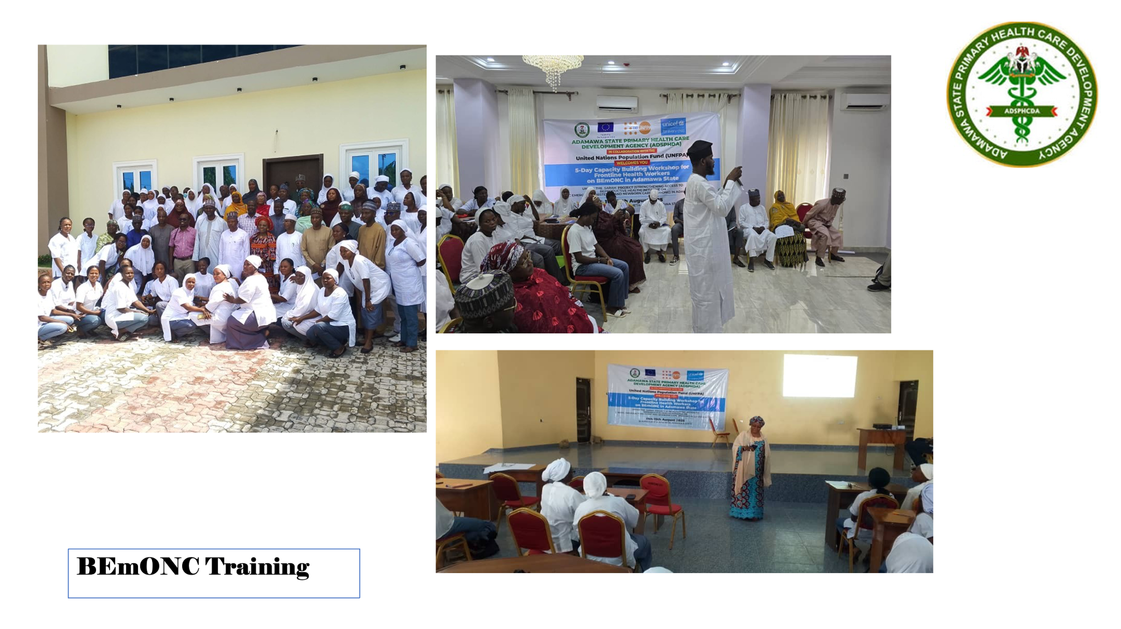
Key milestones and implementation update
HEALTH WORKERS TRAINING
1,231 additional health workers trained to provide quality MNCAH services - including HIV and GBV at health facility and community levels
S/N | ACTIVITY | NO TRAINED
1 | BEmONC training for Community Midwives from Primary Health Care Centers (PHCCs) across the nine MAMII LGAs | 120
2 | 2-week capacity-building ofoctors and Midwives from the nine MAMII Local Government Areas (LGAs) Comprehensive Emergency Obstetric and Newborn Care (CeMONC). | 30
3 | Training of health educators in Comprehensive Adolescents’ Sexual Education | 50
4 | Training of Health and Social Workers from the PHC level as master trainers on Gender-Based Violence (GBV) Case Management. | 30
5 | Training of healthcare providers in Clinical Management of Rape, while | 50
6 | IMCI | 113
7 | Adolescent Health Friendly Services Training | 319
8 | QoC_MPCDSR Training: Improvements in Quality of Care (QoC) were addressed through the re-orientation of 21 Quality Improvement Teams at both Secondary and Primary levels | 519

Slide 7
Key milestones and implementation update
Adolescent and Young People
Adolescents and young people reactivated in 93 wards across the 226 wards in the State
An Adolescent Quarterly State Review Meeting was conducted in conjunction with monthly LGA-level review meetings involving 226 Adolescent Youth Vanguards, as well as 904 Civil Society Organizations (CSOs), Community-Based Organizations (CBOs), and Religious Leaders.
126,558 adolescents and young people reached with adolescent sexual reproductive health and HIV information and services (administrative data)
Health Insurance
15,000 beneficiaries enrolled into Health Insurance scheme linked to RMNCAH services plus GBV survivors
Community Health
Auxiliary Community-based Health Workers – Mama-to-Mama Support Groups reactivated and retrained and kitted in 93 wards across the 9 MAMII LGAs
4,185 Mama-to-Mama Support Group members kitted with job aid and data tools

Slide 8
Key milestones and implementation update
Health Commodities
Family Planning (FP) commodities were acquired and successfully distributed to 456 Primary Health Care Centers (PHCCs) within the state.
In a sustainable development initiative, the Adamawa State Government, through the Adamawa State Primary Health Care Development Agency, has allocated 50 million Naira to the United Nations Population Fund (UNFPA) to enhance the procurement of FP commodities further.
Health information management systems and evidence based PHC and RMNCAH+N services including GBV services programming
Quarterly Development and Dissemination of RMNCAH+N Scorecard and Health Bulletin print at the state and LGA level
Quarterly reviews of Reproductive, Maternal, Newborn, Child, Adolescent, and Nutrition (RMNCAH+N) and Primary Health Care (PHC) performance will be conducted at the state level, with a focus on mainstreaming strategies for addressing Gender-Based Violence (GBV) and harmful practices.
The EmONC assessment currently underway, is evaluating 533 health facilities across 21 Local Government Areas (LGAs) and is now in the final analysis phase

Slide 9
Comparative Analysis of Key MNCH Indicators: Q2 2024 vs Q2 2025

Slide 11

Priority activities planned for Q1 2026
Roll out of Safer Birth Bundle of Care (SBBC) in selected PHCs and General Hospitals
Community MPCDSR
Linkage & Referral: Community to PHC level to General Hospital
Data Quality Self Assessment (DQS) evidence-based and data driven performance reviews for RMNCAH+N services including GBV to strengthen Quality at all levels
Fast track Social and Behavioural Change (SBC) activities to strengthen demand generation
Digitalization of HRH (Biometric system) to improve performance measurement
Roll out of Safer Birth Bundle of Care (SBBC) in selected PHCs and General Hospitals

Slide 12
Challenges experienced
 | Challenges | Mitigation Strategies
1 | Inadequacy and High turnover of trained health workers affecting continuity and quality of SRHR service delivery. | Logistic support provided to motivate Community midwives and Nurses deployed to HTR and high density PHCs
2 | Poor Quality of Data from NHMIS Health Facilities: Inaccurate, incomplete, or delayed data reporting from health facilities using NHMIS tools. | Provide regular data quality assessments (DQAs) and supportive supervision. Train facility staff on correct NHMIS data entry, indicator definitions, and reporting timelines. Implement routine data review meetings at LGA and State levels.

Slide 13
Key asks for the Steering Committee
Support Fast tracking roll out of SBBC
Support for ETS/Ambulance scheme to fasttrack referral
Provisions for establishment of neonatal corner at secondary facilities in MAMII LGAs
High level Advocacy for Sustained Government Commitment
Adamawa State Government allocated ₦50 million this year to enhance the procurement of FP commodities — positive progress.
Continued and increased government counterpart funding is needed to sustain and scale up project interventions
.

Slide 14
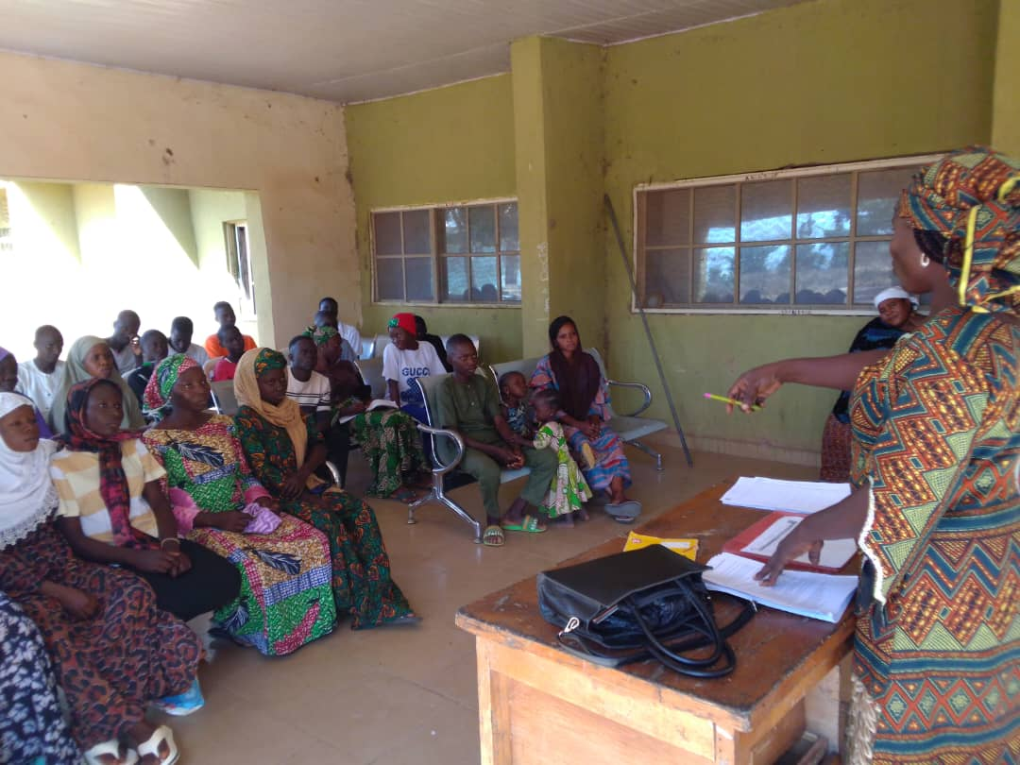
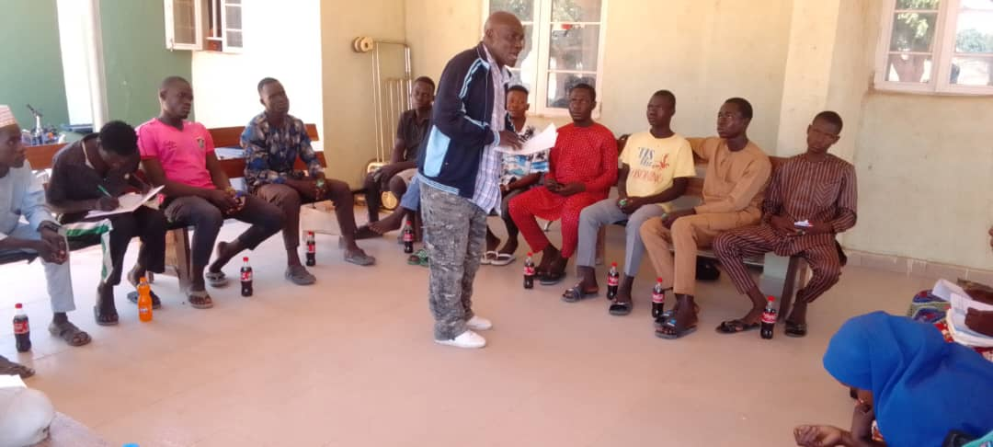
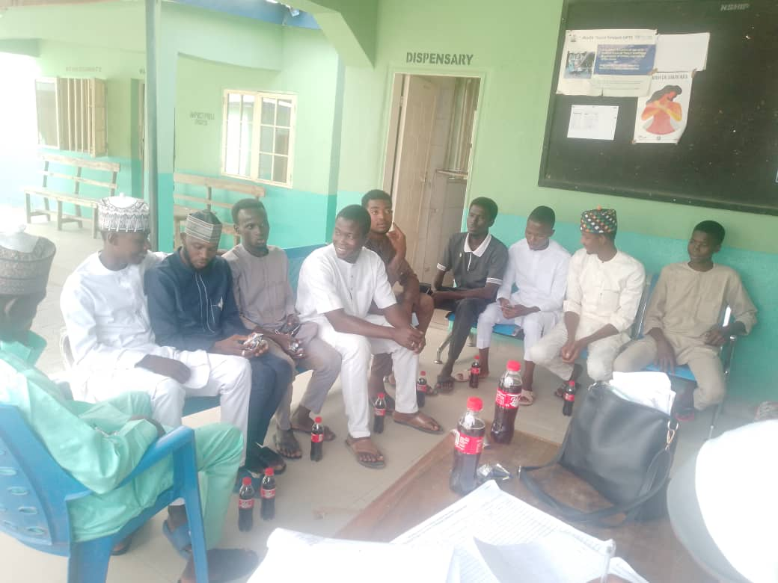
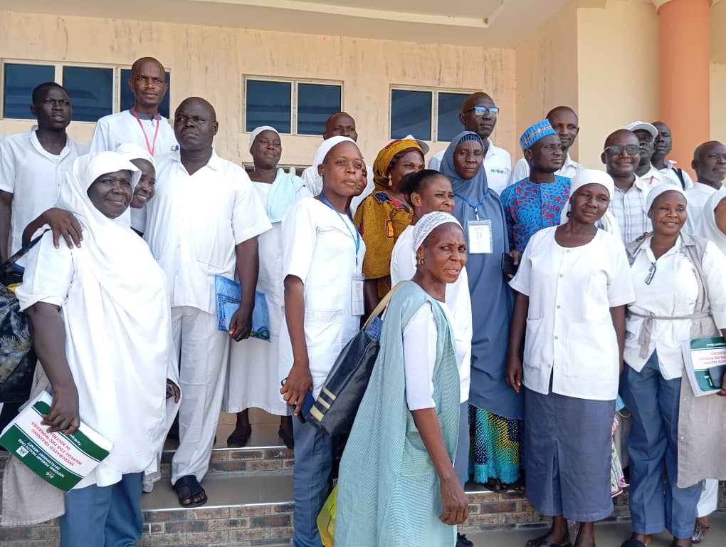
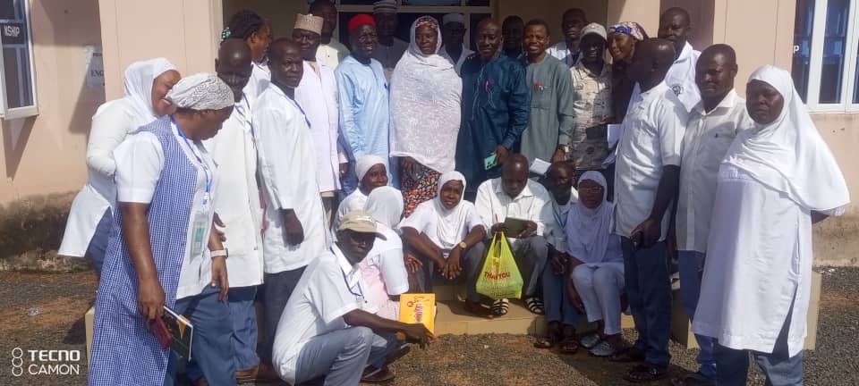
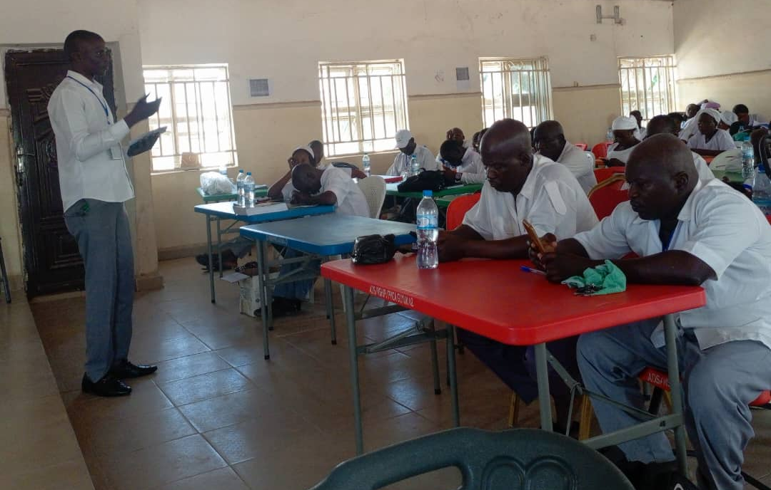
Training of AYPs and HCWs at LGA Level

Slide 15
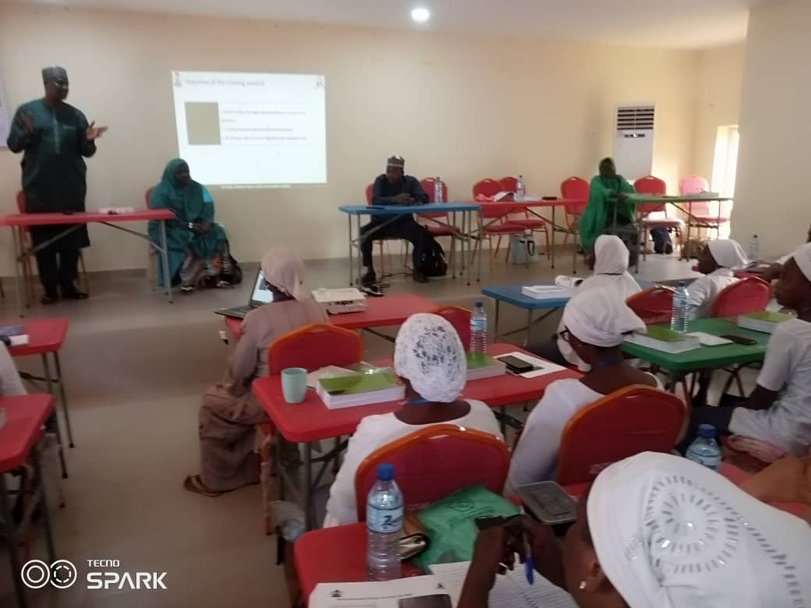
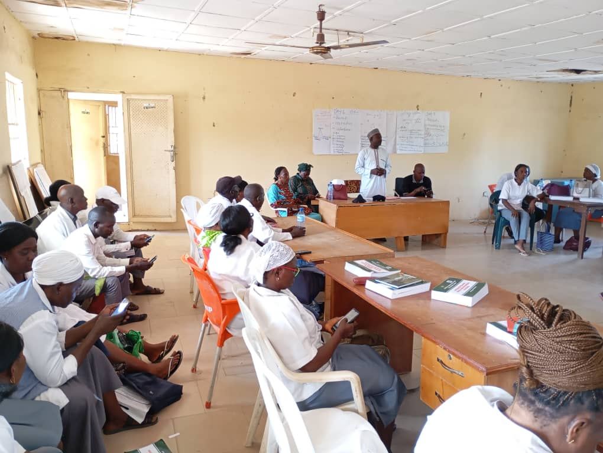
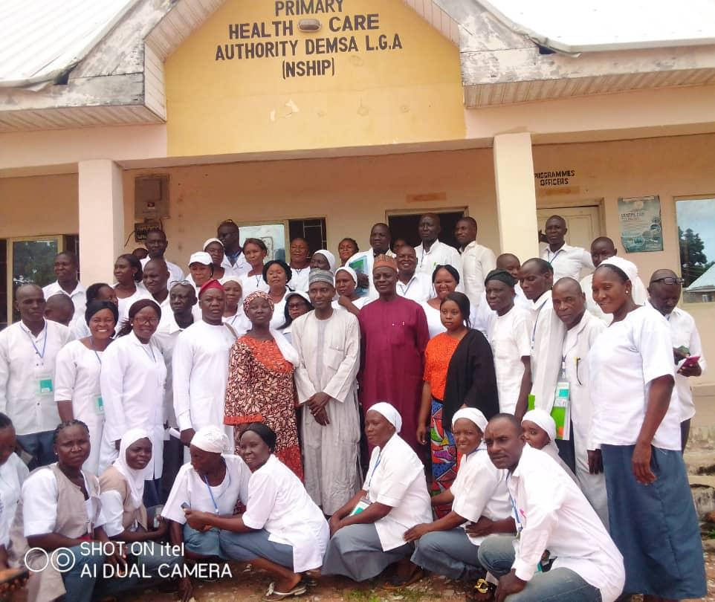
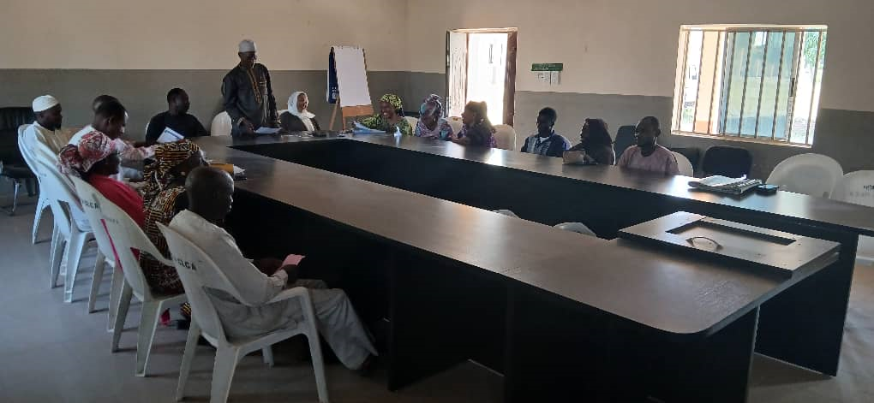
Training of AYPs and HCWs at LGA Level in Adamawa State

Slide 16
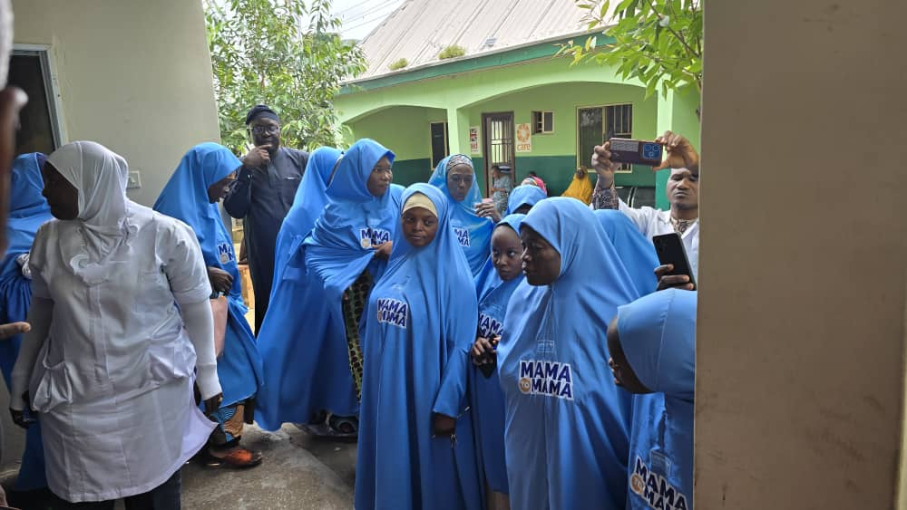
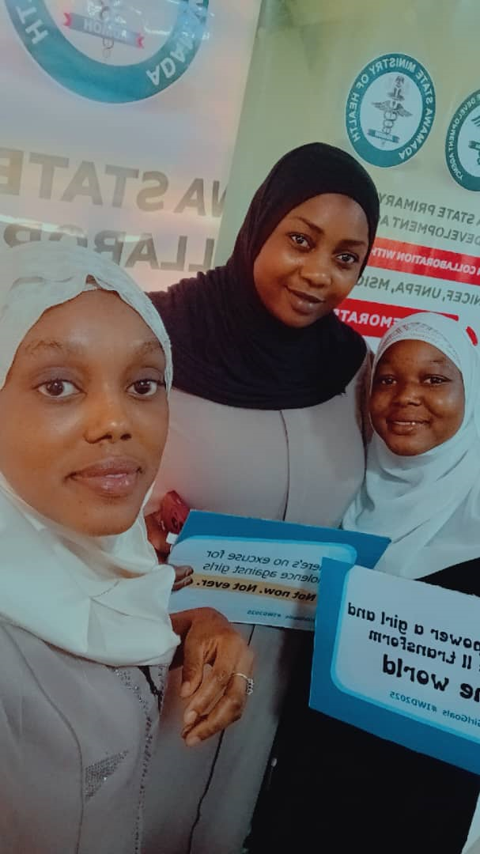
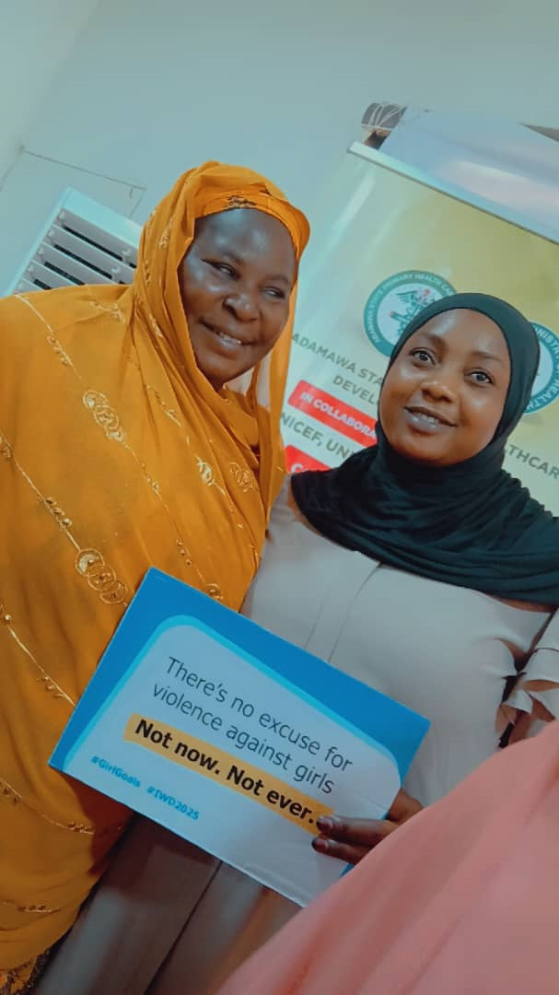

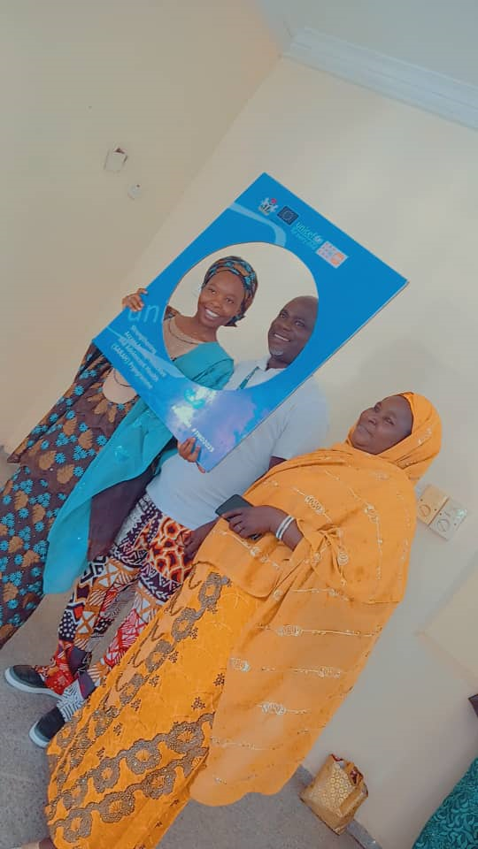
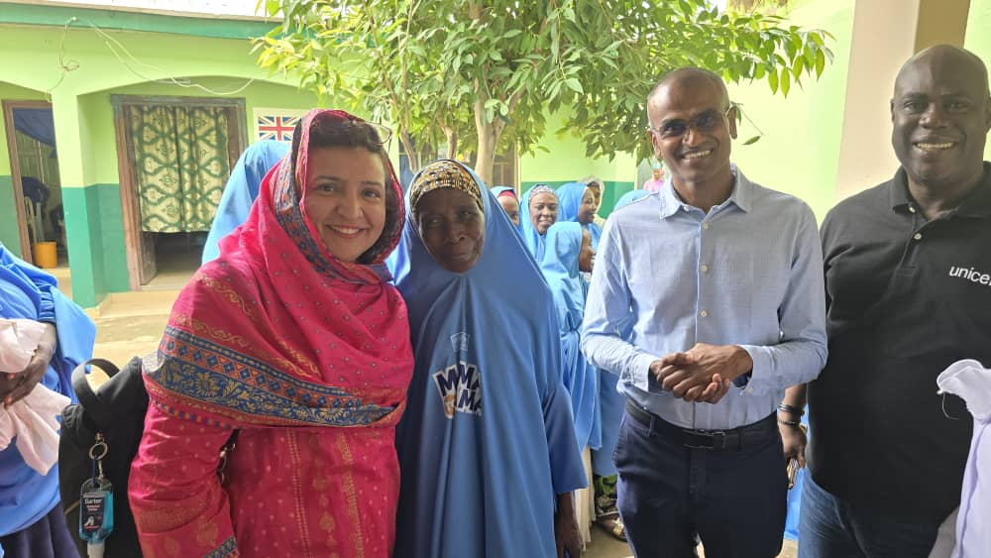

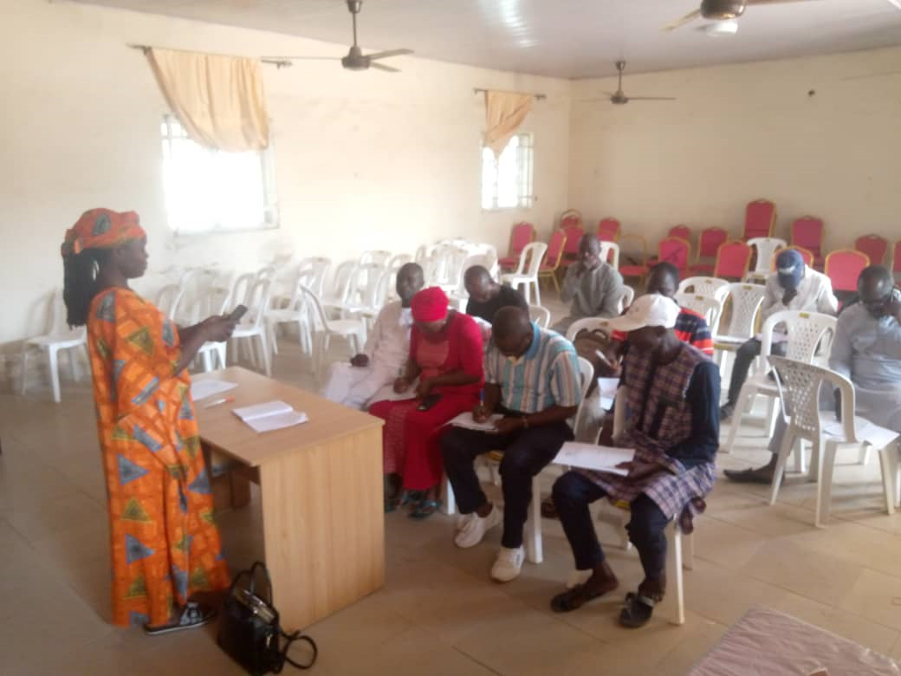
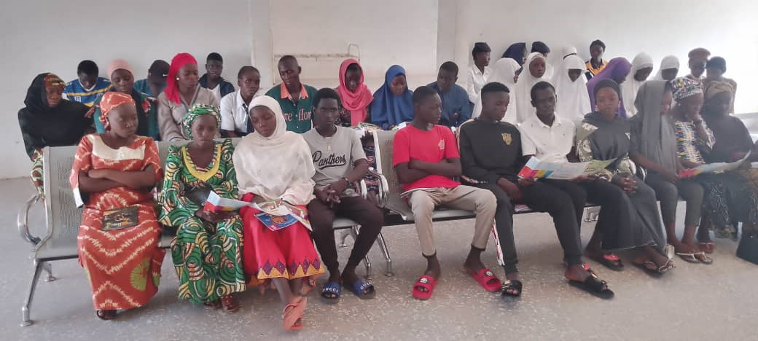

Slide 17
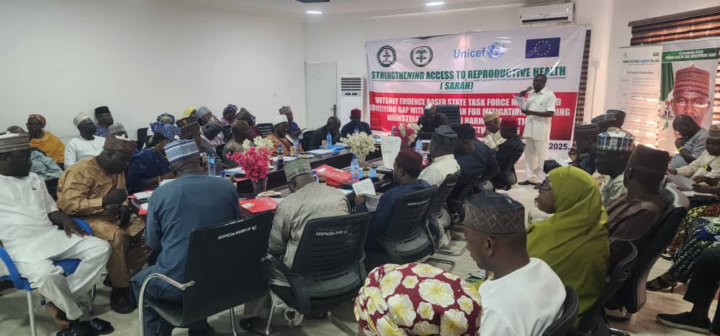
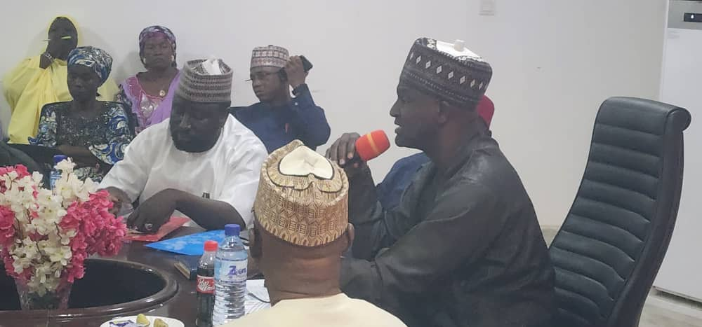

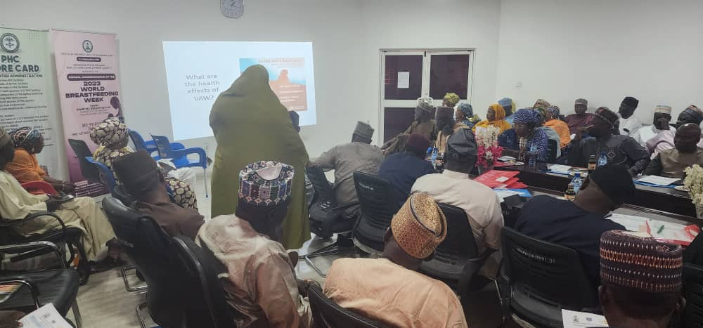
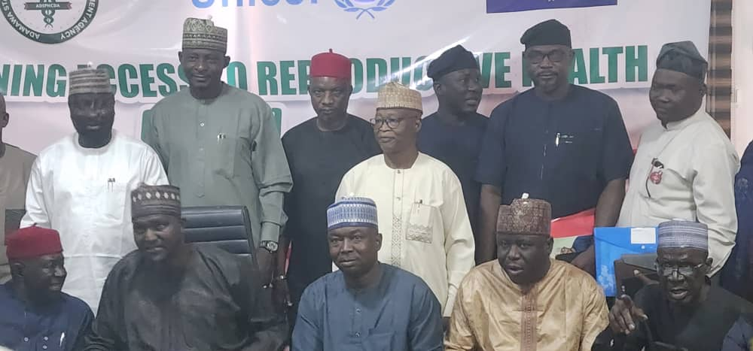
Quarterly Review Meeting with LG Chairmen and ESs on Mainstreaming GBV an Harmful Practice Adamawa state

Slide 18

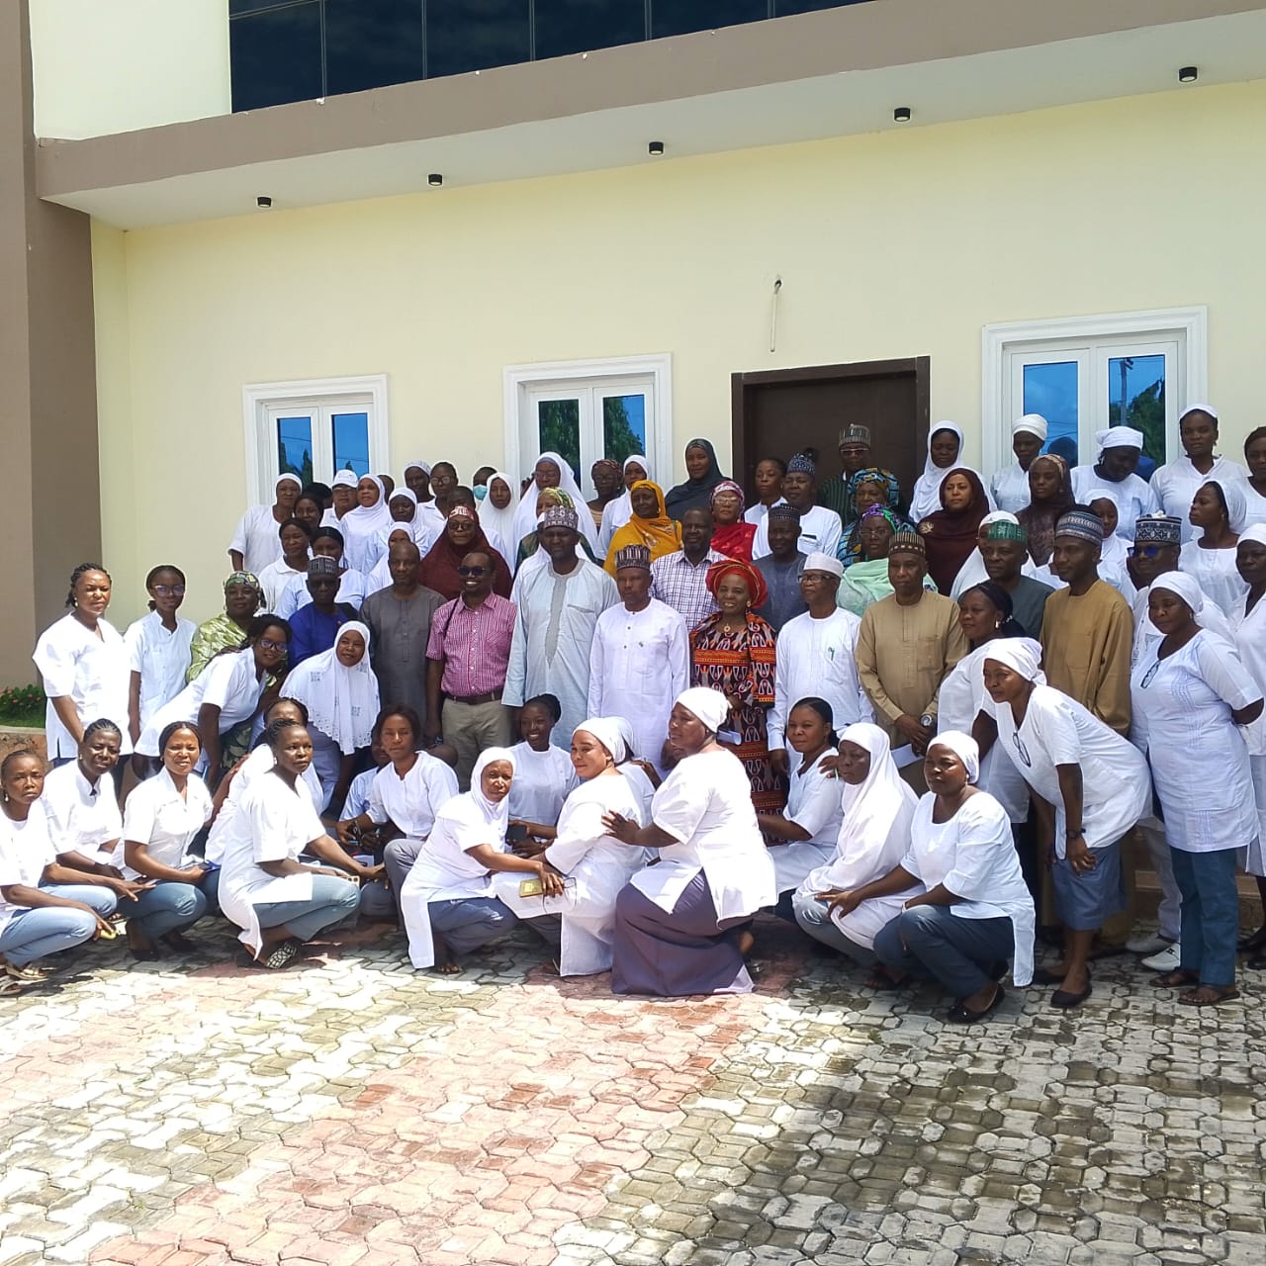
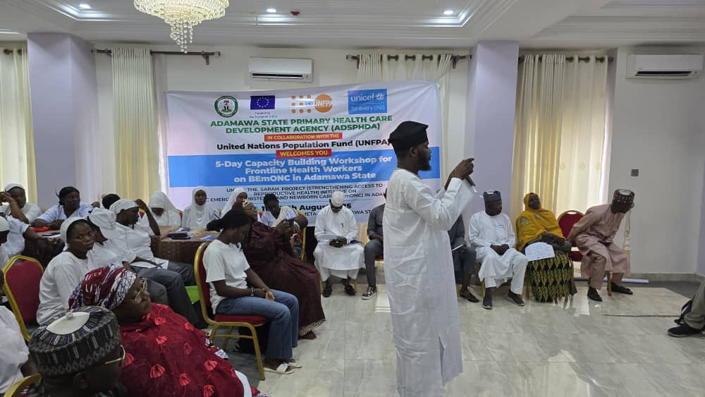
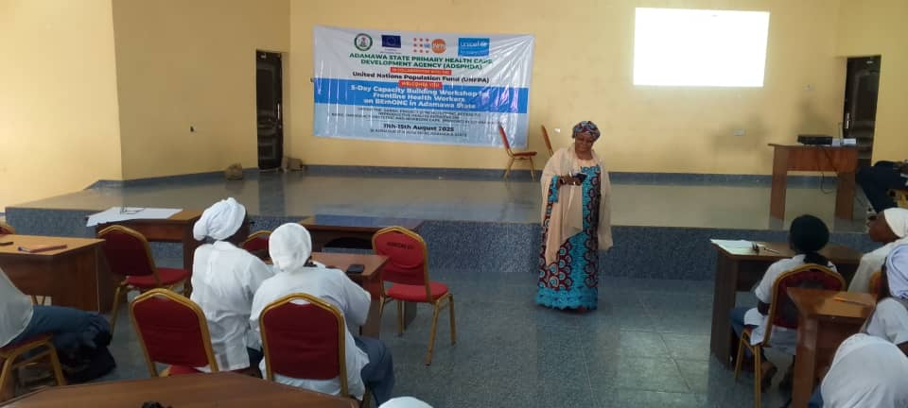
BEmONC Training

Slide 19
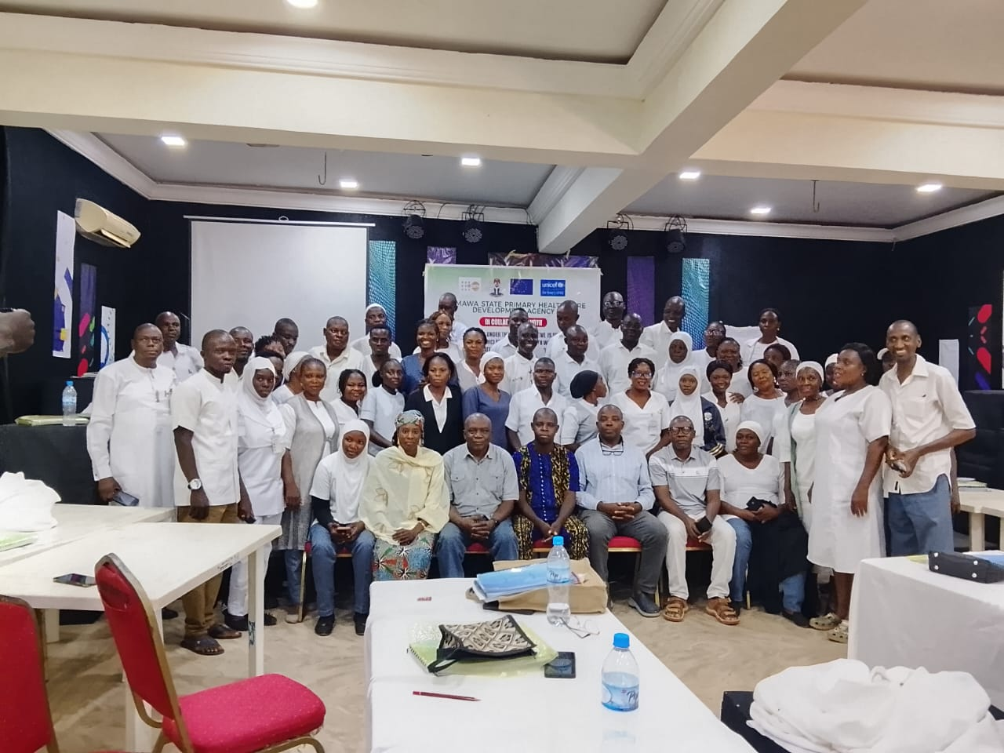
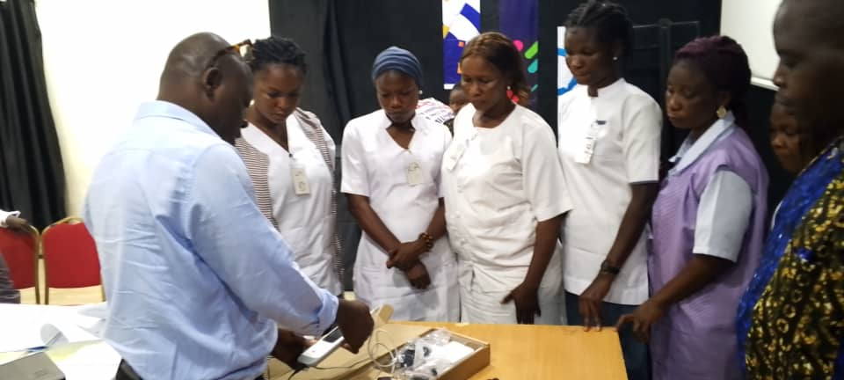
IMCI+ training GROUP PHOTOGRAPH 1ST CLUSTER
DEMONSTRATING PULSE OXIMETER

Slide 20
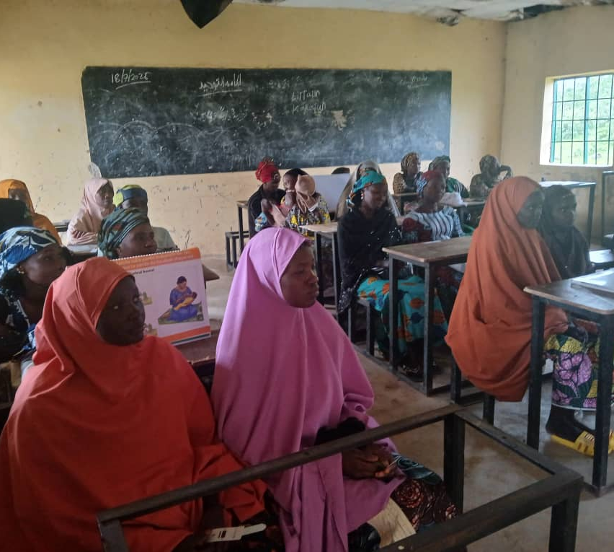
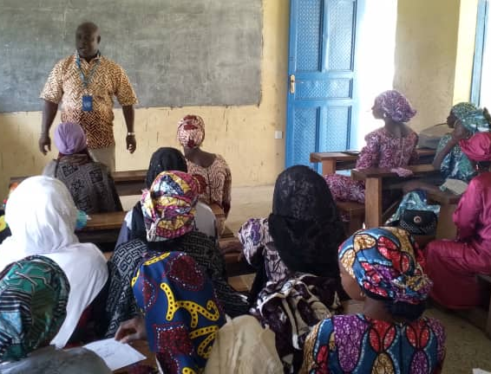
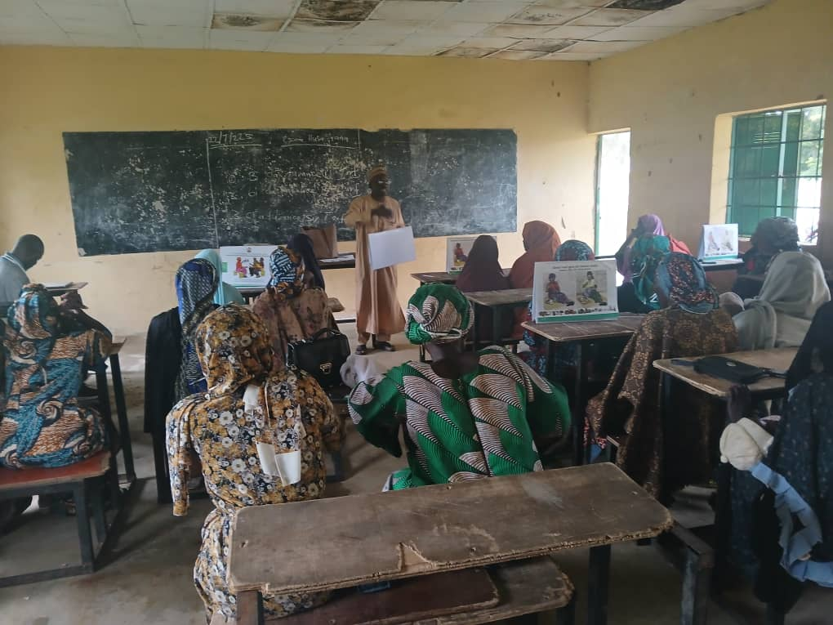
Auxiliary Community Based Health Workers: MAMA-TO-MAMA SUPPORT GROUP TRAINING

Slide 21
Thank you

