Slide 1
Adamawa State 2025 Progress Report

Slide 2
Outline
State Context and Objectives
Overview of the IMPACT Project
Project achievements
  Component 2: Immunization
  Component 3: Knowledge for Change
  Cross-Cutting Achievements
Challenges and Mitigation
Key Lessons Learnt
Financial Performance
Next Steps (October – December 2025)
Conclusion

Slide 3
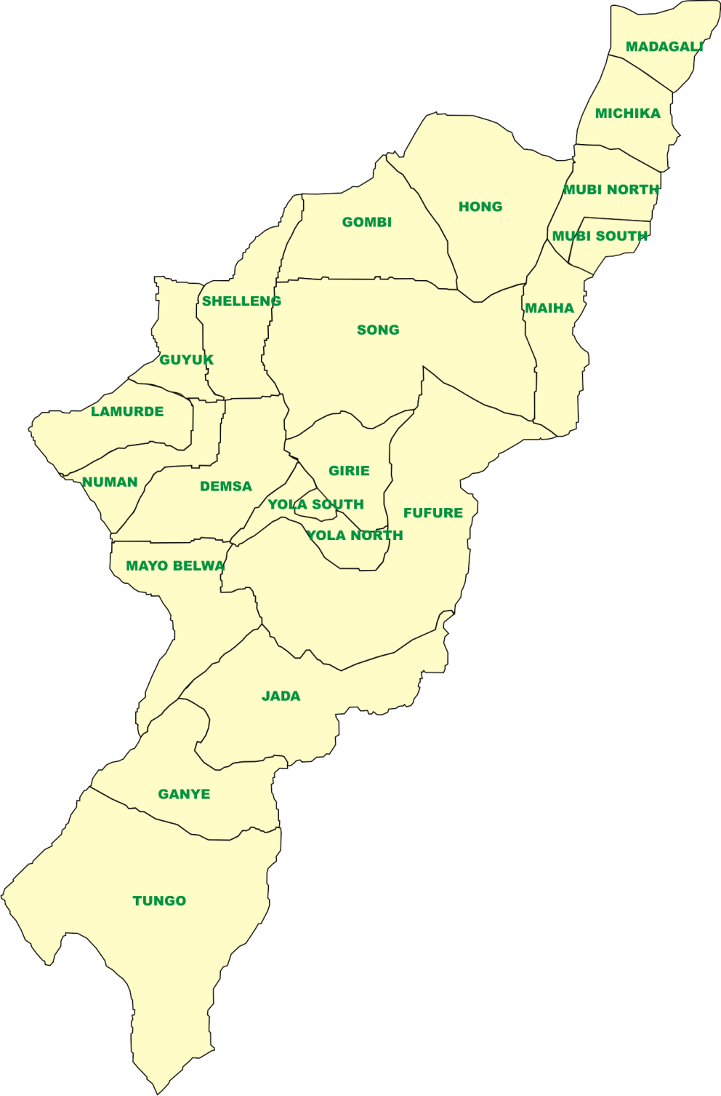
Nigeria
Adamawa State
State Context
  Profile(2025)
  5,453,000 People
  21 LGAs
  226 Wards
  Total no of HFs: 1,070
  BHCPF PHCs: 226
  Teaching Hospital: 1
  FMC: 2
  1 Specialist Hospital
  19 General Hospitals
  Private Hospitals: 150

Slide 4
Overview of the IMPACT Project & Objectives in Adamawa State
As one of the Multi-phase programmatic approach MPA known as Immunization plus and Malaria Progress by Accelerating Coverage and Transforming Services (IMPACT)- a World Bank supported program being implemented since 2022 date
The overall program objective of reducing under five mortality rate by 50%. Mainly to Strengthen immunization and RMNCAH+N service delivery and to reduce morbidity and mortality in children under the age of five (5) years. The project intervention areas includes:
  Direct funding of health facilities for service provision through decentralized facility financing (DFF) to 226 PHCs across 21 LGAs
  Funding of outreach services to improve Routine immunization service delivery in the state
  Operations support to strengthening monitoring and evaluation through digitization of 226 PHCs NHMIS data reporting and provision of 226 laptops
  Health system strengthening intervention by revitalizing of 70 PHCs
  amongst several other innovative approaches that will strengthen the health system.

Slide 5
Key Achievements at-a-Glance - example
Thematic Area | Target (2025) | Achieved
LLINs distributed | ???? | 132,871
Health Workers recruited | 226 | 226-1/HFs
Health Workers trained | 300,000 | 200,000
PHCs without vaccine stockouts | 100% | 80%
Essential Medicines procured and distributed | 226-HFs | 226-HFs
Mama kits supplied | 150/226 | 33,900-----100%
Supportive supervision conducted | 100% | 100%
Outreach sessions conducted | 1120 | 1120 HTR settlement

Slide 6
Component 2 Achievement- Immunization Plus
Subcomponent 2.1: Strengthening Service Delivery: examples
DFF implemented in 226 PHC and has improved access, quality, or coverage in the 21 LGA as follows: Drugs, integrated outreaches
226 PHCs supported to conduct monthly integrated PHC outreaches services in 1120 hard to reach settlements across 21 LGAs
170,429 newborns reached with postnatal care
226 PHCs implement BEmONC standards services
79 PHCs being revitalized (67 completed 85%)
increased from 44,708 in 2022 to 120,897 from January to September 2025
226 PHCs supported with 33,900Mama Kits@150/HF

Slide 7
Component 2 Achievement- Immunization Plus
Subcomponent 2.2: Health Systems Strengthening & Technical Assistance
Conducted DFF refresher training :
  Training of FMs and data clerks (452) On digitalization
  Provided 226 with Laptops
  Training on ESMP
Two rounds of DQAs completed
Improved DHIS2 reporting timeliness from 72 % in 2022 to 100% in 2025
Two rounds ISS and Quality of care assessment conducted
Payment of Q1 and Q2 LGA performance framework to 21 LGAs completed .

Slide 8
Progress towards PDO Achievement
IMPACT INDICATORS | Baseline (Jan. to Sept 2022) | Current achievement (Jan -sept 2025)
Persons presenting with fever & tested by RDT & Microscopy <5yrs | 64,325 | 132,871
Persons with Confirmed Uncomplicated Malaria treated with ACT <5yrs | 50,875 | 86,554
IPT3p use by Pregnant women | 31,848 | 68,190
Deliveries by Skilled Birth Attendants (SBA) | 44,708 | 120,897
Postnatal Clinic Visits Mothers & Newborns 2 - 3d | 33,175 | 170,429
Measles 1 given | 61,643 | 92,053
Penta 3 given | 71,815 | 98,813
Children <5 yrs & PW who received LLIN | 16,520 | 132,871

Slide 9
Component 3 Achievement - Knowledge for Change
Election of new 226 WDCs
Orientation and distribution of ToR to WDC chairmen members
Visit to newly created (7) chiefdoms: project implementation, data and role in improving health services
Performance review –award/recognition to LGA executive chairmen, Chiefdoms and PHCs
Deployment of SBAs to 226 health facilities

Slide 10
Cross-Cutting Achievements
Quartly star
Quarterly TWG meetings with all partners and line MDAs
Establishment of situation room
Participation in quarterly state world bank coordination meetings

Slide 11
Challenges and Mitigation
This slide helps us see what barriers you faced and how you addressed or plan to address them.For each challenge, there should be a practical mitigation strategy - for example, stock-outs mitigated through redistribution, data gaps addressed through DQA, etc.
Challenges | Mitigation
Maldistribution of SBAs due to political interference and insecurity | Introduction of rural posting allowances (equity in payment)
Delay in revitalisation by contractors | -Sanctions and Penalties for delays by contractors -intensify meeting with contractotrs and consultant on revitalisation -Continuous supervision by the PIU to the project sites
Crosscutting activities with the National leads to delay in implementation of activities | Increase coordination between IPS and state & National

Slide 12
Key Lessons Learnt
Realtime data tracking: through situation room analysis
Hybrid (virtual & Physical) suppervision for the optimization of integrated outreach to PHCCs by state program officers 5-4 PHCs per program officers
Targeted coordination meetings: provides indepth discussions and solutions (Meeting with PMOs on referrals)
Incentivising services increase uptake (Mamakits and PostNatal Kits distribution)
Signing MoU with between SPHCDA and WDC: a laverage agints waring WDCs
Secure PHC land: Liaising with the ministry of land and survey and urban planning to provide C-of-O to all PHCs
Quarterly peer Learning between HFs and PHCAs (low performing & high performing)
PIUs mostly staff of the agency for institutional memory

Slide 13
Conclusion
End with a summary statement about the overall progress - what your state has achieved and your commitment moving forward.

Slide 14



