Slide 1
SCORE CARD OF THE MINISTRY OF ENVIRONMENT
AND NATURAL RESOURCES
PRESENTED BY
HON. COMMISSIONER
HON. MOHAMMED SADIQ MOHAMMED
AT THE QUARTERLY MINISTERIAL PRESS BRIEFING
ON 20TH NOVEMBER 2024
@ BANQUET HALL GOVT. HOUSE YOLA

Slide 2
OUR ROLE
Protection, Conservation and Management of the Environment.
These aligns with our mission to:
See that that the people of adamawa consume clean water.
Breath fresh and healthy air
iii. Sustain and manage our Abundant Natural Resources for Future use.
VISION:
To ensure that Adamawa State develops in harmony with the Environment for the overall benefits of its citizens

Slide 3
ACHIEVEMENTS: 2019
Repairs of four number waste evacuation equipment and trucks for solid waste evacuation and disposal within the state capital done in 2019. The repaired vehicle worked effectively in reducing refuse heap within Jimeta and Yola.
The Ministry in collaboration with federal Ministry of Environment in 2019 embarked on street planting of trees across the whole state. This is with a view to providing shade and fresh air, mitigate climate change and to serve as wind break. This project became necessary considering high temperatures usually experienced in Adamawa state between months of March and June, which has resulted to high casualitie due to heatstress.

Slide 4
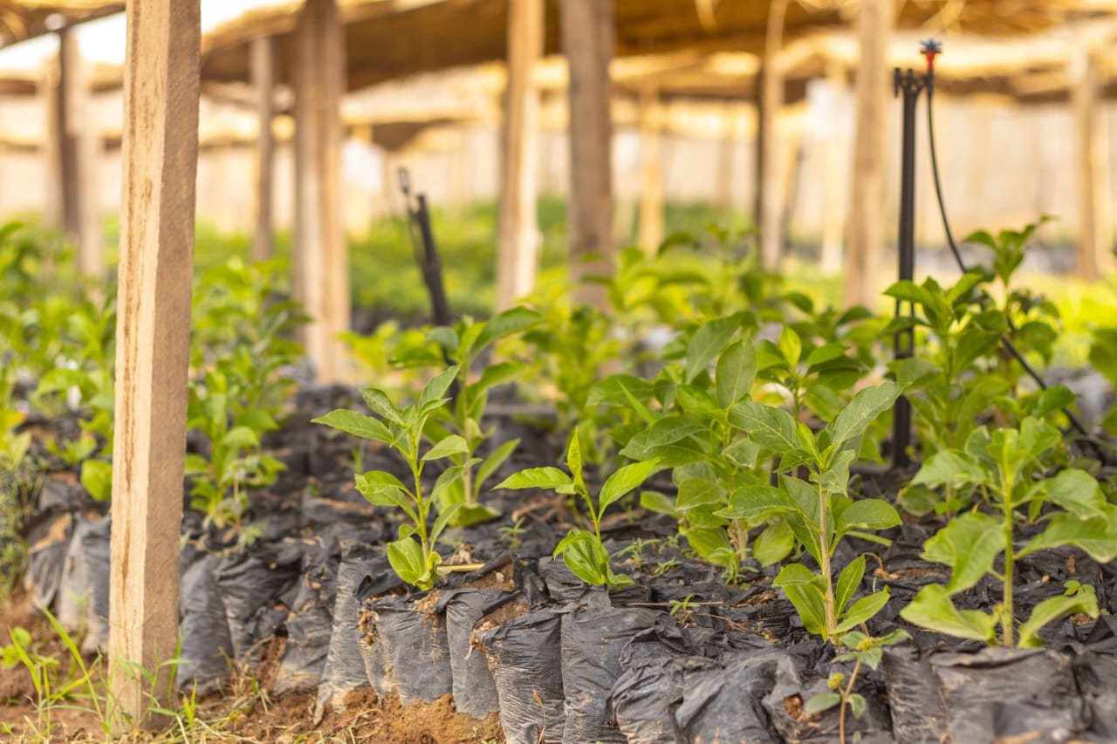
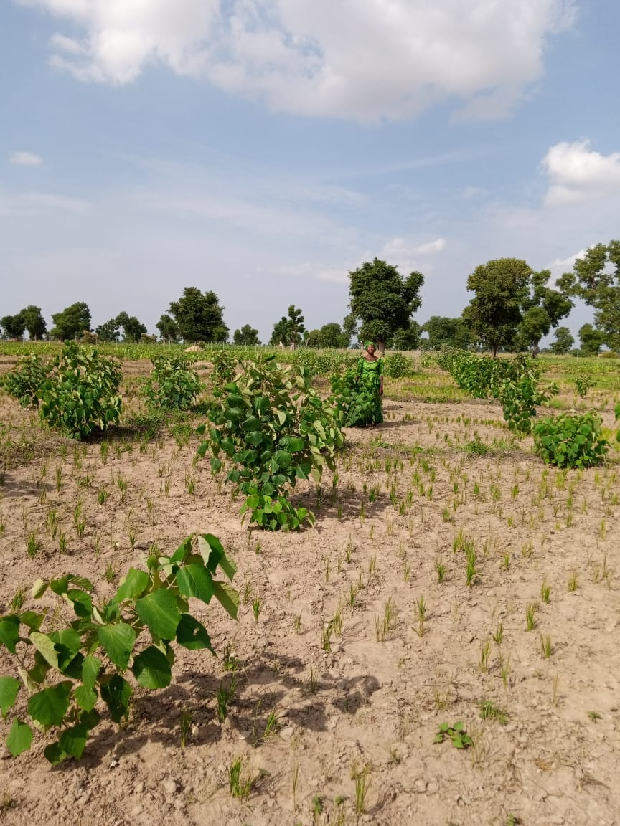
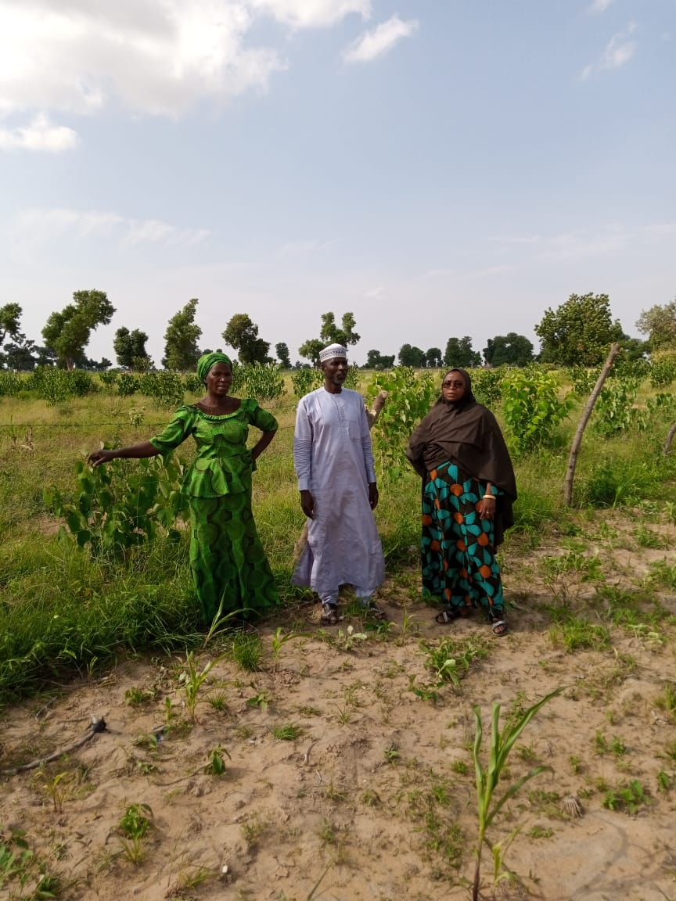
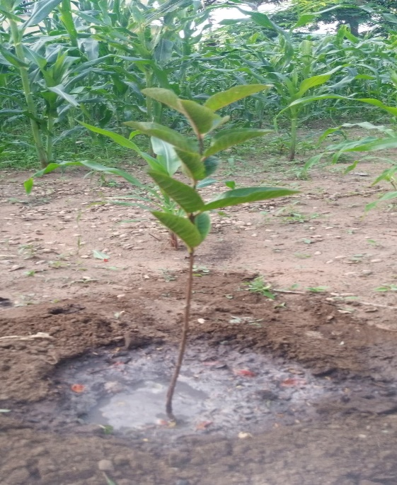

Slide 5
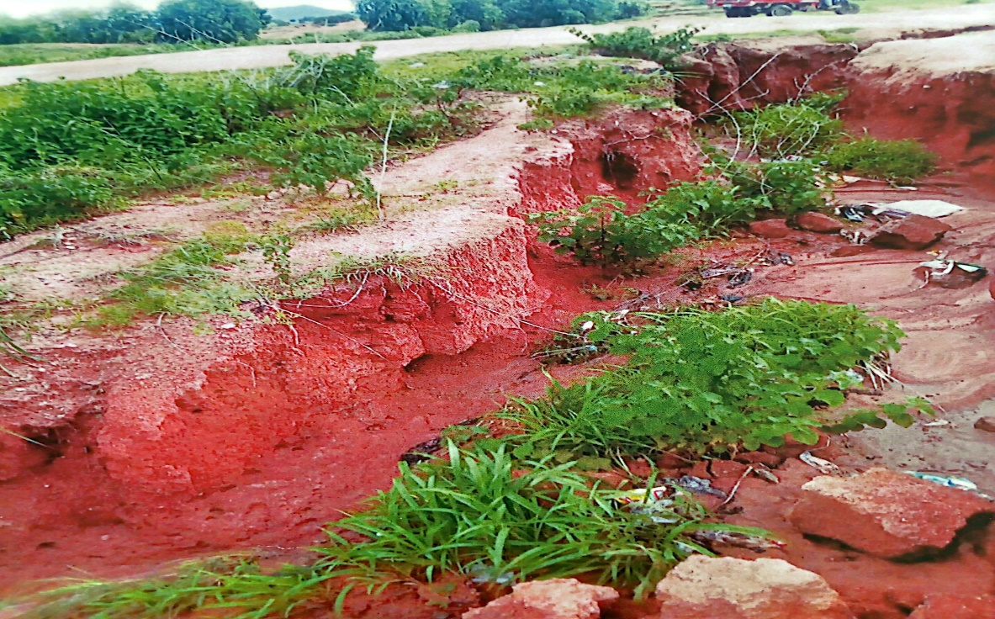
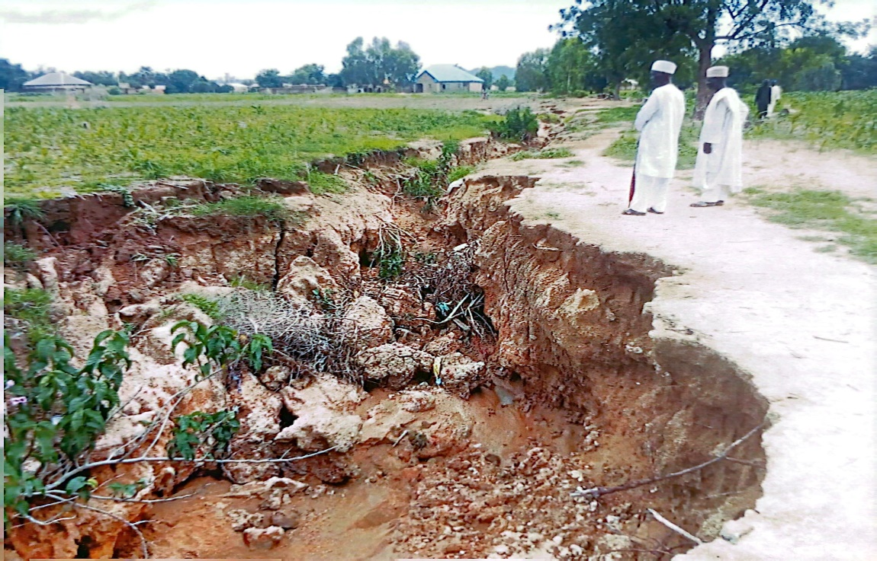
Feasibility Studies on Ecological degraded areas in the state was conducted by staff of Environmental Degradation Control funded by the present administration in 2019.
The report was submitted to Agro climatic resilience in semi-arid landscape (ACReSAL) as a pre- requisite for enlistment of Adamawa State in the project. It was also submitted to Ecological Fund office, Abuja for intervention in which some of the areas had already received attention.

Slide 6
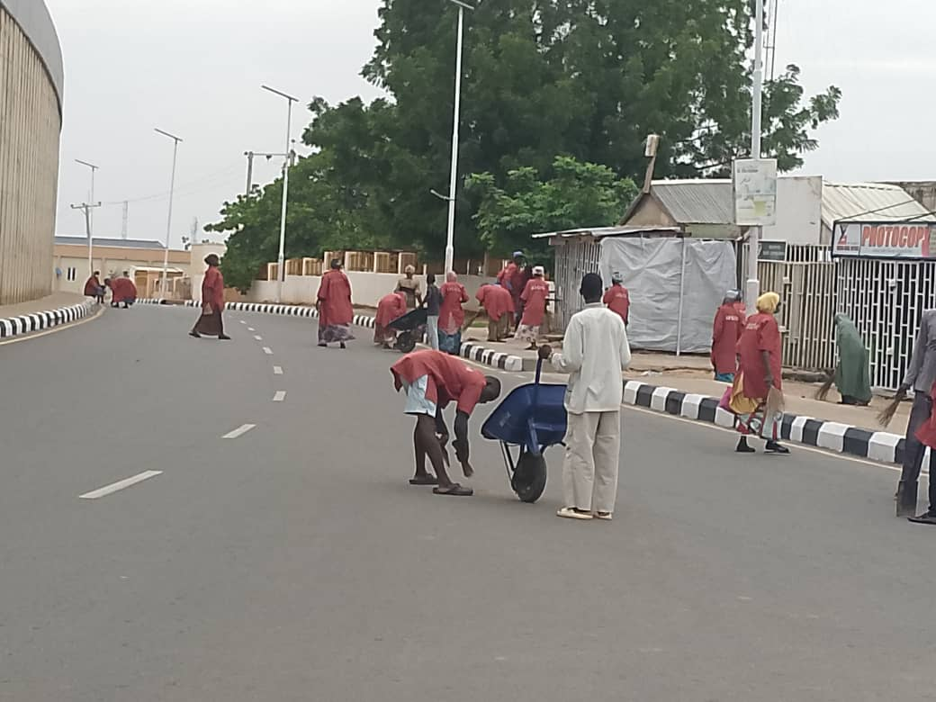
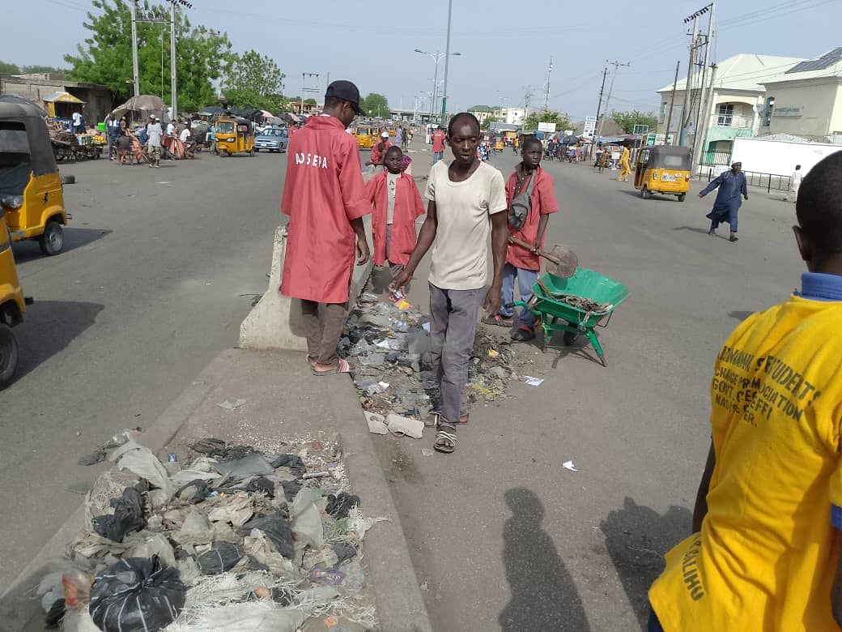
ACHIEVEMENTS: 2021
This administration engaged five Hundred street cleaners, mostly youth in 2021 to sweep and sanitize major streets within the state capital. The exercise has been rated very effective and the process is still on going without any hitch
Street cleaners @ Jimeta Metropolis

Slide 7
2021CONTI.....
Green Climate Fund.
This is an intervention fund for climate change adaptation/ Mitigation for countries that are parties to UNFCC.
Adamawa State Ministry of Environment and Natural Resources applied for the fund in 2021 for climate Adaptation (amount is 10M UDS).
Progress made include:
Letter of expression of interest addressed to Hon. Minister of Environment which was acknowledged
Engagement of an environmental consultant (…..consulting services).
Appointment of Technical Focal Person (Director Environmental Degradation)
Preparation and submission of concept note which was approved.
Appointment of FAO as an accredited entity
Submission of project proposal to FAO

Slide 8
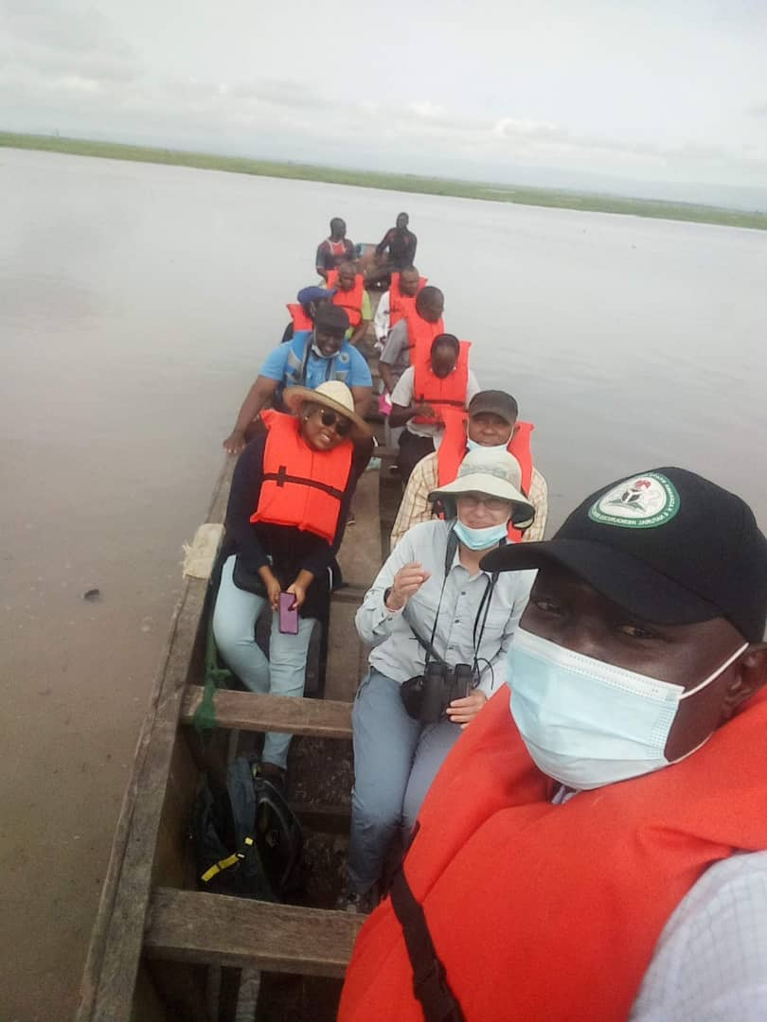
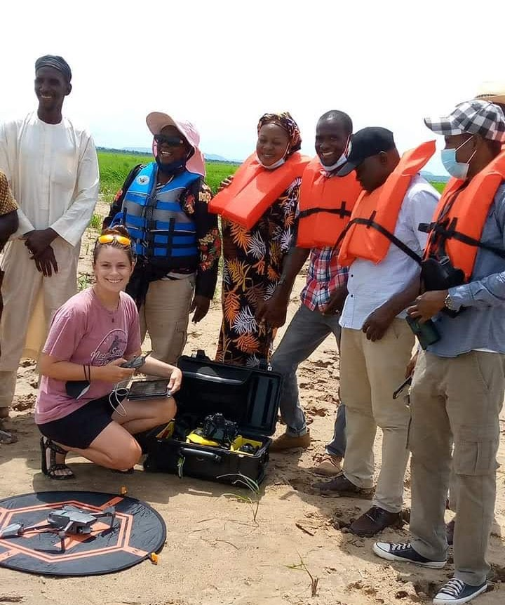
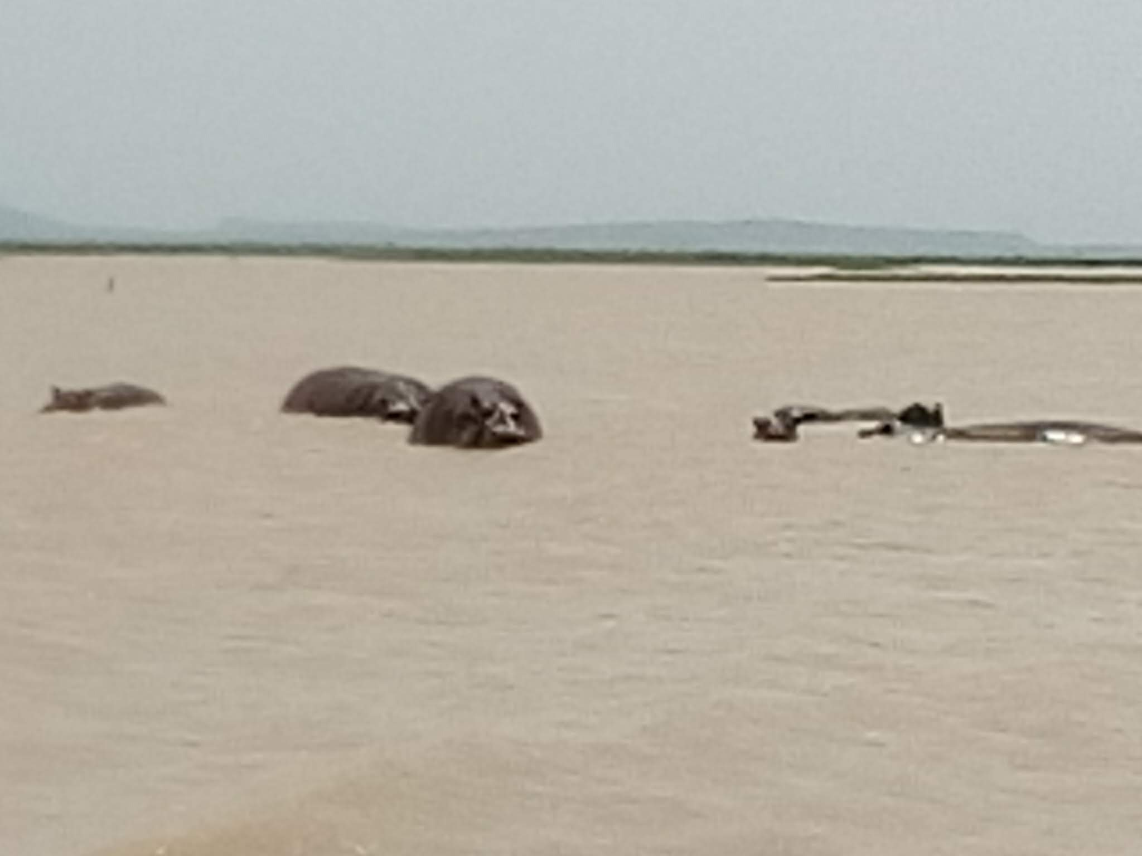
2021CONTI.....
The Ministry entered partnership with key players in wildlife conservation. Between 2019 – 2022, the Ministry through the wildlife department collaborated with a conservation biologist from the USA for hippo conservation and community sensitization at Kiri reservoir and the adjoining communities. We also jointly conducted hippo census and established the approximate number of hippos in the reservoir. A total of approximately 64 hippos were seen and counted. Similarly, we collaborated with African Nature Investors Foundation (ANI), an international NGO with vast technical expertise on wildlife conservation and management with a view also to train our technical staff.
Hippo Survey & Census @ Kiri Dam A

Slide 9
2021CONTI.....
In 2021, the ministry signed an MOU with Adamawa State hunters Association to assist us in protecting our already depleted wildlife resources in a few of our remaining hot spots of wildlife such as around Ganye and Jada LGAs and the partnership is yielding a good result.

Slide 10
ACHIEVEMENTS: 2023
This administration in its effort to curb deforestation in order to mitigate the challenges of climate change in the state, announced the ban on indiscriminate felling down of trees in the state for production of charcoal on June 28 2023. As a result of the ban, the Ministry of Environment, IOM and FAO carried out needs assessment in six LGAs to find alternative source of energy for the citizenry and reduce the pressure on the use of fuel wood. A concept note has since been submitted. Meanwhile, 10 women and youths from each of the 226 wards of the state have been trained on Charcoal Briquette production with a view to training more people in thier various units across the state.

Slide 11
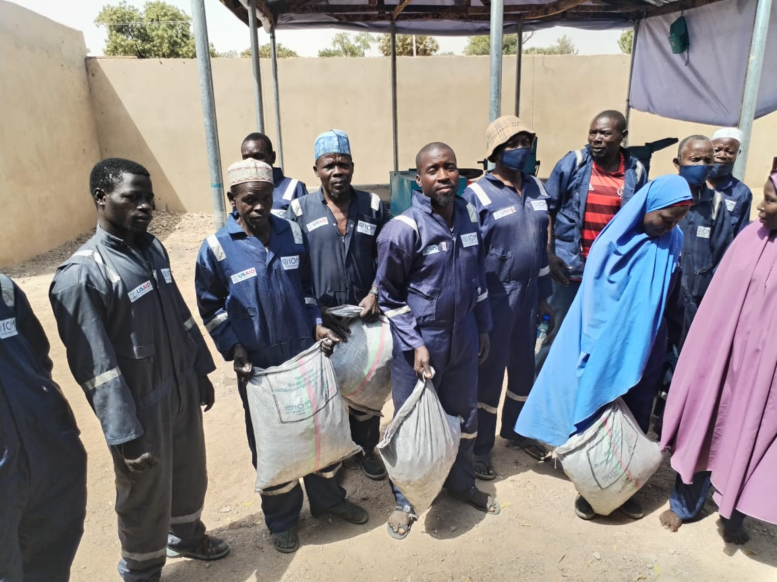
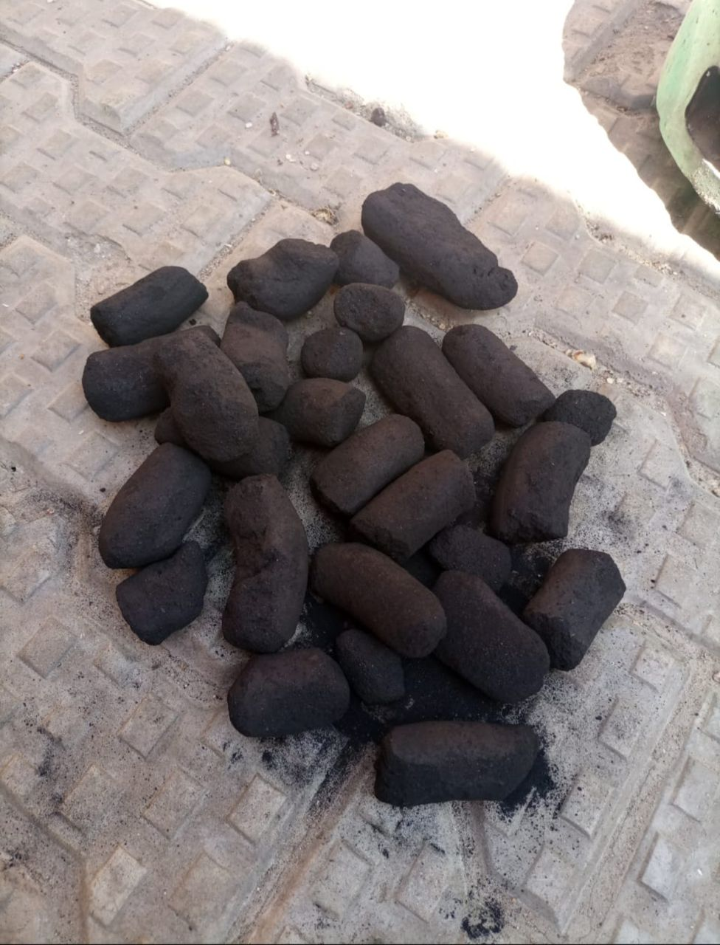
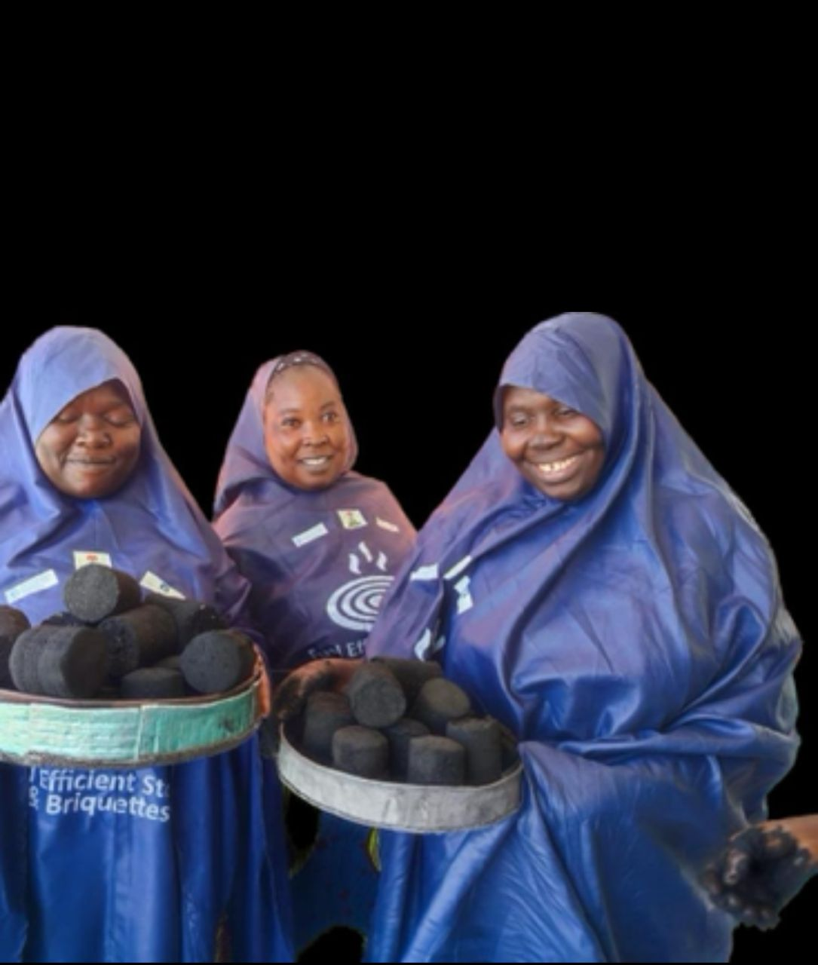

Slide 12
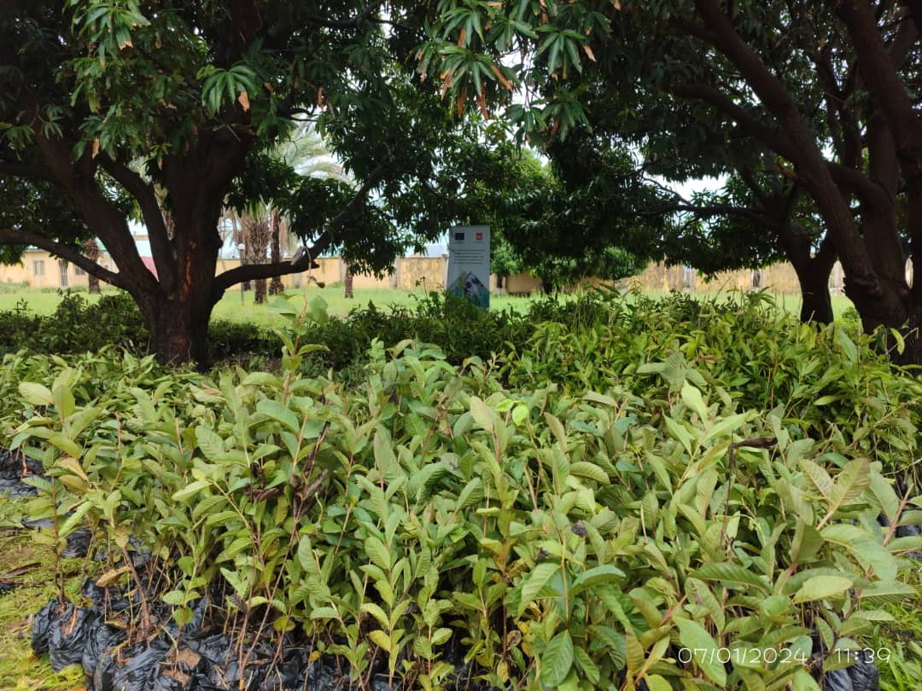
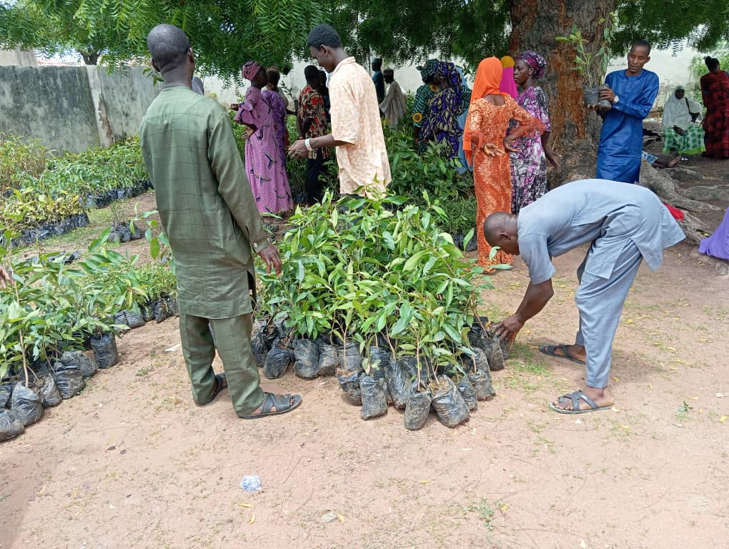
2023 CONTI.......
The Ministry and NRC distributed assorted seedling to communities and individuals in Fufore, Demsa, Numan and Yola North and South.
DISTRIBUTION OF SEEDLINGS TO COMMUNITY MEMBERS

Slide 13
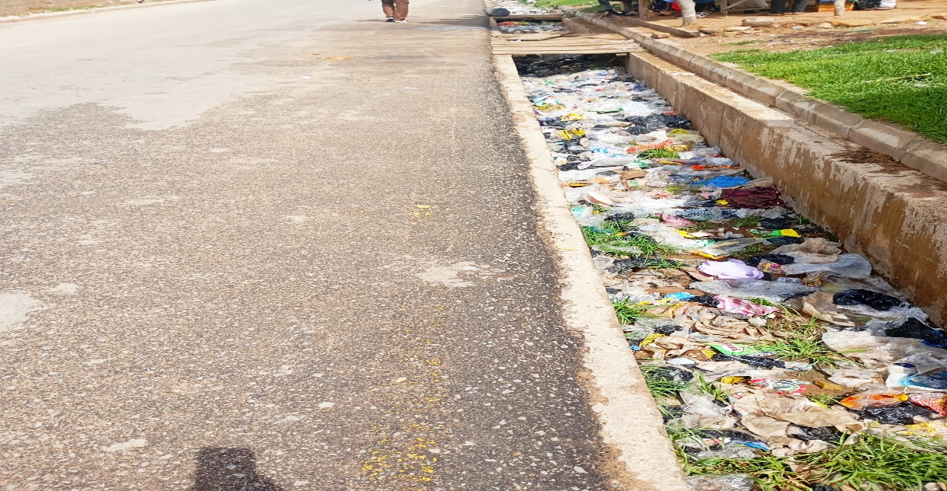
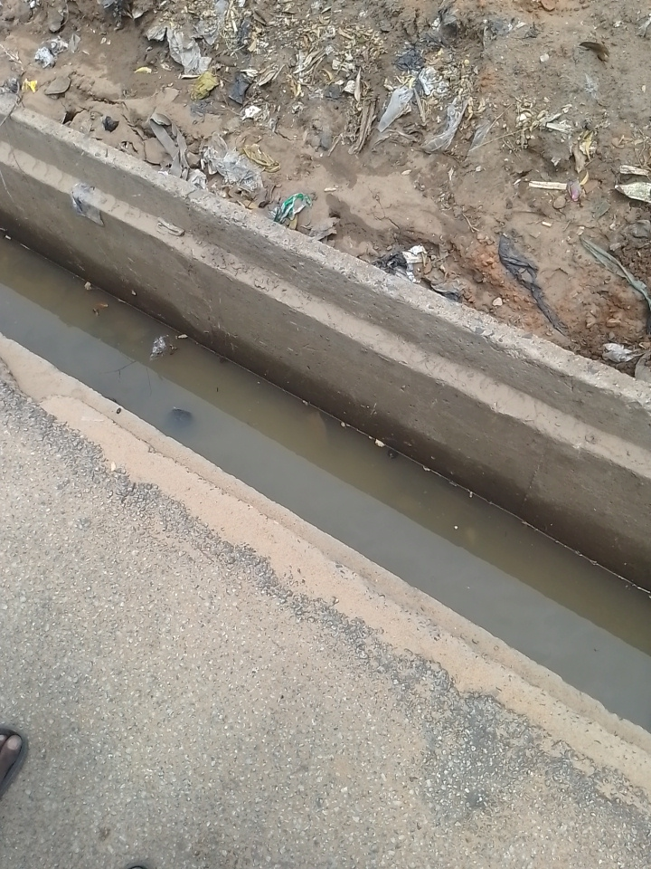
ACHIEVEMENTS: 2024
In conjunction with some commercial banks, and as a part of their cooperate social responsibility the Ministry de-silted and evacuated sand from drainages (both sides) along Galadima Aminu Way (Bank road) early this. This activities has gone along way mitigating overflow of surface run off, maintaining and sanitizing the road which is gate way to the seat of power.
Before
After

Slide 14
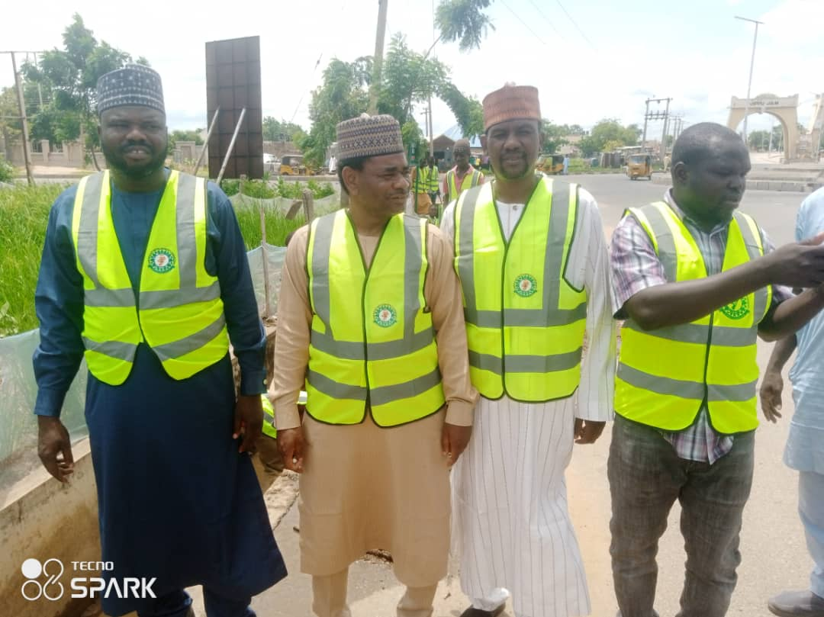
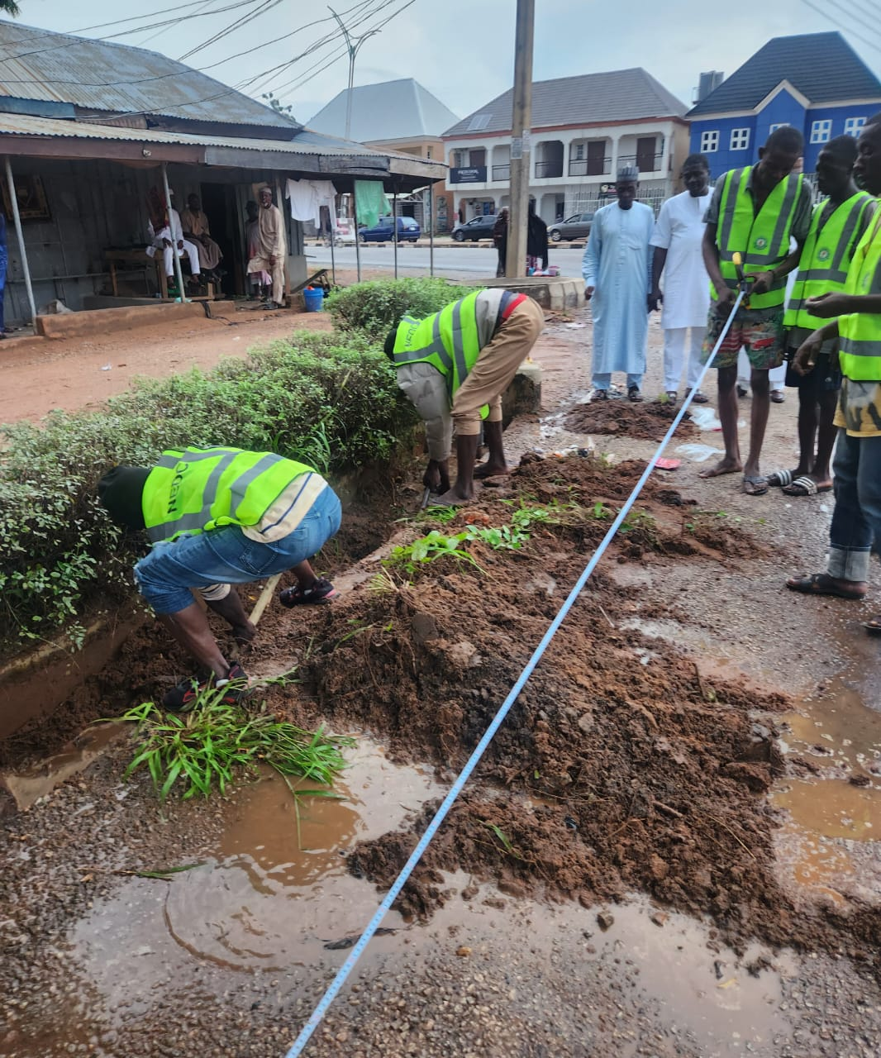
2024 Conti......
North East Development Commission (NEDC) had approved a sixty kilometer length of drainage to be de- silted in the metropolis, a project that has since been executed successfully.
DE- SILTING OF DRAINAGE IN YOLA METROPOLIS

Slide 15
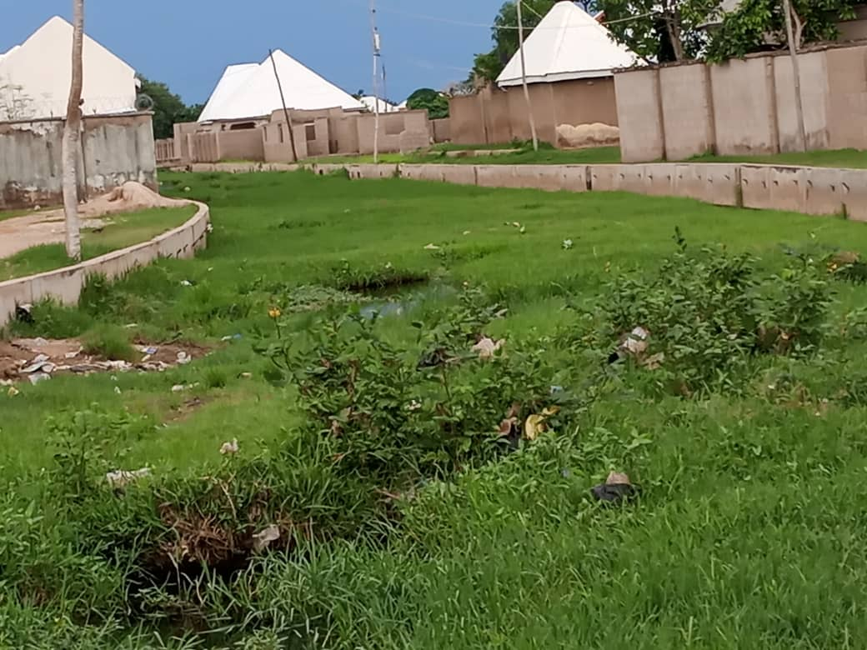
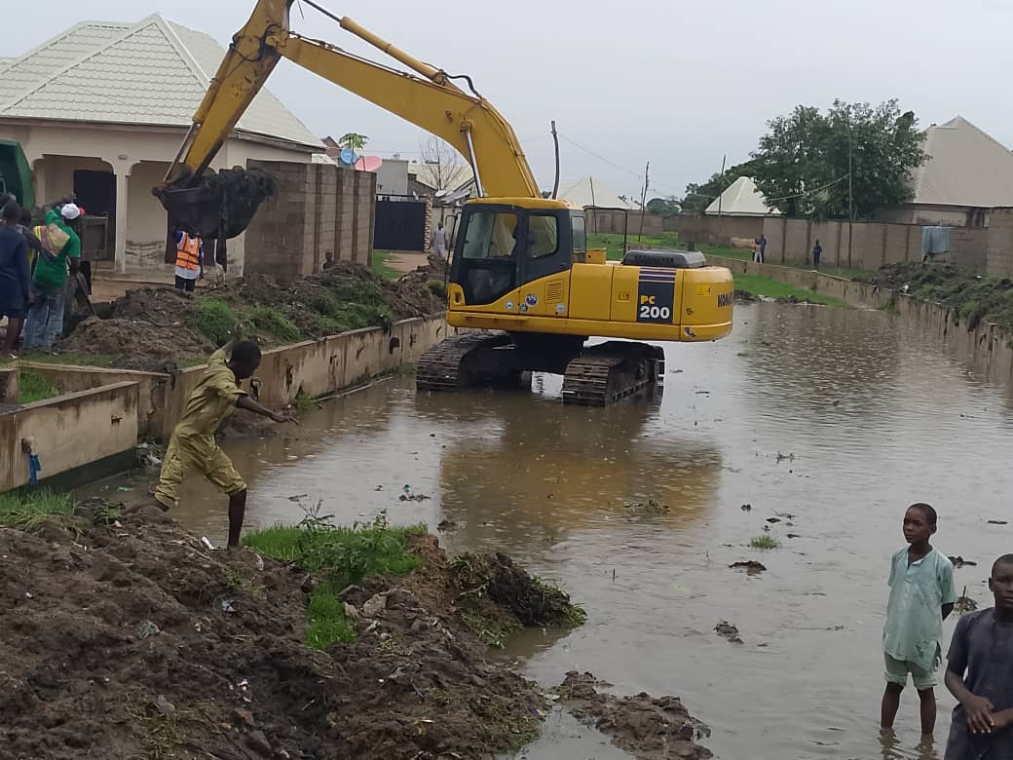
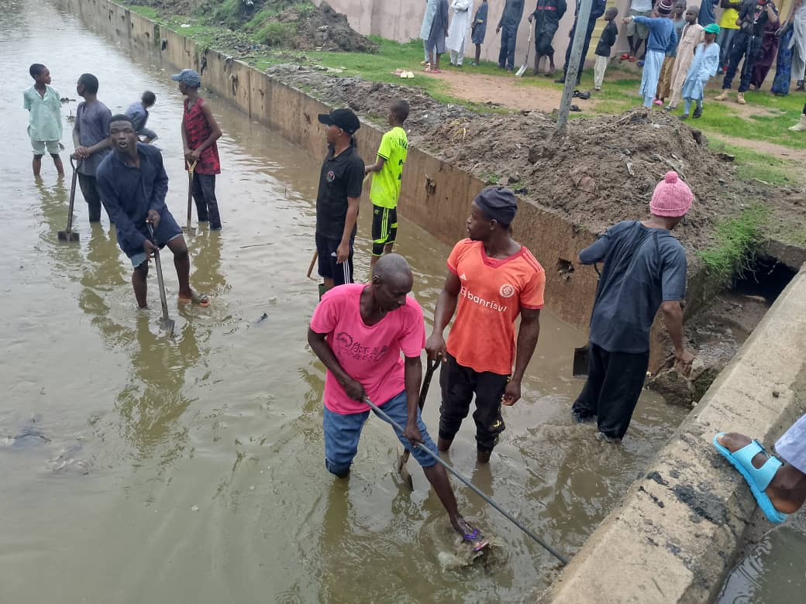
2024 Conti......
De-silting and evacuation of solid waste and silt deposit in storm drainage in Shagari, Sabon pegi area of Yola South. His Excellency graciously approved this exercise in September this year to curb the menace of flood that has been ravaging the residence of shagari sabon Pegi. The project was awarded to Messrs A.S Yadim Nig. Ltd. With strict supervision of the Ministry of Environment and Natural Resources. The project was successfully executed and the impact was felt, as there is no evidence of flood this year in the affected area.
BEFORE
THE PROCESS
AFTER
DE- SILTING OF DRAINAGE AT SHAGARI YOLA SOUTH

Slide 16
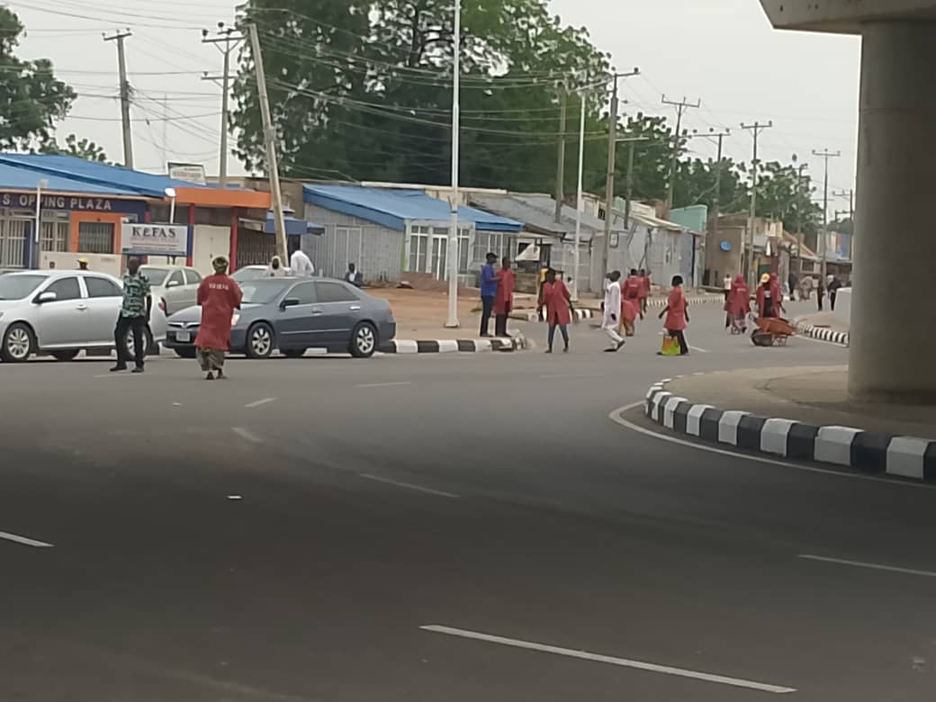
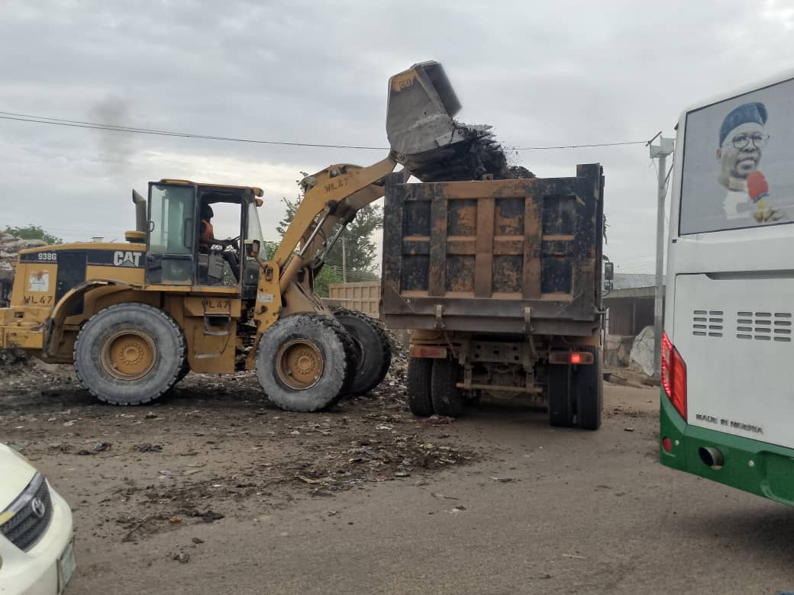
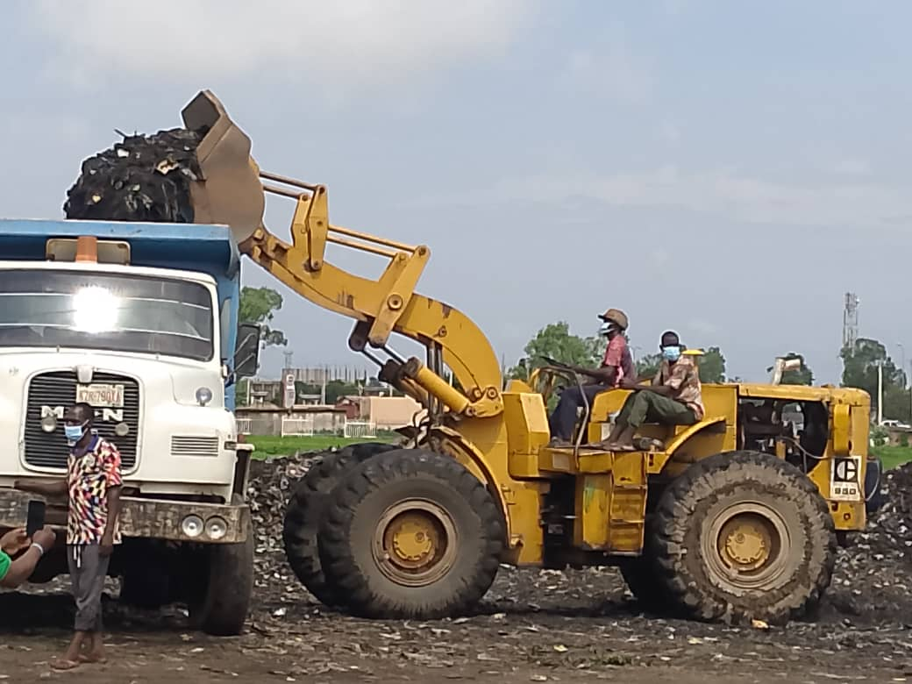
2024 Conti......
This administration graciously approved the re-introduction of monthly environmental sanitation across the whole state in June this year. The exercise is currently going on seamlessly, which Her Excellency, the deputy Governor, Professor Kaletapwa G. Farawta is overseeing and all other commissioners, are members of the implementation committee.

Slide 17
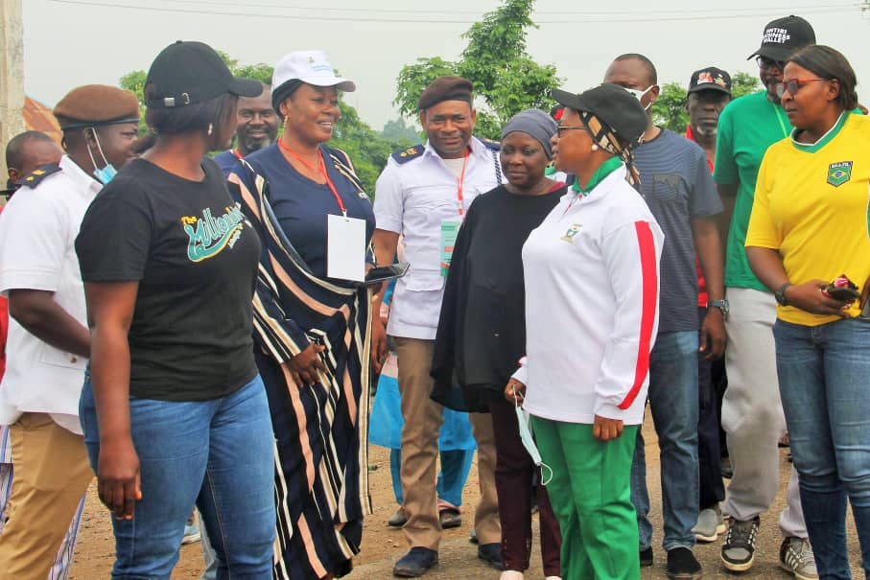
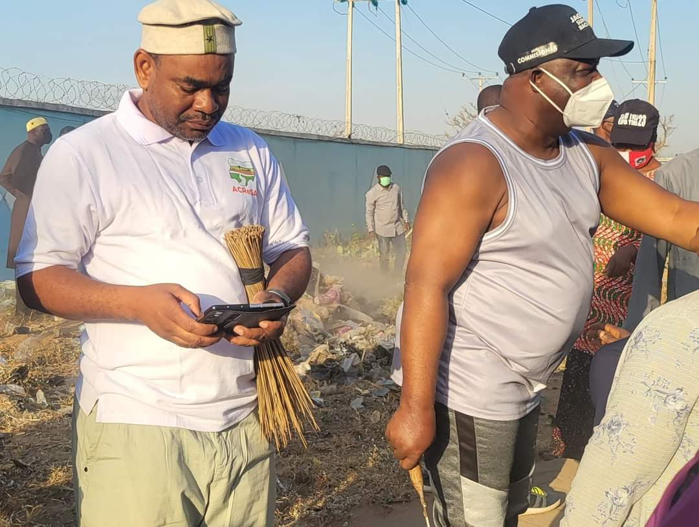
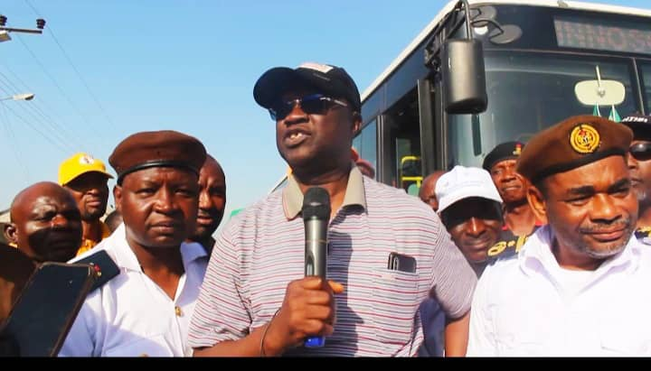

Slide 18
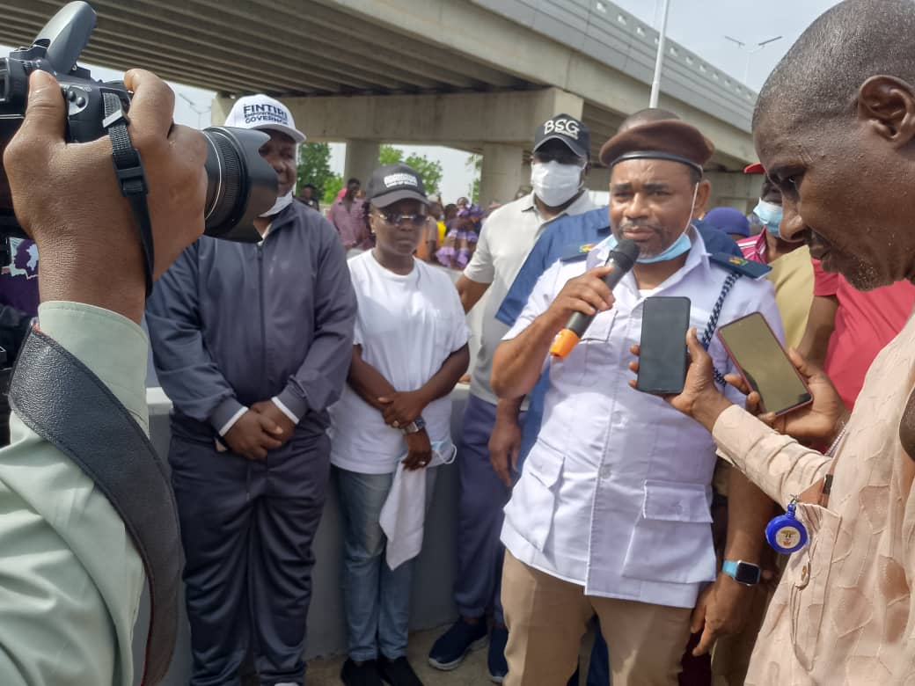
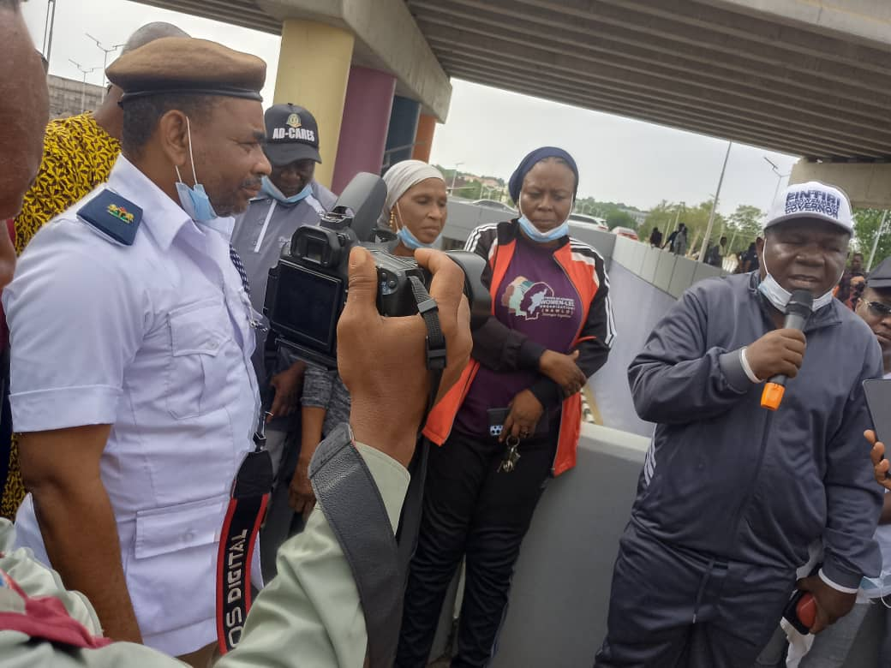

Slide 19
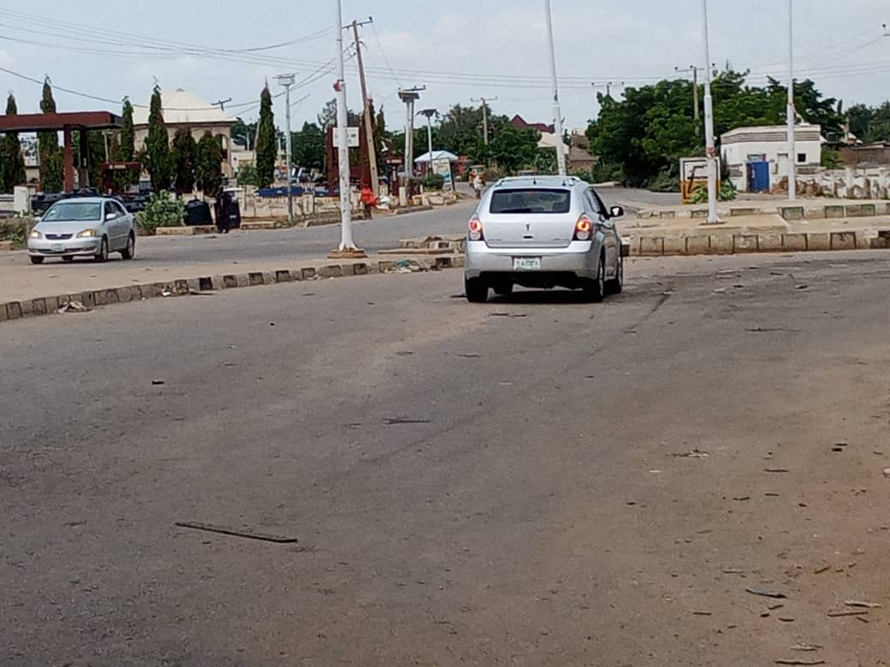
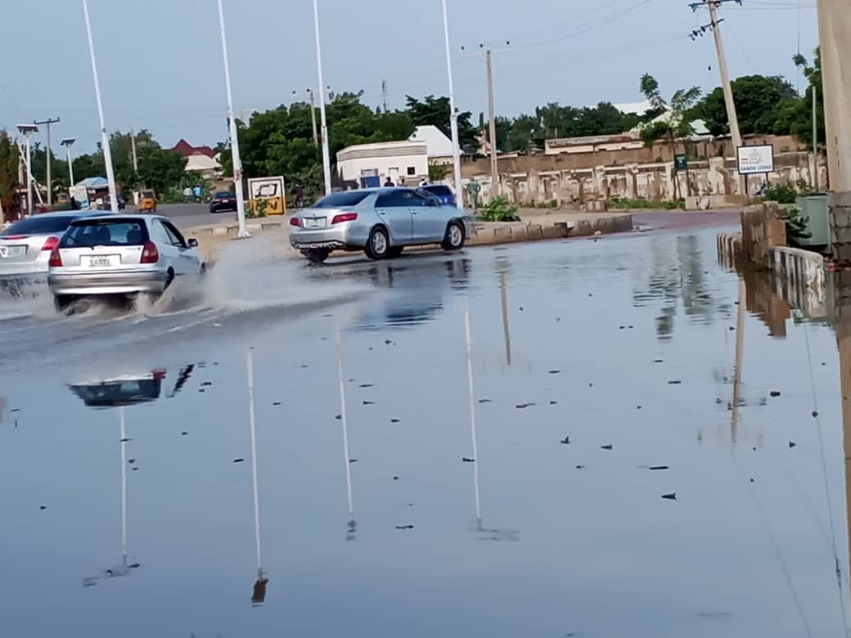
De- Silting of Blocked Drainage that Over-flooded Jippu Jam Roundabout Yola South
BEFORE
AFTER

Slide 20
2024 Conti......
Consequent upon His Excellency’s issuance of executive order banning the activities of scavengers in the state, His Excellency has approved the constitution of a Committee to enforce the ban. The committee has since been inaugurated to that effect

Slide 21
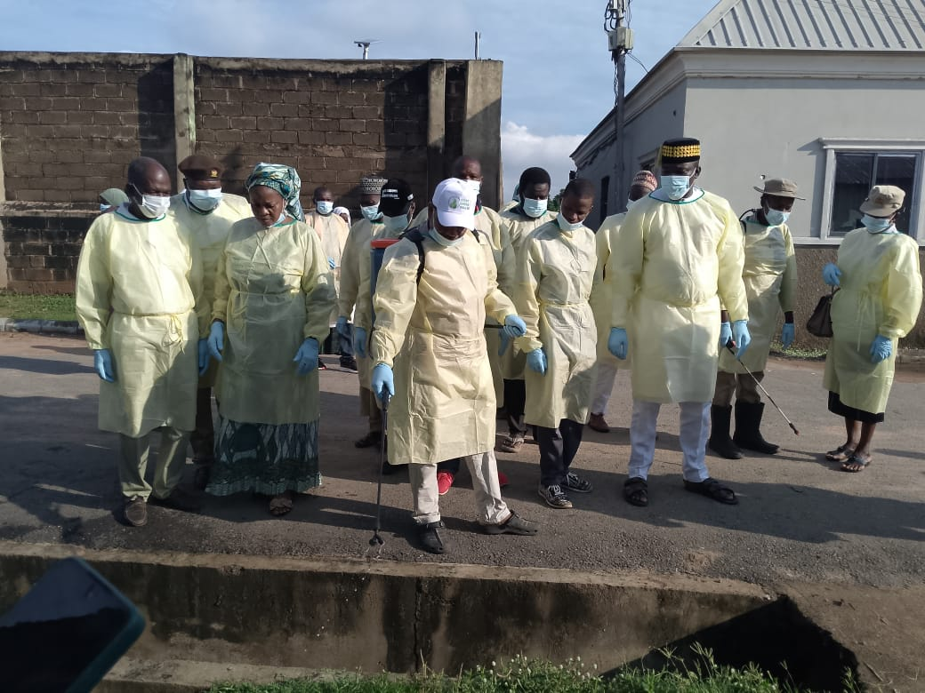
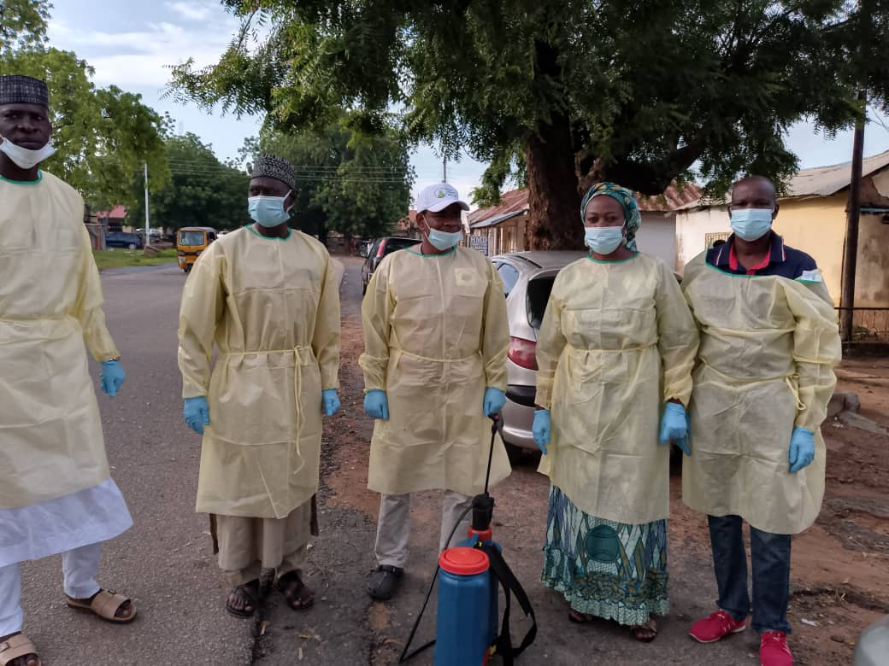
2024 Conti......
The present administration responded to the recent outbreak of cholera in the state. Cholera is regarded as an environmental Health emergency, therefore the Ministry embarked on decontamination and fumigation of all areas affected by this epidemic and other public places within Yola North and South. Areas mostly affected include, Ajiya Ward, Alkalawa Ward, Rumde Ward, Doubeli Ward, Jambutu Ward, Luggere Ward, Gwadabawa Ward, Limawa Ward, and Yelwa Ward.
Fumigation and decontamination @ Alkalawa and Gwadabawa Wards

Slide 22
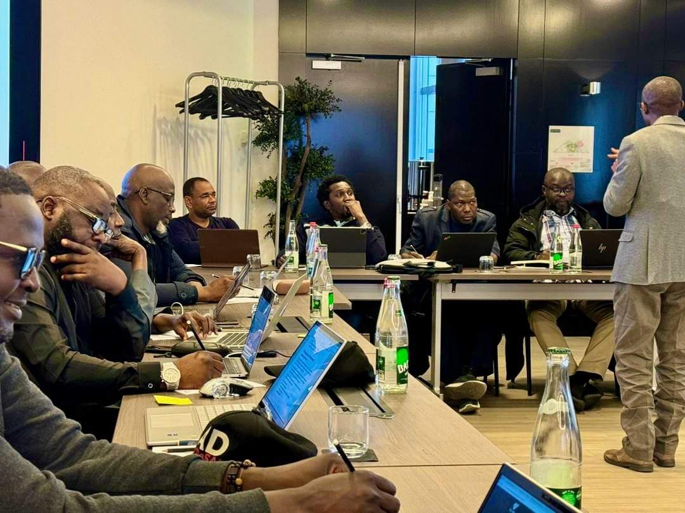
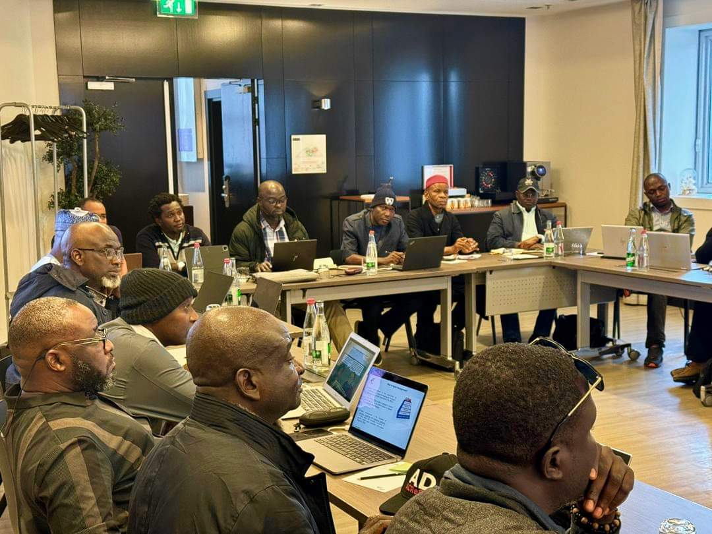
2024 Conti......
As a result of the supervisory role played by the Ministry of Environment on Afforestation which placed Adamawa ACReSAL as the best state in implementation of ACReSAL program as a result, the Ministry obtained sponsorship from ACReSAL for training on Project Management in Paris France in the month of April this year
Project Management Training in Paris France

Slide 23
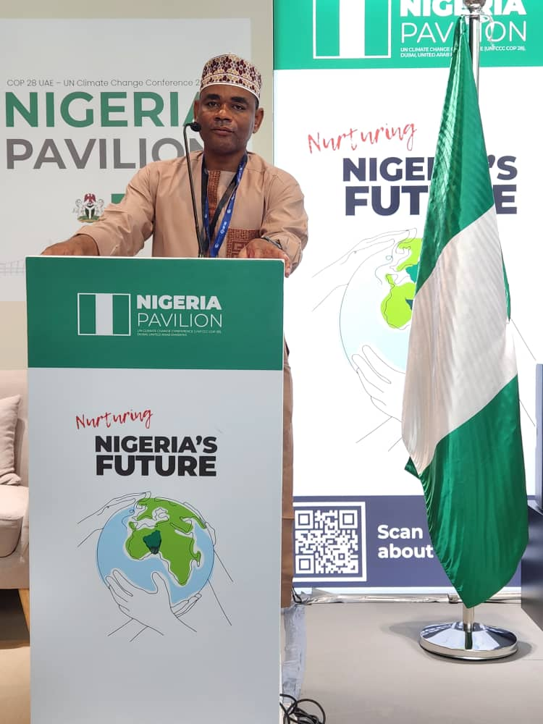
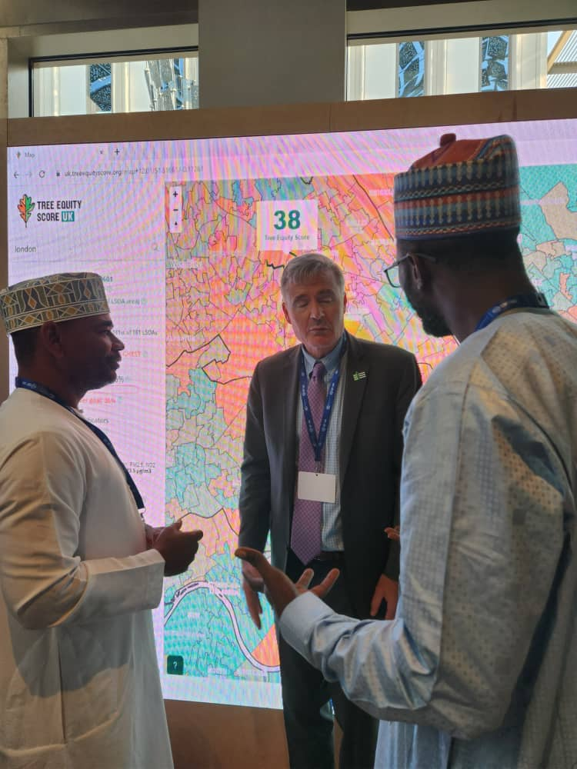
2024 Conti......
This administration was actively represented at COP 28 and 29, and our participation gave us the privilege to liase with other states to convince European Investment Bank (EIB) to support NEWMAP additional financing which the state Government has approved the participation of Adamawa state.
Presentation and Negotiatoin @ COPS 28

Slide 24
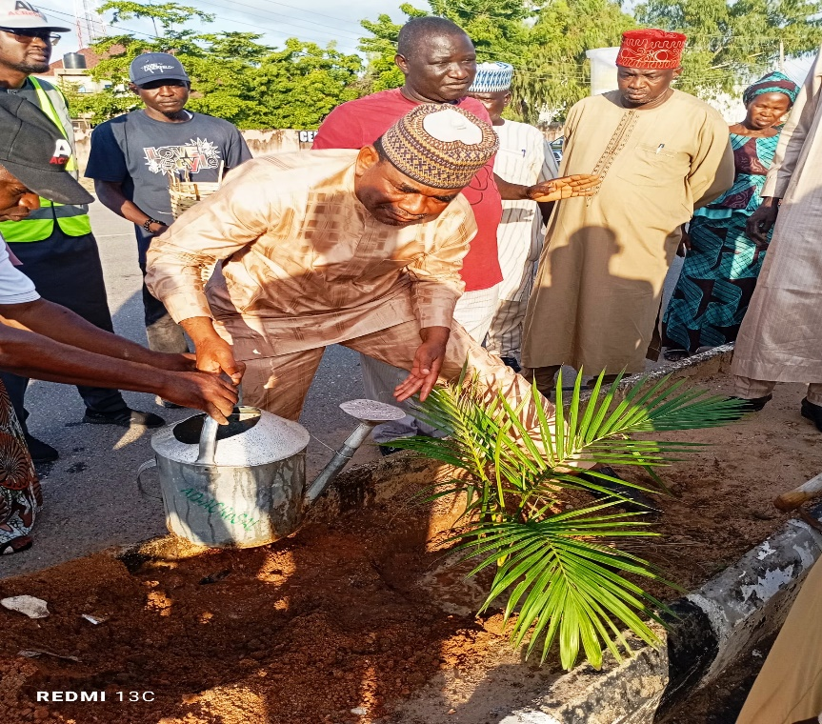
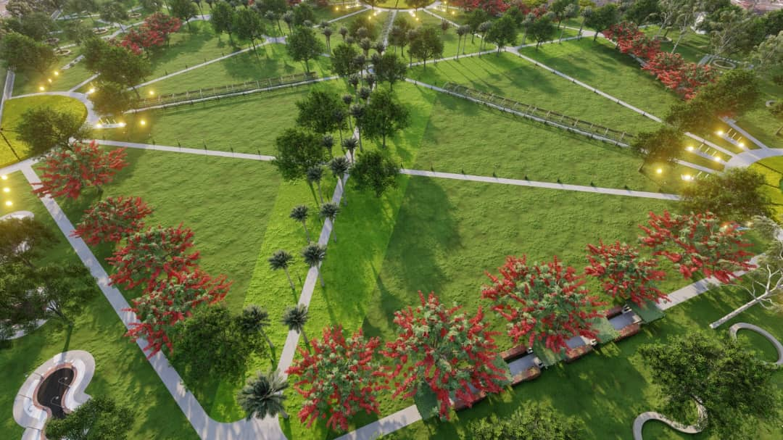
This administration graciously approved Adamawa state Green Initiative Program and the establishment of Fresh Air Recreational Park at the State Capital in 2023. This project in addition to mitigating climate change, will enhance aesthetic beauty of the State Capital and provide recreational facilities for the citizenry.
Tree Planting Along Buba Ardo Road
Model for Green Adamawa Fresh Air Park

Slide 25
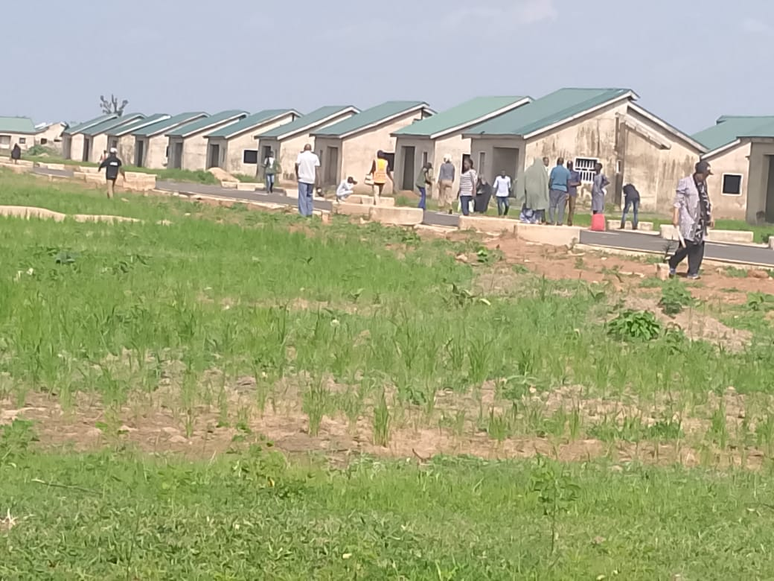
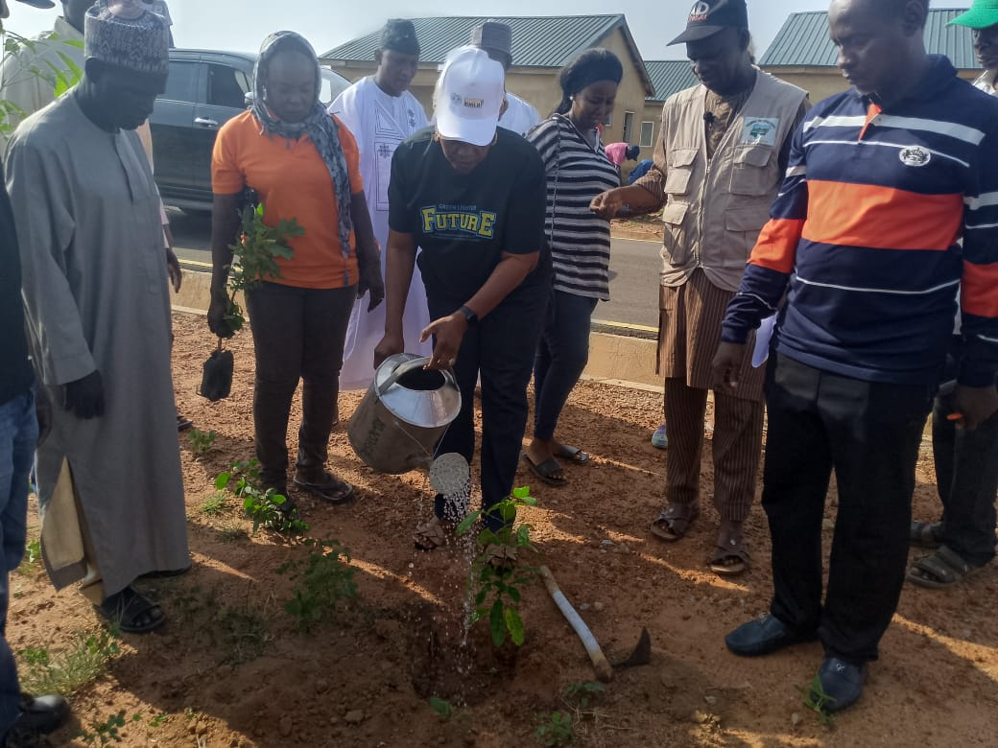
2024 Conti......
The Ministry of Environment is playing a supervisory role in
notable planting of trees at:
Fintiri One Thousand Housing Estate
Planting of Trees in primary and secondary schools in the 21 LGAs
Tree Planting @ Fintiri 1000 Housing Units Malkohi

Slide 26
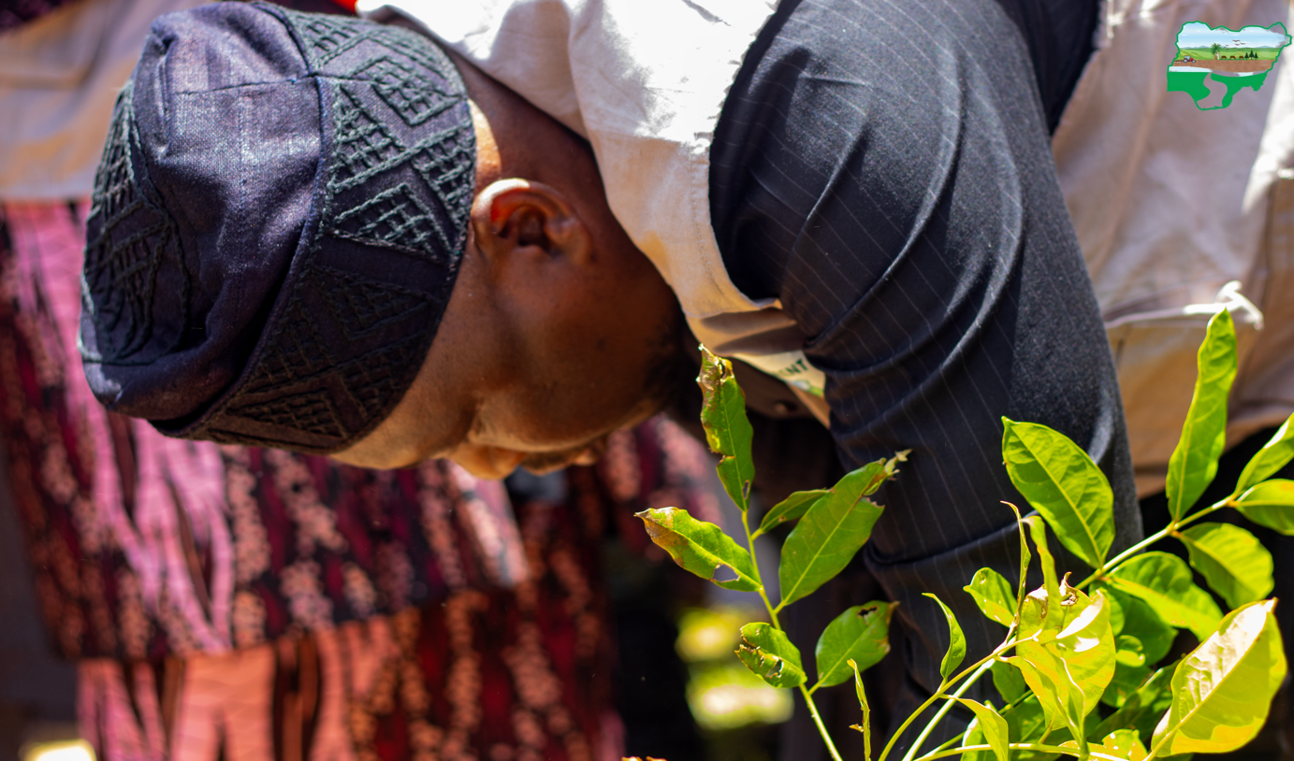
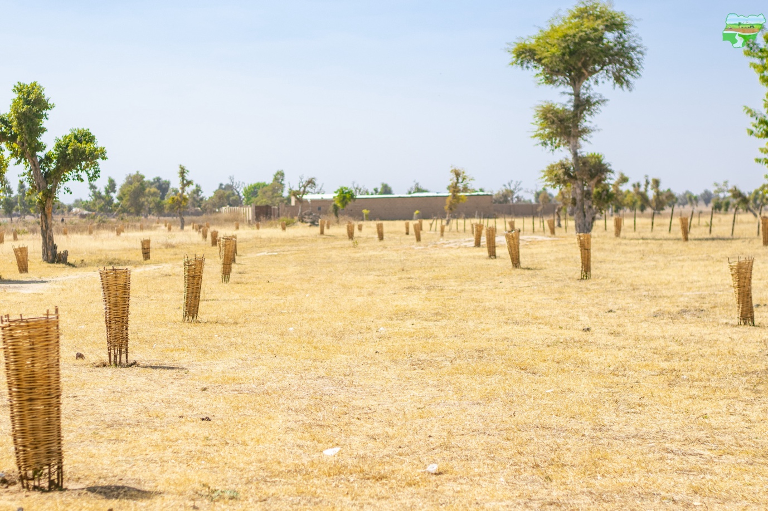
Establishment of woodlot in the twenty one LGAs of Adamawa State
Woodlot @ Jabbilamba

Slide 27
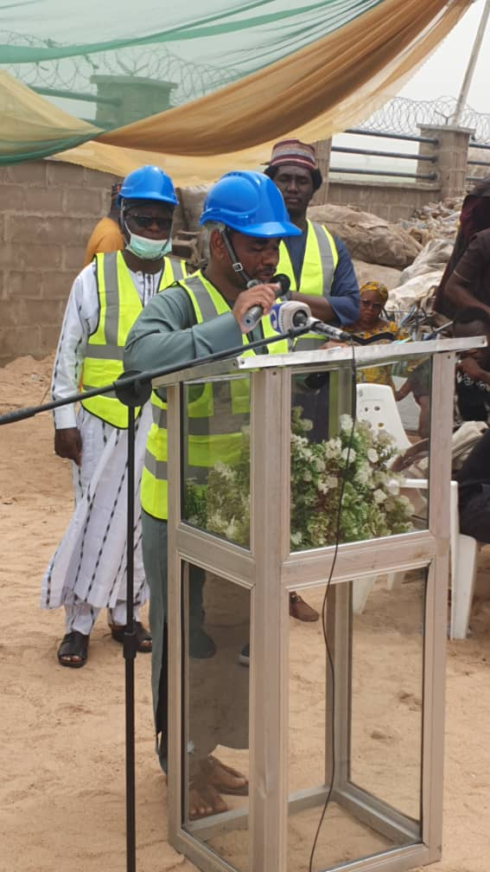
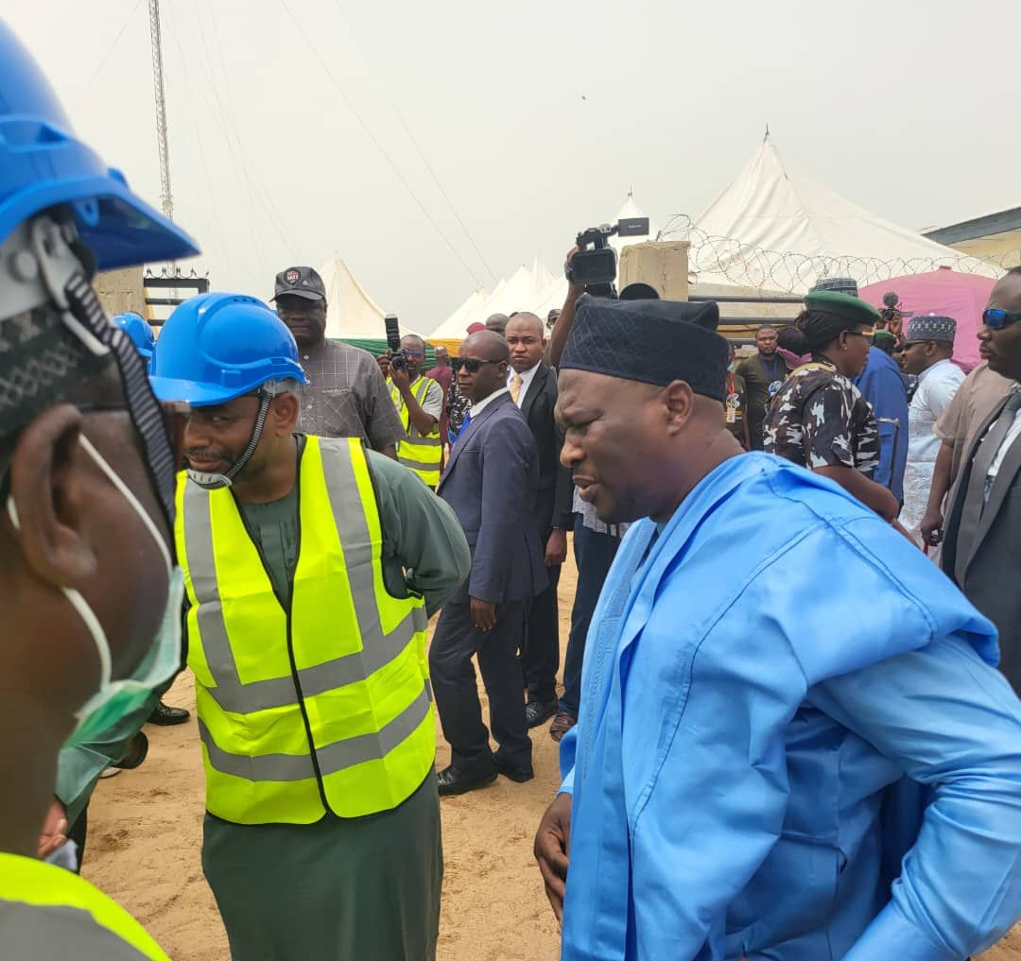
Tearfund in partnership with the Norwegian Government Established one of the best recycling plant in the North East which was commissioned by Rt.Hon. Ahmadu Umaru Fintiri. The plant has since been handed to the State under the supervision of the Ministry.
Commissioning of Waste Recycling Plant @ Sangere Bode

Slide 28
FUTURE PLANS
1. We shall continue actively on our supervision role in ACReSAL project and requesting for more counterpart funding so that we will be able to undertake more intervention projects such as
Construction of dams and reservoir
Flood mitigation
Reclamation of degraded landscape.
2. We will pursue actively our enlistment in the NEWMAP- EIB supported project so as to compliment the effort of ACReSAL in Integrated Landscape management and watershed management.
3.The Ministry submitted a Budget proposal of over eight Billion Naira. If finally approved, we will continue to embark on project and activities that will improve the quality of our Environment, address the challenges of climate change and biodiversity conservation and sustainable development.

Slide 29
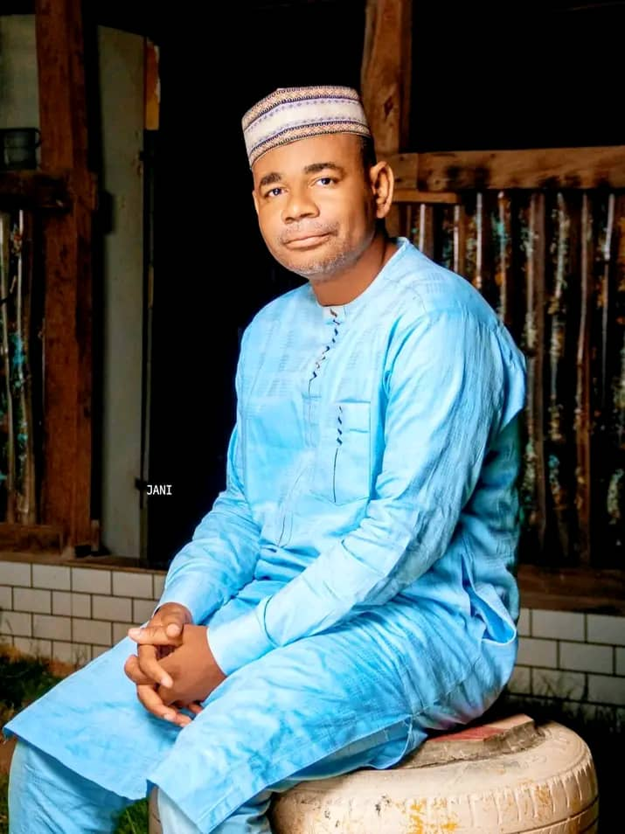
Many THANKs for listening !

