Slide 1
MINISTERIAL PRESS BRIEFING
BY
HON. ADAMU ATIKU ABUBAKAR,
COMMISSIONER FOR WORKS AND ENERGY DEVELOPMENT ADAMAWA STATE
ON THE
ACHIEVEMENTS OF
HIS EXCELLENCY RT. HON. AHMADU UMARU FINTIRI, CON, GOVERNOR
ADAMAWA STATE
IN ROADS CONSTRUCTION/Maintenance and renewable energy in the last two quarters

Slide 2
Protocol
I Would like to first of all cease this opportunity to most graciously welcome you to the Ministerial Press briefing by the Ministry of Works and Energy Development, Adamawa State. This is a great opportunity to make public success recorded in the areas of critical infrastructural development meant to Foster socio-economic growth.
Distinguish guests, ladies and gentlemen. The Ministry's main mandate is to facilitate infrastructural growth and to provide a sustainable energy solution which will significantly address the needs of the populace.

Slide 3
May I also commend the effort of the Adamawa State House of Assembly for the steady passing of the Ministry’s budgets.
It is now my Honour to present details of the projects achieved under the Administration of His Excellency Rt. Hon. Ahmadu Umaru Fintiri's administration in the last two quarters.

Slide 4
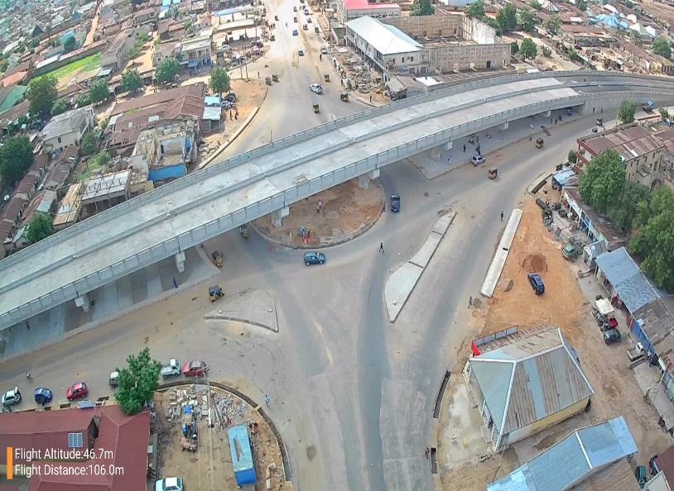
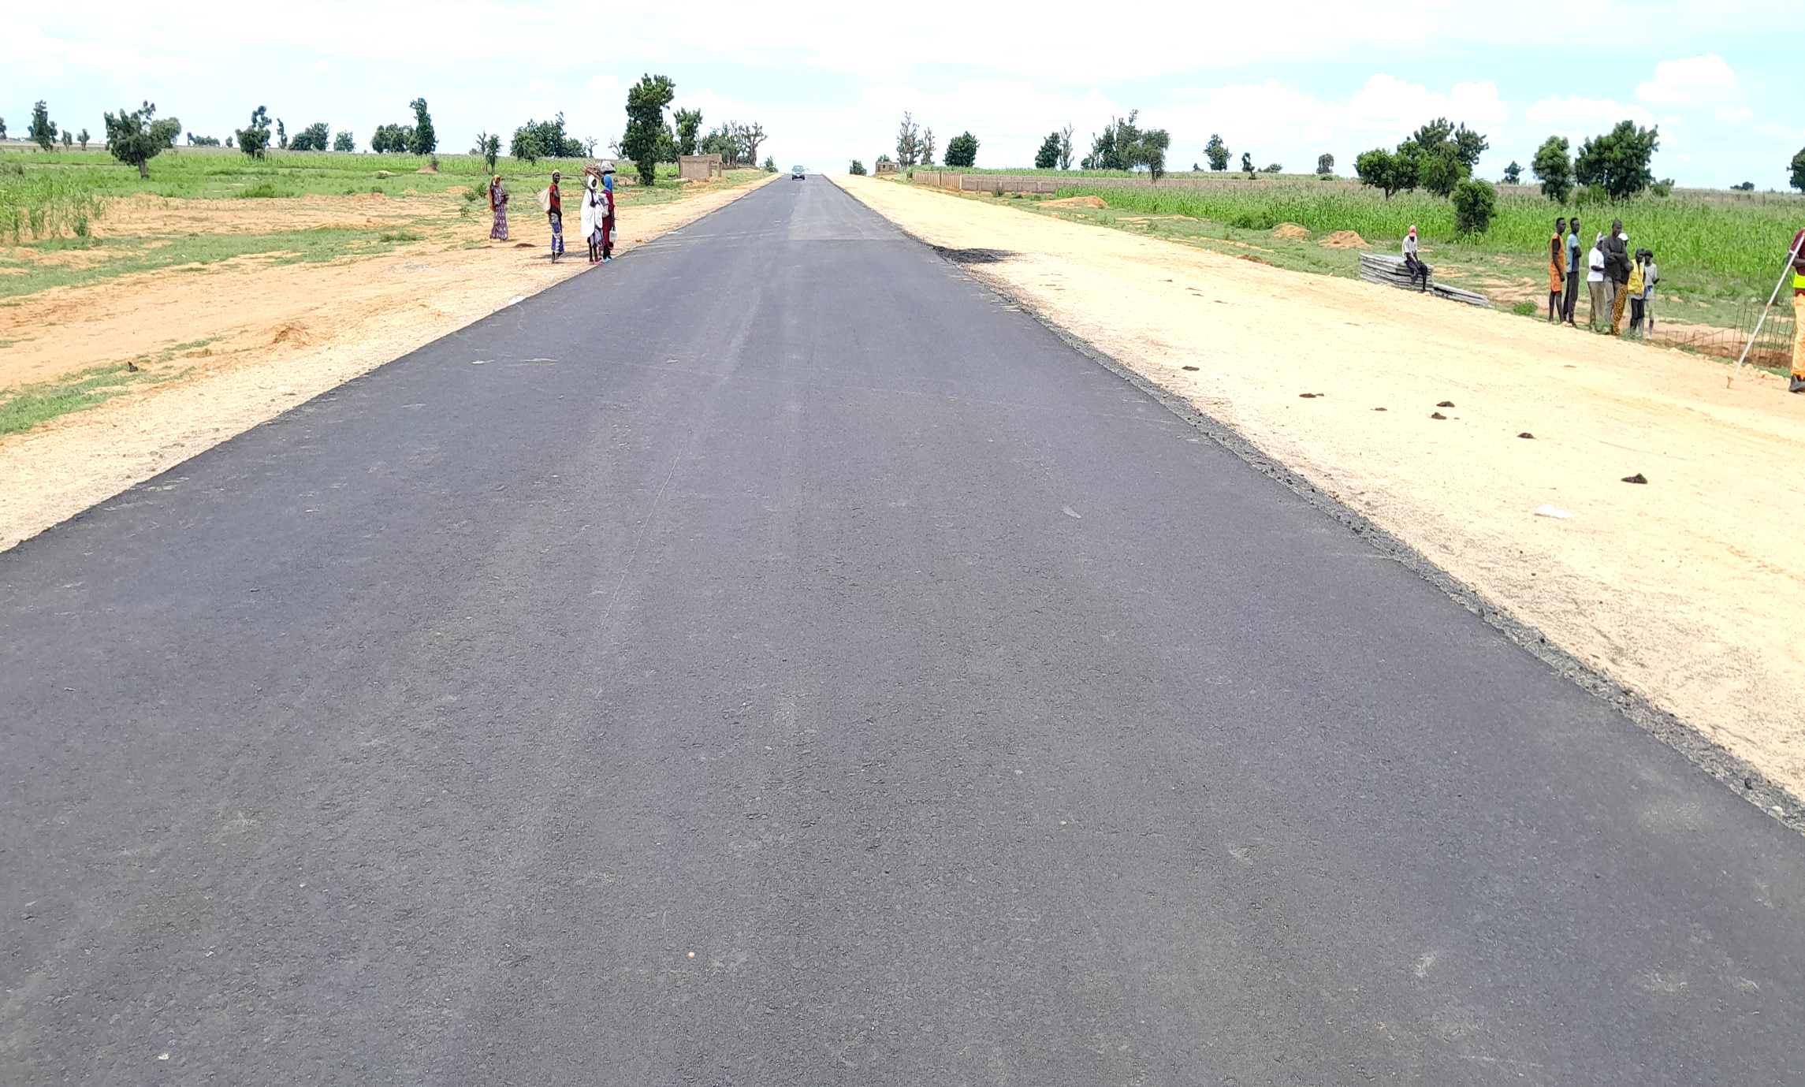
1. Construction of Mubi round about flyover:- this project is awarded in September 2023 to M/s Triacta Nigeria Limited with an 18 months completion period It was awarded out at a cost of N9,264,498,755.33. presently a sum of N7,180,296,808.91 was paid to the contractor whose work has attained 85% level.
2. Construction of Adamawa Super Highway; the Adamawa super highway transverse welcome to Yola, Rumde Kila through army barracks to AA Lawal junction with a 20.8KM stretch:- the contract was earlier awarded to M/s Triacta Nigeria Limited in 2023 with a 30 months period of completion at a sum of N21,819,848,239.30. After a variation to cater for the Construction of 7-span flyover at A.A Lawan Junction and half cloverleaf at welcome to Yola Junction with the Super highway, the contract was reviewed to a Sum of N40,639,675,580.65. The sum of N23,303,359,667.13 was paid to the contractor with a 50% level of completion and will last within a period of 30months.

Slide 5
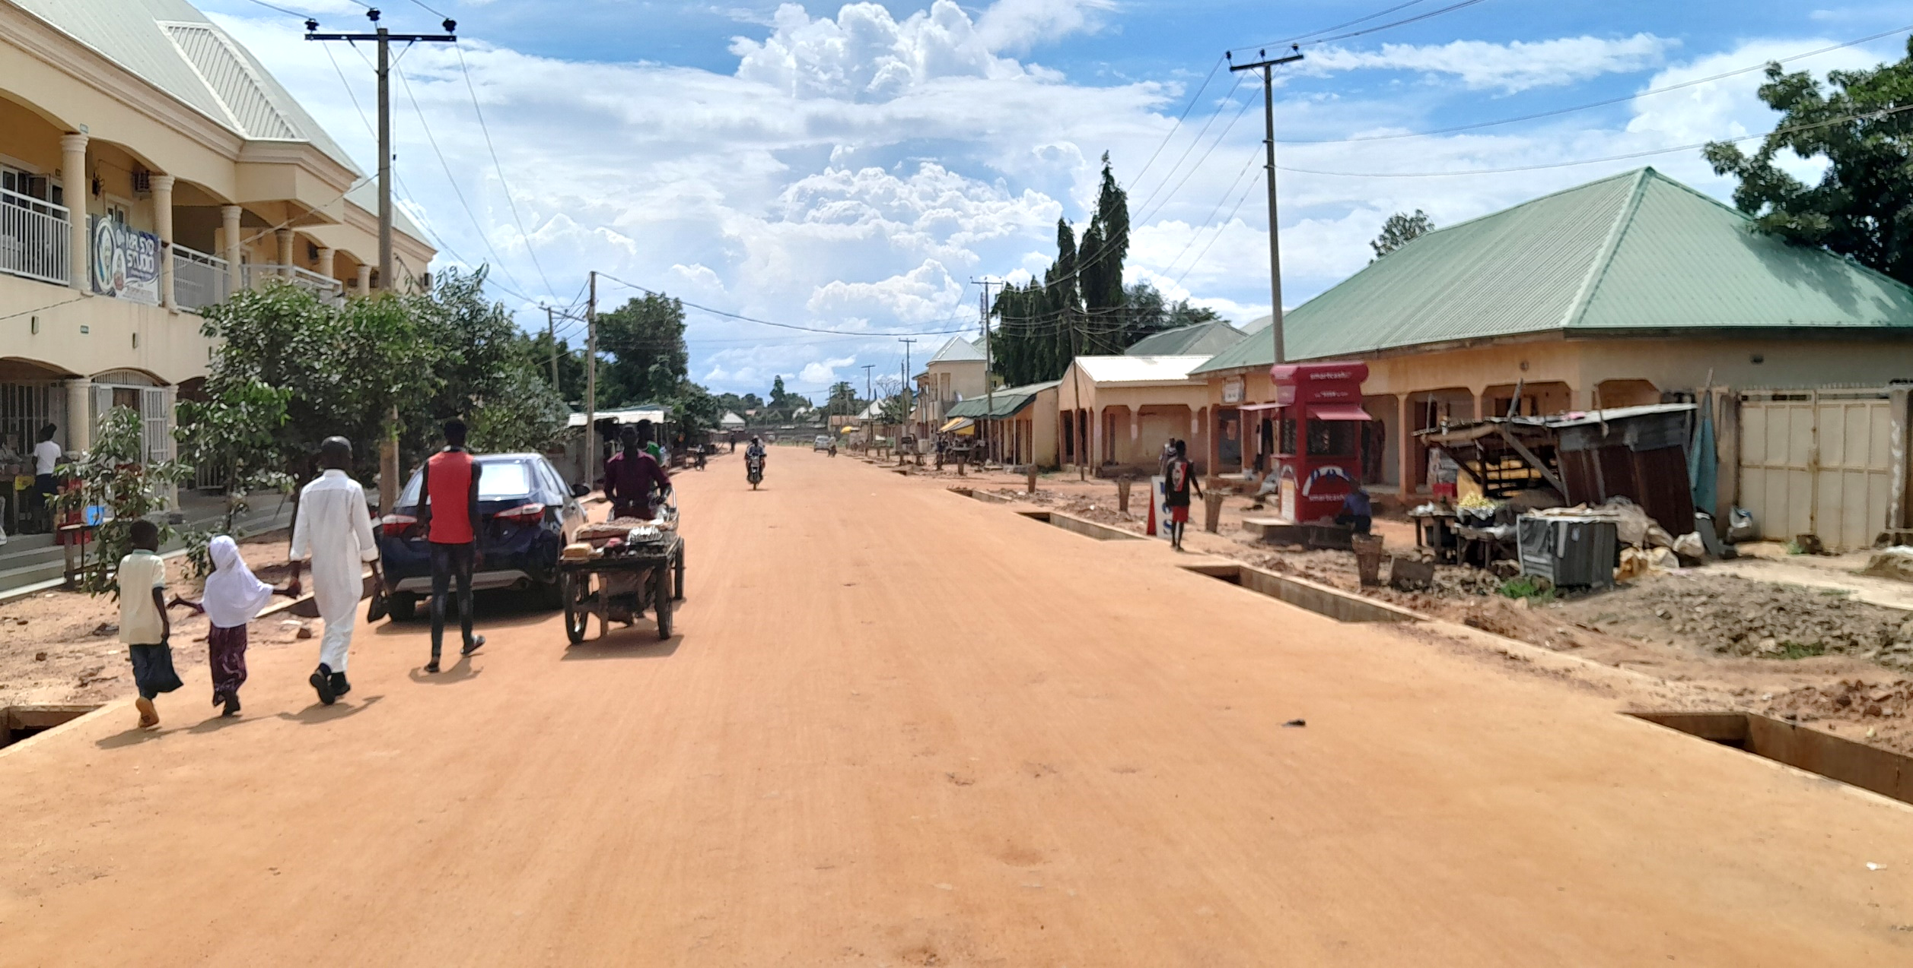
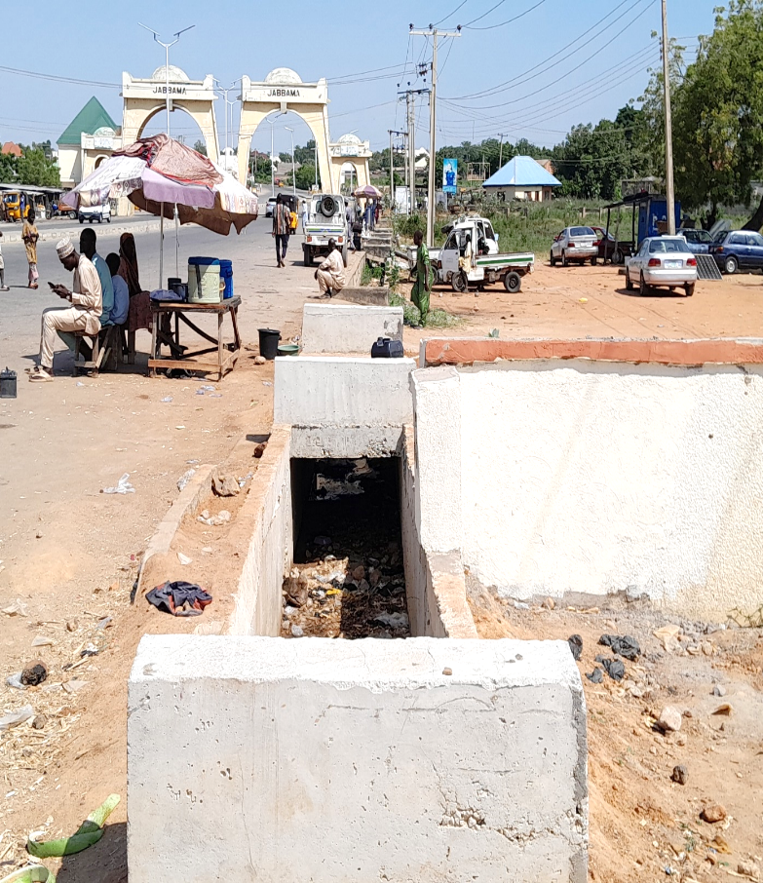
3. Construction of road Network at Federal Housing Unit estate in Girei Local Government:- This project is an 18.3 kilometer stretch awarded in 2024 and with a one year completion period. It was awarded at a cost of N16,162,977,659,98. A sum of N8,069,955,068.56 was paid to the firm, Triacta Nigeria Limited and has attained 45% level of completion.
4. Construction of 1.5m×1m × 172m drain along Jippu Jam round about:- This project was awarded to ATB Barracks Limited in August 2024 at a cost of N38,760,506,78 and was fully paid and completed.

Slide 6
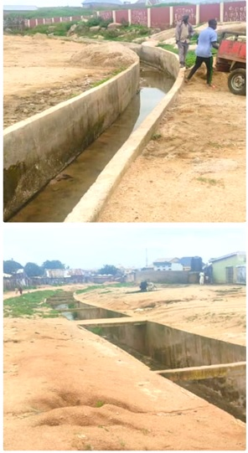
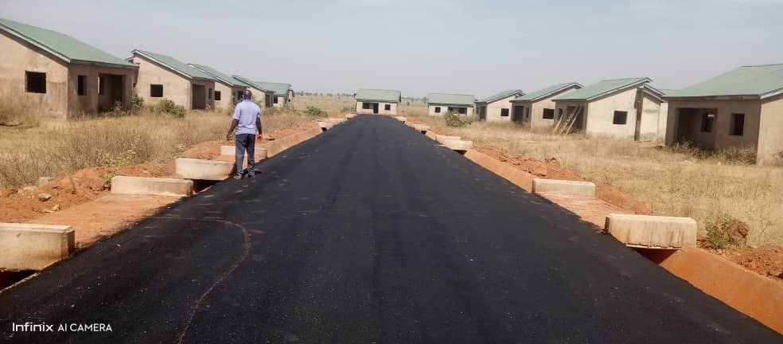
5. Contract for the market upgrade erosion/flood control in 12 markets in the state:- This project was awarded to Rocad Construction Limited in January 2024 with a 12 months completion period. It was awarded at a cost of N2,456,143,605.19. out of this amount N2,292,987,983.65 was released to the contractor who has attained a substantial level of completion as work is ongoing.
6. Construction of 1000 Housing Unit Road Network:- This project was awarded to Jodalsom Global Limited on a contract sum of N4,484,485,119.89 and was fully paid to the contractor the project is completed.

Slide 7
Distinguish ladies and gentlemen let me also state here, that the Ministry also awarded new projects. While some have started others are about to start. They include the following;

Slide 8
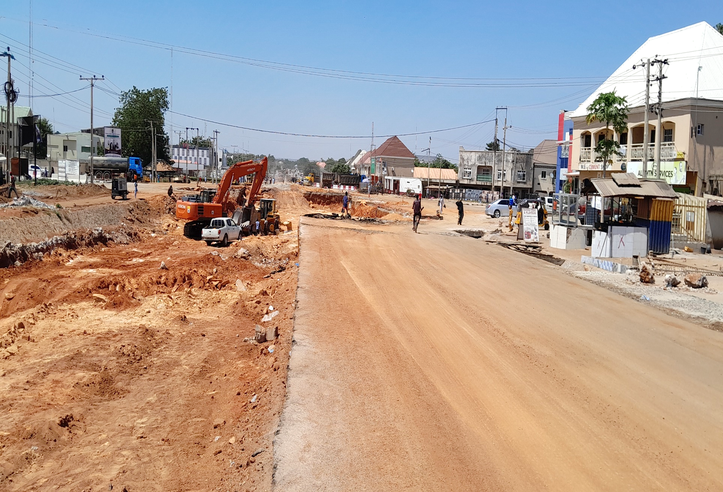
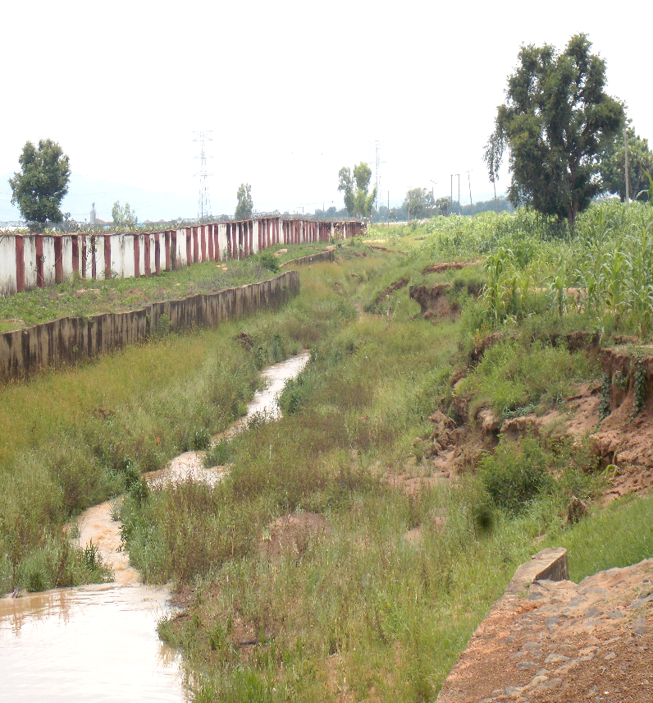
7. Expansion of the Remaining Section of Galadima Aminu way and the Construction of an Underpass at Fire Service Roundabout:- The project was awarded to M/s Triacta Nigeria limited at a cost of N13,851,900,523.13. The work has already started and it is expected to be completed in 18 months.
8. Construction/ Extension of Concrete Storm Water Drain from FGGC and behind the Air Force Comprehensive Secondary School:- This project is just awarded to M/s Triacta Nigeria limited at a cost of N3,942,372,989.33. The contractor is preparing to mobilize to site.

Slide 9
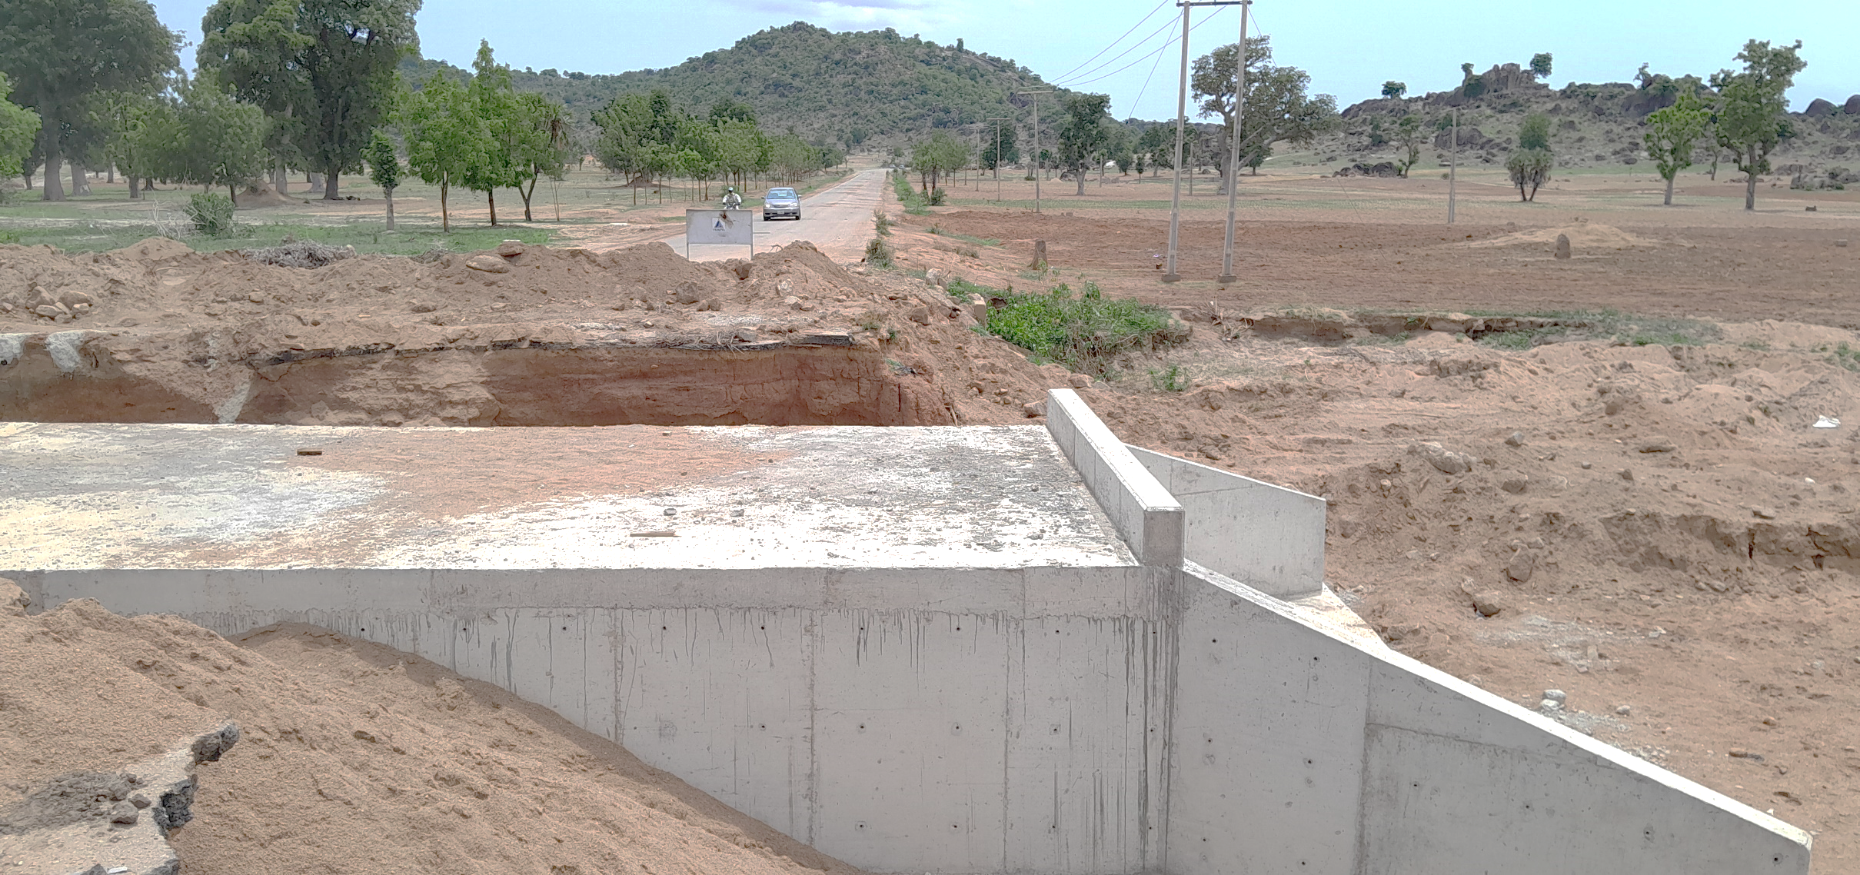
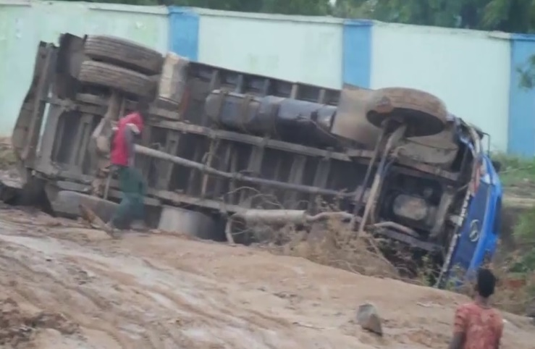
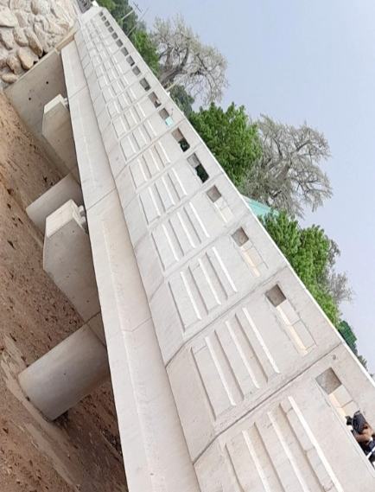
9. Construction of 2.5 m x 1.2m Double cell Culvert and Dredging of Inlet and Outlet of Culvert Along Mararraba Mubi Michika to Maiduguri Highway:- This project was awarded to M/s Triacta Nigeria limited was however already completed 100% it was carried out at a cost of N45,472,111.02.
10. Before the Construction of the bridge, the road had led to crashes of heavy duty vehicles with luggages.
The Construction of 3 Span Bridge with Approaches Across River Wuro Ngayandi was awarded to M/s Triacta Nigeria Limited at a cost of N893,063,013,125 with a 6 months completion period. The contract was completed 100%.

Slide 10
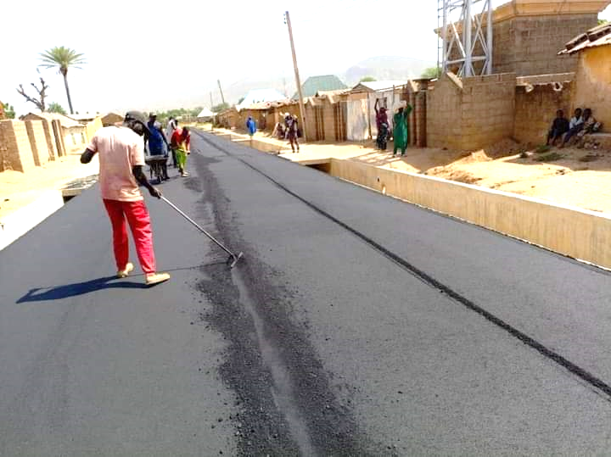
11. Construction of 1.95km Township Road and 140m of 1.5×1.0m Outfall Drain in Madagali:- This is another project that was already completed 100%. It was awarded to M/s Triacta Nigeria Limited at a cost of N883,702,509.30.
12. Construction of Mararraba Garta-Kamale road in Michika :- This project awarded to M/s Triacta Nigeria Limited has a 7.5 km stretch at a contract sum of N4,365,535,284.17 it has an 18 months period of completion and a sum of N1,200,000,000.00 was paid to the contractors as part of mobilization fee.
13. Reconstruction of Sukur Road in Madagali:- This project is also recently awarded to M/s Rocad Construction Limited at a sum of N2,548,803,932.03 a sum of N1,019,521,572.81 was paid to the contractor as 40% Advance to mobilize the site.

Slide 11
CONCLUSION
Distinguish guests, ladies and gentlemen. These are the score cards of the Government of Rt. Hon Ahmadu Umaru Fintiri in the 2nd and 3rd quarters alone infrastructural development of the new Adamawa state.
Thank you.

