Slide 1
MINISTERIAL PRESS BRIEFING
BY HON. IBRAHIM MIJINYAWA
THE HONOURABLE COMMISSIONER MINISTRY FOR LOCAL GOVERNMENT AFFAIRS ON THE ACTIVITIES OF THE MINISTRY FOR THE PERIOD 2019 TO DATE HELD ON 19TH NOVEMBER, 2024 AT THE BANQUET HALL, GOVERNMENT HOUSE, YOLA

Slide 2
Members of the Press, it is my singular honour and pleasure to brief you on the activities of this Ministry which was created in 1994 with the sole responsibility of coordinating the affairs of the 21 Local Governments and 50 State Development Areas of Adamawa State.

Slide 3
This Ministry is headed by my humble self (Honourable Commissioner) with a Permanent Secretary and five Directors, of Administration, Finance, Local Governments, Planning Research and Statistics and Electronic Payment Departments. Each of these Departments perform her specialized functions under the Permanent Secretary. The major functions of the Ministry include among many, the following:

Slide 4
Presiding over the Joint Account Allocation Committee monthly meetings of the 21 Local Governments for the disbursement of funds to the Local Governments as regulated by the relevant Laws. This also include the coordination of Joint Projects of the Local Governments where the Ministry provide a due process guide in line with the resolutions of JAAC.

Slide 5
Supervision of the Joint Projects being executed by the Local Governments in line with the policy thrust of His Excellency the Executive Governor Rt. Hon. Ahmadu Umaru Fintiri, aimed at bringing even development across the 21 Local Governments of the State.

Slide 6
Coordinating the activities of the Boards under the Ministry which include Local Government Service Commission and Local Government Staff Pension Board. Each of these Boards perform its specialized functions affecting the Staff of the Local Governments. The LGSC deal with Staff recruitment, training, discipline and promotion while the Local Government Staff Pension Board primarily deal with the payment of gratuity and pension of the retirees of Local Government Staff which covers Local Education Authority Staff, Local Government Primary Health Care Staff and core Local Government Staff.

Slide 7
Gentle men of the press, with this brief on functions and responsibilities of the Ministry, let me go straight to the on-going projects being undertaken by the 21 Local Governments under the supervision of the Ministry.

Slide 8
RENOVATION OF CONFERENCE HALL OF THE DEPUTY GOVERNOR’S OFFICE
The Hall serve as the venue of the Joint Account Allocation Committee meetings of the 21 Local Governments. The Local Governments awarded the contract for the complete remodeling of the conference hall, furnishing, provision of the public address system, Landscaping of the surrounding of the conference hall by bitumen surfacing. The work is at 98% completion level. (See pictures).

Slide 9
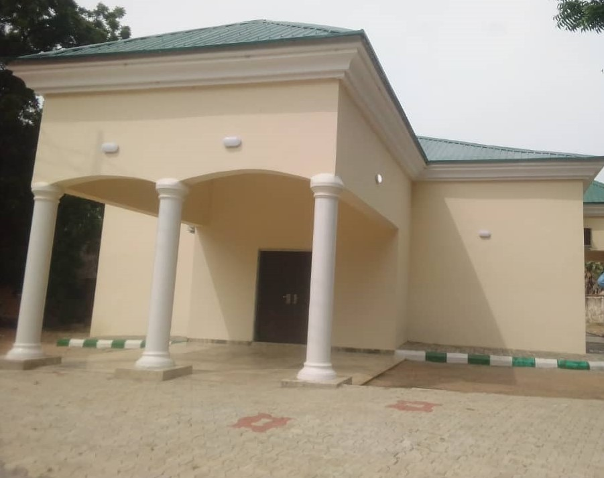
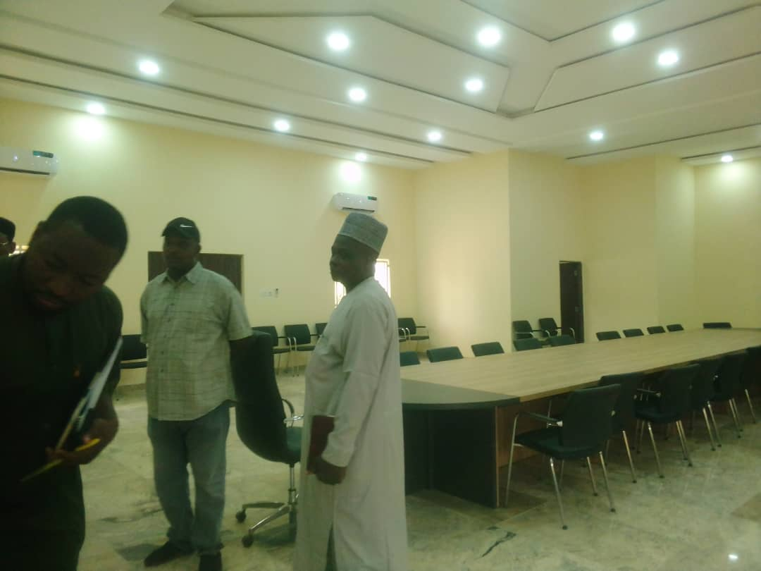
RENOVATION OF CONFERENCE HALL OF THE DEPUTY GOVERNOR’S OFFICE
Front View
Interior View

Slide 10
CONSTRUCTION OF MODEL PRE-PRIMARY, PRIMARY, JUNIOR SECONDARY SCHOOLS AND MULTIPURPOSE HALL.
The Model Schools was conceived by the 21 Local Governments and got the approval of the Executive Governor Rt. Hon. Ahmadu Umaru Fintiri because the project falls in line with his 8point agenda, one of which is the Educational Policy Project of this Government. The details of the model schools across the 21 Local Governments are composed of 4 lots in each of the 20 Local Governments except Yola North that has six lots as follows:

Slide 11
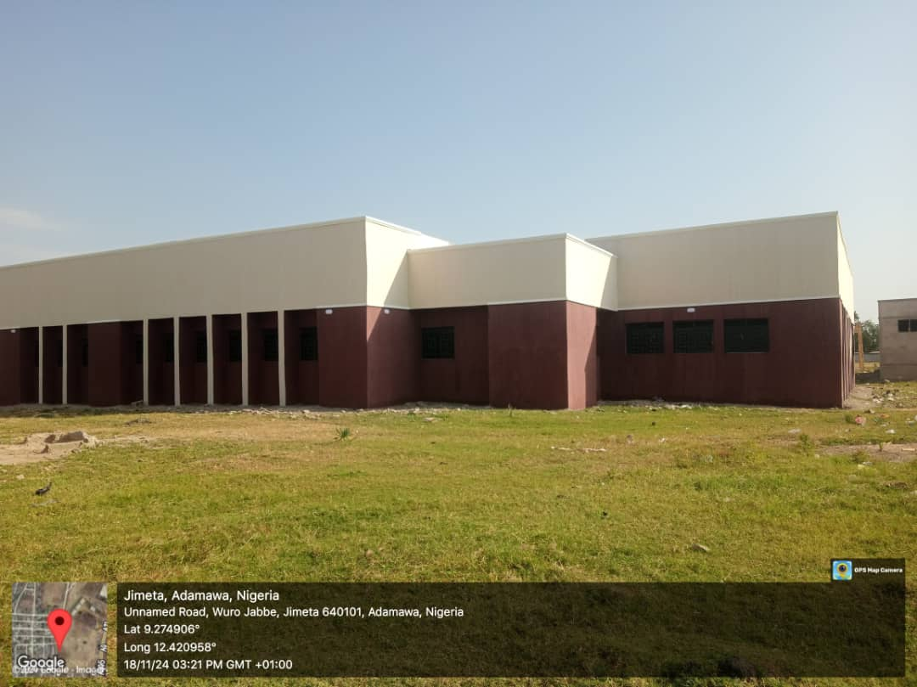
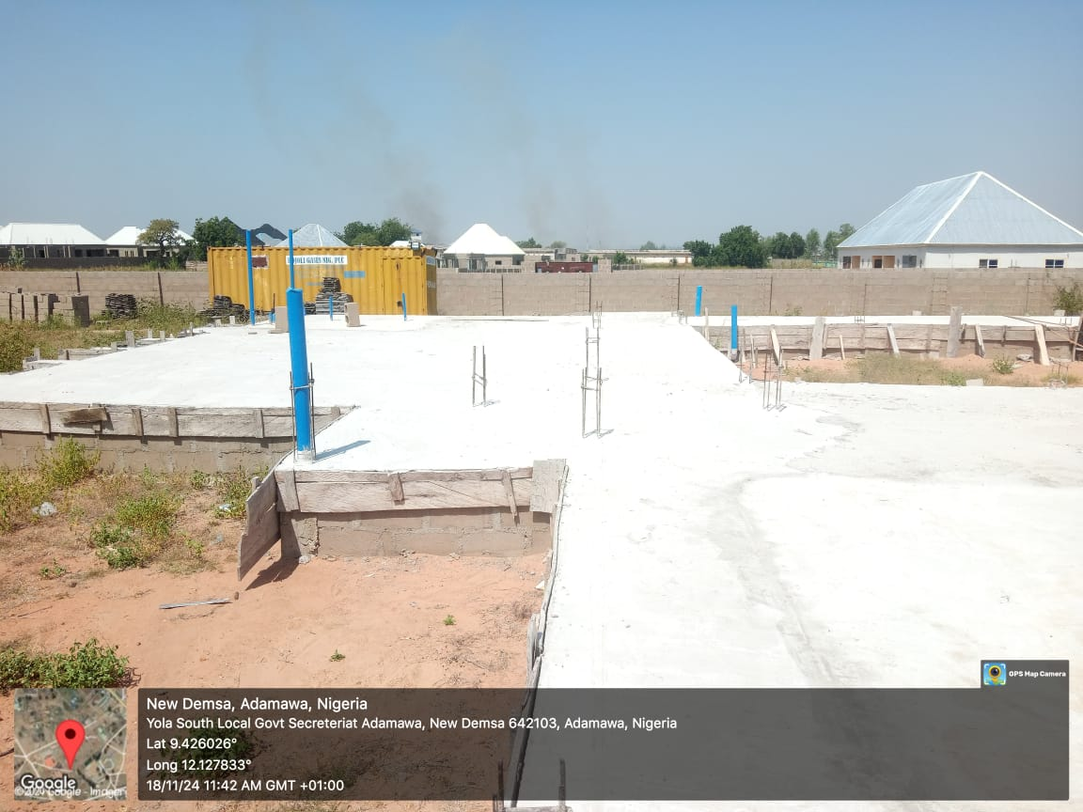
Model Schools in Pictures
YOLA NORTH
DEMSA

Slide 12
Lot 1 Is for construction of Pre-Primary School, gate house, external works such as Land scaping, tree planting and perimeter fencing in each of the Local Governments.
Lot 2 Involves the construction of 2-unit blocks of a classrooms for primary schools.
Lot 3 Involves the construction of a block of 9 classrooms for Junior Secondary School.
Lot 4 Involves the construction of multipurpose hall and 3 number of VIP toilets which are replicated in 20 Local Government while in Yola North six lots were constructed.

Slide 13
The construction of the model schools which was awarded in January 2024 with a completion period of eight months (August 2024). However, due to the delay from the contractors, the completion period was not met. The Ministry expressed great disappointment with the attitude of the contractors.
It is to be noted that as at the time of the award of the contract in January 2024 the 21 Local Governments have set aside funds enough to pay the contractors as they execute the projects and submit the certificate of valuation duly certified by the Consultants.

Slide 14
The Ministry through Monitoring and Evaluation team has always ensured that no Contractor is paid for work performance not achieved. The Ministry also ensured that no Contractor’s payment is delayed to enable early delivery of the projects. I have on several occasions gone out to assess the progress of work by the contractors. On observing the slow pace of work by some of the contractors I had to summon all the contractors to notify them that this Government will never tolerate abandoned projects syndrome and therefore they are expected to perform as per terms of their contractual agreement.

Slide 15
I told them in specific terms that any contractor that fails to perform will have his or her contract revoked. Warning letters were served to the contractors considered to be lagging behind. The Contractors cried out that prices of item shot up after the award of the contract. The Ministry in consideration of the fuel subsidy withdrawal and dollar exchange rise reviewed their contract upward by 10% to encourage performance of the Contractors for early delivery of the projects.

Slide 16
RENOVATION OF GOVERNMENT LODGES IN LOCAL GOVERNMENTS.
The 21 Local Governments approved the renovation of Local Government Lodges in phases to provide comfortable and secured accommodation for visiting Government officials to the Local Governments. So far, Mubi North, Numan II and Guyuk Lodges have been renovated. Gulak (Buba Marwa) Lodge is undergoing renovation which is at 95% completion. Five other lodges at Gombi, Fufore, Mayo Belwa, Numan II and Ganye have been assessed for renovation which has commenced at Mayo Belwa and Gombi. It is hoped that most of these renovations will be completed within the year 2024 or at worst within the first quarter of 2025. Those lodges whose renovation has been completed are attested to be excellent by guests. (pix).

Slide 17
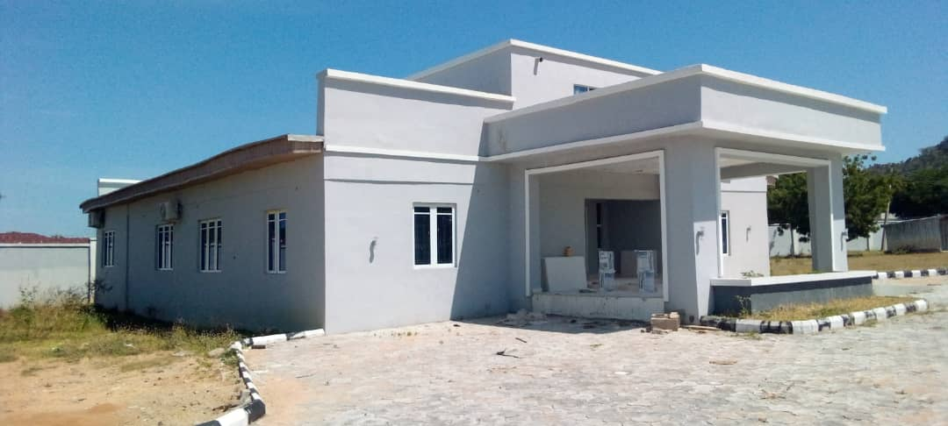
Government Lodge Gulak

Slide 18
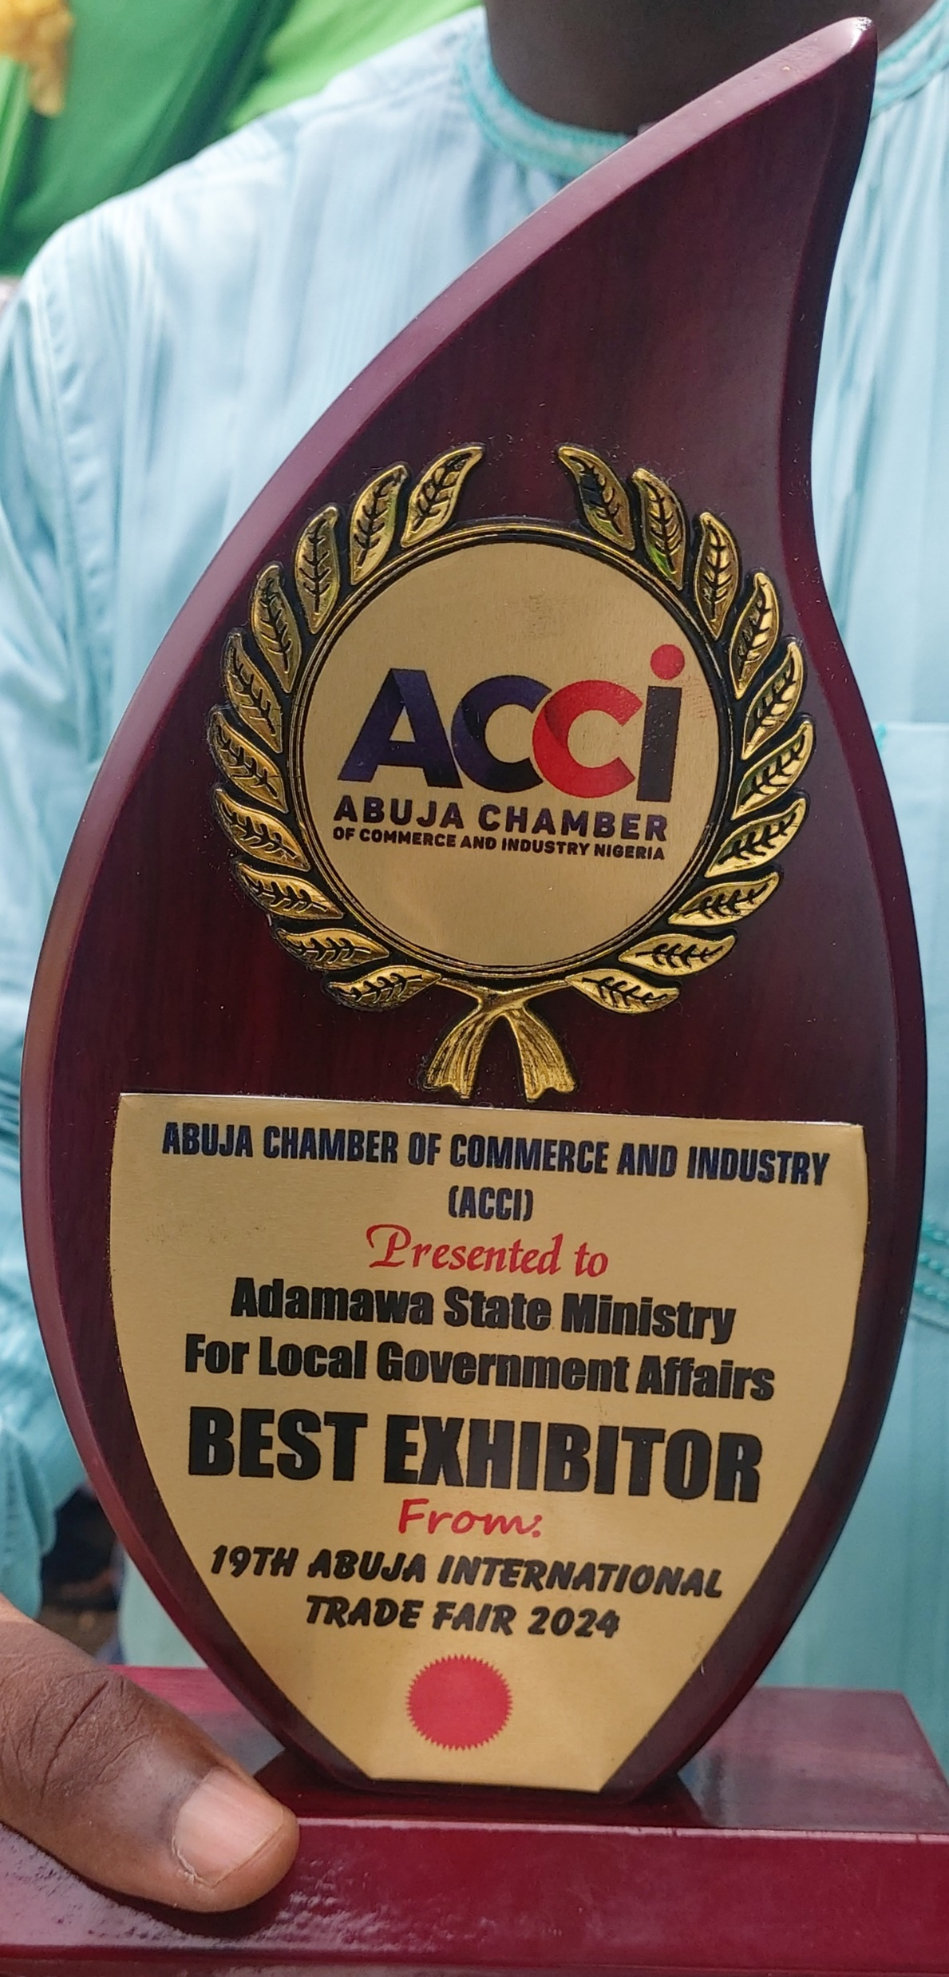
TRADE FAIRS 2024
The 21 Local Governments through the coordination of the Ministry participated in the 15th North East Joint Domestic Trade Fair – Bauchi 2024 and 19th Abuja International Trade Fair where the State emerged first position in display of Agricultural produce and mineral resources. Investors promised to visit the State to assess the possibility of investing in mineral resource extraction. The State was also invited to participate in the upcoming Lagos International trade fair. The Ministry will continue to encourage the Local Governments participation in Local and International Trade Fairs to showcase the State’s rich agricultural and mineral resources to the World.

Slide 19
GRADUAL REDUCTION OF PAYMENT OF GRATUITY.
The Ministry in keying into His Excellency’s posture of paying gratuity to our pensioners has encouraged Local Governments to improve the amount set aside for the monthly payment of gratuity. The Local Governments have graciously increased the amount set aside monthly for the payment of gratuity from ₦500,000:00 per Local Government to ₦3,000,000:00 per Local Government every month. The Local Government Staff Pension Board (LGSPB) have been directed to display the list of beneficiaries of these funds Local Government by Local Government monthly.

Slide 20
IMPLEMENTATION OF ₦70,000 MINIMUM WAGE.
The Local Governments have started the gradual implementation of the minimum wage across the Local Government Staff. The Ministry is encouraging the gradual implementation of minimum wage until the ₦70,000:00 minimum wage is attained in full. At the moment the Local Governments have moved from the ₦30,000:00 minimum wage in operation to ₦40,000:00 in September 2024 in compliance to HE’s pronouncements.

Slide 21
STAFF TRAINING AND PROMOTION
The Ministry facilitated the promotion of 57 Staff during the period under review and sponsored Staff to various Capacity building workshops to NIPSS, ASCON and other professional membership registration with ANAN and FCIA (Association of National Accountants of Nigeria and Fellow Chartered Institute of Administration) etc.

Slide 22
IMPROVEMENT OF INTERNAL CONTROL MECHANISM
The Ministry has stepped up Internal control mechanism to deter change of date of birth of Staff who do so to make them stay longer in service. The E-Payment Department of the Ministry always processes monthly salary bill on or before 15th of every month to enable early payment of salary in line with HE’s pronouncement to ensure payment of salary on or before 25th of every month.

Slide 23
INSTALLATION OF SOLAR POWERED ENERGY IN THE MINISTRY
The Ministry in trying to address the epileptic electricity supply to the Ministry installed 40KVA solar powered energy to the Ministry which is capable of powering all the electrical appliances of the Ministry such as air conditioners, computers, standing fans etc.

Slide 24
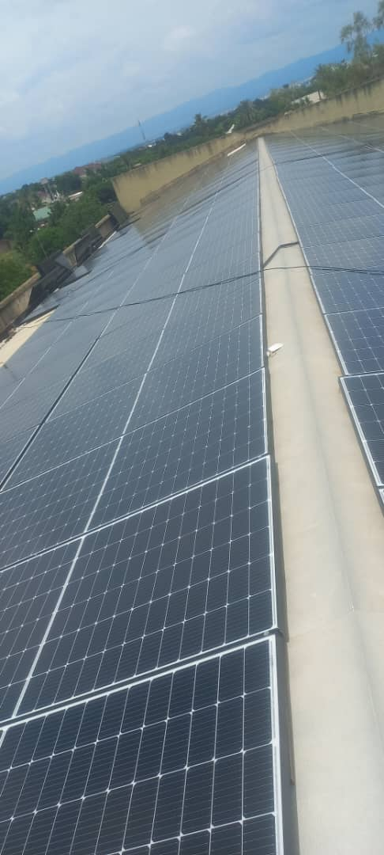
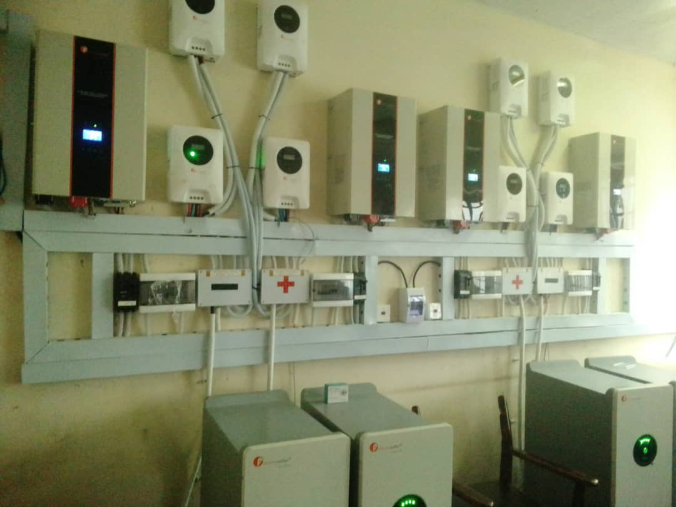
SOLAR POWER IN PICTURES

Slide 25
PURCHASE OF OFFICIAL VEHICLES
The Ministry procured 2No Toyota Hilux 2023 model for the official use and 1No Toyota Land Cruiser Prado 2023 model which were paid in full.

Slide 26
PURCHASE OF RELIEF MATERIAL TO ALLEVIATE THE SUFFERING OF FLOOD VICTIMS THE STATE.
The Ministry in collaboration with the 21 Local Governments intervened in the purchase of various relief materials such as matrasses, mats, disinfectants, detergents etc. which have been distributed to flood victims across the State worth more than ₦882M.

Slide 27
PURCHASE OF FOOD COMMODITIES SUCH AS RICE, MAIZE, INDOMIE NOODLES ETC.
The Ministry in collaboration with the Local Governments purchased food commodities from time to time to be distributed to the public in the State to reduce the food hardship experienced by the general public largely necessitated by insurgent who denied our peasant farmers in carrying out their farming activities. The sum of over ₦5.5 Billion have been spent on the provision of these food commodities.

Slide 28
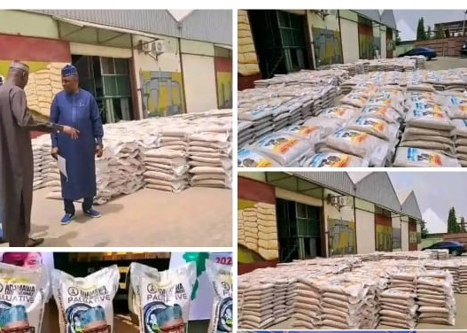
FOOD ITEMS IN PICTURES

Slide 29
PURCHASE OF SECURITY KITS FOR OUR LOCAL VIGILANTES IN THE LOCAL GOVERNMENTS.
The Local Governments in collaborations with the Ministry purchased security kits to equip our local hunters/vigilante such as uniforms, touch lights, helmets etc. which was distributed across the Local Governments to boost the morale of the volunteer vigilante in supplementing the efforts of the Army, Police, Civil Defense, DSS etc.
The Local Governments spent a whoofing sum of ₦380M.

Slide 30
PUBLIC TRANSPORT SYSTEM.
The Local Governments in collaboration with the Ministry in supplementing the laudable efforts of the State Government in alleviating the skyrocketing transport fare in the nation provoked by the withdrawal of petroleum subsidy purchased the buses today tagged as fresh air transport system in the State. This has become the major means of transport in the State. The 21 vehicles gulfed over ₦800M

Slide 31
INTERVENTION ON PUBLIC HEALTH IN THE STATE.
The Local Governments through coordination of the Ministry have intervened in various ways in providing logistics, Drugs, Immunization and mitigation of disease outbreaks in the State through PHCDA which placed the State on high ranking in addressing health issues in the nation. All these Interventions are in addition to regular payment of Staff salaries of PHCDA. (Pix).

Slide 32
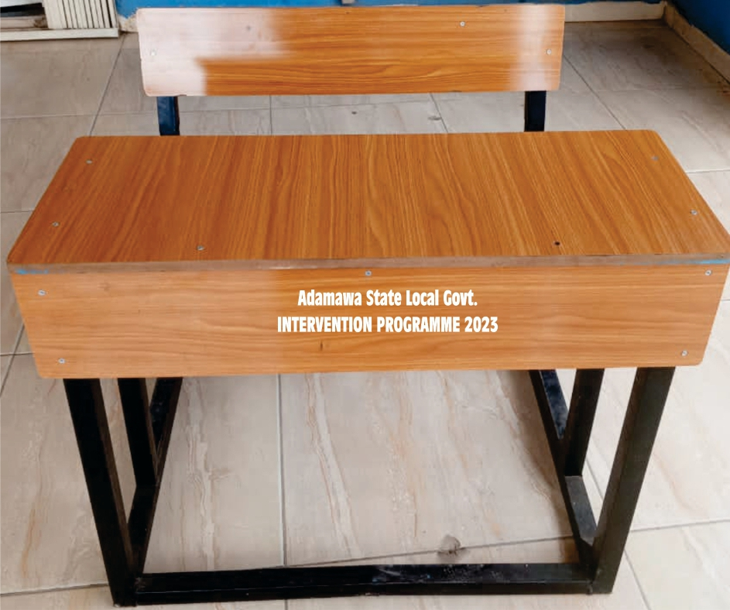
INTERVENTION IN EDUCATION
The Local Governments under the coordination of the Ministry have Intervened in provision of instructional materials and 2-seater welded Desk and Chair in our Primary schools, Junior Secondary Schools and above all the ongoing construction of world class model schools across the State. All these interventions in the sum of about 2.23 Billion is in addition to the regular mandatory salary payment of the Staff of LEAs (Local Education Authorities)

Slide 33
CEMETERY RELOCATION.
The Ministry in collaboration with the 21 Local Governments in observance that the cemetery opposite the Adamawa State Polytechnic is filled up, initiated the fencing of the new cemetery at Sangere Bode with water facilities, drainages and access roads to provide a modern cemetery to the State and is expected to be completed soon. The project was awarded at about ₦494 million.

Slide 34
TRAINING OF LOCAL GOVERNMENT STAFF IN REGISTERING NIGERIANS DOMICILED IN THEIR LG AREAS WITH EASE.
The 21 Local Governments in collaboration with the Ministry on observing the difficulties people pass through to get National Identity Cards, initiated the procurement of Registered Computers with the National Identity Management Commission (NIMC) to register all citizens at their various Local Governments to be uploaded to the NIMC Portal. The process is near completion. All enrollees will have their NIN cards printed on the spot of registration. Total sum of ₦285 Million was expended on this project.

Slide 35
Ladies and gentlemen of the Press, it has been my pleasure to update you with the performance of the Ministry during the period under review. We will continue to update you and the public on the activities of the Ministry.
Finally, I thank you all for attending this briefing and implore you to objectively report Government efforts in delivering services to its electorates.

Slide 36
THANK YOU FOR LISTENING

