Slide 1
MINISTRY OF TRANSPORT DEVELOPMENT. ADAMAWA STATE. MINISTERIAL PRESS BRIEFING.

Slide 2
STRUCTURE (ORGANOGRAM)
To effectively carry out its statutory functions/responsibilities, the Ministry is structured into five (5) Directorates, four (4) Units and one (1) Parastatal as indicated below;
Administration
Finance
Planning, Research and Statistics
Road Traffic Administration.
Transport Operations.
Adamawa State Transport Board, is the only Parastatal under the Ministry with 7-man Board Members in accordance with Part II (5) (a-e) of the Adamawa State Board Edict No. 4 of 1999

Slide 3
STATUTORY FUNCTIONS/RESPONSIBILITIES OF THE MINISTRY (MANDATES):
In line with its Vision and Mission, the Ministry is expected to perform the following statutory mandates:
Implementation of the State Government’s Policies and Programs on transport geared towards the creation and maintenance of enabling environment for the provision of safe, cheap and affordable means of both land and water transport to the people of the State.
Establishment of Adamawa State Transport Data Bank, with all relevant information in respect of Transportation in the State could be stored and retrieved as and when required.
Creating enabling environment that could encourage and attract both National and International investors through Private Partnership Participation (PPP) arrangement to come to Adamawa State thereby enhancing the development of transport industry.
Enforcement of traffic laws and ordinances for proper Transport regulation and traffic management in the State.

Slide 4
Design standard specification and construction of traffic signals, signs and markings, operation and management of urban traffic system etc.
Partner with Private and Public Sectors such as Federal Government, National and International Donor Agencies etc. in the development of transport facilities in the State.
Partner with stakeholders on transport such as Federal and State Ministries of Transport, Federal Road Safety Corps, the Nigerian Police, Civil Defense Corps, and National Union of Road Transport Workers (NURTW) etc. for appropriate regulation of transport in the State.
Training/retraining, testing and certification of drivers, evaluation of boarded/accident vehicles, road traffic control management and monitoring etc.
Liaise with other relevant agencies to inform, educate and enlighten the general public on road safety requirements.

Slide 5
Cont. STATUTORY FUNCTIONS/ RESPONSIBILITIES OF THE MINISTRY (MANDATES):
Supervision and control transport related businesses, these are:
All unions of Transport related business in the State.
Dealers of motor vehicles/motorcycles, Keke Napep in the State.
All water ways transport unions and operators.
All Private Transport Companies in the State;
Register and regulate Keke Napep operations in the State;
All Private Driving Schools in the State;
All vehicles spare parts dealers; and
All vehicles mechanics operation.
Other functions of this Ministry, which are the basic responsibilities/functions of Vehicle Inspection Officers (VIO) Department include:
  Conducting road checks for road worthiness of vehicles to enhance revenue through renewal of vehicle particulars;
  Inspection of accidental vehicles within the State;
  Testing of drivers to obtain National Driver’s license; and
  Giving testimonies in Courts of Law in terms of accidents that occurred on the road.

Slide 6
ACHIEVEMENTS
The Ministry had convened a stakeholders meeting of the transport sector and appealed to members to support Government in its desire to make the transport sector a real revenue generating Ministry. This it is yielding a good result.
The Inland Water Ways Operators which had been hitherto not under the regulation/supervision of the Ministry of Transport is now working earnestly, with the Ministry to have a complete inventory of all its operations for revenue generation, safety, service delivery and security.
The Ministry also sought and obtained the approval from the Judiciary for the engagement of a mobile Court under the Chairmanship of the Chief Magistrate Court No.5, J/Yola to enforce and handle all cases of revenue defaulters of the Ministry.

Slide 7
CONT.
The Ministry has also obtained Executive Council approval on the need for the transformation of Ministry of Transport to Ministry of Transport Development and the reforms were presently on going.
The Bills for the establishment of Adamawa Road Transport and Traffic management Agency(ARTTMA) and also to amend Adamawa Transport Board Edith 1999 has been passed by the State House of Assemble awaiting final assent by the Governor.
The Ministry concluded arrangement to key into program with one consulting firm (Hyembula Enterprises a consultancy Division) and Shippers Council of Nigeria to select, identify and advice on project that are beneficial for socioeconomic development of the State. The project identified and selected known as Vehicle Transit Areas (VTAs) cited at Ngurore, Yola South L.G.A, and Sahuda, Mubi South L.G.A. The Land identified for VTAs at Ngugore has been compensated last month by this administration. Hyembula Enterprises has been reengaged to facilitate the implementation of the project VTAs.

Slide 8
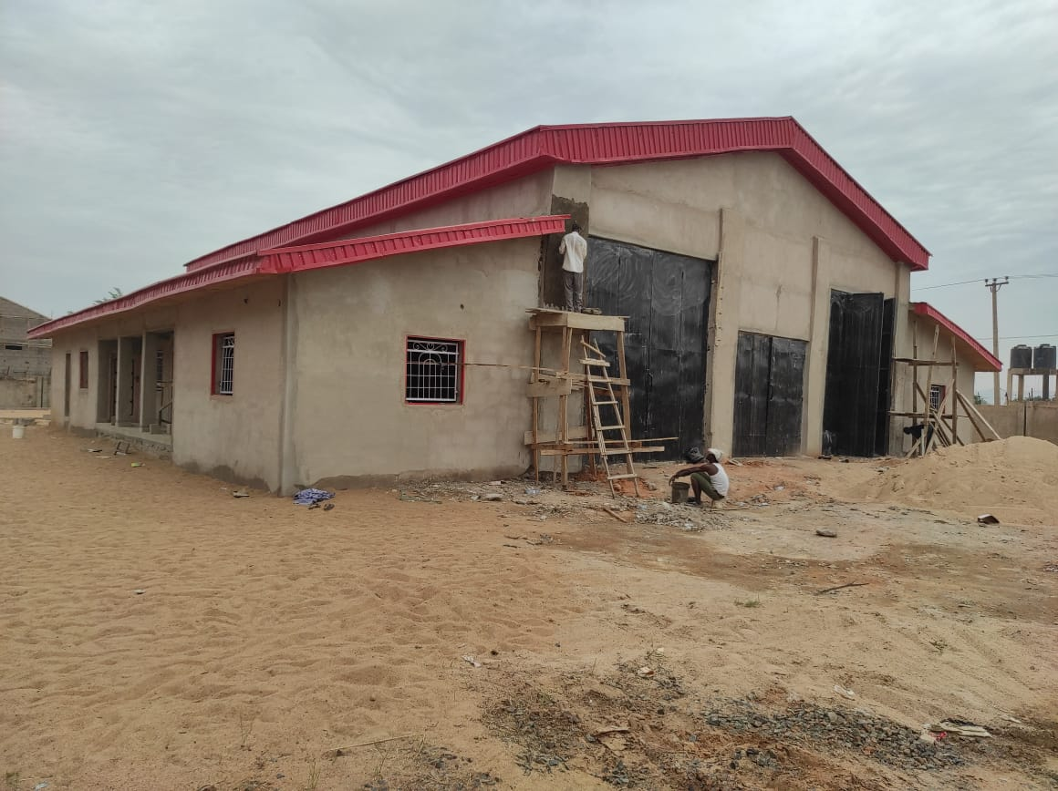
Cont.
The Ministry has also obtained Executive Council approval on the need for the transformation of Ministry of Transport to Ministry of Transport Development and the reforms were presently on going.
The Bills for the establishment of Adamawa Road Transport and Traffic management Agency(ARTTMA) and also to amend Adamawa Transport Board Edith 1999 has been passed by the State House of Assemble awaiting final assent by the Governor.

Slide 9
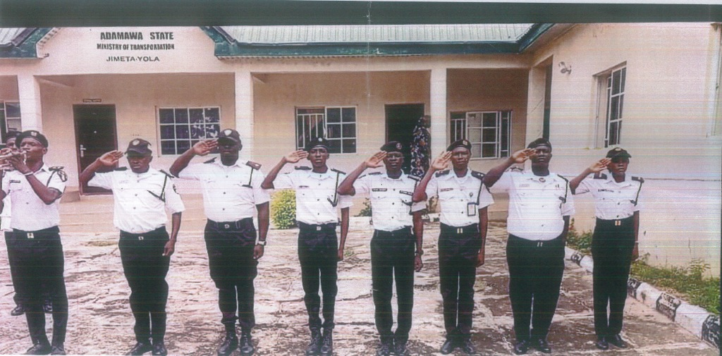
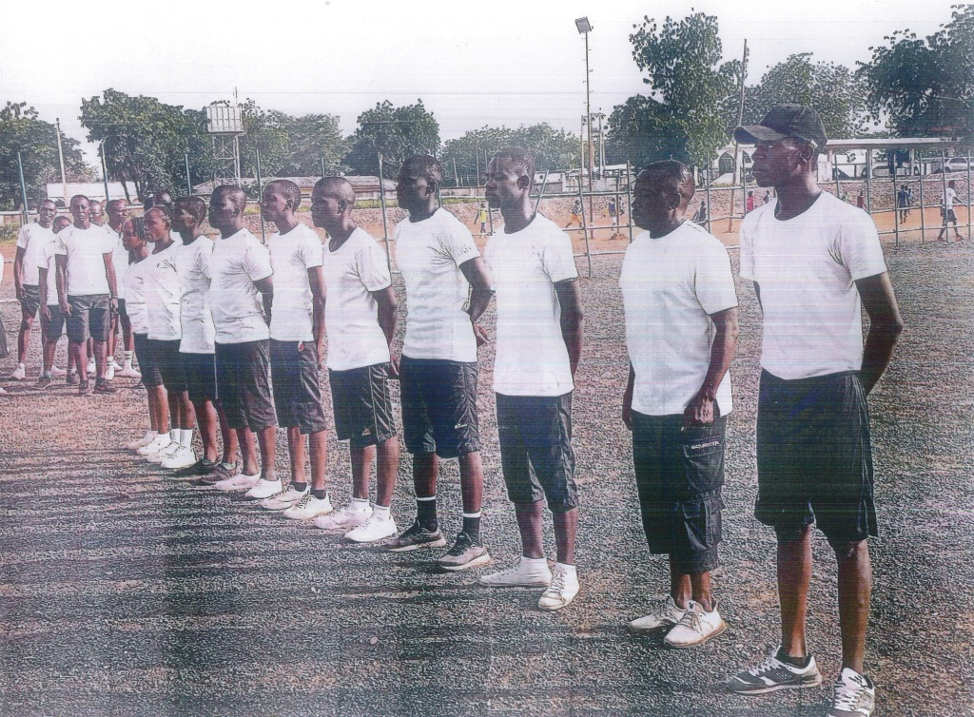
CONT. ACHEIVEMENTS
A waiver for the recruitment of 80no. Vehicles Inspection Officers has been granted by His Excellency. The Ministry liaised with CSC and recruited 44 seniors and 36 juniors Vehicles Inspection Officers(VIOS) respectively as of September, 2021. This has greatly improved the operations and revenue generation of the Ministry.

Slide 10
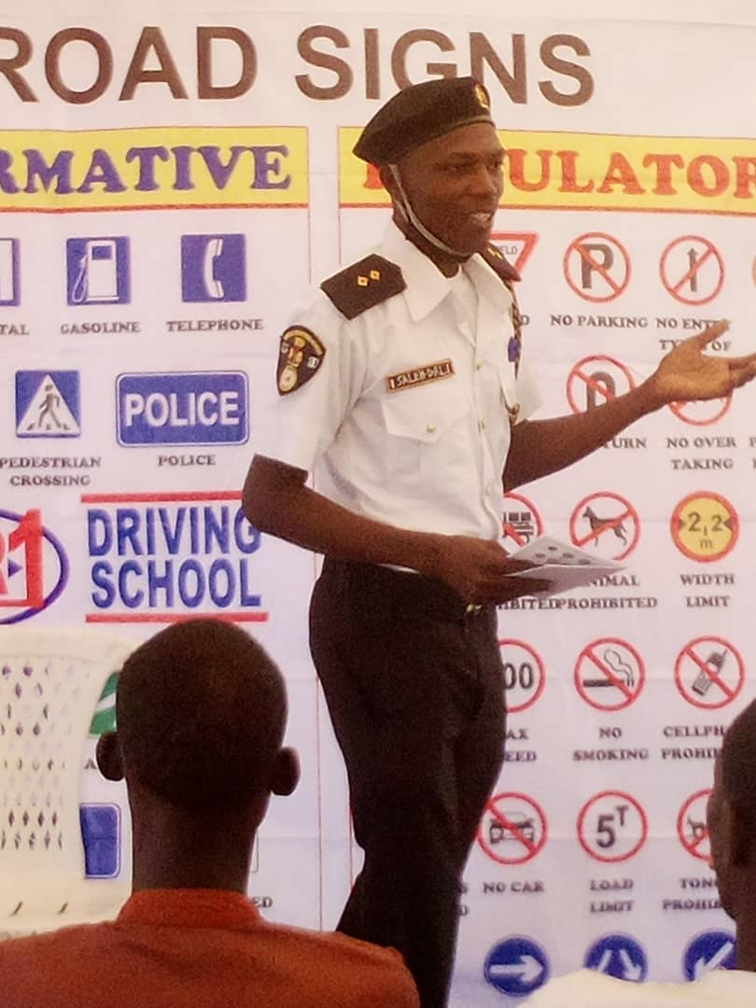
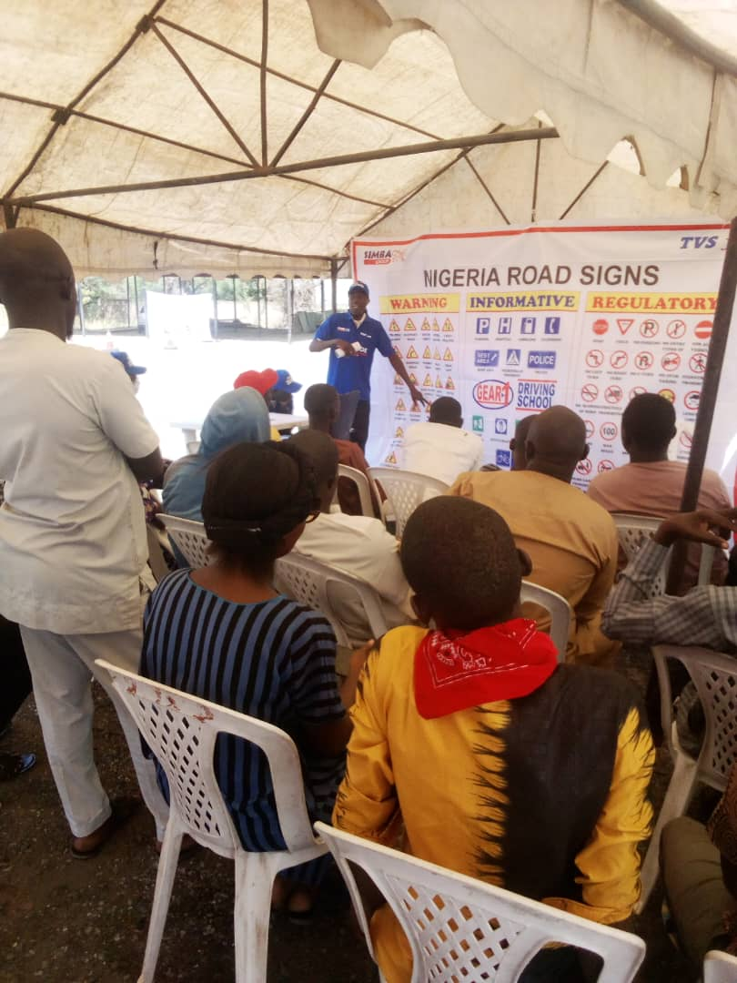
CONT.
H.E has also approved the procurement of uniforms for the recruited 80no. VIOs.
H.E Ahmadu Umaru Fintri has approved the training of the 80no.recruited VIOs in the State for the first time by external Consultant. This training has greatly improved the performance of the VIOs.
H.E has blessed the training and re-training of Tricycle operators within the State in collaboration with TVS management.

Slide 11
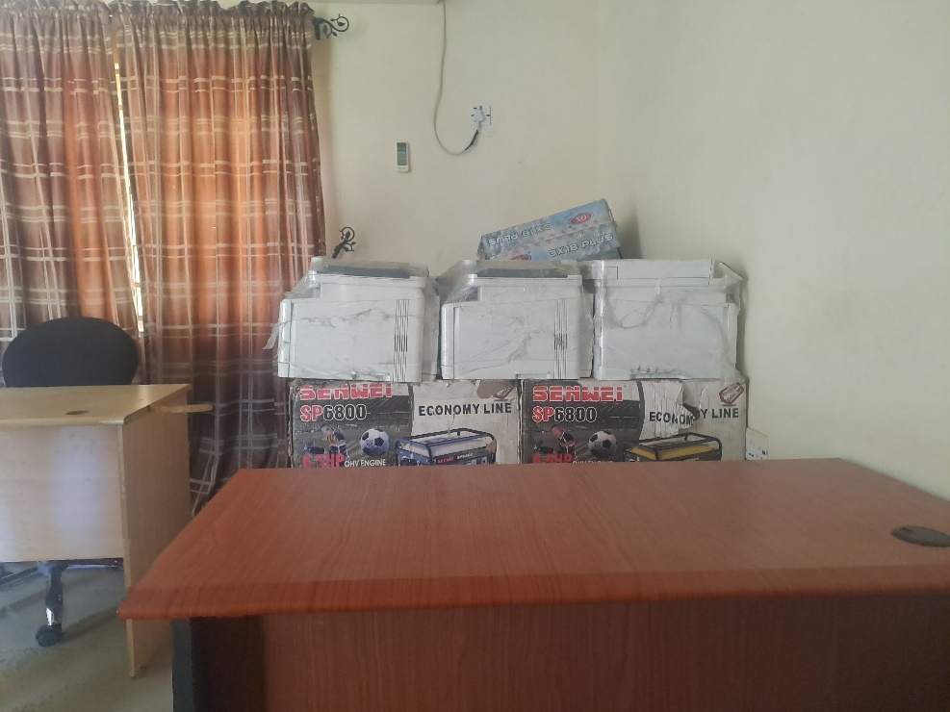
CONT.: ACHIEVEMENTS
The Ministry has sought and obtained funds for establishing of ICT for the Registration of Tricycles (Keke-Napep) plying in the State capital and its environ. The exercise is ongoing and about 32455 Tricycles has been registered and captured from September, 2021 to date, and this has improved the revenue generation of the State.

Slide 12
CONT.: ACHEIVEMENTS
The Ministry has sought and obtained funds for extension of Biometric Registration of Tricycles (KEKE-NAPEP) to all Local Governments in the State and it is ongoing.
The Ministry has sought and obtained funds for the Construction of a Parameter Wall Fencing of the Ministry in 2023 which has been completed.
The Ministry under the Directorate of Road Traffic Management (DRTM), now has a full fledge (RTO) Road Tax Office since August 2022.
The Directorate of Road Traffic Management (RTM) has commenced DTT (Drivers Theory Test) since March 2022
It has commenced Automated Roadworthiness services since March 2021 and Pre-Registration Process commenced sept 2022.
The Ministry has been attending conference of Directors/CVIOs of the Federal Yearly under this administration.
H.E has approved Road Traffic Activities Rebates for the Directorate.

Slide 13
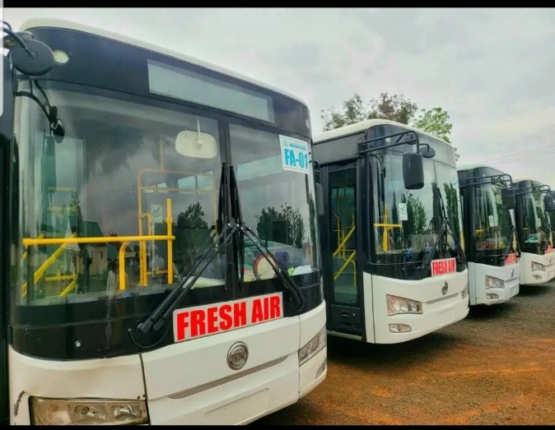
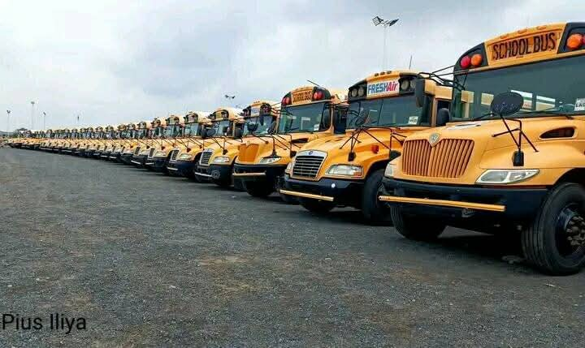
CONT.: ACHEIVEMENTS
Under this administration the government has in the year under review procured 41 palliative luxurious buses to ease the transportation challenges of its citizens and is yielding a good result. At present the citizens pays only 50% of the current transport fare across the state, 22 out of 41 of buses was allotted to the Adamawa Transport Board and the rest to various Institutions and this is yielding a positive result of high learning in the State.

Slide 14
CONT: ACHIEVEMENTS
Fresh Air Buses routes across the State
  Yola – Ganye - Daily
  Yola – Numan - Daily
  Yola – Mubi - Daily
  Yola – Fufore - Daily
  Yola – MAU - Daily
  Numan – Lamurde - Daily
  Mubi – Madagali - Daily
  Guyuk – Numan - Weekly
  Yola – Toungo - Weekly
  Fufore – Gurin - Weekly
  Yola – Mayo Belwa - Weekly
  Numan – Shelleng - Weekly

Slide 15
CONT: ACHIEVEMENTS
With the approval of the present government, the ministry in collaboration with Adamawa State Board of Internal Revenue Award Consultancy service /contract to ALSDOS CONSULT LTD for Building of a Problem Solving(portal) for Tricycle Riders Registration in the State. A MoU has been signed to that effect and implementation is ongoing.
xxiv. Sensitization exercise has been successfully conducted at the sunshine terminus for drivers and station managers in the 3rd quarter of the year 2024.
xxvi. The present government has released fund for the renovation of the burnt Permanent Secretary’s office; work is ongoing.

Slide 16
REVENUE:
The revenue generation of both the ministry and the Adamawa Sunshine company has really improved to appreciable level, especially with the recruitment of VIOs, Provision of palliative buses, introduction of the new unit (Haulage Unit), introduction of additional routes, which include Lagos, Sokoto and Enugu is another factor responsible for the improvement in the revenue of the ministry.

Slide 17
RECOMMENDATION ON WAY FORWARD
Ministry of Transportation, when fully operational, is expected to be the most viable and revenue generating Ministry in the State. However, more needs to be done for the Ministry to become fully operational as a revenue generating outfit of the State Government. This include, among other things: -
The acquiesce (assenting) of relevant laws by the Governor passed by the State House of Assembly
  The Bill for the establishment of Adamawa Road Transport and Traffic Management Agency (ARTTMA).
  The amendment of Adamawa Transport Edict 1999.
The provision of operational/patrol vehicles
Recruitment of more VIO’s
Purchase of operational vehicles and communication gadgets
Purchase of taxis and buses for intercity and intra-city services
Provision of additional State Government Motor Parks
establishment of bus-stops and baileys etc. within the State.
There is a need for the establishment of a Government owned driving school in the State.

Slide 18
THANK YOU FOR LISTENING

