Slide 1

MINISTERIAL PRESS BRIEFING 4TH QUARTER 2024
ADAMAWA STATE
MINISTRY OF WOMEN AFFAIRS AND SOCIAL DEVELOPMENT UNDER THE OFFICE OF THE FIRST LADY HER EXCELLECY HAJIYA LAMI UMARU FINTIRI
Presented by the Honourable Commissioner
Mrs. Neido G. Kofulto

Slide 2
INTRODUCTION
The Ministry of Women Affairs and Social Development was created in July, 1997 with the objectives of executing government policies to improve the quality of lives of women and children on sustainable basis, it is also charged with the responsibility of repositioning women and children who are undoubtedly the most vulnerable group within the society by advancing their socio-economic and political interest so as to march the development of the Nation.
To this end, the vision of the Ministry is to create a caring and integrated system of Social Development services that will facilitate human development and improve the quality of life. With a mission to ensure the provision of comprehensive integrated, sustainable and high quality social development services that will help reduce vulnerability and poverty and to create an enabling environment for sustainable development in partnership with those committed to building a caring Adamawa State.
The Ministry is further saddled with the responsibility of Executing social welfare and rehabilitation policies, programmes and projects of the state Government, which are aimed at improving the lives of physically, challenged persons and providing psycho-social support to internally displaced persons humanitarians’ service to the people in the state.

Slide 3
SCOPE/OBJECTIVES OF THE MINISTRY
The role of the Ministry is to developed policies and to ensure the delivery of a range of social welfare services aim at providing equitable and sustainable improvement in the quality of life of all citizens of our society through skills acquisitions, common needs such as education, morals and physical needs. Others are to provide psycho-social supports programmes to especially the vulnerable i.e. (the aged, women, children and people living with disability).

Slide 4
STRUCTURE OF THE MINISTRY
The Ministry is composed of five (5) Directorates, headed by Directors and acting Directors respectively. The departments include the following:-
Administration and Finance Directorates
Women Affairs Directorates
Child Development Directorates
Social Welfare Directorates
Rehabilitation Directorates

Slide 5
CHILD DEVELOPMENT DEPARTMENT
The Child Department is responsible for handling all issues concerning children in the state which include their welfare and wellbeing.
The Ministry of Women Affairs and Social Development in collaboration with UNICEF have enrolled one hundred and Fifty-Two (152) adolescent children (Boys Eighty-Six (86) and Sixty-Six (66) Girls) into various skill acquisition trainings based on their respective choices which include Furniture, welding, Automobile electrical work, Automobile mechanical work, Tailoring, Aluminum construction work, shoe making, Hair dressing, Tiles laying, knitting etc and the training are currently on going in Mubi-North, Mubi-South, Madagali and Michika Local Government Areas of the State

Slide 6
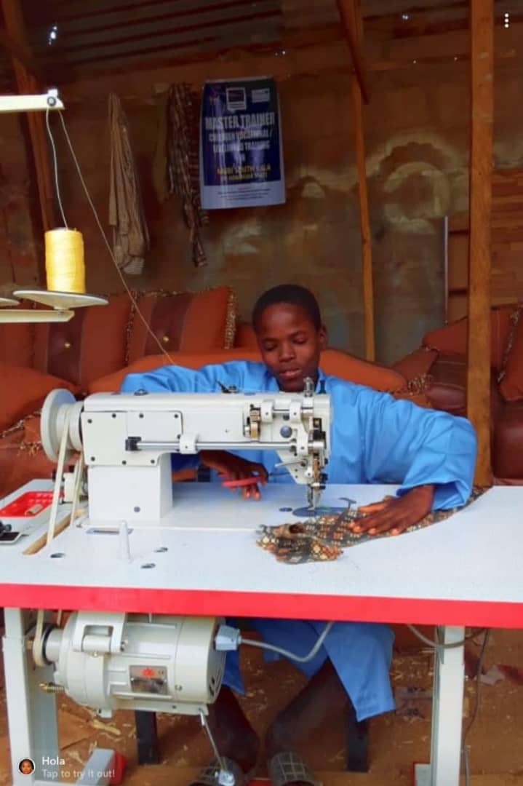
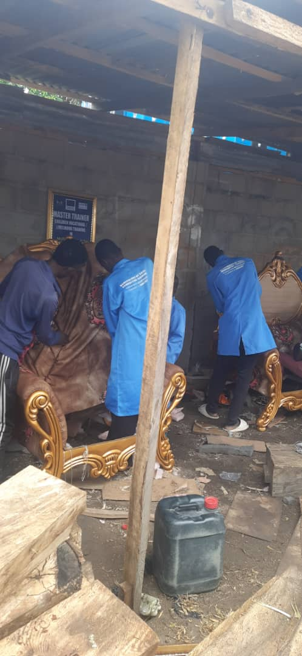
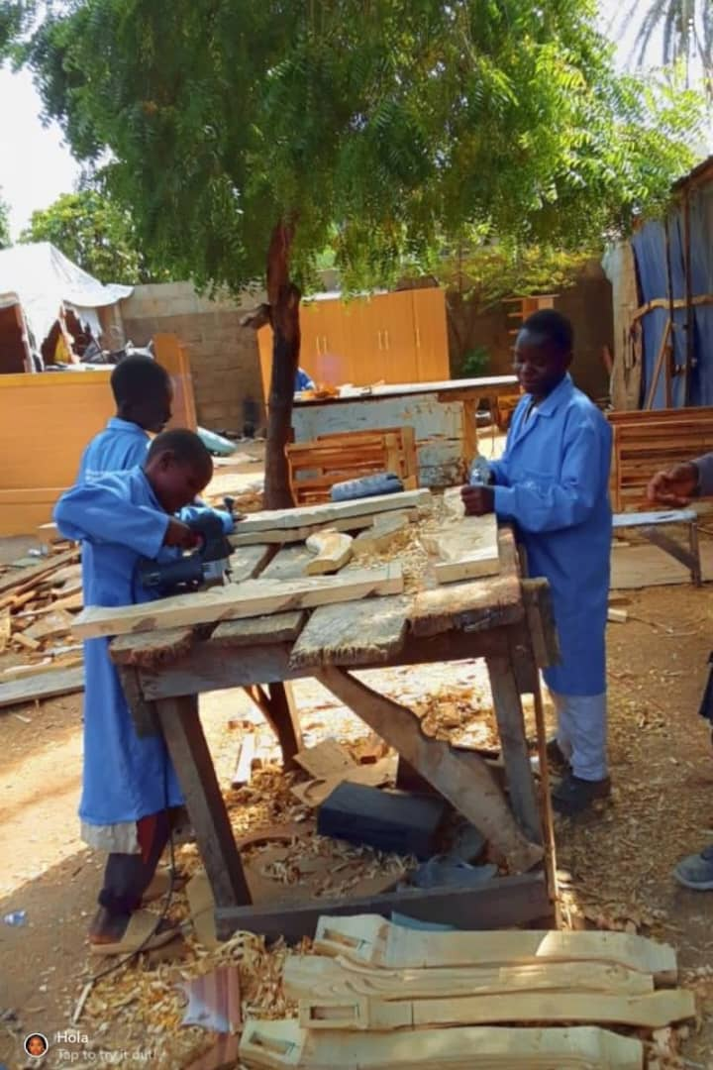
SKILL ACQUISITION TRAINING

Slide 7
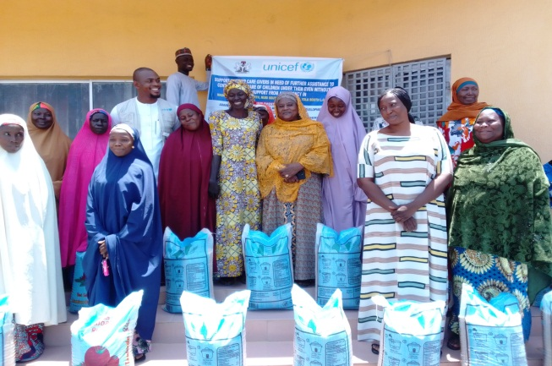
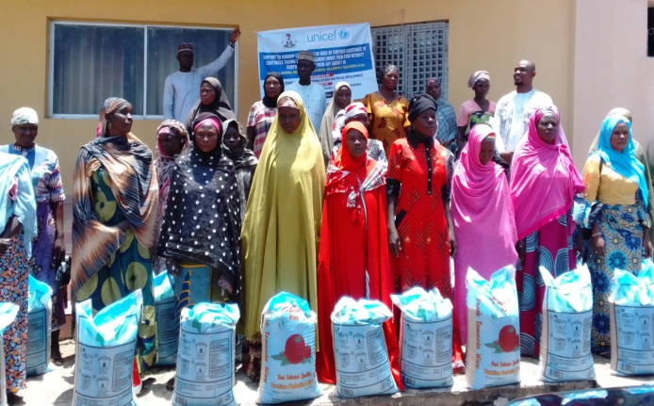
Subsequently, fifty (50) female caregivers of vulnerable children were provided with support based on needs to boost their respective petty businesses and increase their income generation to be able to carter for the needs of the vulnerable children under them. Hence, reduce the current hardship. The supports were provided in Yola-North and Yola-South Local Government Areas of the state.

Slide 8
WOMEN AFFAIRS DEPARTMENT
The Department of Women Affairs is one of the core departments of the Ministry charged with the responsibility of promoting women’s welfare and advancement.
The Ministry has a Women Development Centre in the state capital and one each in the twenty-one (21) Local Government Areas of the State which are manned by the Local Governments. These centres provide training on skill acquisition for women, such as tailoring, knitting, catering, hairdressing, weaving, ceramic works etc. In addition safe space centre was set up in the Ministry in collaboration with UNFPA as a result of Boko Haram that trigger the North East Nigeria in 2024.

Slide 9
The safe space centers include:-
Women and Girls safe space (WGSS spy) state Polytechnic, Yola.
Hope Centre Numan.
Women and Girls Safe Space (WGSS) Viniklang or Day Bola.
One Stop Centre, Yola.
NYSC Host Community or Camp.
Malkohi Host Community.

Slide 10
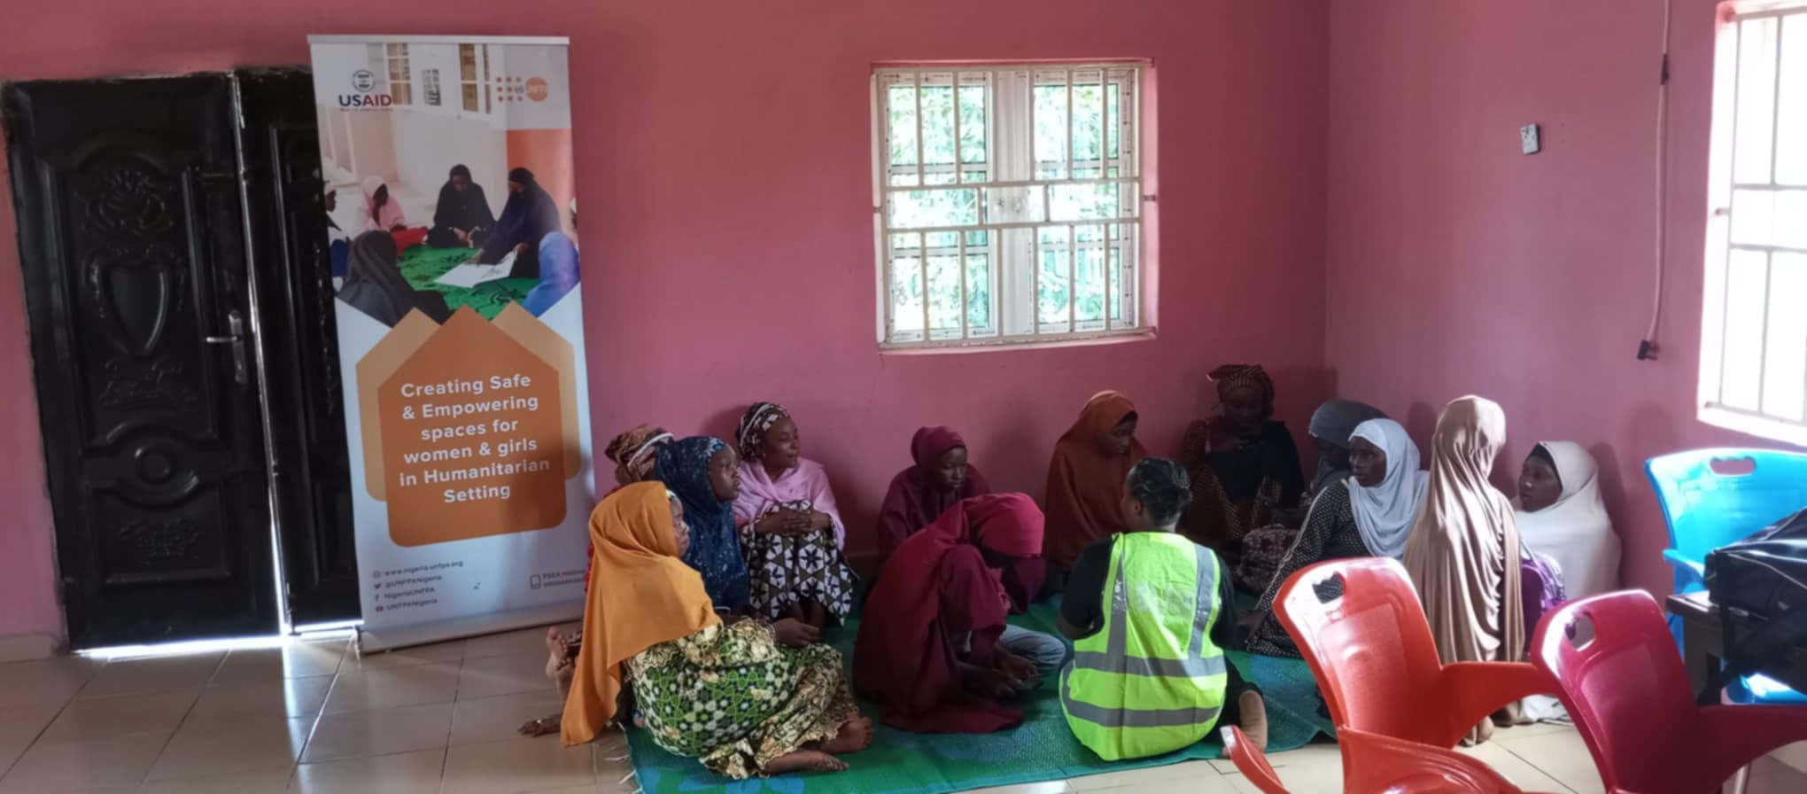
The following are some of the activities carried out in the safe space centers as follows:-
Awareness session on sexual violence, its consequences and importance of reporting GBV cases on time with final year female students of Adamawa State Polytechnic Yola (SPY), Women and Girls Safe Space (WGSS).

Slide 11
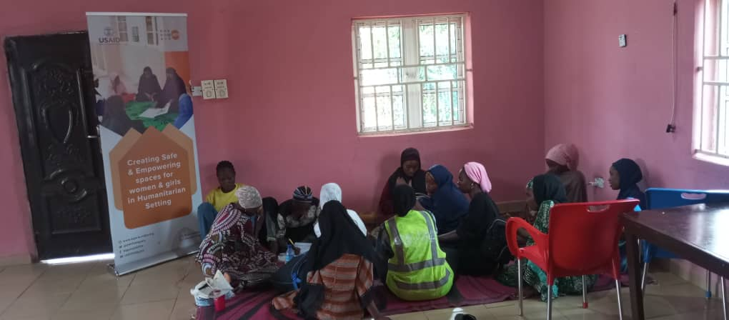
Sensitization/awareness session on importance of accessing the safe space and services provided with adolescent girls of State Polytechnic Yola (SPY).

Slide 12
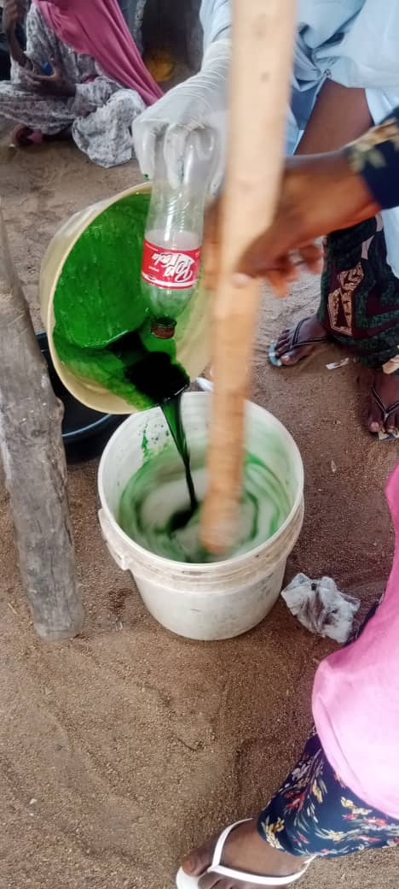
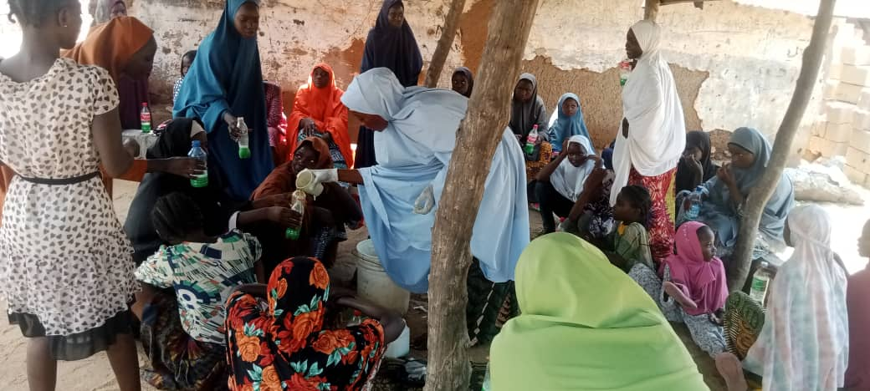
Sensitization/awareness session on GBV prevention with some male students at Women and Girls Safe Space State Polytechnic Yola (WGSS SPY).
Awareness on importance of not being idle as a girl child and also a house wife and skill acquisition on how to make liquid soap with adolescent girls and women opposite Anguwan Makera in Numan Local Government Areas (LGAs).

Slide 13
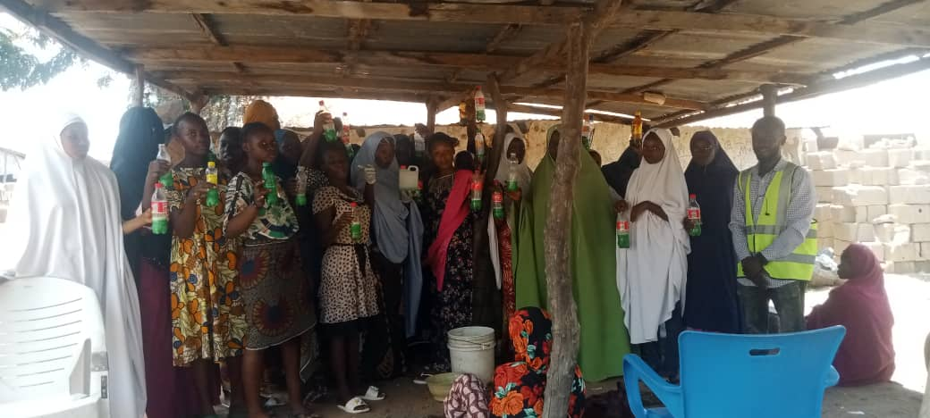
TRAINING ON LIQUID SOAP PRODUCTION

Slide 14
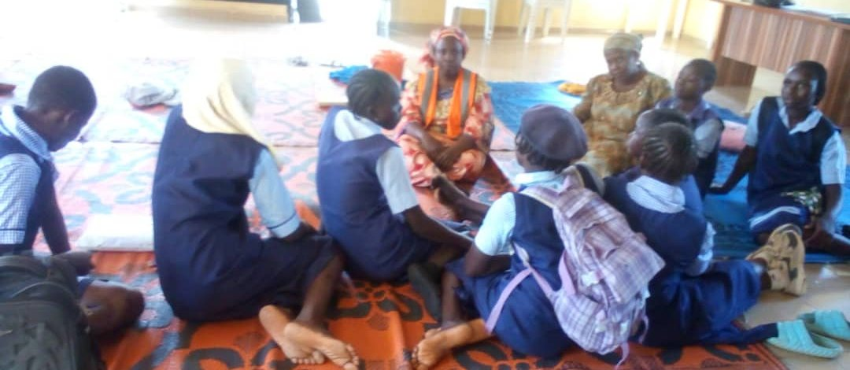
Guidance and counseling session on rape, for survivors to be reporting on time with adolescent girls, below sixteen (16) at safe spaces Government Day Secondary School (GDSS) Viniklang.

Slide 15
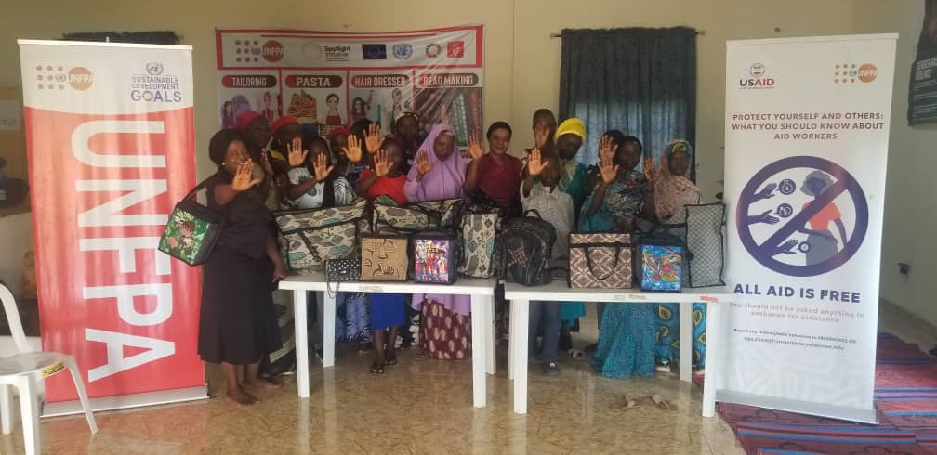
This sections is training of trainee for women and adolescent girls acquiring skills on how to make lunch bag, hand bag, school bag, traveling bag, chain bag and side bag at one stop centre Yola.

Slide 16
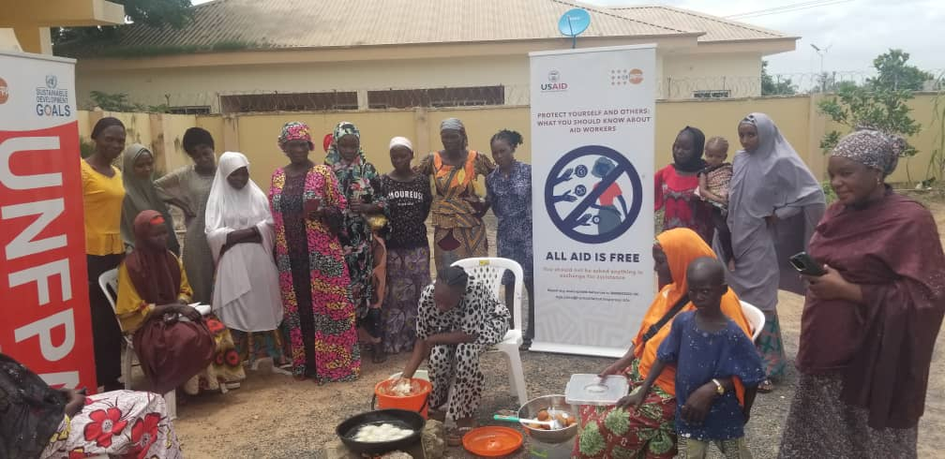
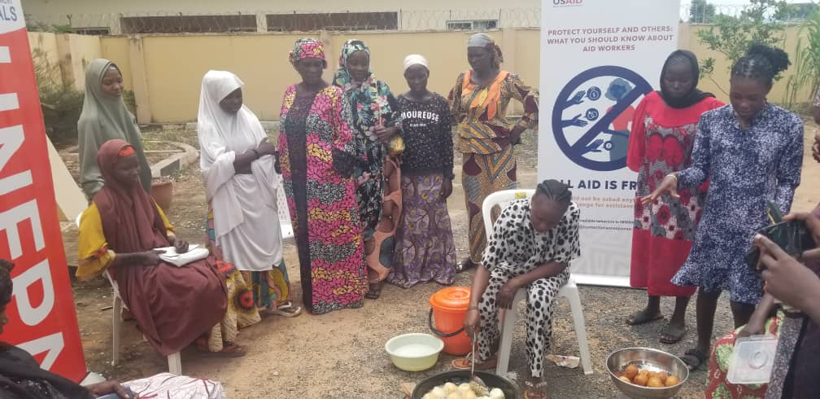
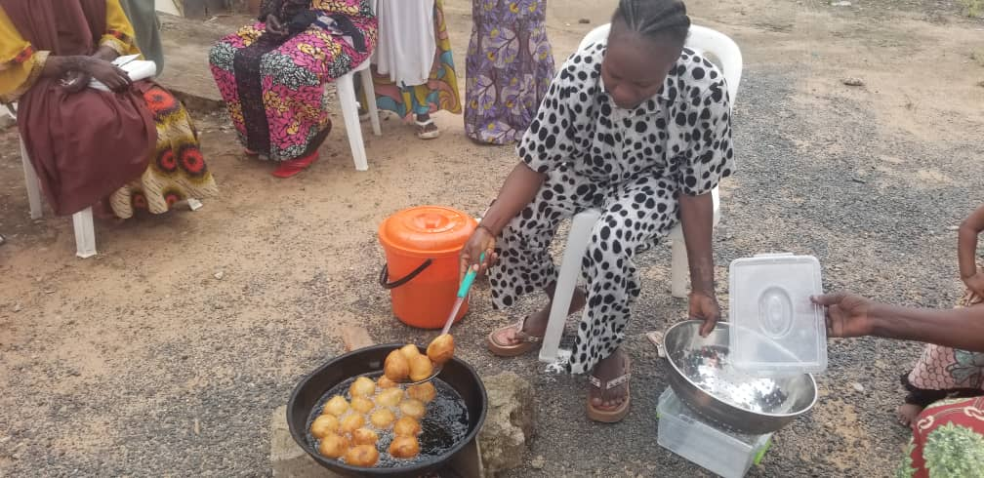
Production of dignity kits in progress at one stop Centre Yola.
Skill acquisition, trainees, training, others on how to cut materials to sew bed sheets Women and four (4) girls benefited from skills acquisition and economic empowerment activities at one stop centre Yola. Women and adolescent girls participating in vocational skills programmes in puff puff making at one stop centre Yola.

Slide 17
This is a session on menstrual and personal hygiene with adolescent girls in NYSC Camp at host community.
Mental Health and psycho-social support/MHPSS/Nutrition Counseling at NYSC Camp.
Ante –natal care service (ANC) in Malkohi Host Community and distribution of delivery kits.
Skill acquisition session in Malkohi Host Community Local Pasta and tailoring.

Slide 18
SOCIAL WELFARE DEPARTMENT
The department is saddled with the following responsibilities.
Reformation of delinquent children
Provide Psycho-Social Support, counseling and repatriation in times of emergencies especially to internally displaced persons (IDPs)
Cater for the elderly in the society.
Hospital social work/assistance.
Work towards social being and development of families in the society.
Generates revenue to the State through the issuance of license for the operation of cinema, video, pools and gaming machine, tambola and liquor business.

Slide 19
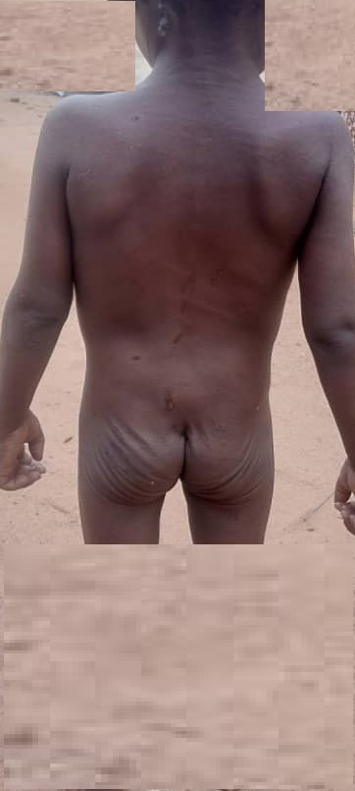
Family case with Thirty-Three (33) cases was recorded, these included marital dispute, case of divorce child abuse, lack of maintenance, early marriage and pregnancy out of wed lock. A recent case of a step mother that violated her two (2) step children, the both parents were arrested prosecuted and convicted on 5th October, 2024.

Slide 20
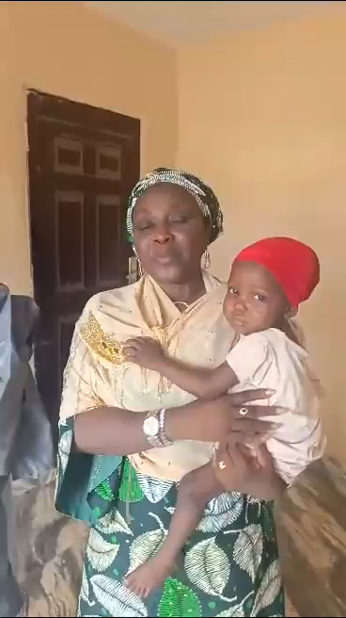
THE HONOURABLE COMMISSIONER WITH THE CHILD ABUSED

Slide 21
Psycho-Social Support (PSS) is service rendered by social workers to vulnerable and survivors of Gender Based Violence, traumatized, depressed as a result of insurgency and other disasters like flooding etc.
Remand Home correctional center for children in conflict with laws or delinquent act, under the age of eighteen years. There are four (4) Remand Homes cross the three (3) Geopolitical zones (Numan, Mubi, Ganye and Jimeta).
The total number of inmates remanded, rehabilitated and reunified with their parent is one hundred and twenty (120) in the last three (3) months.
The Department repatriated twenty-five destitute and unaccompanied children and adolescent girls back to their states of origin for proper reunification with their parent and caregivers. At Balel Maiha Local Government Areas (LGAs) on 21st June, 2024.

Slide 22
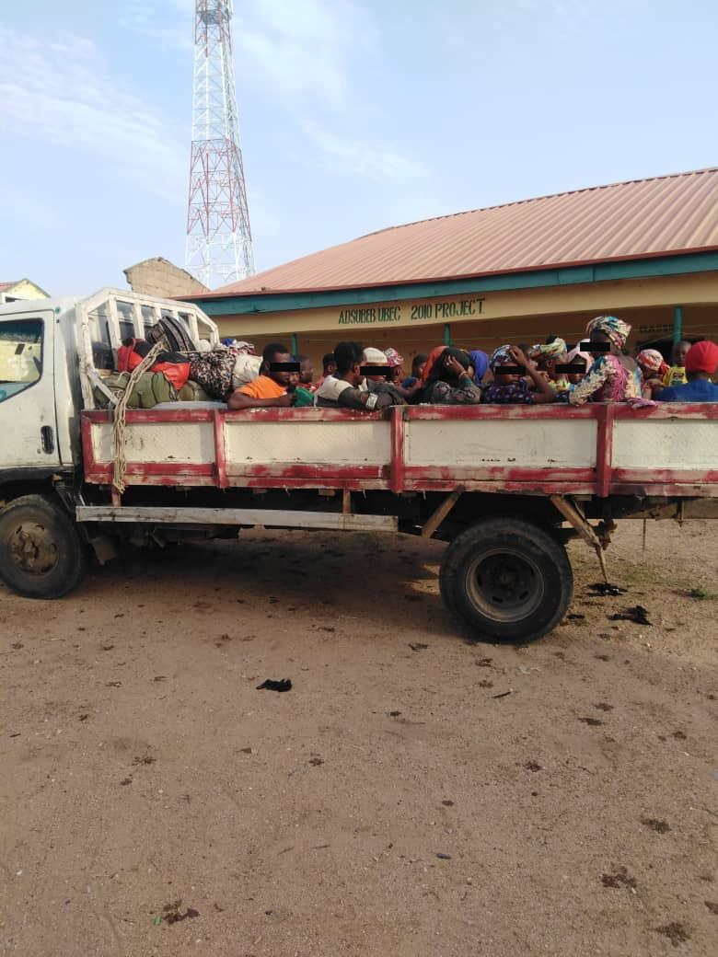
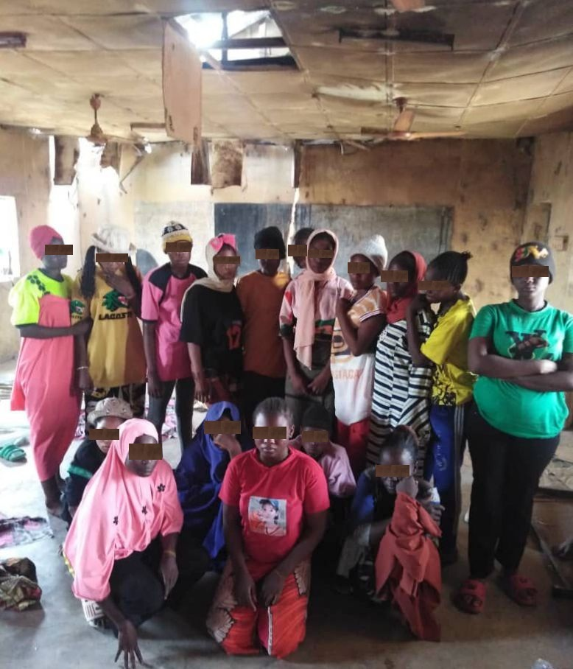
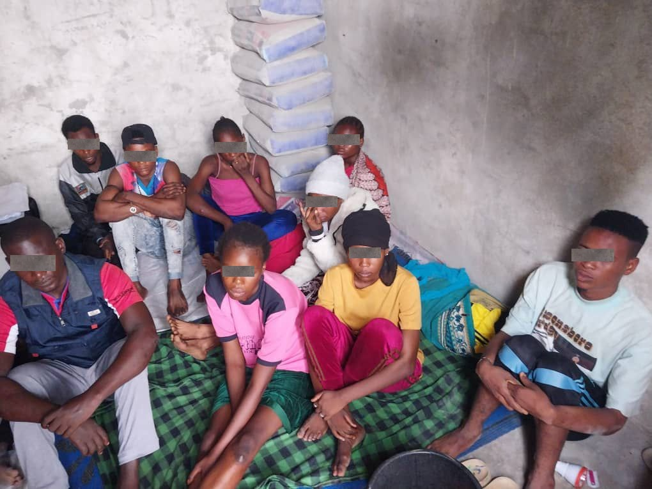
PICTURES OF THOSE REPATRIATED

Slide 23
Department with the effort of social worker has rendered Mental Health and Psycho-Social (MHPSS) service to five (5) traumatized, frustrated and depressed patients at hospital and clinic at Mubi and Yola respectively.
CARE FOR THE ELDERLY
The Ministry just celebrated the 2024 International Day for the older persons with presentation of gifts items at Gidan tshofofi in Numan Local Government Areas (LGAs) where thirty (30) people benefited. Also, at the women Development center Yola, where eighty beneficiaries including Persons with Disability (PWDs) benefited.

Slide 24
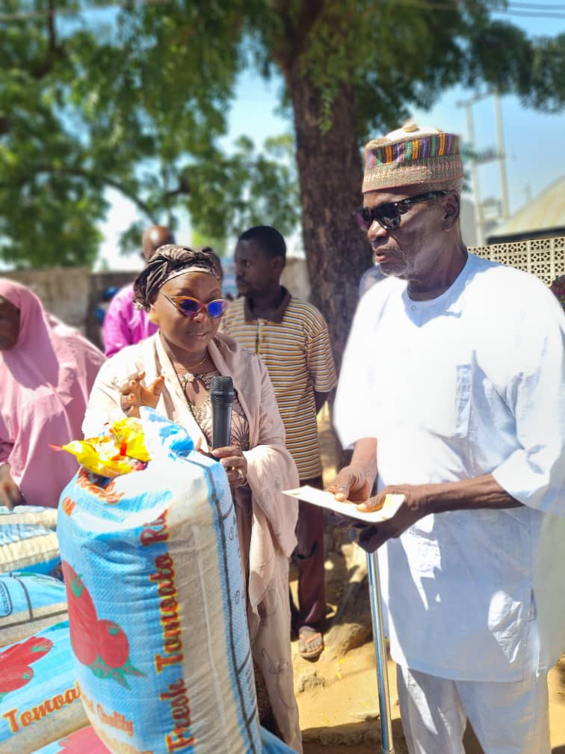
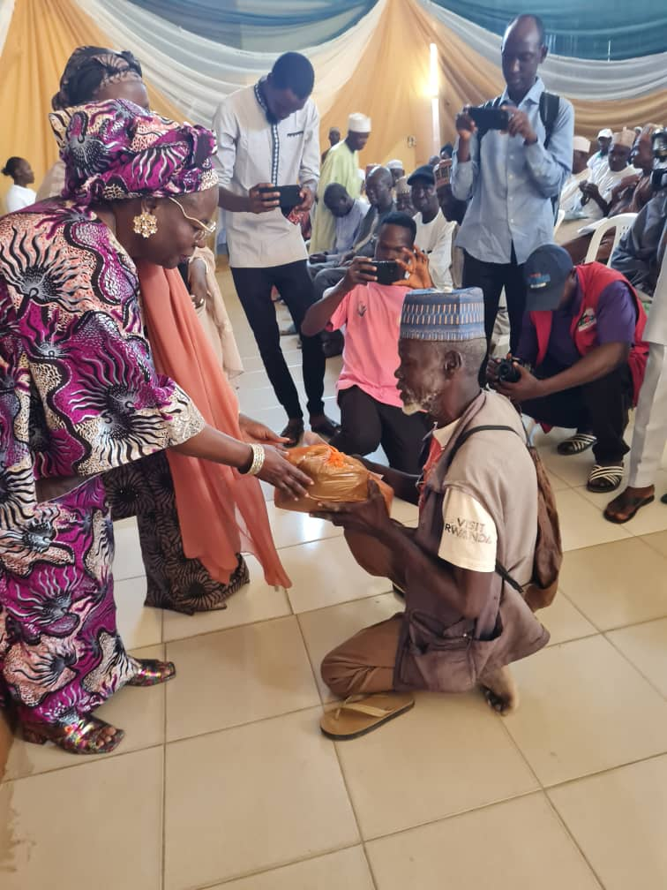
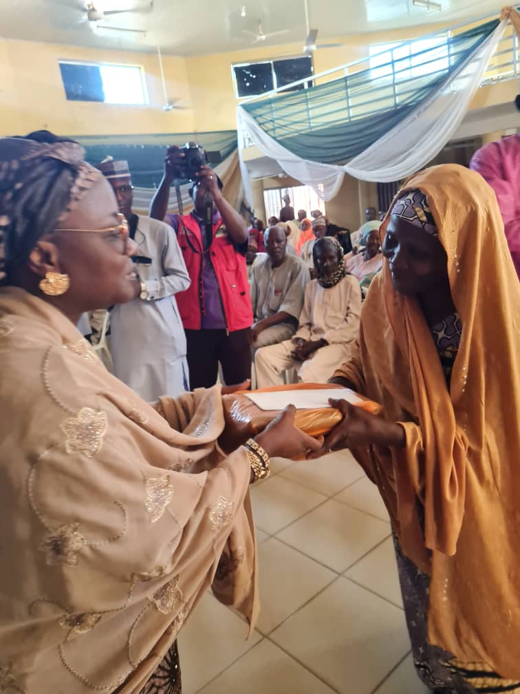
INTERNATIONAL DAY FOR THE OLDER PERSONS, 2024

Slide 25
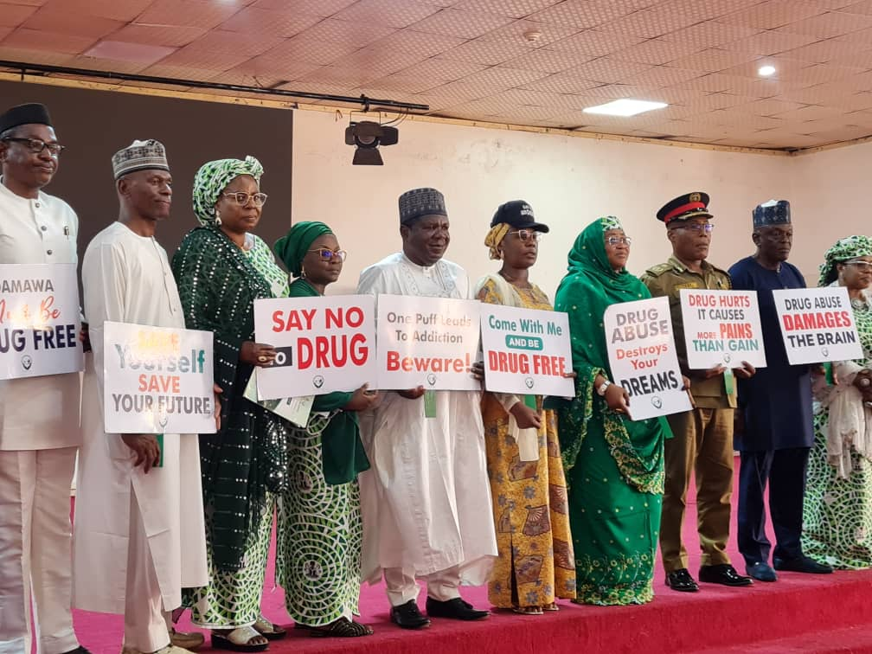
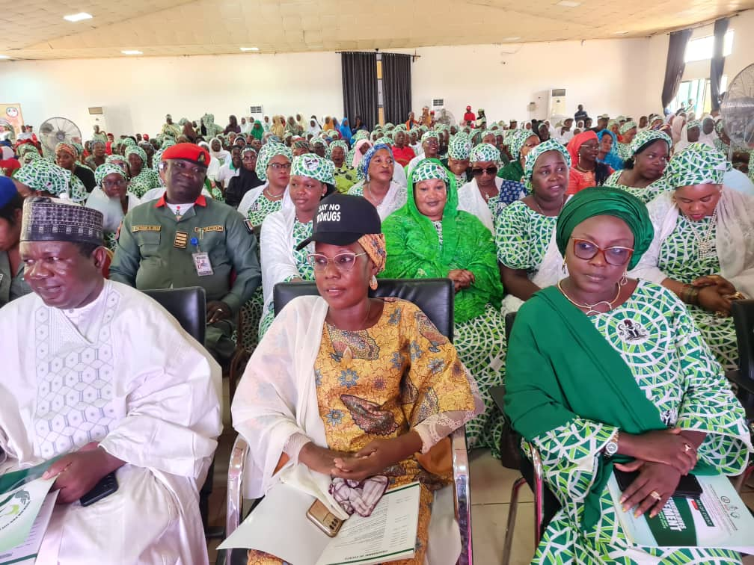
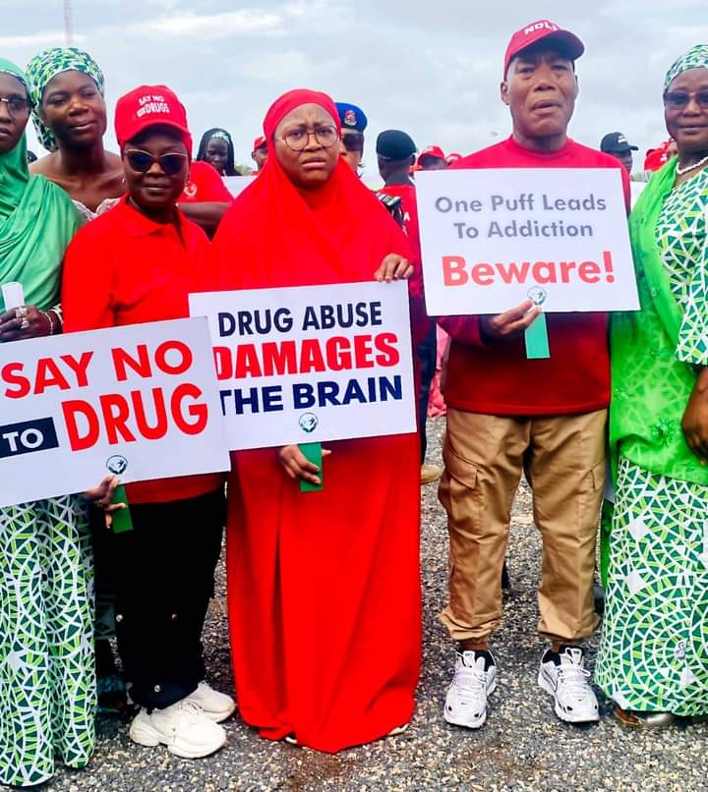
SENSITIZATION ON DRUGS ABUSE
Ministry engagement with stakeholders to join forces in addressing the rising concerns of drugs related issues across Adamawa State with a special focus on protecting the younger generation from the harmful effect of drugs misused. Aimed at sensitizing the public.

Slide 26
REHABILITATION DEPARTMENT
The department is responsible for the following:-
Provision of Welfare Service/training of all categories of persons with disabilities to give them a sense of belonging.
Coordinate educational policies with other relevant MDA’s, Federal, State and non-governmental organizations with the aim of empowering the disable for self-reliance.
Public education towards understanding that there is ability in disability and that the disable people have equal rights to every opportunity like the able persons.
Representation on National Committee on Rehabilitation.
Counseling of the Physically Challenged persons
Exhibition of products produced by persons with disability at rehabilitation centers, trade fairs and International exhibitions.

Slide 27
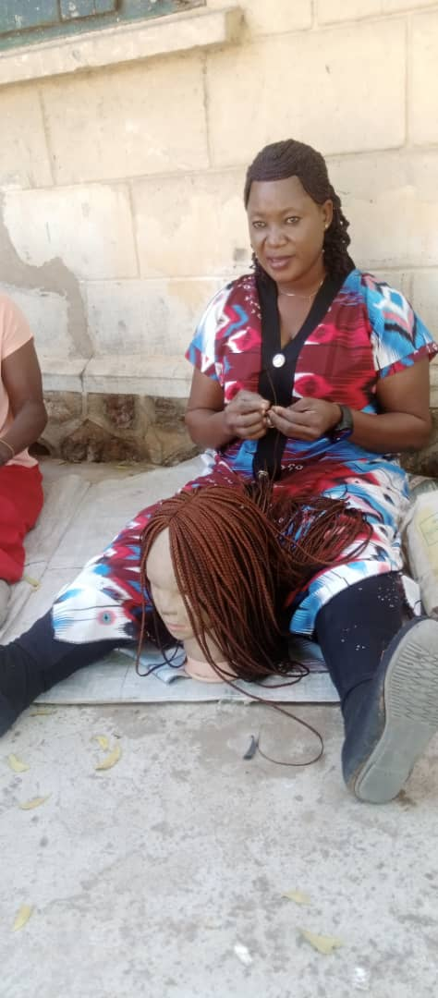
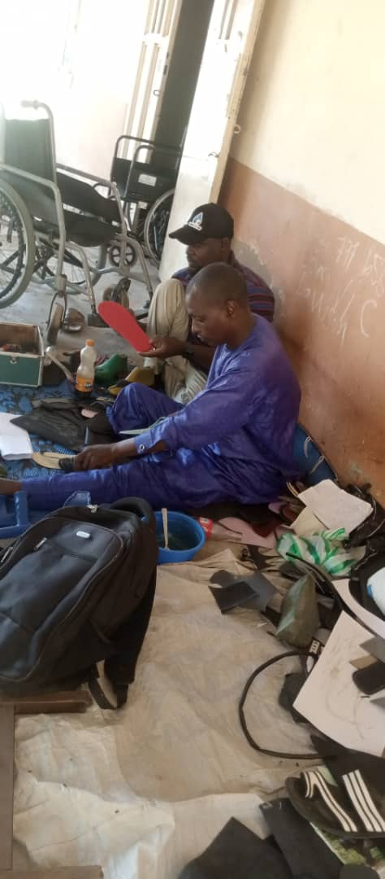
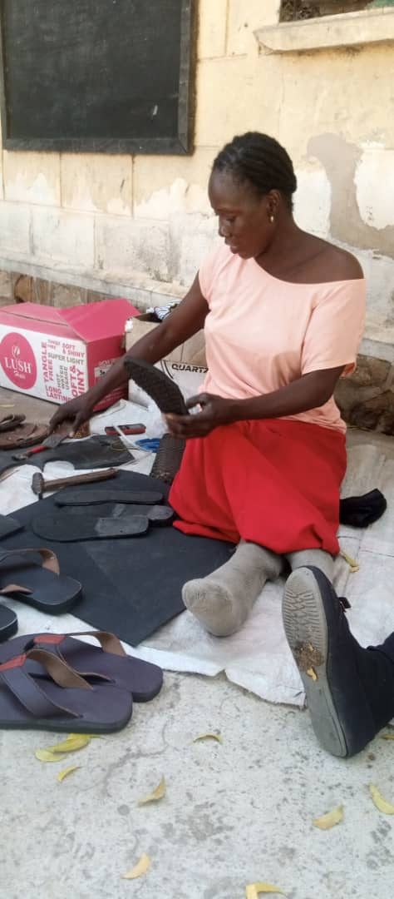
PHYSICAL CHALLENGE PERSONS ON TRAINING

Slide 28
CHALLENGES
Lack of adequate funding for payment of mental health psychosocial support (MHPSS) volunteers.
All the women and girls safe spaces need renovation and the centre need to be connected with national grid TCN.
Lack of startup pack or grant for women and girls to start business.
Lack of skills acquisition material to women and girls at the safe space centres.
Lack of vehicle for awareness/sensitization.
Remand Homes in Michika, Mubi and Ganye need to be renovated.
Lack of vehicle for transporting of inmate from Remand Home to courts and hospital.

Slide 29
Lack of office accommodation for area social welfare officers across twenty-one (21) Local Government Areas (LGAs).
Inadequate staff across the twenty-one (21) Local Government Areas (LGAs).
Dilapidated Building structure Blown off roofs, destroyed working materials e.g frames of different sizes; chairs; table and window of the building were destroyed at the Blind workshops.
Dilapidated Equipment the equipment needed for production in the centers were destroyed by heavy rain and can no longer be useful e.g rime for doormats, carpets of different sizes and computer stands at the Blind workshops.
Lack of instructors for ICT training.
Most of the computer are out dated.
Ministry’s running cost is inadequate to serve the need at orphanage and remand home due to high cost of consumables.

Slide 30
WAY FORWARD
Government should capture the payment of MHPSS Volunteers on the Ministry’s budget.
Women and girls safe space centers need to be connected with YEDC.
Women that are being trained in various skills need to be given start up pack or grants to start business.
Sensitization and awareness creation on women to be self-reliant need to be conducted.
There is need for more training and capacity building for physically challenges to stop street begging.
Government should continue to sensitize the public, stakeholders and the community and even the media on how to handle the disabled to avoid stigmatization.

Slide 31
There should be policy and programme that will ensure gender fairness and equal opportunity and inclusion in all activities.
Government should make provision of rams and rails for easily accessibility to government structure and other public places by persons with disabilities.
People with disability should be included in decision making in the society to have sense of belonging.
Need for upward review of Ministry’s running cost to cater for need of children at the Orphanage and Remand Home.
Need to permanent the daily rated nannies at the orphanage and to employ more and to allow for shite in there duties.

Slide 32
MINISTRY PROJECTION FOR NEXT YEAR, 2025
To see a caring and integrated system that will facilitate human development.
To see an improvement in the quality of life of the people of Adamawa State.
To see that the level of poverty is reduce especially among the vulnerable, i.e. the aged, women and children and people with disability.
To see an enabling environment for a sustainable partnership with those who are committed to building a caring Adamawa State for growth and development.

Slide 33
THANK YOU

